Slide 1
Algorithm
Algorithm
For a in AP:
If Max_timeslot < a.timeslot :
Max_timeslot = a.timeslot
If Max_rssi < a.rssi :
Max_rssi = a.rssi
Max_ap = a
Max_timeslot을 가지고 다운로드 가능한 Avail_bitrate 계산
If | Avail_bitrate – Req_bitrate | < threshold :
Handover 없이 계산한 Bitrate 사용
Else :
Knapsack 알고리즘을 통한 handover

Slide 2
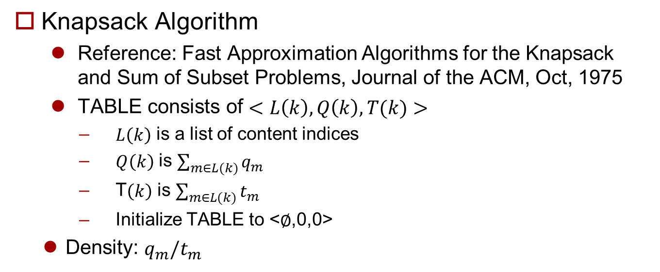
Knapsack Algorithm
Knapsack Algorithm
Reference: Fast Approximation Algorithms for the Knapsack and Sum of Subset Problems, Journal of the ACM, Oct, 1975
TABLE consists of $<L\left(k\right),Q\left(k\right),T(k)>$
$L\left(k\right)$ is a list of content indices
$Q\left(k\right)$ is $\sum_{m∈L(k)}{q_{m}}$
T$\left(k\right)$ is $\sum_{m∈L(k)}{t_{m}}$
Initialize TABLE to <$∅$,0,0>
Density: $q_{m}/t_{m}$

