Slide 1
mDASH: A Markov Decision-Based Rate Adaptation Approach for Dynamic HTTP Streaming Chao Zhou, Chia-When Lia, Senor Member, IEEE and Zongming Guo IEEE TRANSACTION ON MULTIMEDIA
Notes:
다.

Slide 2
Contents
Introduction
Formulation
Experiment
Conclusion
In my Research
Notes:
발표 순서는 다음과 같습니다

Slide 3
Introduction
Without an effective rate adaptation algorithm, a DASH client may suffer from frequent interruptions and significant visual quality degradation
For example, a video bitrate higher than the available bandwidth would cause network congestion
On the other hand, when the video bitrate is lower than the available bandwidth, the visual quality cannot reach the maximum allowed by the available bandwidth

Slide 4
Introduction
There are several rate adaptation schemes proposed for DASH, such as bandwidth-based schemes and buffer-based schemes
The bandwidth-based schemes mainly aim to dynamically adapt the video bitrate to an available bandwidth, which usually leads to a low bandwidth utilization and cannot reach the maximum quality allowed by the available bandwidth
Buffer-based schemes are focused on stabilizing the buffer occupancy within a certain range to ensure continuous video play-back. However, such kind of schemes generally lead to frequent bitrate switching which could be visually very annoying

Slide 5
Introduction
Markov decision-based approaches have been proposed to model the dynamics of a video streaming system under time-varying network conditions
It considers both the bandwidth-based and buffer-based schemes.
In addition, proposed a reward function for three different scenarios of buffer occupancy to measure the effectiveness of each rate-switching decision.
Adjust bitrate considering buffer occupancy and available bandwidth to maximize user’s QoE

Slide 6

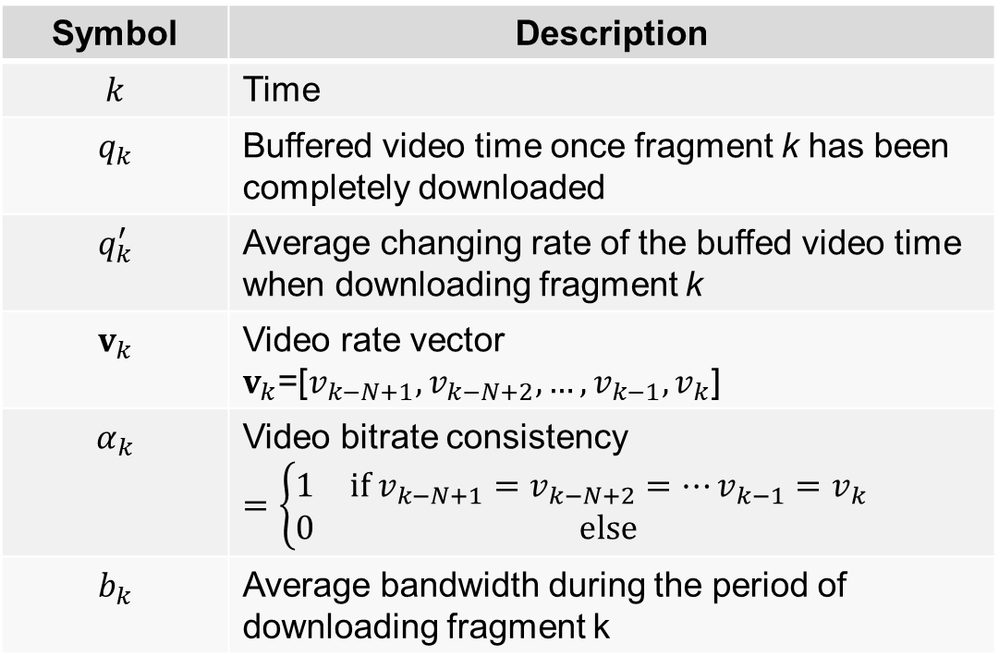
Formulation
State
$u_{k}=(q_{k},q_{k}^{′},v_{k},α_{k},b_{k})$
Symbol | Description
$$k$$ | Time
$$q_{k}$$ | Buffered video time once fragment k has been completely downloaded
$$q_{k}^{′}$$ | Average changing rate of the buffed video time when downloading fragment k
$$v_{k}$$ | Video rate vector $v_{k}$=[$v_{k−N+1},v_{k−N+2},…,v_{k−1},v_{k}$]
$$α_{k}$$ | Video bitrate consistency $$=\left\{\begin{matrix}1 & if v_{k−N+1}=v_{k−N+2}=…v_{k−1}=v_{k} \\ 0 & else\end{matrix}\right.$$
$$b_{k}$$ | Average bandwidth during the period of downloading fragment k

Slide 7
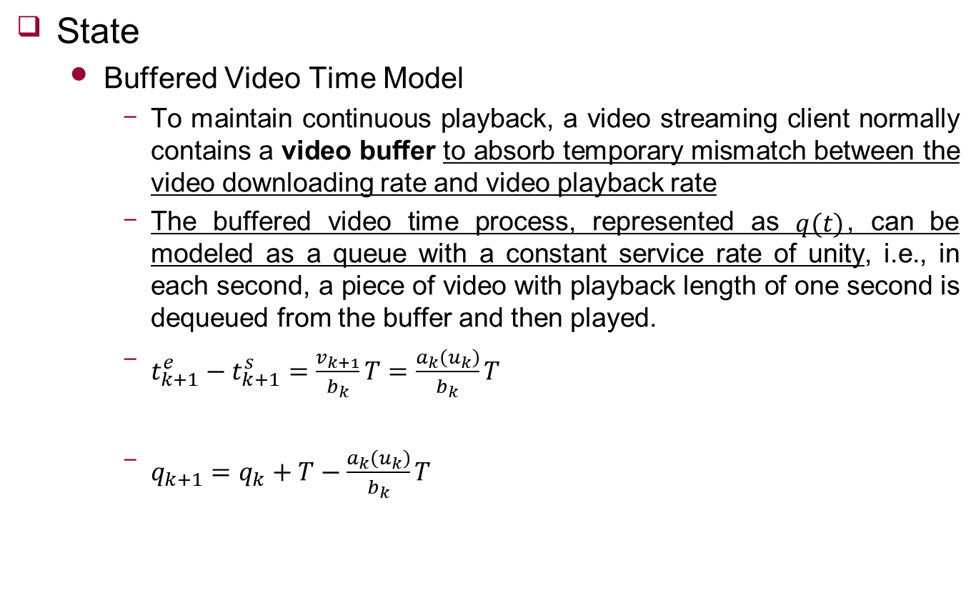
Formulation
State
Buffered Video Time Model
To maintain continuous playback, a video streaming client normally contains a video buffer to absorb temporary mismatch between the video downloading rate and video playback rate
The buffered video time process, represented as $q(t)$, can be modeled as a queue with a constant service rate of unity, i.e., in each second, a piece of video with playback length of one second is dequeued from the buffer and then played.
$t_{k+1}^{e}−t_{k+1}^{s}=\frac{v_{k+1}}{b_{k}}T=\frac{a_{k}\left(u_{k}\right)}{b_{k}}T$
$q_{k+1}=q_{k}+T−\frac{a_{k}\left(u_{k}\right)}{b_{k}}T$

Slide 8
Formulation
Reward
To measure the effectiveness of an action
Used to find the optimal video rate that maximizes the QoE
Takes into account the effects of video playback quality, video rate switching frequency and amplitude, buffer overflow/underflow, and buffer occupancy on user experience.
For the video playback quality and video rate switching frequency and amplitude, the mean video rate and temporal variance of video rate associated with the latest N segments are used to measure the rewards

Slide 9
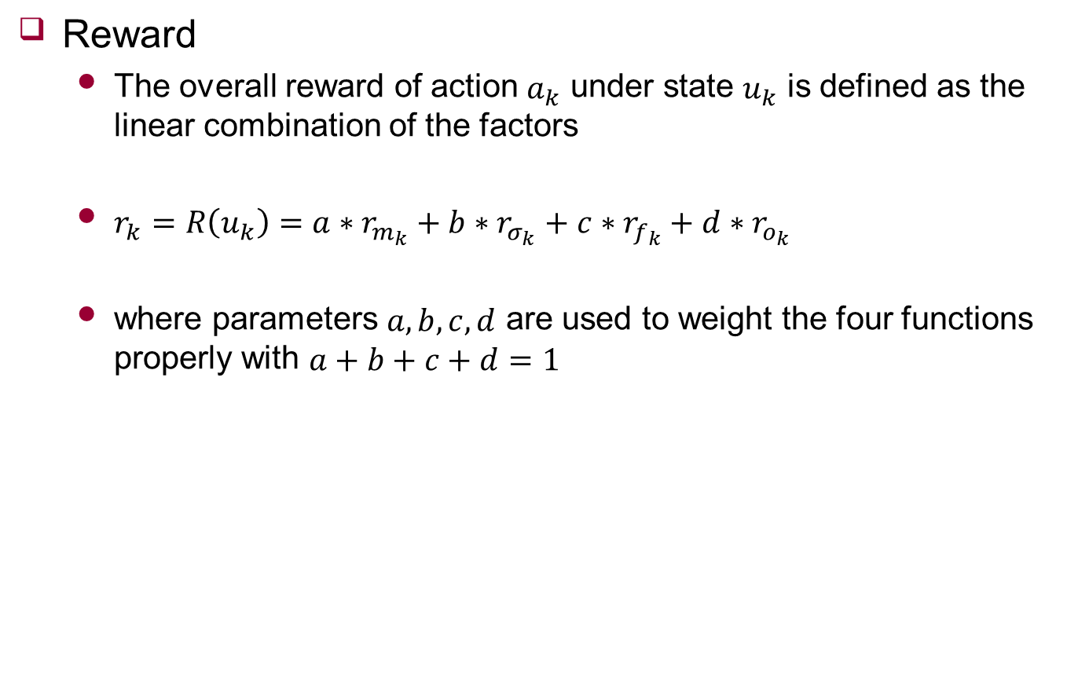
Formulation
Reward
The overall reward of action $a_{k}$ under state $u_{k}$ is defined as the linear combination of the factors
$r_{k}=R\left(u_{k}\right)=a∗r_{m_{k}}+b∗r_{σ_{k}}+c∗r_{f_{k}}+d∗r_{o_{k}}$
where parameters $a,b,c,d$ are used to weight the four functions properly with $a+b+c+d=1$

Slide 10
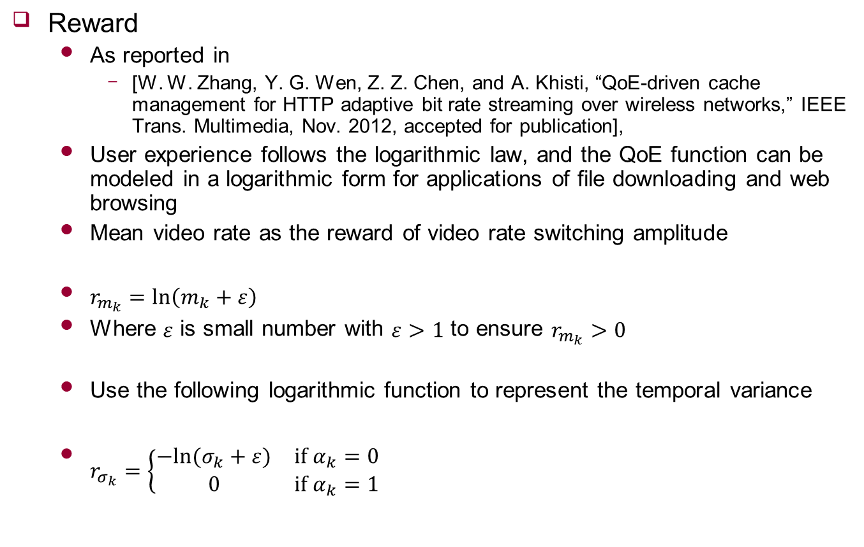
Formulation
Reward
As reported in
[W. W. Zhang, Y. G. Wen, Z. Z. Chen, and A. Khisti, “QoE-driven cache management for HTTP adaptive bit rate streaming over wireless networks,” IEEE Trans. Multimedia, Nov. 2012, accepted for publication],
User experience follows the logarithmic law, and the QoE function can be modeled in a logarithmic form for applications of file downloading and web browsing
Mean video rate as the reward of video rate switching amplitude
$r_{m_{k}}=\ln\left(m_{k}+ε\right)$
Where $ε$ is small number with $ε>1$ to ensure $r_{m_{k}}>0$
Use the following logarithmic function to represent the temporal variance
$r_{σ_{k}}=\left\{\begin{matrix}−ln⁡(σ_{k}+ε) & if α_{k}=0 \\ 0 & if α_{k}=1\end{matrix}\right.$
Notes:
$m_{k}$와 $σ_{k}$는 $v_{k}$의 평균과 표준편차

Slide 11
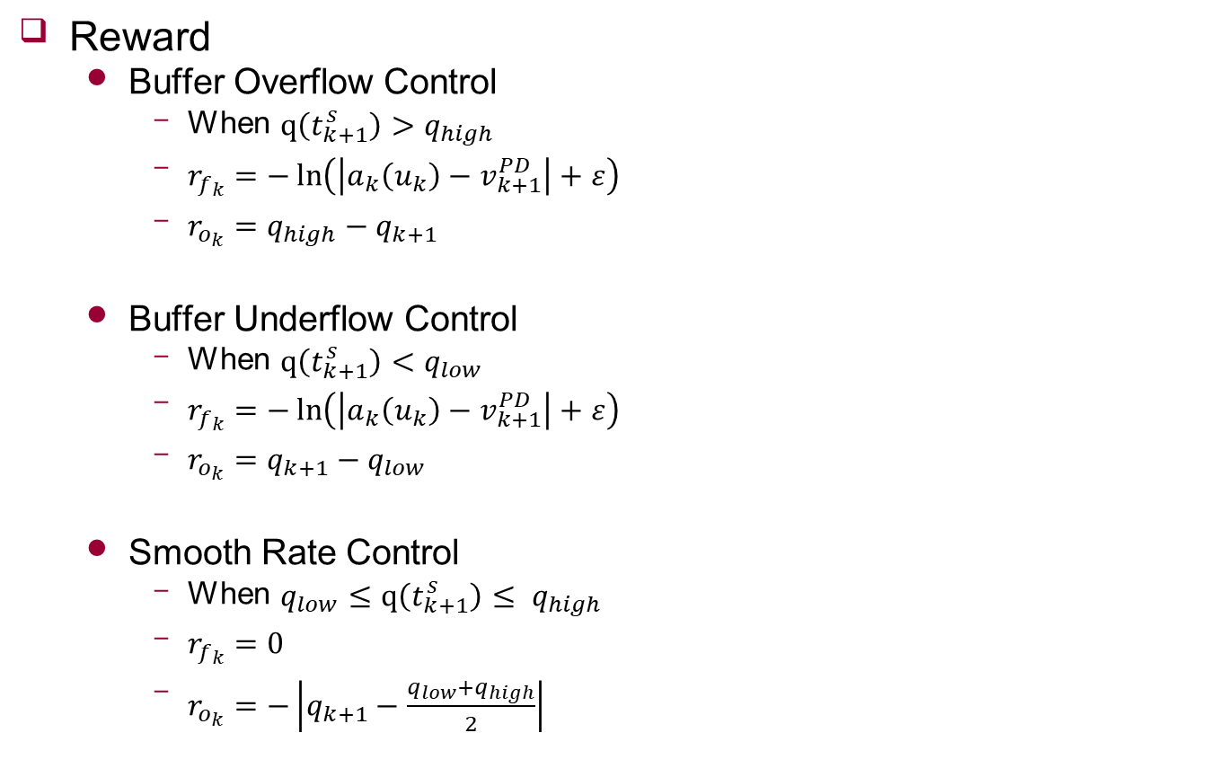
Formulation
Reward
Buffer Overflow Control
When $q\left(t_{k+1}^{s}\right)>q_{high}$
$r_{f_{k}}=−\ln\left(\left|a_{k}\left(u_{k}\right)−v_{k+1}^{PD}\right|+ε\right)$
$r_{o_{k}}=q_{high}−q_{k+1}$
Buffer Underflow Control
When $q\left(t_{k+1}^{s}\right)<q_{low}$
$r_{f_{k}}=−\ln\left(\left|a_{k}\left(u_{k}\right)−v_{k+1}^{PD}\right|+ε\right)$
$r_{o_{k}}=q_{k+1}−q_{low}$
Smooth Rate Control
When $q_{low}≤q\left(t_{k+1}^{s}\right)≤ q_{high}$
$r_{f_{k}}=0$
$r_{o_{k}}=−\left|q_{k+1}−\frac{q_{low}+q_{high}}{2}\right|$

Slide 12
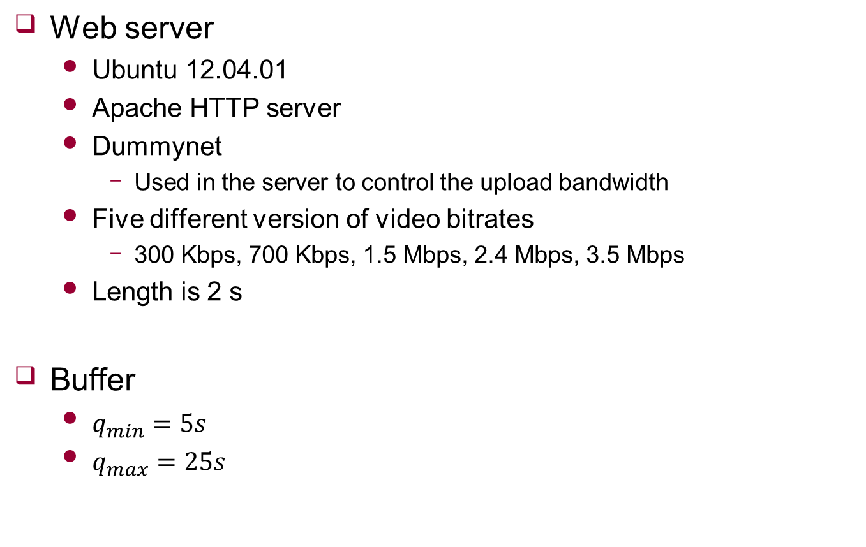
Experiment
Web server
Ubuntu 12.04.01
Apache HTTP server
Dummynet
Used in the server to control the upload bandwidth
Five different version of video bitrates
300 Kbps, 700 Kbps, 1.5 Mbps, 2.4 Mbps, 3.5 Mbps
Length is 2 s
Buffer
$q_{min}=5s$
$q_{max}=25s$

Slide 13
Experiment
Other methods
Netflix
Famous DASH clients
Based on the bandwidth
The latest SDP-based (named sdpDASH)
Selected by Markov decision
Typical buffer based (named bufDASH)
Based on the buffer occupancy
Optimal solution
To compare result

Slide 14
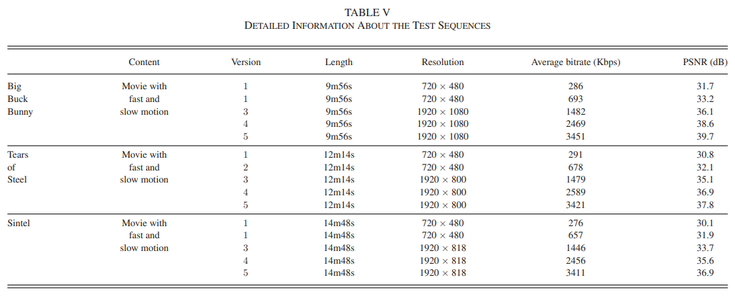
Experiment

Slide 15
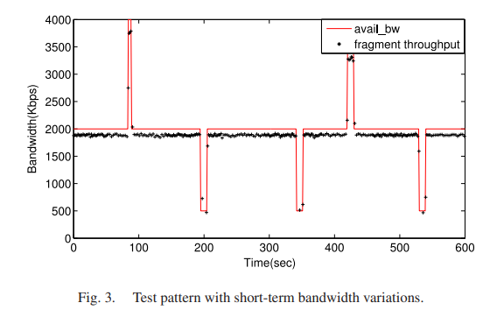
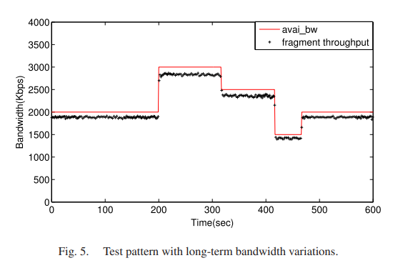
Experiment
About bandwidth
Avail_bw denotes the available bandwidth controlled by Dummynet
Fragment throughput refers to the download throughput for a particular fragment

Slide 16
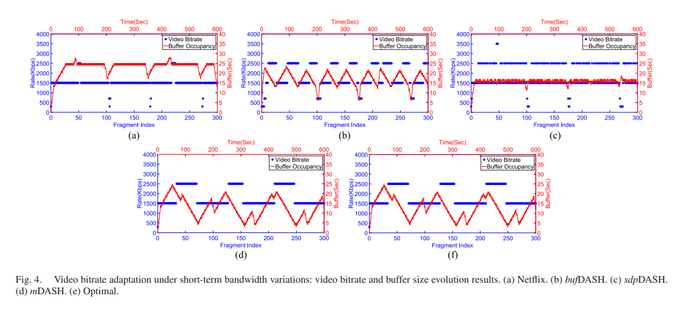
Experiment
Impact of Short-Term Bandwidth Variations

Slide 17
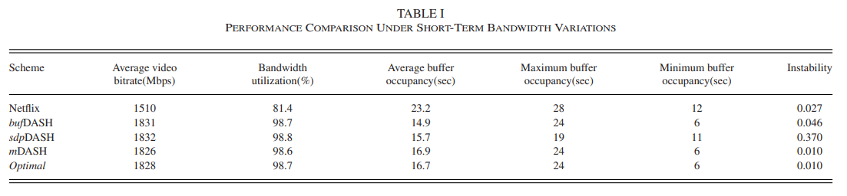
Experiment
Impact of Short-Term Bandwidth Variations

Slide 18
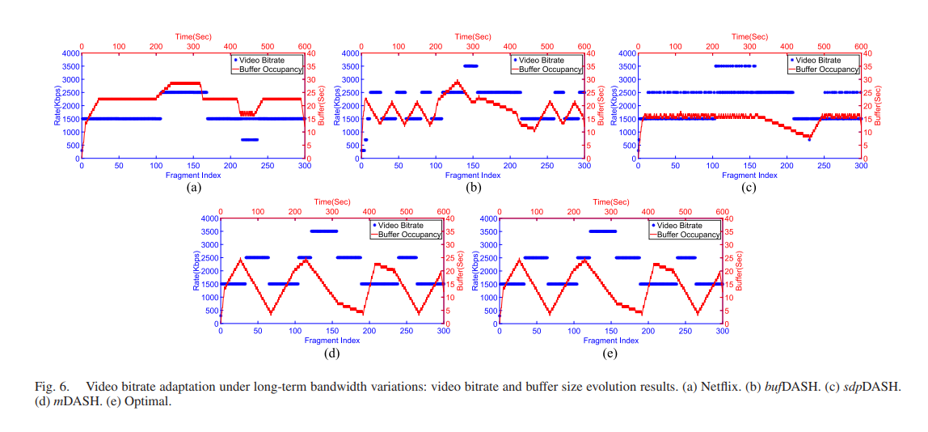
Experiment
Impact of Long-Term Bandwidth Variations

Slide 19
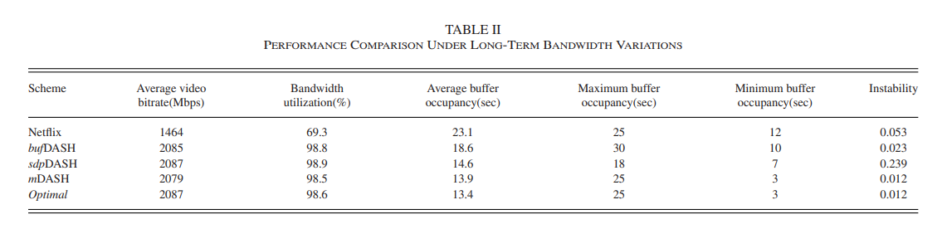
Experiment
Impact of Long-Term Bandwidth Variations

Slide 20
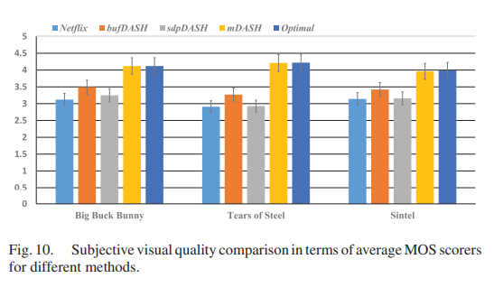
Experiment
Subjective Visual Quality Evaluation

Slide 21
Conclusion
Proposed a Markov decision based rate adaptation approach for dynamic HTTP streaming
Took into account several system parameters that have critical impact on visual quality, including video playback quality, video rate switching frequency and amplitude, buffer overflow/underflow, and buffer occupancy

Slide 22
In my Research
Consider buffer time
The dimension of action is so big
So, will consider only one dimension action
Bitrate selection
Handoff
I think “bitrate selection” can be solved greed algorithm
So, I will apply DQN to “handoff”

