Slide 1
Reference
Related Paper
“MPMTP: MultiPath Multimedia Transport Protocol using systematic raptor codes over wireless networks,”
Estimate PLR(Packet Loss Rate)

Slide 2
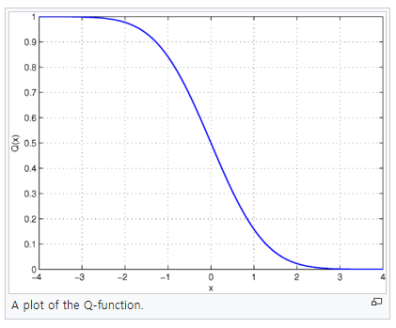
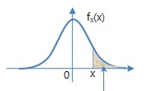

Q-Function
Formulation
$Q\left(x\right)=P\left(X>x\right)=1−F_{x}(x)=\frac{1}{\sqrt{2π}}\int_{x}^{∞}{e^{−\frac{t^{2}}{2}}}dt$
Assume $μ=0, σ^{2}=1$
Derive probability using Gaussian distribution easily
< http://www.ktword.co.kr/abbr_view.php?m_temp1=4376 >
< https://en.wikipedia.org/wiki/Q-function >

Slide 3

Q-Function
Estimation
$P\left(x<θ\right)=Q\left(\frac{x−μ}{σ}\right)$
$\frac{x−μ}{σ}=Q^{−1}(P\left(x<θ\right))$
$x−μ=σ∙Q^{−1}\left(P\left(x<θ\right)\right)$
$x=σ∙Q^{−1}\left(P\left(x<θ\right)\right)+μ$
To Do
How to define $P\left(x<θ\right)$

