Slide 1

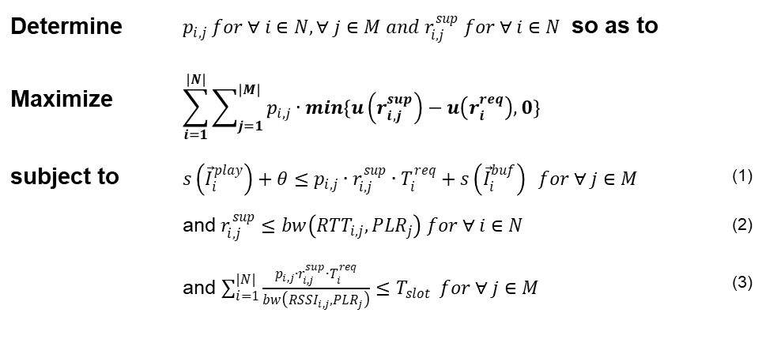
maximize QoE
Formulation
If there are APs which can fulfill UE's request [$bw\left({RTT}_{i,j},{PLR}_{j}\right)≥r_{i}^{req}$]
Select bitrate [constraint 1, 3 and $r_{i,j}^{sup}≅r_{i}^{req}$]
Others [$bw\left({RTT}_{i,j},{PLR}_{j}\right)<r_{i}^{req}$]
Check each APs(m)
Sort UE by requested bitrate ($O(n∙\log{n})$ )
Choose K UEs which have high requested bitrate
Decrease K UE’s bitrate one step until total QoE is maximized ($O(L)$, $L$ is the number of bitrate level )
Estimate available bitrate [using constraint 3] and
Select bitrate [using constraint 1, 2 and $r_{i,j}^{sup}≅r_{i}^{req}$]
Change other APs (K UE) ($O(2^{K})$)
Estimate available bitrate [using constraint 3] and
Select bitrate [using constraint 1, 2 and $r_{i,j}^{sup}≅r_{i}^{req}$]
Choose best case which maximizes total QoE
Consider two cases ($O(n∙2^{K}∙\log{n}))$
Determine | $p_{i,j} for ∀ i∈N, ∀ j∈M and r_{i,j}^{sup} for ∀ i∈N$ so as to
Maximize | $$\sum_{i=1}^{|N|}{\sum_{j=1}^{|M|}{p_{i,j}∙min\{u\left(r_{i,j}^{sup}\right)−u\left(r_{i}^{req}\right),0\}}}$$
subject to | $s\left({\vec{I}}_{i}^{play}\right)+θ≤p_{i,j}∙r_{i,j}^{sup}∙T_{i}^{req}+s\left({\vec{I}}_{i}^{buf}\right) for ∀ j∈M$ | (1)
 | and $r_{i,j}^{sup}≤bw\left({RTT}_{i,j},{PLR}_{j}\right) for ∀ i∈N$ | (2)
 | and $\sum_{i=1}^{|N|}{\frac{p_{i,j}∙r_{i,j}^{sup}∙T_{i}^{req}}{bw\left({RSSI}_{i,j},{PLR}_{j}\right)}≤T_{slot}} for ∀ j∈M$ | (3)
K
↓

