Slide 1
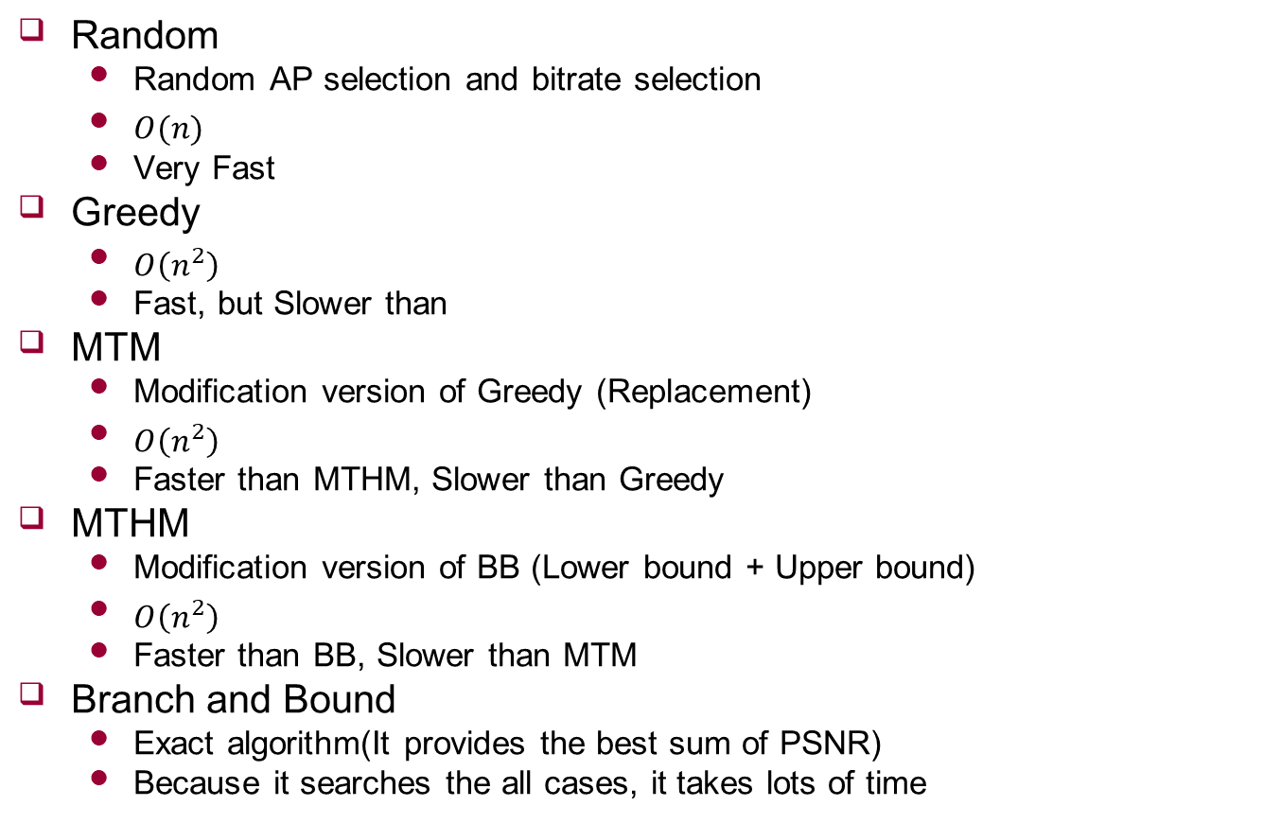
Characteristics
Random
Random AP selection and bitrate selection
$O(n)$
Very Fast
Greedy
$O\left(n^{2}\right)$
Fast, but Slower than
MTM
Modification version of Greedy (Replacement)
$O\left(n^{2}\right)$
Faster than MTHM, Slower than Greedy
MTHM
Modification version of BB (Lower bound + Upper bound)
$O\left(n^{2}\right)$
Faster than BB, Slower than MTM
Branch and Bound
Exact algorithm(It provides the best sum of PSNR)
Because it searches the all cases, it takes lots of time

