Slide 1
State
State must represent situation
Information that computer can use is timeslot
Other information can not be helpful
If value is bigger than 0, it means there is connection between UE and AP
UE
AP Timeslot
0 | 0.3 | 0 | 0 | 0.1
0 | 0 | 0 | 0 | 0
0 | 0 | 0 | 0 | 0.2
0 | 0 | 0.5 | 0 | 0
0 | 0 | 0 | 0 | 0
0 | 0.25 | 0 | 0 | 0
AP

Slide 2
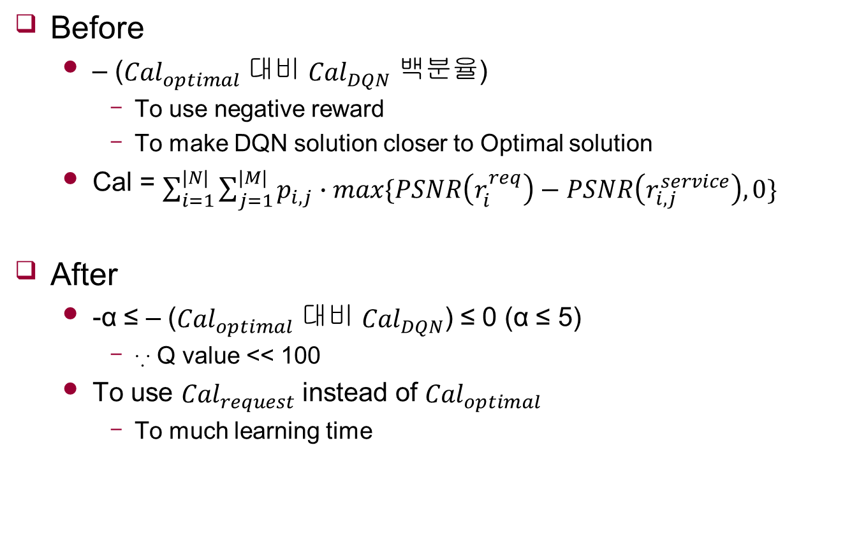
Reward
Before
– (${Cal}_{optimal}$ 대비 ${Cal}_{DQN}$ 백분율)
To use negative reward
To make DQN solution closer to Optimal solution
Cal = $\sum_{i=1}^{|N|}{\sum_{j=1}^{|M|}{p_{i,j}∙max\{PSNR\left(r_{i}^{req}\right)−PSNR\left(r_{i,j}^{service}\right),0\}}}$
After
-α ≤ – (${Cal}_{optimal}$ 대비 ${Cal}_{DQN}$) ≤ 0 (α ≤ 5)
∵ Q value << 100
To use ${Cal}_{request}$ instead of ${Cal}_{optimal}$
To much learning time

Slide 3
DQN vs Optimal solution
When action is not changed

