Slide 1
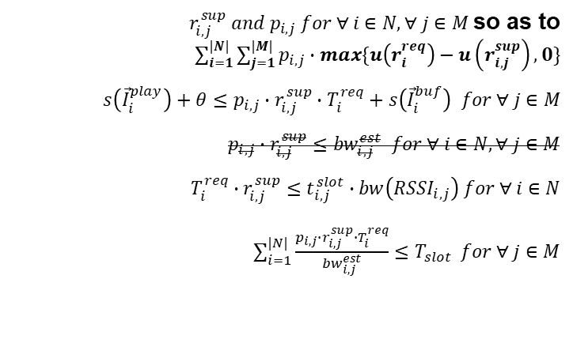
Formulation
Determine Minimize subject to and and and
$r_{i,j}^{sup} and p_{i,j} for ∀ i∈N, ∀ j∈M$so as to $\sum_{i=1}^{|N|}{\sum_{j=1}^{|M|}{p_{i,j}∙max\{u\left(r_{i}^{req}\right)−u\left(r_{i,j}^{sup}\right),0\}}}$ $s\left({\vec{I}}_{i}^{play}\right)+θ≤p_{i,j}∙r_{i,j}^{sup}∙T_{i}^{req}+s\left({\vec{I}}_{i}^{buf}\right) for ∀ j∈M$ $$p_{i,j}∙r_{i,j}^{sup}≤{bw}_{i,j}^{est} for ∀ i∈N, ∀ j∈M$$ $$T_{i}^{req}∙r_{i,j}^{sup}≤t_{i,j}^{slot}∙bw\left({RSSI}_{i,j}\right) for ∀ i∈N$$ $\sum_{i=1}^{|N|}{\frac{p_{i,j}∙r_{i,j}^{sup}∙T_{i}^{req}}{{bw}_{i,j}^{est}}≤T_{slot}} for ∀ j∈M$

Slide 2
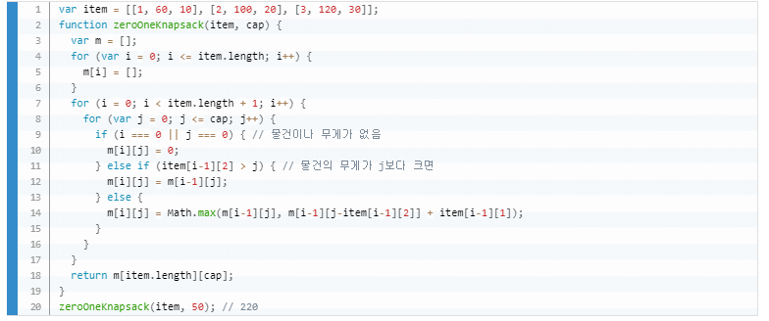
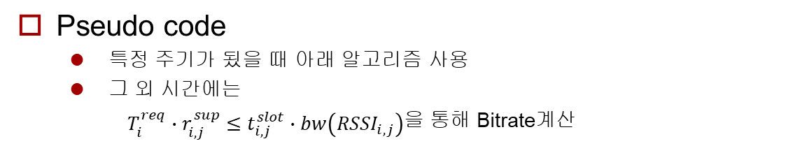
Algorithm
Pseudo code
특정 주기가 됬을 때 아래 알고리즘 사용
그 외 시간에는
$T_{i}^{req}∙r_{i,j}^{sup}≤t_{i,j}^{slot}∙bw\left({RSSI}_{i,j}\right)$을 통해 Bitrate계산
AP loop 추가
Loop가 끝날 때 어떤 AP에서 퀄리티가 최대인지 판단
< https://www.zerocho.com/category/Algorithm/post/584b979a580277001862f182 >
Notes:
코드 보여주기

