Slide 1
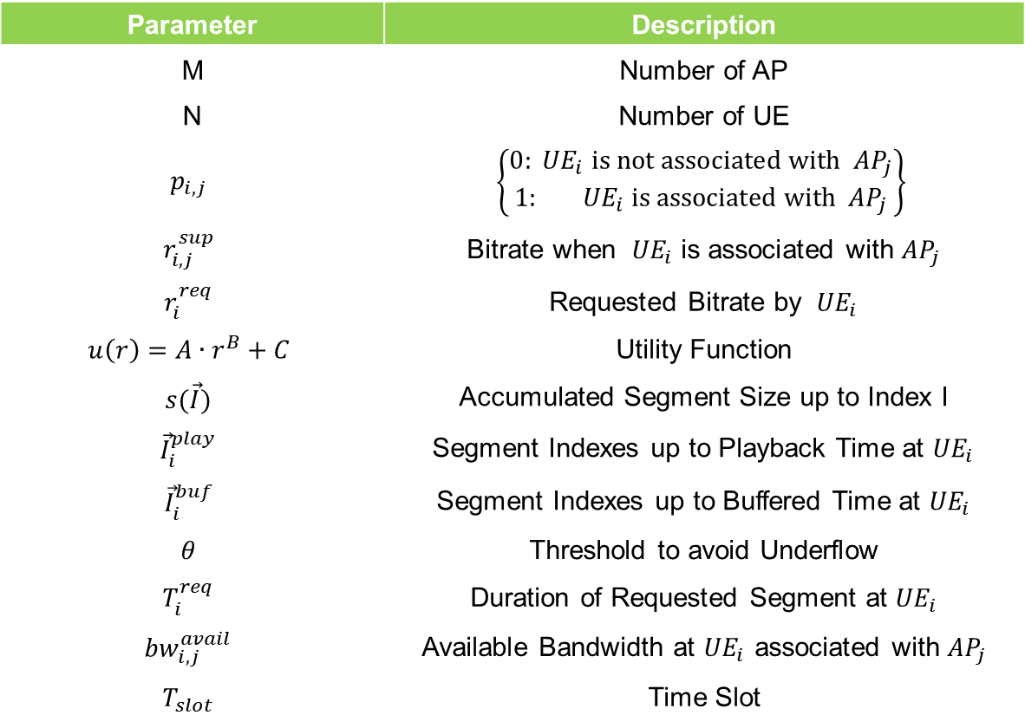
Problem Formulation
Parameter | Description
M | Number of AP
N | Number of UE
$$p_{i,j}$$ | $$\left\{\begin{matrix}0:{ UE}_{i} is not associated with{ AP}_{j} \\ 1:{ UE}_{i} \text{is} \text{associated} \text{with}{ AP}_{j}\end{matrix}\right\}$$
$$r_{i,j}^{sup}$$ | Bitrate when ${ UE}_{i}$ is associated with ${AP}_{j}$
$$r_{i}^{req}$$ | Requested Bitrate by ${ UE}_{i}$
$$u\left(r\right)=A∙r^{B}+C$$ | Utility Function
$$s(\vec{I})$$ | Accumulated Segment Size up to Index I
$${\vec{I}}_{i}^{play}$$ | Segment Indexes up to Playback Time at ${UE}_{i}$
$${\vec{I}}_{i}^{buf}$$ | Segment Indexes up to Buffered Time at ${UE}_{i}$
$$θ$$ | Threshold to avoid Underflow
$$T_{i}^{req}$$ | Duration of Requested Segment at ${UE}_{i}$
$${bw}_{i,j}^{avail}$$ | Available Bandwidth at ${UE}_{i}$ associated with ${AP}_{j}$
$$T_{slot}$$ | Time Slot

Slide 2
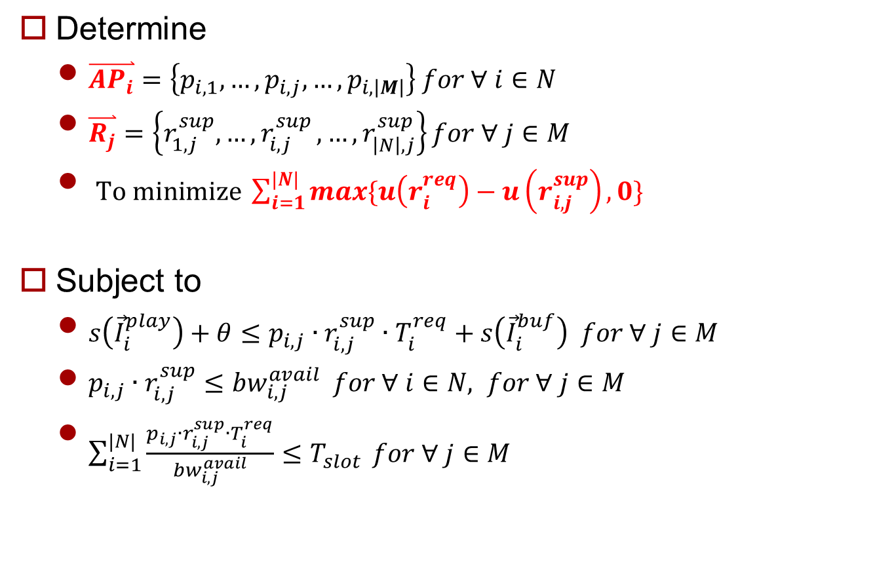
Problem Formulation
Determine
$\overset{⃑}{{AP}_{i}}=\left\{p_{i,1},…,p_{i,j},…,p_{i,\left|M\right|}\right\} for ∀ i∈N$
$\overset{⃑}{R_{j}}=\left\{r_{1,j}^{sup},{…,r}_{i,j}^{sup},…,r_{\left|N\right|,j}^{sup}\right\}for ∀ j∈M$
$To minimize \sum_{i=1}^{|N|}{max\{u\left(r_{i}^{req}\right)−u\left(r_{i,j}^{sup}\right),0\}}$
Subject to
$s\left({\vec{I}}_{i}^{play}\right)+θ≤p_{i,j}∙r_{i,j}^{sup}∙T_{i}^{req}+s\left({\vec{I}}_{i}^{buf}\right) for ∀ j∈M$
$p_{i,j}∙r_{i,j}^{sup}≤{bw}_{i,j}^{avail} for ∀ i∈N, for ∀ j∈M$
$\sum_{i=1}^{|N|}{\frac{p_{i,j}∙r_{i,j}^{sup}∙T_{i}^{req}}{{bw}_{i,j}^{avail}}≤T_{slot}} for ∀ j∈M$
< SDN-assisted HTTP Adaptive Streaming over Wi-Fi Network >

Slide 3
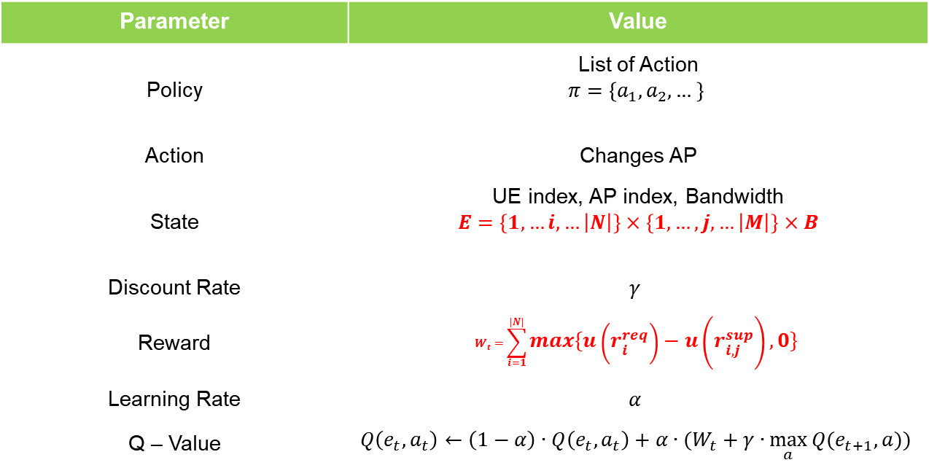
MDP Definition
Find Policy which minimize long term reward
Parameter | Value
Policy | List of Action $$π=\left\{a_{1},a_{2},… \right\}$$
Action | Changes AP
State | UE index, AP index, Bandwidth $$E=\left\{1,…i,…\left|N\right|\right\}×\left\{1,…,j,…\left|M\right|\right\}×B$$
Discount Rate | $$γ$$
Reward | $$W_{t}=\sum_{i=1}^{|N|}{max\{u\left(r_{i}^{req}\right)−u\left(r_{i,j}^{sup}\right),0\}}$$
Learning Rate | $$α$$
Q – Value | $$Q\left(e_{t},a_{t}\right)←\left(1−α\right)∙Q\left(e_{t},a_{t}\right)+α∙(W_{t}+γ∙\max_{a}{Q(e_{t+1},a))}$$

Slide 4
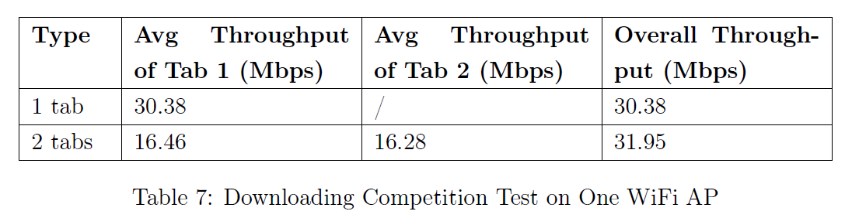
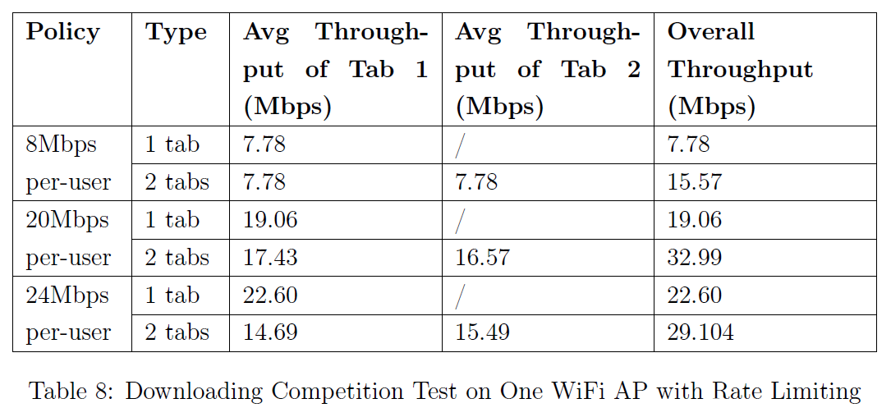
An SDN Platform for Traffic Offloading
Number of UEs
< An SDN Platform for Traffic Offloading >
Notes:
주변 AP에서 bandwidth 정보 얻는 것 혹은
OpenFlow Protocol에 Bandwidth라든지 traffic 정보 포함해서 보내는 것
유저가 원하는 request가 reasonable한 경우 혹은
유저가 원하는 request가 aggressive한 경우, 이 경우는 대역폭을 제약하든지

Slide 5
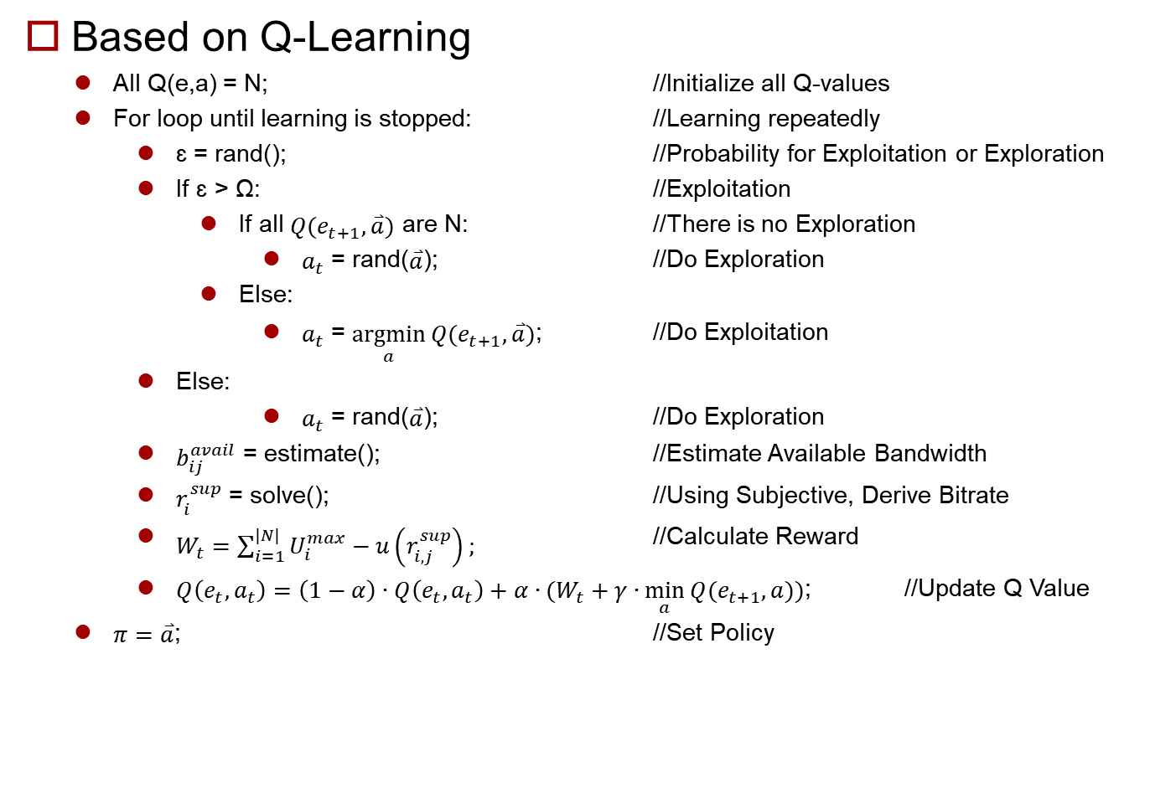
Algorithm
Based on Q-Learning
All Q(e,a) = N; //Initialize all Q-values
For loop until learning is stopped: //Learning repeatedly
ɛ = rand(); //Probability for Exploitation or Exploration
If ɛ > Ω: //Exploitation
If all $Q(e_{t+1},\overset{⃑}{a})$ are N: //There is no Exploration
$a_{t}$ = rand($\overset{⃑}{a}$); //Do Exploration
Else:
$a_{t}$ = $\underset{a}{argmin}{Q(e_{t+1},\overset{⃑}{a})}$; //Do Exploitation
Else:
$a_{t}$ = rand($\overset{⃑}{a}$); //Do Exploration
$b_{ij}^{avail}$ = estimate(); //Estimate Available Bandwidth
$r_{i}^{sup}$ = solve(); //Using Subjective, Derive Bitrate
$W_{t}=\sum_{i=1}^{|N|}{U_{i}^{max}−u\left(r_{i,j}^{sup}\right)};$ //Calculate Reward
$Q\left(e_{t},a_{t}\right)=\left(1−α\right)∙Q\left(e_{t},a_{t}\right)+α∙(W_{t}+γ∙\min_{a}{Q(e_{t+1},a))}$; //Update Q Value
$π=\overset{⃑}{a}$; //Set Policy
Notes:
Bandwidth 추정함수 알고리즘 상세히

Slide 6
Future Work
Making model to predict bandwidth after load balancing
Notes:
다음 시간 Bandwidth 예측하는 것 위주로 발표(여분 되면 System Architecture까지)

