Slide 1
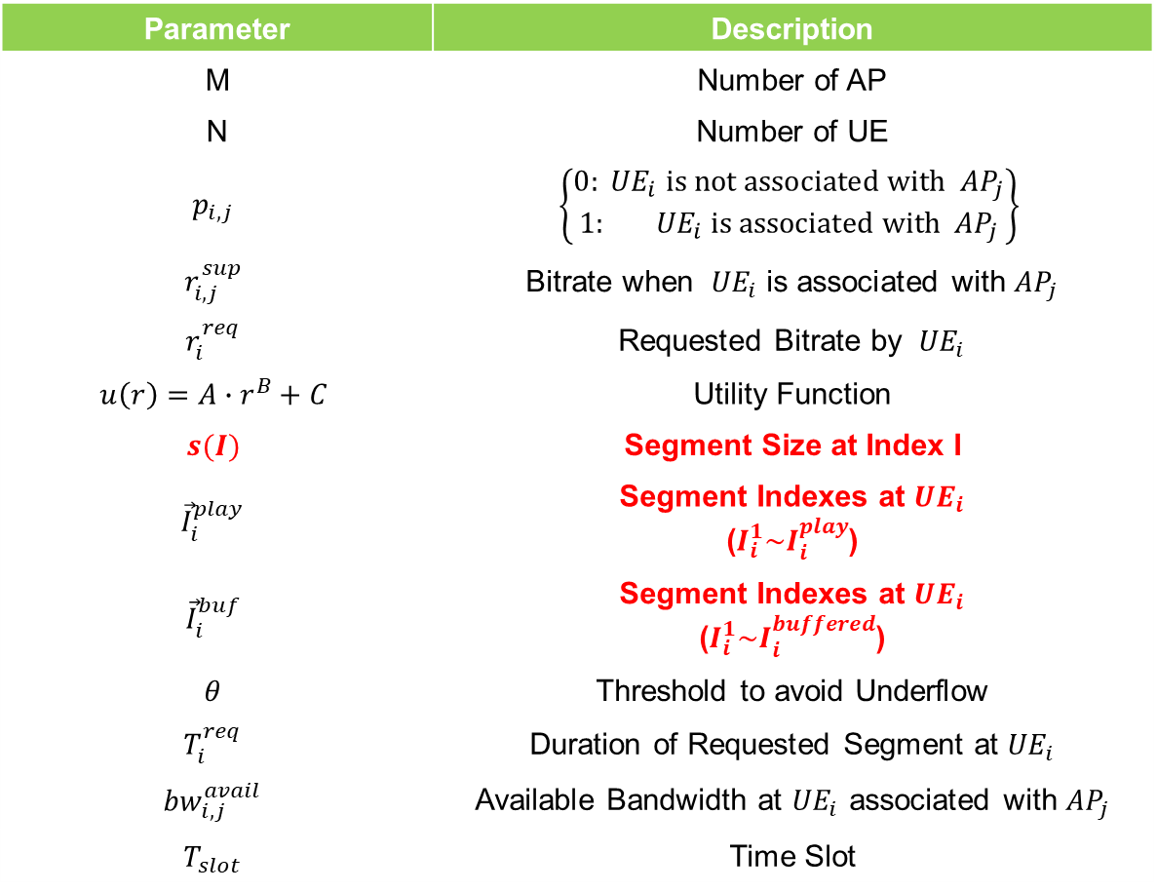
Problem Formulation
Parameter | Description
M | Number of AP
N | Number of UE
$$p_{i,j}$$ | $$\left\{\begin{matrix}0:{ UE}_{i} is not associated with{ AP}_{j} \\ 1:{ UE}_{i} \text{is} \text{associated} \text{with}{ AP}_{j}\end{matrix}\right\}$$
$$r_{i,j}^{sup}$$ | Bitrate when ${ UE}_{i}$ is associated with ${AP}_{j}$
$$r_{i}^{req}$$ | Requested Bitrate by ${ UE}_{i}$
$$u\left(r\right)=A∙r^{B}+C$$ | Utility Function
$$s(I)$$ | Segment Size at Index I
$${\vec{I}}_{i}^{play}$$ | Segment Indexes at ${UE}_{i}$ ($I_{i}^{1}\sim I_{i}^{play}$)
$${\vec{I}}_{i}^{buf}$$ | Segment Indexes at ${UE}_{i}$ ($I_{i}^{1}\sim I_{i}^{buffered}$)
$$θ$$ | Threshold to avoid Underflow
$$T_{i}^{req}$$ | Duration of Requested Segment at ${UE}_{i}$
$${bw}_{i,j}^{avail}$$ | Available Bandwidth at ${UE}_{i}$ associated with ${AP}_{j}$
$$T_{slot}$$ | Time Slot

Slide 2


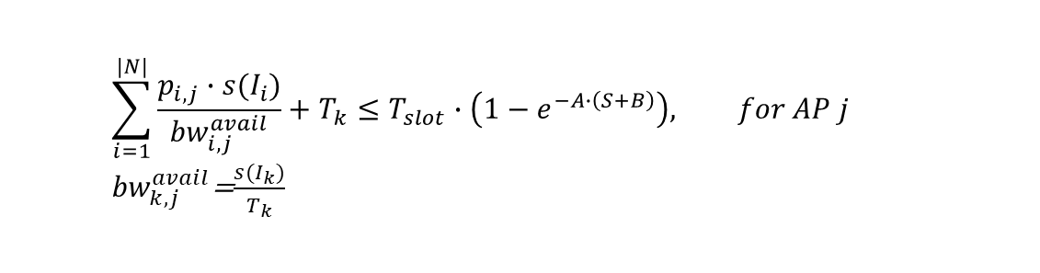

Bandwidth Estimation
To optimize Bitrate, need to know bandwidth
?
Resize Time Slot
1~20Kbps
$$1−e^{−A∙(S+B)}$$
< An SDN Platform for Traffic Offloading >
0.5~11Kbps
Consider RSSI
UE1
UE2
$$\sum_{i=1}^{|N|}{\frac{p_{i,j}∙s(I_{i})}{{bw}_{i,j}^{avail}}}+T_{k}≤T_{slot}∙\left(1−e^{−A∙\left(S+B\right)}\right), for AP j$$
${bw}_{k,j}^{avail}$=$\frac{s(I_{k})}{T_{k}}$
Notes:
TDMA에서
채널 퀄리티(RSSI) 좋으면 dense하게 보낼 수 있음
채널 퀄리티(RSSI) 좋지 않으면 sparse하게 보냄

Slide 3

Testbed
For verification
Proxy Server
export http_proxy="<AP IP>:<Port number>“
iptables -D INPUT -p tcp --dport <Port number> -j ACCEPT
Notes:
Proxy 서버 만들기

