Slide 1
Research Jae Jun Ha Media Computing and Networking Laboratory POSTECH 2018-11-09
Notes:
세미나 발표를 시작하겠습니다.

Slide 2
Contents
Contents
Modified Formulation
Time Resource
Algorithm
Fairness
Simulation
Future Work

Slide 3
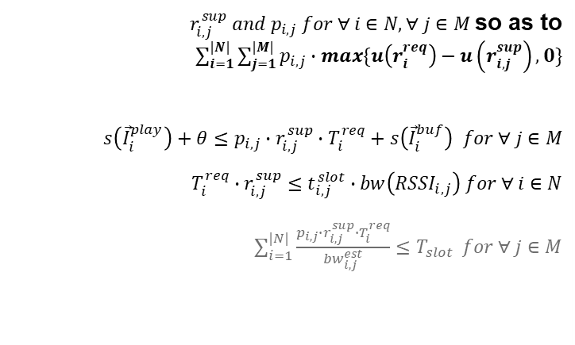
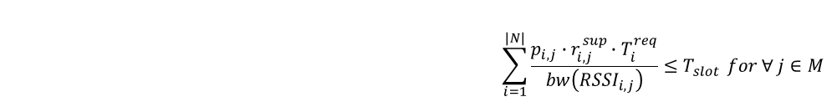
Modified Formulation
Using RSSI to estimate bandwidth
Determine Minimize subject to and and
$r_{i,j}^{sup} and p_{i,j} for ∀ i∈N, ∀ j∈M$so as to $\sum_{i=1}^{|N|}{\sum_{j=1}^{|M|}{p_{i,j}∙max\{u\left(r_{i}^{req}\right)−u\left(r_{i,j}^{sup}\right),0\}}}$ $s\left({\vec{I}}_{i}^{play}\right)+θ≤p_{i,j}∙r_{i,j}^{sup}∙T_{i}^{req}+s\left({\vec{I}}_{i}^{buf}\right) for ∀ j∈M$ $$T_{i}^{req}∙r_{i,j}^{sup}≤t_{i,j}^{slot}∙bw\left({RSSI}_{i,j}\right) for ∀ i∈N$$ $\sum_{i=1}^{|N|}{\frac{p_{i,j}∙r_{i,j}^{sup}∙T_{i}^{req}}{{bw}_{i,j}^{est}}≤T_{slot}} for ∀ j∈M$
$$\sum_{i=1}^{|N|}{\frac{p_{i,j}∙r_{i,j}^{sup}∙T_{i}^{req}}{bw\left({RSSI}_{i,j}\right)}≤T_{slot}} for ∀ j∈M$$

Slide 4





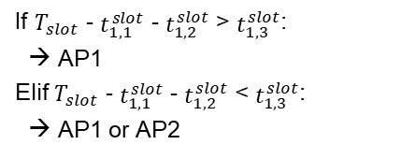
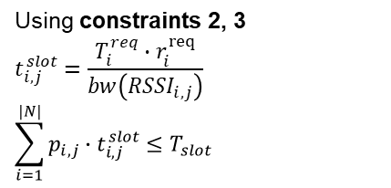
Time Resource
AP1
$$t_{1,1}^{slot}$$
$$t_{2,1}^{slot}$$
UE1
UE2
$$T_{slot}$$
Using constraints 2, 3
$$t_{i,j}^{slot}=\frac{T_{i}^{req}∙r_{i}^{req}}{bw\left({RSSI}_{i,j}\right)}$$
$$\sum_{i=1}^{|N|}{p_{i,j}∙t_{i,j}^{slot}≤T_{slot}}$$
Where?
AP2
$$T_{slot}$$
If $T_{slot}$ - $t_{1,1}^{slot}$ - $t_{1,2}^{slot}$ > $t_{1,3}^{slot}$:
→ AP1
Elif $T_{slot}$ - $t_{1,1}^{slot}$ - $t_{1,2}^{slot}$ < $t_{1,3}^{slot}$:
→ AP1 or AP2

Slide 5
Algorithm
function dfs(index_ue):
if index_ue == N + 1:
sum = 0
for i from 1 to N:
sum += max(ue[i].reqQuality – ue[i].quality, 0)
sol = min(sum, sol)
for j from 1 to M:
if p[index_ue][j] == False:
continue
if ap[j].timeslot == T:
continue
c[index_ue][j] = True
if ue[index_ue].timeslot + ap[j].timeslot <= T:
ue[index_ue].quality = calQality(index_ue, ue[index_ue].timeslot)
ap[j].timeslot += ue[index_ue].timeslot
else:
ue[index_ue].quality = calQality(index_ue, T - ap[j].timeslot)
ap[j].timeslot = T
dfs(index_ue + 1)
c[index_ue][j] = False
restore(ue[index_ue], ap[j])
Sum == 0:
Using Threshold
So, Sum > Threshold
Consider fairness
C version simulation code
https://github.com/jaejunha/Paper
/blob/master/Code/SDN_Application/handover.cpp

Slide 6
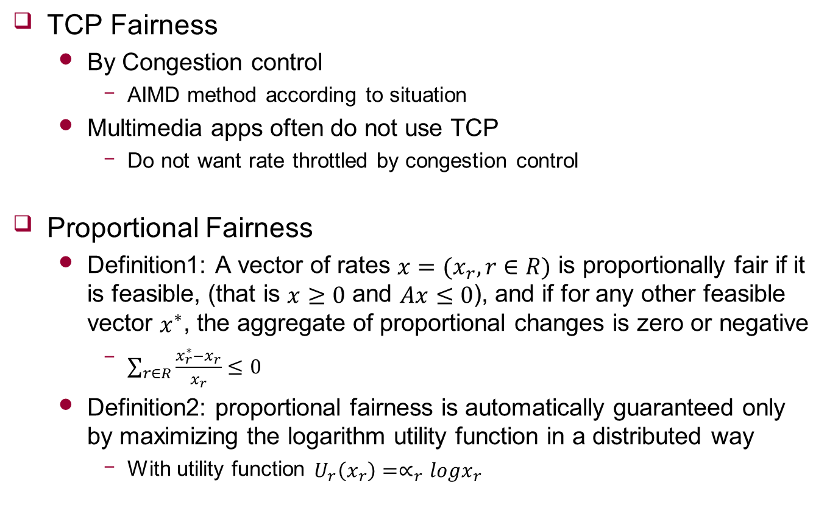
Fairness
TCP Fairness
By Congestion control
AIMD method according to situation
Multimedia apps often do not use TCP
Do not want rate throttled by congestion control
Proportional Fairness
Definition1: A vector of rates $x=(x_{r},r∈R)$ is proportionally fair if it is feasible, (that is $x≥0$ and $Ax≤0$), and if for any other feasible vector $x^{∗}$, the aggregate of proportional changes is zero or negative
$\sum_{r∈R}{\frac{x_{r}^{∗}−x_{r}}{x_{r}}}≤0$
Definition2: proportional fairness is automatically guaranteed only by maximizing the logarithm utility function in a distributed way
With utility function $U_{r}\left(x_{r}\right)=∝_{r}logx_{r}$

Slide 7
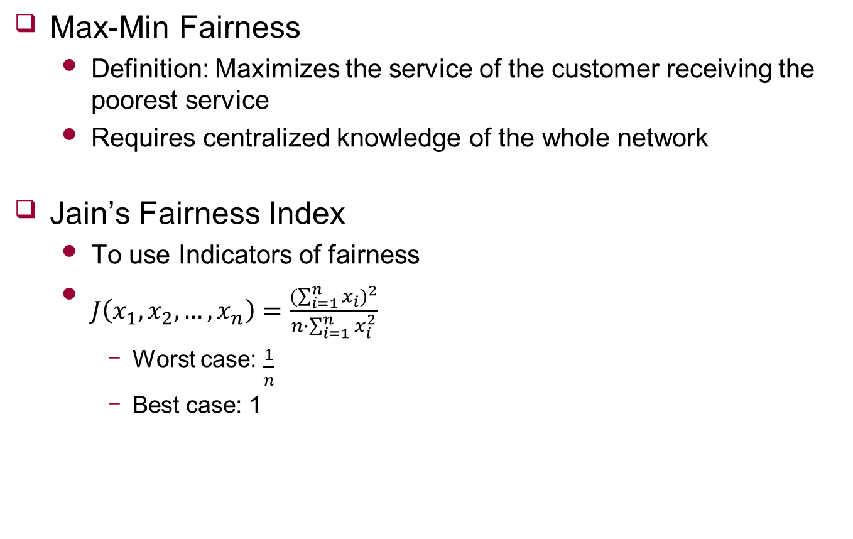
Fairness
Max-Min Fairness
Definition: Maximizes the service of the customer receiving the poorest service
Requires centralized knowledge of the whole network
Jain’s Fairness Index
To use Indicators of fairness
$J\left(x_{1},x_{2},…,x_{n}\right)=\frac{{(\sum_{i=1}^{n}{x_{i}})}^{2}}{n∙\sum_{i=1}^{n}{x_{i}^{2}}}$
Worst case: $\frac{1}{n}$
Best case: 1
Notes:
실제적으로 영향 미치는 것은 공격적인 사용자들 임

Slide 8
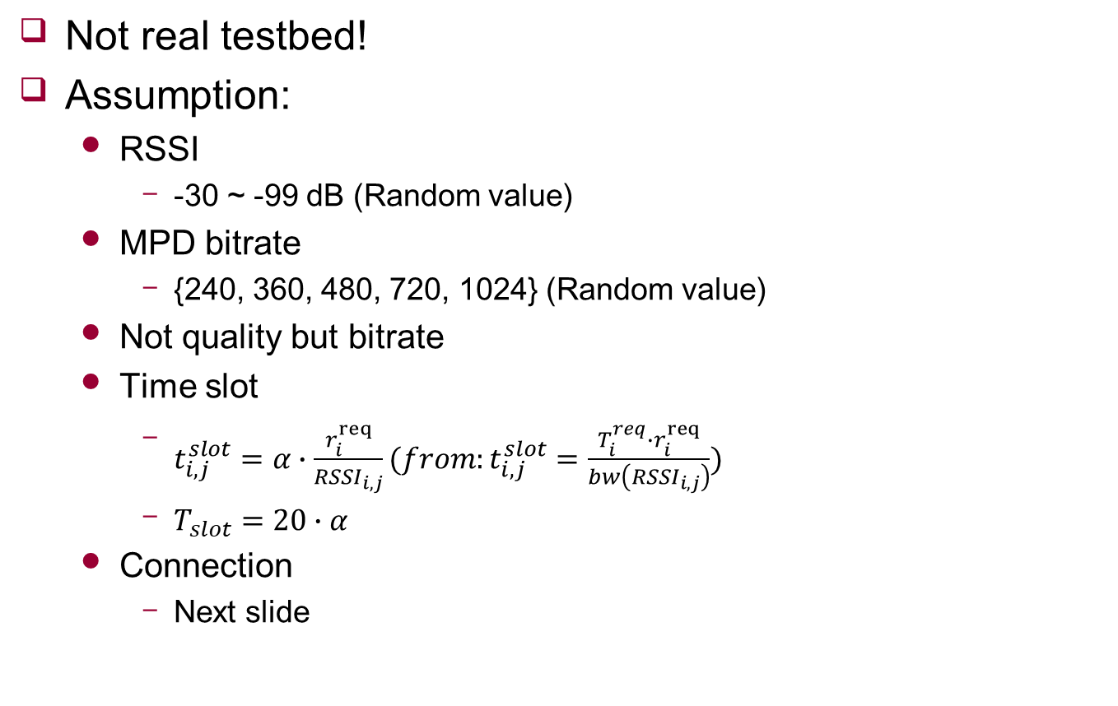
Simulation
Not real testbed!
Assumption:
RSSI
-30 ~ -99 dB (Random value)
MPD bitrate
{240, 360, 480, 720, 1024} (Random value)
Not quality but bitrate
Time slot
$t_{i,j}^{slot}=α∙\frac{r_{i}^{req}}{{RSSI}_{i,j}}(from:t_{i,j}^{slot}=\frac{T_{i}^{req}∙r_{i}^{req}}{bw\left({RSSI}_{i,j}\right)})$
$T_{slot}=20∙α$
Connection
Next slide
Notes:
Handover AP에 얼마나 잘 배분 되는지

Slide 9

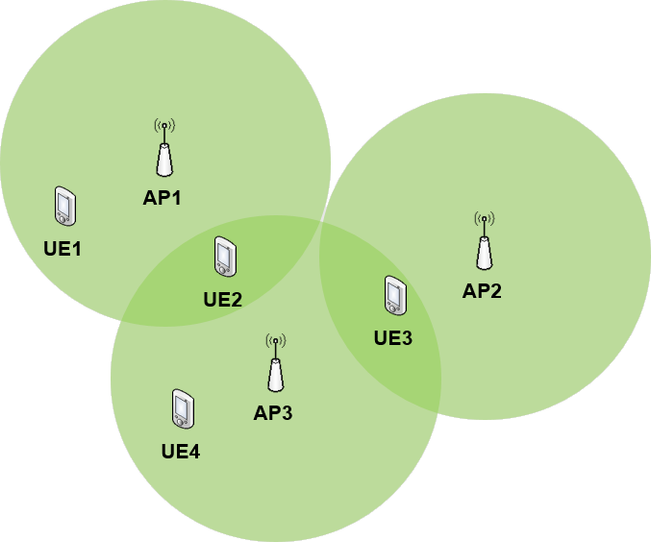
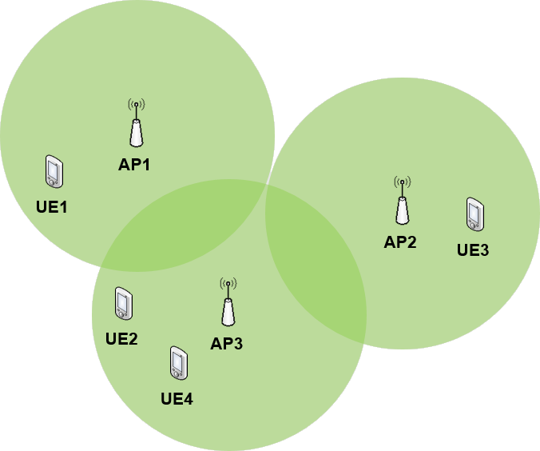
Simulation - Connection
AP1
UE1
UE2
AP2
UE3
AP3
UE4
AP1
UE1
AP2
UE3
UE2
AP3
UE4
<Connection 1>
<Connection 2>

Slide 10
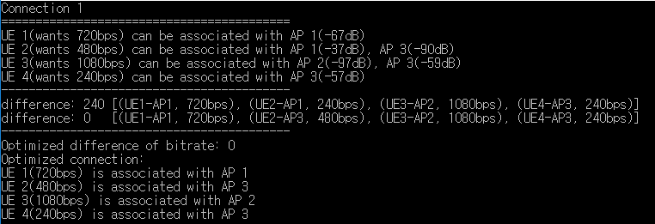
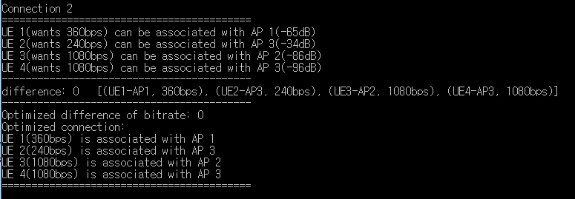
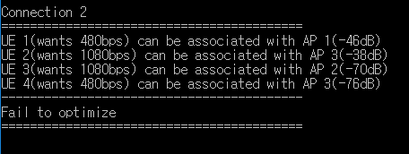
Simulation
Success
Fail
Some UEs doesn’t have connection with any AP
Notes:
시간 복잡도는 ?

Slide 11
Future work
Utility Function
Performance comparison

