Slide 1
Background
ARIMA…(need to read related paper)

Slide 2
Problem Description
동기 등, 선배들 자료 찾아서 뭐 써야 되는 지 보기
Parameter들 정의하는 게 아님

Slide 3
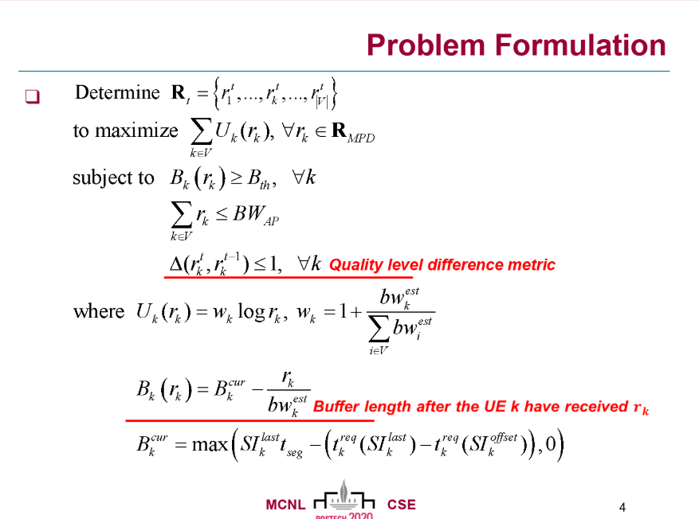
Problem Formulation
이환욱 석사 Problem Formulation 예시

Slide 4
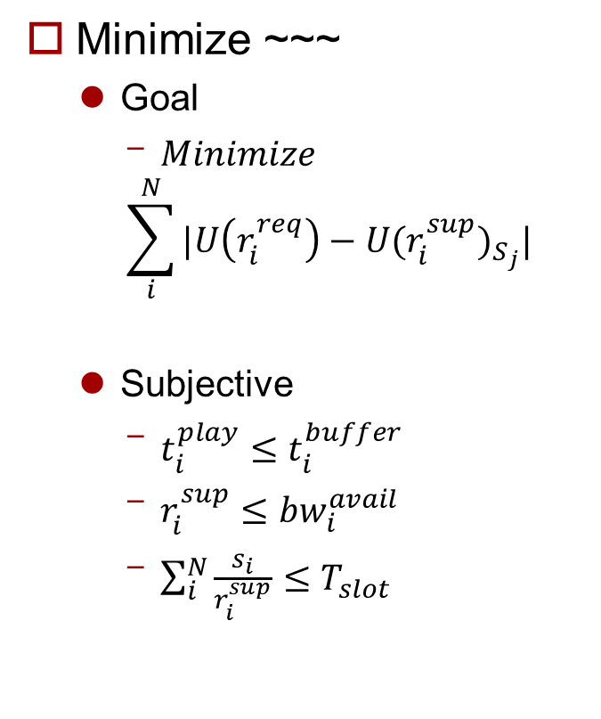
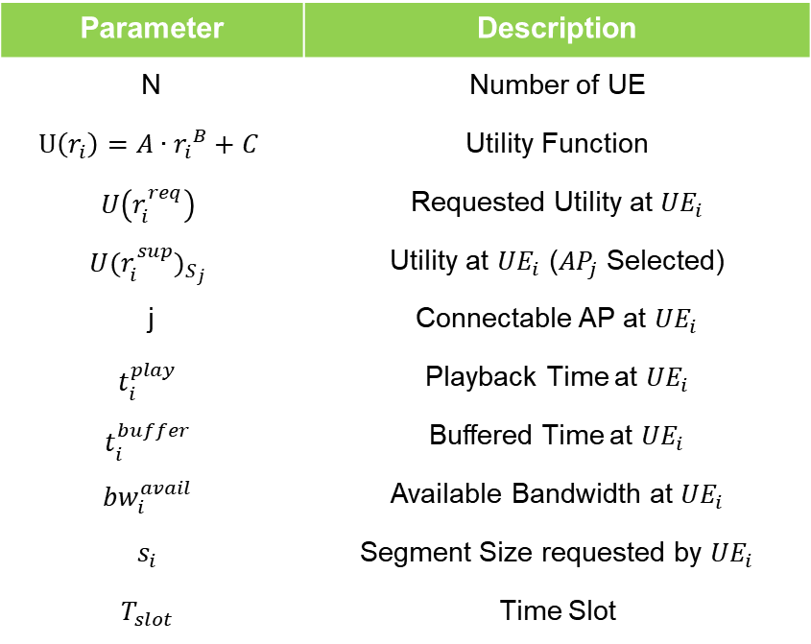
Problem Formulation
Minimize ~~~
Goal
$Minimize$
$$\sum_{i}^{N}{|U\left(r_{i}^{req}\right)−{U(r_{i}^{sup})}_{S_{j}}|}$$
Subjective
$t_{i}^{play}≤t_{i}^{buffer}$
$r_{i}^{sup}≤{bw}_{i}^{avail}$
$\sum_{i}^{N}{\frac{s_{i}}{r_{i}^{sup}}≤T_{slot}}$
Parameter | Description
N | Number of UE
$$U\left(r_{i}\right)=A∙{r_{i}}^{B}+C$$ | Utility Function
$$U\left(r_{i}^{req}\right)$$ | Requested Utility at ${UE}_{i}$
$${U(r_{i}^{sup})}_{S_{j}}$$ | Utility at ${UE}_{i}$ (${AP}_{j}$ Selected)
j | Connectable AP at ${UE}_{i}$
$$t_{i}^{play}$$ | Playback Time at ${UE}_{i}$
$$t_{i}^{buffer}$$ | Buffered Time at ${UE}_{i}$
$${bw}_{i}^{avail}$$ | Available Bandwidth at ${UE}_{i}$
$$s_{i}$$ | Segment Size requested by ${UE}_{i}$
$$T_{slot}$$ | Time Slot
Notes:
지적 받은 것:
각 Parameter들이 측정 가능한지

Slide 5
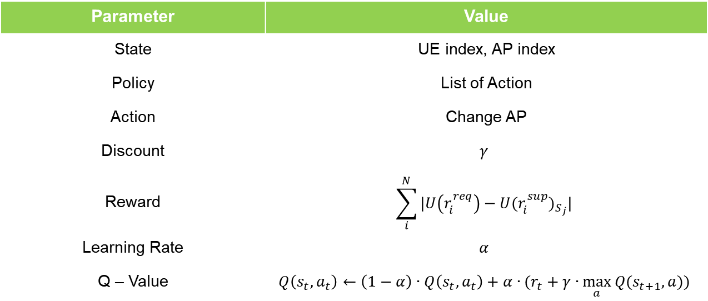
Problem Formulation
MDP
Find Policy which minimize long term reward
Using Q – Learning (at first, all Q = 1)
Parameter | Value
State | UE index, AP index
Policy | List of Action
Action | Change AP
Discount | $$γ$$
Reward | $$\sum_{i}^{N}{|U\left(r_{i}^{req}\right)−{U(r_{i}^{sup})}_{S_{j}}|}$$
Learning Rate | $$α$$
Q – Value | $$Q\left(s_{t},a_{t}\right)←\left(1−α\right)∙Q\left(s_{t},a_{t}\right)+α∙(r_{t}+γ∙\max_{a}{Q(s_{t+1},a))}$$

Slide 6
System Architecture
Contents
Contents
Contents

Slide 7
Future Work
Modified Problem Formulation

