Slide 1
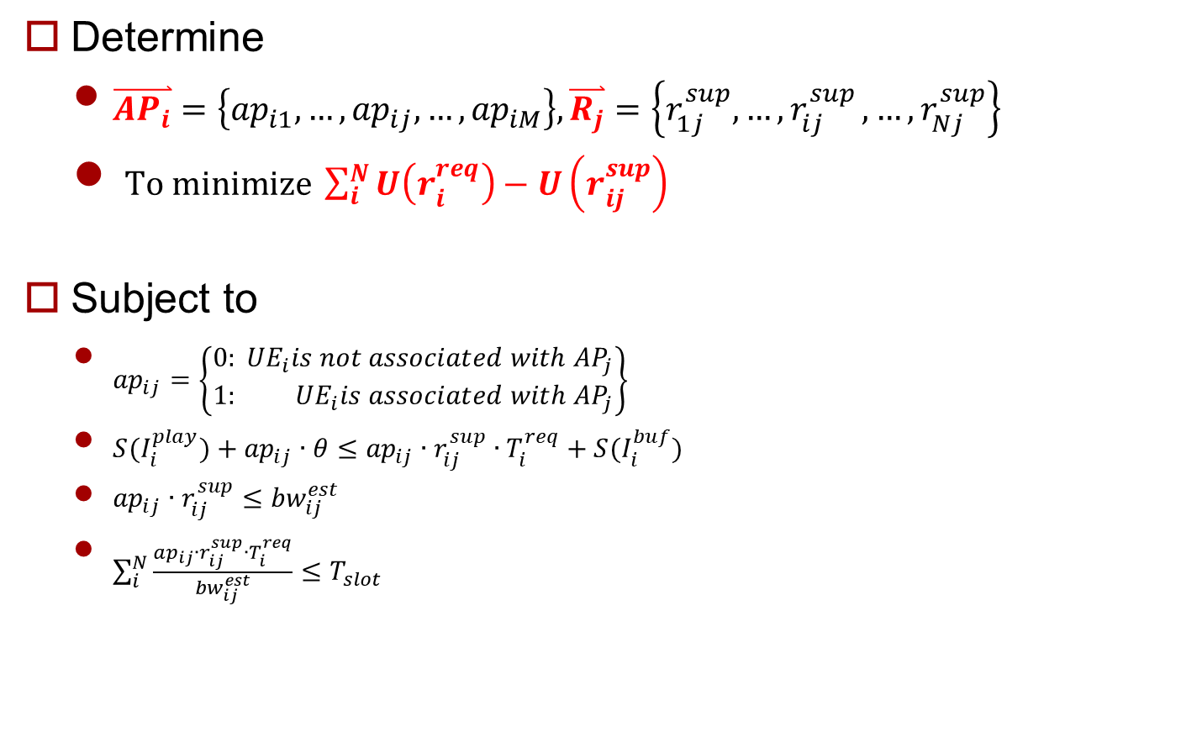
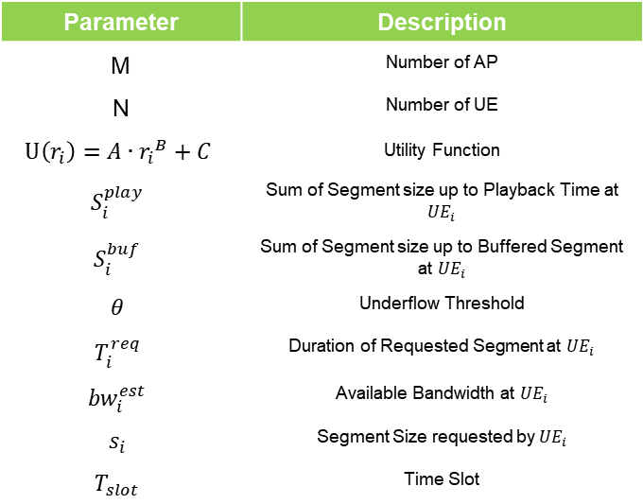
Problem Formulation
Determine
$\overset{⃑}{{AP}_{i}}=\left\{{ap}_{i1},…,{ap}_{ij},…,{ap}_{iM}\right\}, \overset{⃑}{R_{j}}=\left\{r_{1j}^{sup},{…,r}_{ij}^{sup},…,r_{Nj}^{sup}\right\}$
$To minimize \sum_{i}^{N}{U\left(r_{i}^{req}\right)−U\left(r_{ij}^{sup}\right)}$
Subject to
${ap}_{ij}=\left\{\begin{matrix}0: {UE}_{i}is not associated with{ AP}_{j} \\ 1: {UE}_{i}is associated with{ AP}_{j}\end{matrix}\right\}$
$S(I_{i}^{play})+{ap}_{ij}∙θ≤{ap}_{ij}∙r_{ij}^{sup}∙T_{i}^{req}+S(I_{i}^{buf})$
${ap}_{ij}∙r_{ij}^{sup}≤{bw}_{ij}^{est}$
$\sum_{i}^{N}{\frac{{ap}_{ij}∙r_{ij}^{sup}∙T_{i}^{req}}{{bw}_{ij}^{est}}≤T_{slot}}$
Parameter | Description
M | Number of AP
N | Number of UE
$$U\left(r_{i}\right)=A∙{r_{i}}^{B}+C$$ | Utility Function
$$S_{i}^{play}$$ | Sum of Segment size up to Playback Time at ${UE}_{i}$
$$S_{i}^{buf}$$ | Sum of Segment size up to Buffered Segment at ${UE}_{i}$
$$θ$$ | Underflow Threshold
$$T_{i}^{req}$$ | Duration of Requested Segment at ${UE}_{i}$
$${bw}_{i}^{est}$$ | Available Bandwidth at ${UE}_{i}$
$$s_{i}$$ | Segment Size requested by ${UE}_{i}$
$$T_{slot}$$ | Time Slot
< SDN-assisted HTTP Adaptive Streaming over Wi-Fi Network >
Notes:
지적 받은 것:
bitrate 어떻게 줄일 건지

Slide 2
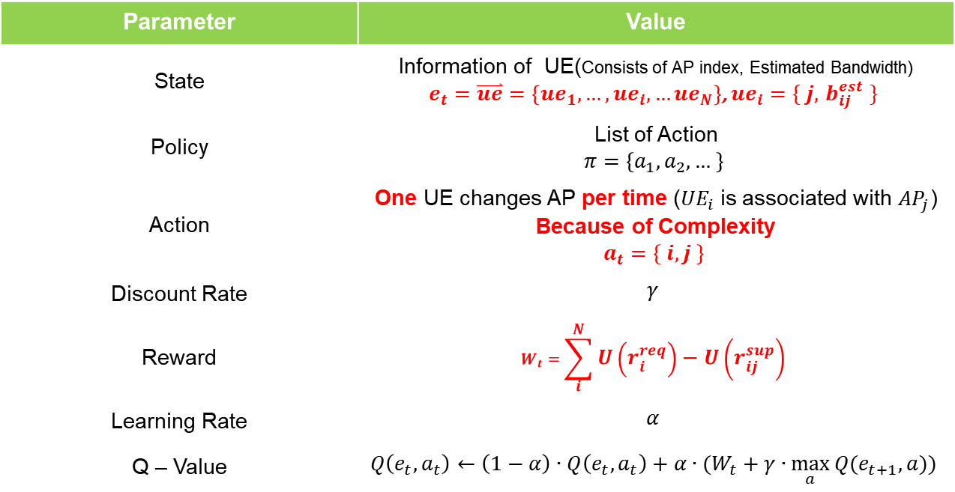
MDP Definition
Find Policy which minimize long term reward
Parameter | Value
State | Information of UE(Consists of AP index, Estimated Bandwidth) $e_{t}=\overset{⃑}{ue}=\left\{{ue}_{1}, …,{ue}_{i}, …{ue}_{N}\right\}$, ${ue}_{i}=\{ j, { b}_{ij}^{est} \}$
Policy | List of Action $$π=\left\{a_{1},a_{2},… \right\}$$
Action | One UE changes AP per time (${UE}_{i}$ is associated with ${AP}_{j}$) Because of Complexity $$a_{t}=\left\{ i, j \right\}$$
Discount Rate | $$γ$$
Reward | $$W_{t}=\sum_{i}^{N}{U\left(r_{i}^{req}\right)−U\left(r_{ij}^{sup}\right)}$$
Learning Rate | $$α$$
Q – Value | $$Q\left(e_{t},a_{t}\right)←\left(1−α\right)∙Q\left(e_{t},a_{t}\right)+α∙(W_{t}+γ∙\max_{a}{Q(e_{t+1},a))}$$
Notes:
State 지적 받을 요소 있음

Slide 3


Bandwidth Estimation
Bandwidth is decided by
Connected AP
Time (input for ARIMA model)
When network is changed (AP changed), need to estimate changed bandwidth
RSSI
Number of UEs
?
?
1~20Kbps
2~23Kbps
?
0.5~11Kbps
< before >
< after >

Slide 4
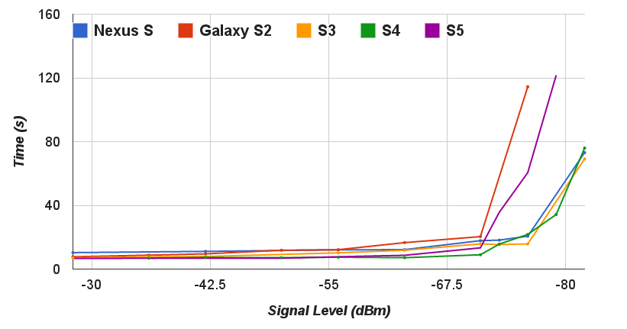
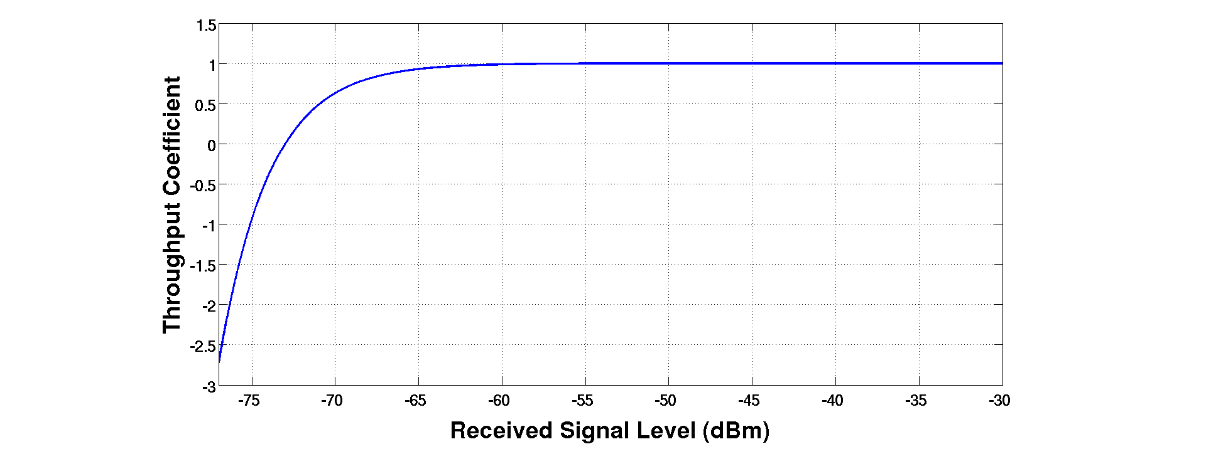
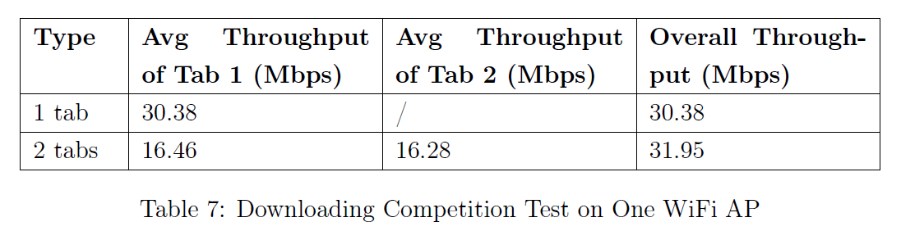

An SDN Platform for Traffic Offloading
RSSI
$1−e^{−k_{0}∙(S−k_{1)}}$
Number of UEs
< An SDN Platform for Traffic Offloading >
< An SDN Platform for Traffic Offloading >

Slide 5
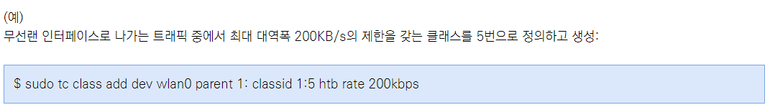
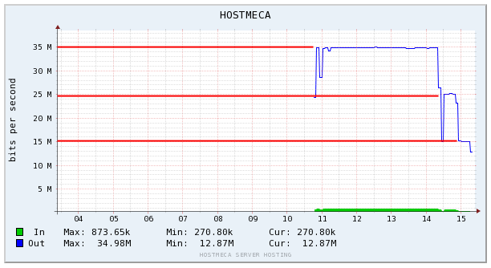
An SDN Platform for Traffic Offloading
Set Total Bandwidth
Using “tc” command
< http://skylit.tistory.com/217 >
< An SDN Platform for Traffic Offloading >
< http://blog.naver.com/PostView.nhn?blogId=dme1004&logNo=220942689584&beginTime=0&jumpingVid=&from=section&redirect=Log&widgetTypeCall=true >

Slide 6
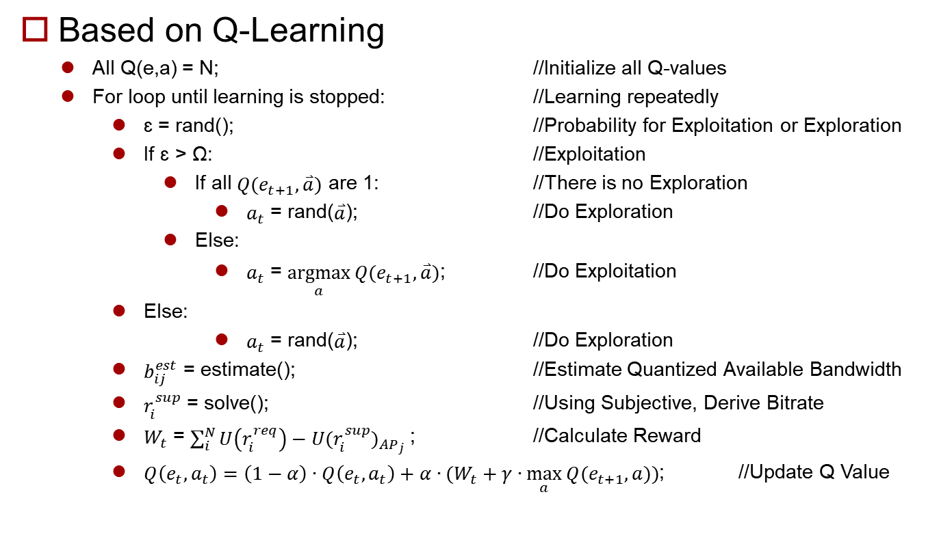
Algorithm
Based on Q-Learning
All Q(e,a) = N; //Initialize all Q-values
For loop until learning is stopped: //Learning repeatedly
ɛ = rand(); //Probability for Exploitation or Exploration
If ɛ > Ω: //Exploitation
If all $Q(e_{t+1},\overset{⃑}{a})$ are 1: //There is no Exploration
$a_{t}$ = rand($\overset{⃑}{a}$); //Do Exploration
Else:
$a_{t}$ = $\underset{a}{argmax}{Q(e_{t+1},\overset{⃑}{a})}$; //Do Exploitation
Else:
$a_{t}$ = rand($\overset{⃑}{a}$); //Do Exploration
$b_{ij}^{est}$ = estimate(); //Estimate Quantized Available Bandwidth
$r_{i}^{sup}$ = solve(); //Using Subjective, Derive Bitrate
$W_{t}$ = $\sum_{i}^{N}{U\left(r_{i}^{req}\right)−{U(r_{i}^{sup})}_{{AP}_{j}}}$; //Calculate Reward
$Q\left(e_{t},a_{t}\right)=\left(1−α\right)∙Q\left(e_{t},a_{t}\right)+α∙(W_{t}+γ∙\max_{a}{Q(e_{t+1},a))}$; //Update Q Value

