Slide 1
Research Jae Jun Ha Multimedia Computing and Networking Lab POSTECH 2018-07-27
Notes:
세미나 발표를 시작하겠습니다.

Slide 2
Contents
Contents
Problem Formulation
MDP & Q Learning
MDP Definition
Bandwidth Estimation
An SDN Platform for Traffic Offloading
Q-Learning
Algorithm
Future Work
Notes:
수정한 Problem Formulation 설명
왜 MDP를 이용해 문제를 푸는 지 설명
알고리즘을 Q-Learning으로 푸는데 Q-Learning에 대한 간단한 설명

Slide 3
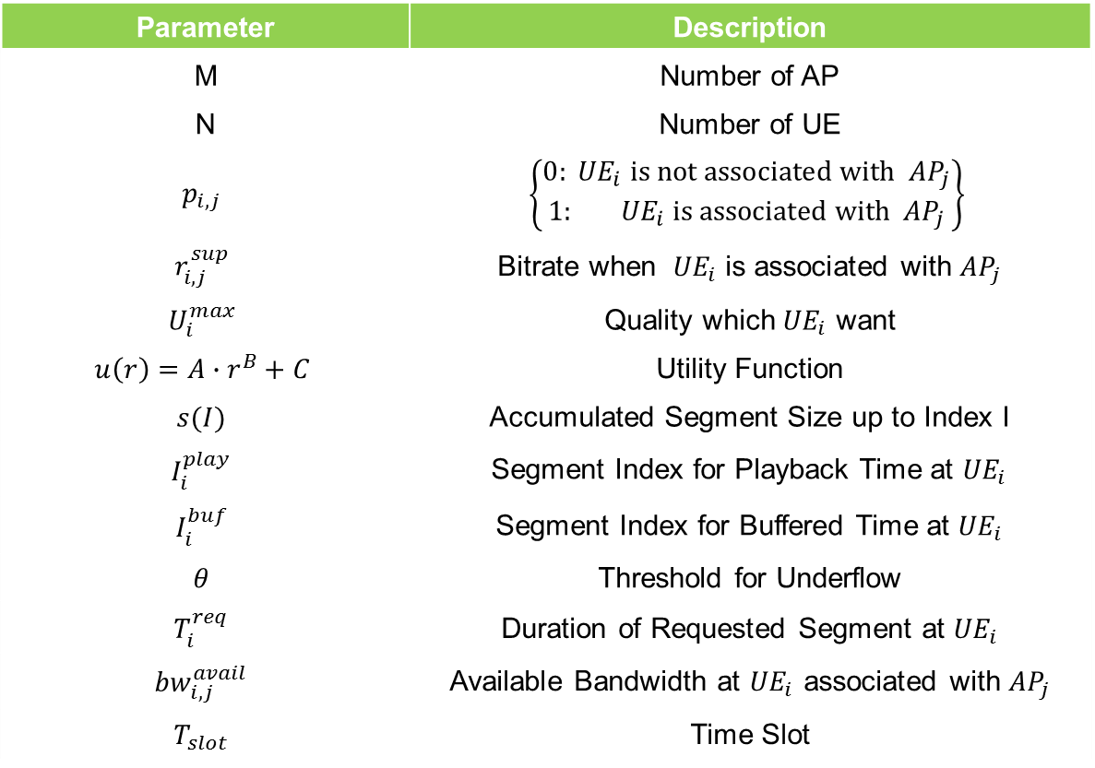
Problem Formulation
Parameter | Description
M | Number of AP
N | Number of UE
$$p_{i,j}$$ | $$\left\{\begin{matrix}0:{ UE}_{i} is not associated with{ AP}_{j} \\ 1:{ UE}_{i} \text{is} \text{associated} \text{with}{ AP}_{j}\end{matrix}\right\}$$
$$r_{i,j}^{sup}$$ | Bitrate when ${ UE}_{i}$ is associated with ${AP}_{j}$
$$U_{i}^{max}$$ | Quality which${ UE}_{i}$ want
$$u\left(r\right)=A∙r^{B}+C$$ | Utility Function
$$s(I)$$ | Accumulated Segment Size up to Index I
$$I_{i}^{play}$$ | Segment Index for Playback Time at ${UE}_{i}$
$$I_{i}^{buf}$$ | Segment Index for Buffered Time at ${UE}_{i}$
$$θ$$ | Threshold for Underflow
$$T_{i}^{req}$$ | Duration of Requested Segment at ${UE}_{i}$
$${bw}_{i,j}^{avail}$$ | Available Bandwidth at ${UE}_{i}$ associated with ${AP}_{j}$
$$T_{slot}$$ | Time Slot
Notes:
지적 받은 것:
bitrate 어떻게 줄일 건지

Slide 4
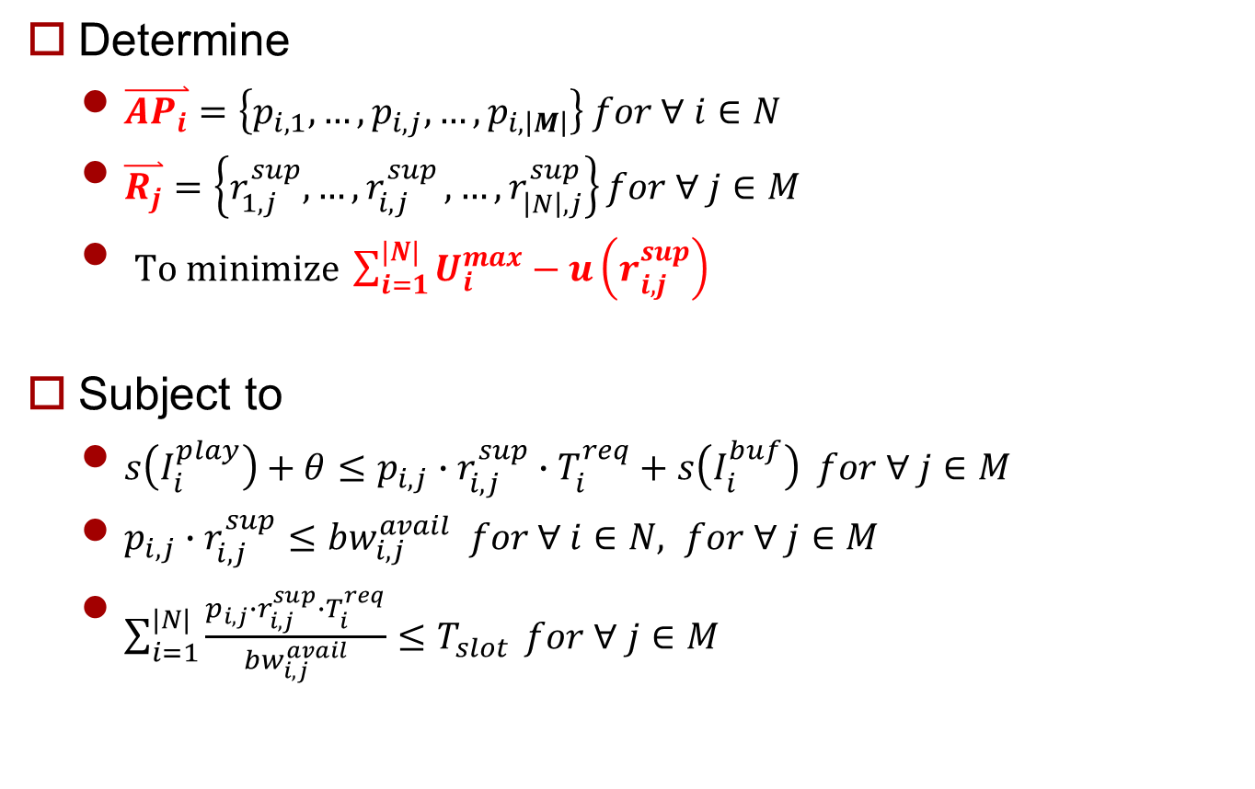
Problem Formulation
Determine
$\overset{⃑}{{AP}_{i}}=\left\{p_{i,1},…,p_{i,j},…,p_{i,\left|M\right|}\right\} for ∀ i∈N$
$\overset{⃑}{R_{j}}=\left\{r_{1,j}^{sup},{…,r}_{i,j}^{sup},…,r_{\left|N\right|,j}^{sup}\right\}for ∀ j∈M$
$To minimize \sum_{i=1}^{|N|}{U_{i}^{max}−u\left(r_{i,j}^{sup}\right)}$
Subject to
$s\left(I_{i}^{play}\right)+θ≤p_{i,j}∙r_{i,j}^{sup}∙T_{i}^{req}+s\left(I_{i}^{buf}\right) for ∀ j∈M$
$p_{i,j}∙r_{i,j}^{sup}≤{bw}_{i,j}^{avail} for ∀ i∈N, for ∀ j∈M$
$\sum_{i=1}^{|N|}{\frac{p_{i,j}∙r_{i,j}^{sup}∙T_{i}^{req}}{{bw}_{i,j}^{avail}}≤T_{slot}} for ∀ j∈M$
< SDN-assisted HTTP Adaptive Streaming over Wi-Fi Network >
Notes:
지적 받은 것:
bitrate 어떻게 줄일 건지

Slide 5
MDP & Q Learning
Used in Reinforce Learning with Q-Learning
MDP: Definition of Problem
Q-Learning: Solution of Problem
Solution (Q-Learning) is based on Dynamic Programming)
Using extra memory to solve problem
Deriving globally optimization
Greedy vs Dynamic Programming
Greedy algorithm derive locally optimization

Slide 6
MDP & Q Learning
Greedy vs Dynamic Programming
Greedy
DP
50 + 10 = 60
30 + 40 = 70
30
40
30
40
10
10
20
50
30
50
50
20
30
20
30

Slide 7
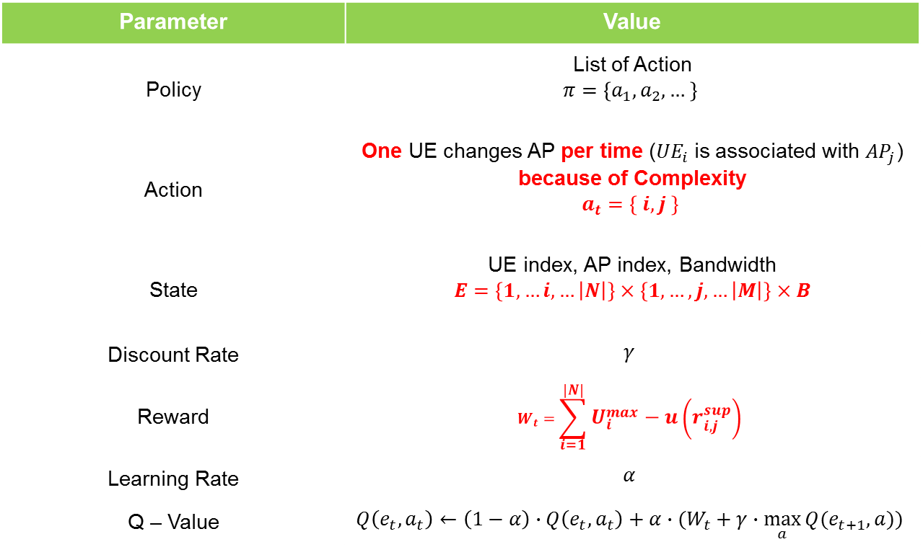
MDP Definition
Find Policy which minimize long term reward
Parameter | Value
Policy | List of Action $$π=\left\{a_{1},a_{2},… \right\}$$
Action | One UE changes AP per time (${UE}_{i}$ is associated with ${AP}_{j}$) because of Complexity $$a_{t}=\left\{ i, j \right\}$$
State | UE index, AP index, Bandwidth $$E=\left\{1,…i,…\left|N\right|\right\}×\left\{1,…,j,…\left|M\right|\right\}×B$$
Discount Rate | $$γ$$
Reward | $$W_{t}=\sum_{i=1}^{|N|}{U_{i}^{max}−u\left(r_{i,j}^{sup}\right)}$$
Learning Rate | $$α$$
Q – Value | $$Q\left(e_{t},a_{t}\right)←\left(1−α\right)∙Q\left(e_{t},a_{t}\right)+α∙(W_{t}+γ∙\max_{a}{Q(e_{t+1},a))}$$
Notes:
State 지적 받을 요소 있음

Slide 8


Bandwidth Estimation
Bandwidth is decided by
Connected AP
Time (input for ARIMA model)
When network is changed (AP changed), need to estimate changed bandwidth
RSSI
Number of UEs
?
?
1~20Kbps
2~23Kbps
?
0.5~11Kbps
< before >
< after >

Slide 9
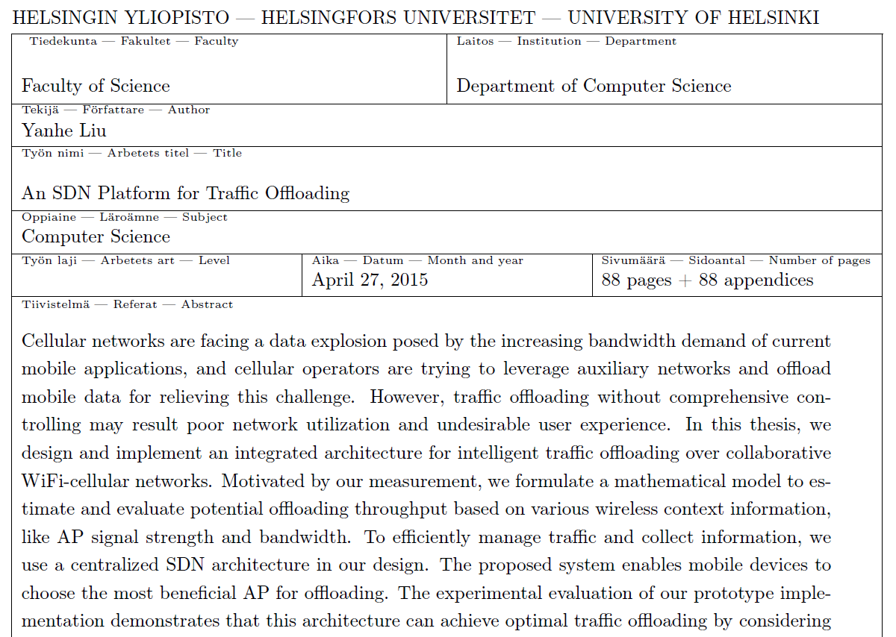
An SDN Platform for Traffic Offloading
< An SDN Platform for Traffic Offloading >

Slide 10
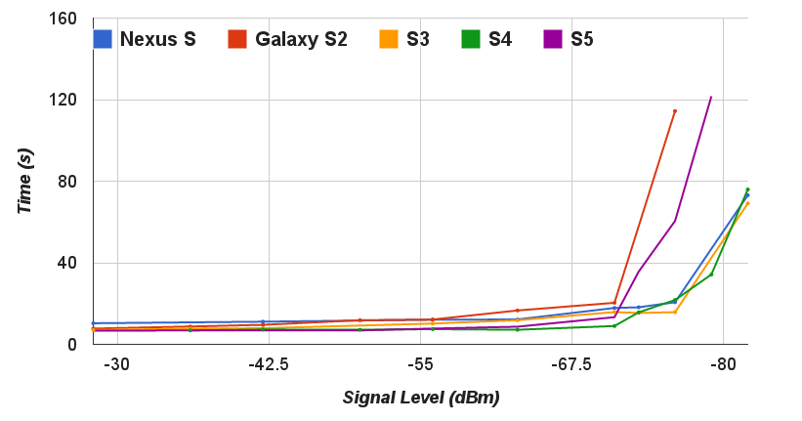
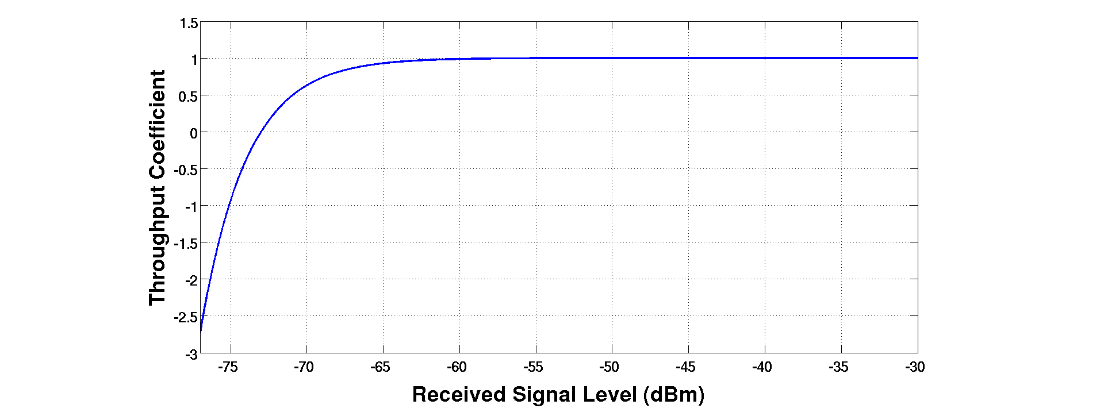

An SDN Platform for Traffic Offloading
RSSI
$1−e^{−\frac{1}{3}∙(S+73)}$
< An SDN Platform for Traffic Offloading >

Slide 11
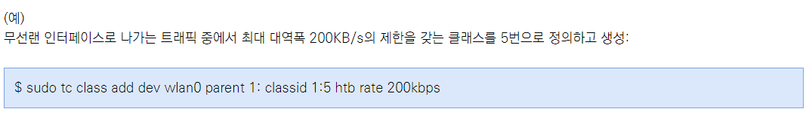
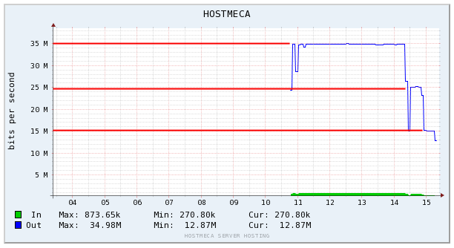
An SDN Platform for Traffic Offloading
“tc” command
< http://skylit.tistory.com/217 >
< An SDN Platform for Traffic Offloading >
< http://blog.naver.com/PostView.nhn?blogId=dme1004&logNo=220942689584&beginTime=0&jumpingVid=&from=section&redirect=Log&widgetTypeCall=true >

Slide 12
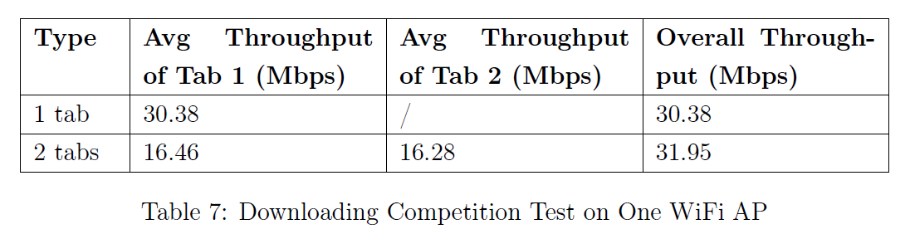
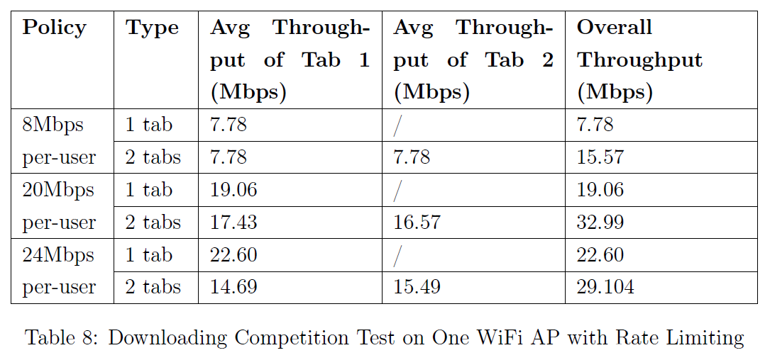
An SDN Platform for Traffic Offloading
Number of UEs
< An SDN Platform for Traffic Offloading >

Slide 13
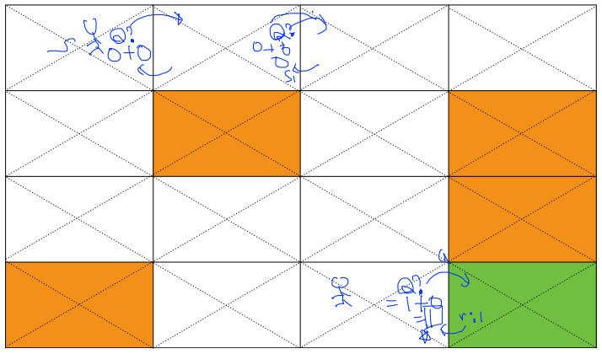
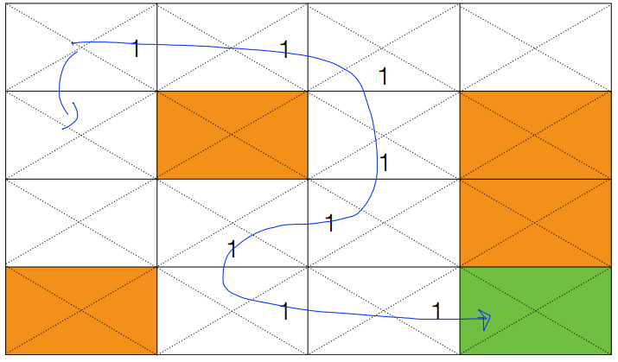
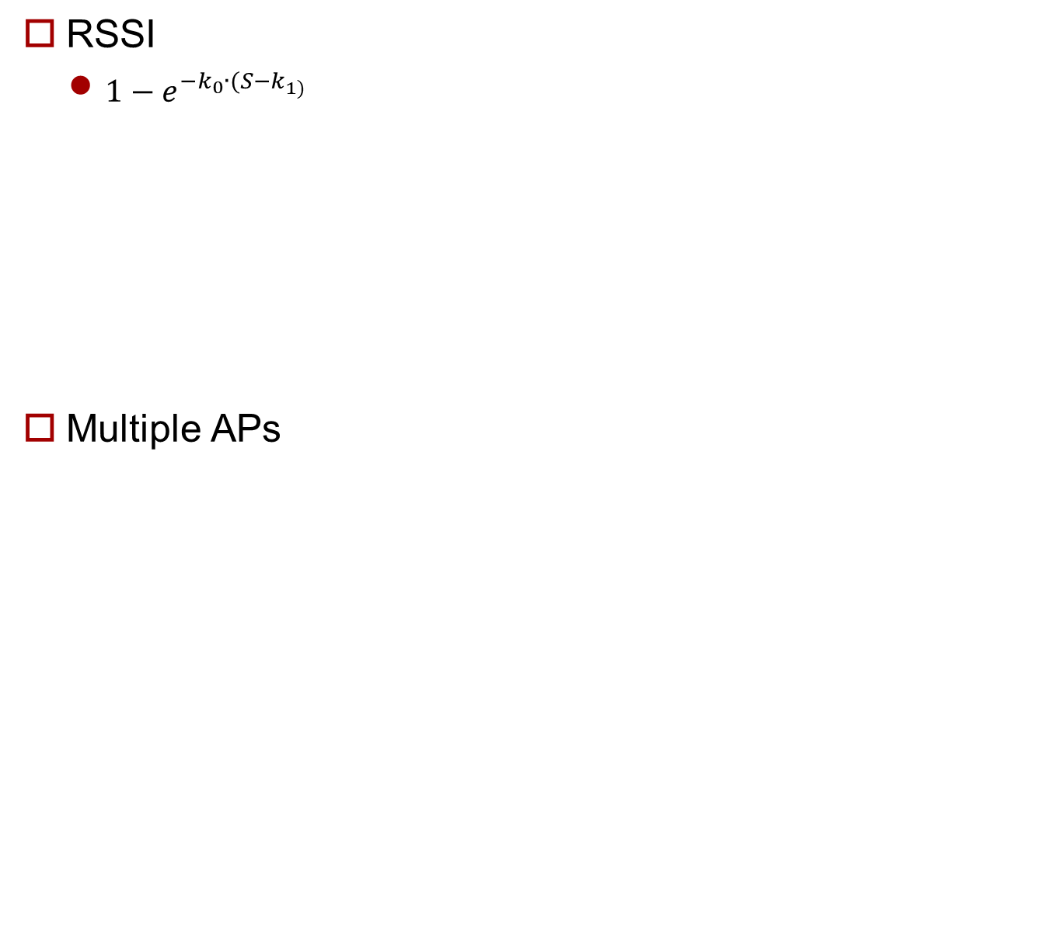
Q-Learning
Exploitation vs Exploration
$a_{t}$ = $\underset{a}{argmax}{Q(e_{t+1},\overset{⃑}{a})}$
$a_{t}$ = rand($\overset{⃑}{a}$)
< https://hunkim.github.io/ml/RL/rl03.pdf >
Notes:
여기서 t가 뭘 의미할지 생각해보기
Q-Learning 자체에 질문 들어올 수 있음
Q 값이 어느 정도 결정 되지 않으면 Exploitation을 할 수 없음

Slide 14
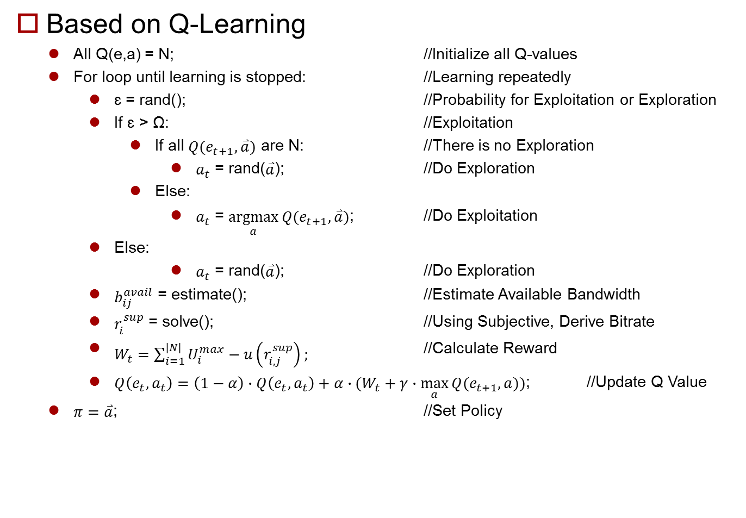
Algorithm
Based on Q-Learning
All Q(e,a) = N; //Initialize all Q-values
For loop until learning is stopped: //Learning repeatedly
ɛ = rand(); //Probability for Exploitation or Exploration
If ɛ > Ω: //Exploitation
If all $Q(e_{t+1},\overset{⃑}{a})$ are N: //There is no Exploration
$a_{t}$ = rand($\overset{⃑}{a}$); //Do Exploration
Else:
$a_{t}$ = $\underset{a}{argmax}{Q(e_{t+1},\overset{⃑}{a})}$; //Do Exploitation
Else:
$a_{t}$ = rand($\overset{⃑}{a}$); //Do Exploration
$b_{ij}^{avail}$ = estimate(); //Estimate Available Bandwidth
$r_{i}^{sup}$ = solve(); //Using Subjective, Derive Bitrate
$W_{t}=\sum_{i=1}^{|N|}{U_{i}^{max}−u\left(r_{i,j}^{sup}\right)};$ //Calculate Reward
$Q\left(e_{t},a_{t}\right)=\left(1−α\right)∙Q\left(e_{t},a_{t}\right)+α∙(W_{t}+γ∙\max_{a}{Q(e_{t+1},a))}$; //Update Q Value
$π=\overset{⃑}{a}$; //Set Policy

Slide 15
Future Work
Making model to predict bandwidth after load balancing

