Slide 1
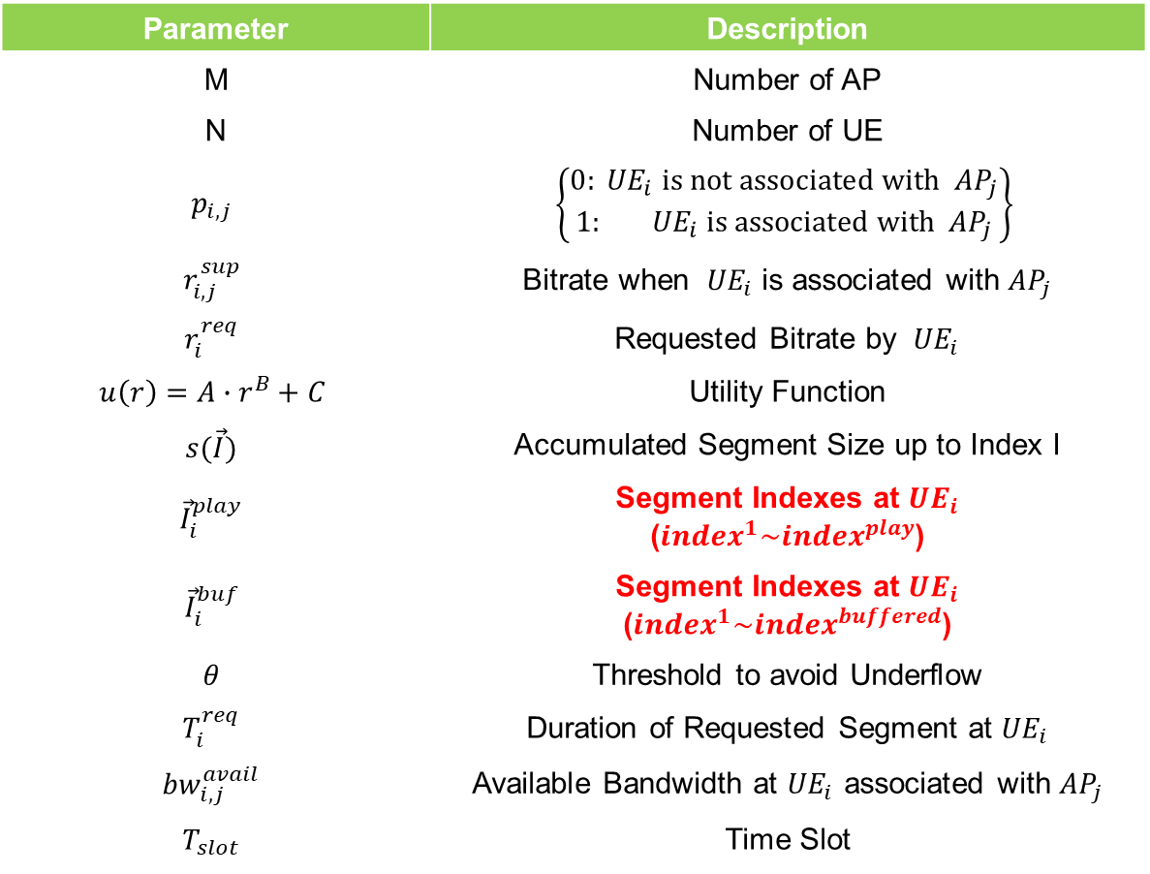
Problem Formulation
Parameter | Description
M | Number of AP
N | Number of UE
$$p_{i,j}$$ | $$\left\{\begin{matrix}0:{ UE}_{i} is not associated with{ AP}_{j} \\ 1:{ UE}_{i} \text{is} \text{associated} \text{with}{ AP}_{j}\end{matrix}\right\}$$
$$r_{i,j}^{sup}$$ | Bitrate when ${ UE}_{i}$ is associated with ${AP}_{j}$
$$r_{i}^{req}$$ | Requested Bitrate by ${ UE}_{i}$
$$u\left(r\right)=A∙r^{B}+C$$ | Utility Function
$$s(\vec{I})$$ | Accumulated Segment Size up to Index I
$${\vec{I}}_{i}^{play}$$ | Segment Indexes at ${UE}_{i}$ (${index}^{1}\sim {index}^{play}$)
$${\vec{I}}_{i}^{buf}$$ | Segment Indexes at ${UE}_{i}$ (${index}^{1}\sim {index}^{buffered}$)
$$θ$$ | Threshold to avoid Underflow
$$T_{i}^{req}$$ | Duration of Requested Segment at ${UE}_{i}$
$${bw}_{i,j}^{avail}$$ | Available Bandwidth at ${UE}_{i}$ associated with ${AP}_{j}$
$$T_{slot}$$ | Time Slot

Slide 2




Bandwidth Estimation
To optimize Bitrate, need to know bandwidth
?
1~20Kbps
0.5~11Kbps
UE1
UE2
Problem Formulation
$$\sum_{i=1}^{|N|}{\frac{p_{i,j}∙r_{i,j}^{sup}∙T_{i}^{req}}{{bw}_{i,j}^{avail}}≤T_{slot}} for ∀ j∈M$$
Consider RSSI
$$1−e^{−A∙(S+B)}$$
< An SDN Platform for Traffic Offloading >
UE3’s Bandwidth
Notes:
Time Slot은 충돌 방지하기 위해서 사용하는 것?
원래 의도 잘못 된 점?

Slide 3

Verification
Testbed Setting
Cannot access external IP address
OVS Setting

