Slide 1
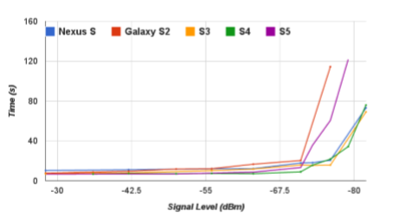


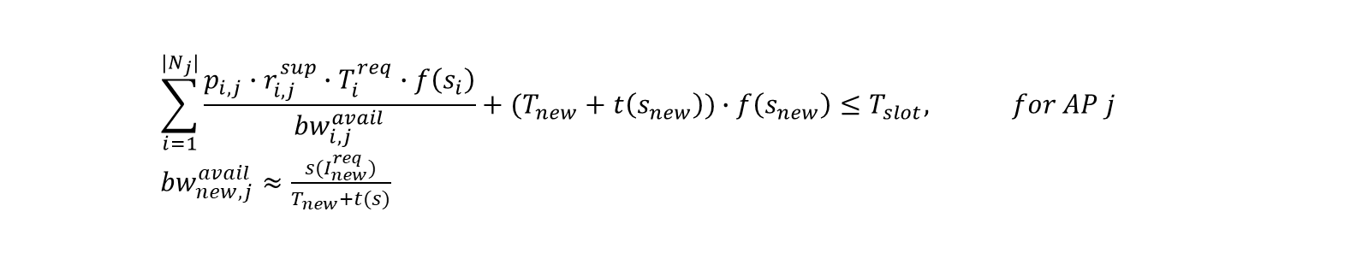
Estimate Bandwidth
To optimize Bitrate, need to know bandwidth
?
Resize Time Slot
1~20Kbps
0.5~11Kbps
Consider RSSI
UE1
UE2
$$\sum_{i=1}^{|N_{j}|}{\frac{p_{i,j}∙r_{i,j}^{sup}∙T_{i}^{req}∙f\left(s_{i}\right)}{{bw}_{i,j}^{avail}}}+(T_{new}+t\left(s_{new}\right))∙f\left(s_{new}\right)≤T_{slot}, for AP j$$
${bw}_{new,j}^{avail}≈\frac{s(I_{new}^{req})}{T_{new}+t(s)}$

