Slide 1
Research Jae Jun Ha Media Computing and Networking Laboratory POSTECH 2019-03-08
Notes:
세미나 발표를 시작하겠습니다.

Slide 2
Contents
Utility Function
Performance
Bandwidth model
Future Work

Slide 3

Utility Function
Utility function
The relationship between bitrate and PSNR can be expressed as a logarithmic function through curve fitting.
It can consider proportional fairness because of logarithmic function
It has the form of $a∙\ln\left(r\right)+b$
The value a and b may have different values depending on the characteristics of video
BigBuckBunny
Can get PSNR data from
http://www-itec.uni-klu.ac.at/ftp/datasets/mmsys12/BigBuckBunny/PSNR/xls/bunny_2s/
Result of curve fitting is $2.7863∙\ln\left(r\right)+22.27$

Slide 4

Utility Function
Result of comparing previous utility function and current utility function
The utility functions defined last week is $\ln\left(r_{req}−r_{sup}\right)$
The utility functions defined this week is $a∙\ln\left(r\right)+b$

Slide 5
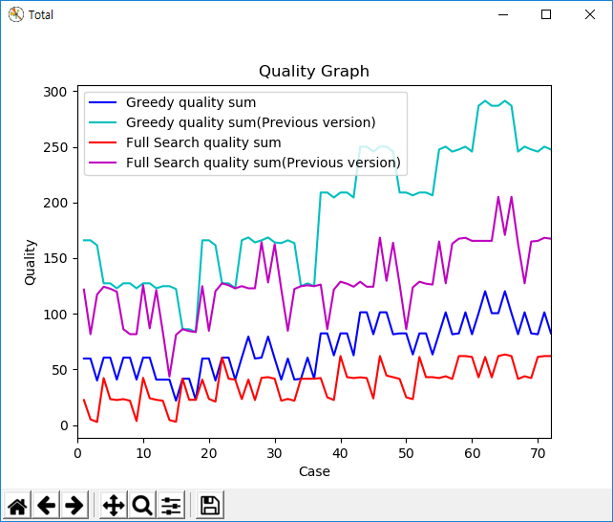
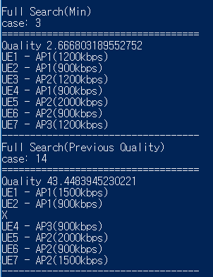
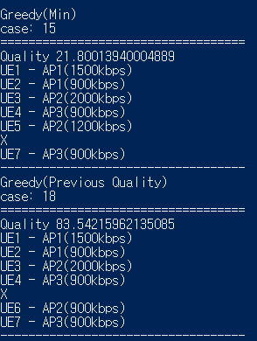
Utility Function
Result of comparing previous utility function and current utility function
Test 7UEs and 3APs
1

Slide 6
Performance
Compare MKP Solutions
7UEs and 3APs
Greedy: 26.86, 0.00035 sec
MTHM: 21.04, 0.00109 sec (3.1 times)
Branch and Bound: 15.01, 0.00243 sec (6.9 times)
Full Search: 15.01, 0.11670 sec (333.4 times)
 |  | 1 | 2 | 3 | 4 | 5 | 6 | 7 | 8 | 9 | 10
Greedy | Quality | 0.80 | 40.13 | 38.71 | 40.75 | 21.18 | 44.58 | 1.42 | 19.76 | 42.35 | 18.95
 | Time | 0.00026 | 0.00045 | 0.00024 | 0.00040 | 0.00039 | 0.00039 | 0.00025 | 0.00059 | 0.00027 | 0.00024
MTHM | Quality | 0.80 | 40.13 | 19.76 | 40.75 | 21.18 | 24.20 | 1.42 | 19.76 | 42.35 | 0
 | Time | 0.00066 | 0.00144 | 0.00081 | 0.00110 | 0.00107 | 0.00141 | 0.00158 | 0.00120 | 0.00073 | 0.00085
Branch and Bound | Quality | 0.62 | 40.13 | 2.22 | 21.00 | 20.38 | 23.40 | 0 | 18.95 | 23.40 | 0
 | Time | 0.00082 | 0.00079 | 0.00205 | 0.00322 | 0.00456 | 0.00275 | 0.00408 | 0.00270 | 0.00227 | 0.00110
Full Search | Quality | 0.62 | 40.13 | 2.22 | 21.00 | 20.38 | 23.40 | 0 | 18.95 | 23.40 | 0
 | Time | 0.09924 | 0.00820 | 0.02357 | 0.33582 | 0.36667 | 0.09318 | 0.15913 | 0.02510 | 0.00227 | 0.05380

Slide 7

Bandwidth Model
Using RTT and PER
M. Mathis, J. Semke, J. Mahdavi, and T. Ott, “The macroscopic behavior of the TCP congestion avoidance algorithm,” ACM SIGCOMM Computer Communication Review, vol. 27, no, 3, pp. 67–82, Jul. 1997.
$BW=\frac{MSS}{RTT}∙\frac{C}{\sqrt{p}}$

Slide 8
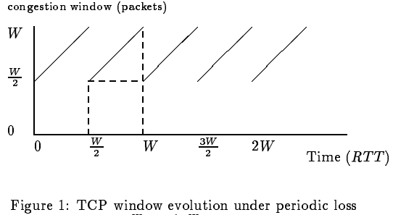


Bandwidth Model
Using RTT and PER
< The macroscopic behavior of the TCP congestion avoidance algorithm >

Slide 9
Future work
To develop HTTP protocol for proxy
UE send data to AP through HTTP protocol
GET request resource
POST send UE data
ex) buffer state, PER, RTT, etc…

