Slide 1
PSNR
From
http://www-itec.uni-klu.ac.at/ftp/datasets/mmsys12/BigBuckBunny/PSNR/xls/bunny_2s/
bitrate | pnsr
50 | 33.6547
100 | 35.4833
150 | 36.3855
200 | 36.9516
250 | 37.5495
300 | 38.004
400 | 38.6665
500 | 39.0831
600 | 39.8976
700 | 40.3022
900 | 40.9024
1200 | 41.8901
1500 | 42.5653
2000 | 43.2401
2500 | 44.2963
3000 | 44.9356
4000 | 45.8244
5000 | 46.3708
6000 | 46.6794
8000 | 47.027

Slide 2
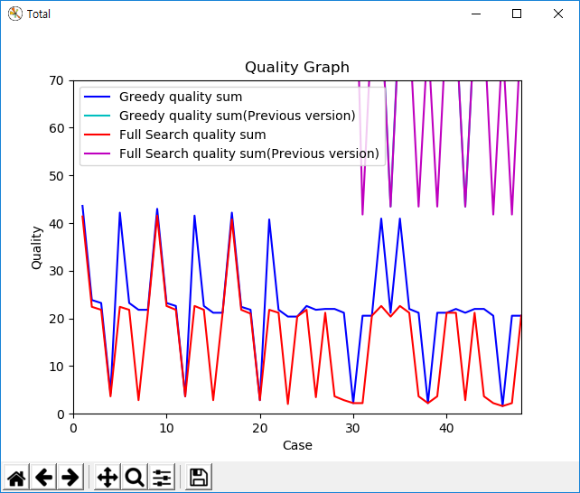
PSNR
Difference

