Slide 1
Research Jae Jun Ha Media Computing and Networking Laboratory POSTECH 2018-11-23
Notes:
세미나 발표를 시작하겠습니다.

Slide 2
Contents
Contents
Algorithm
Bandwidth Curve-Fitting
Future Work

Slide 3
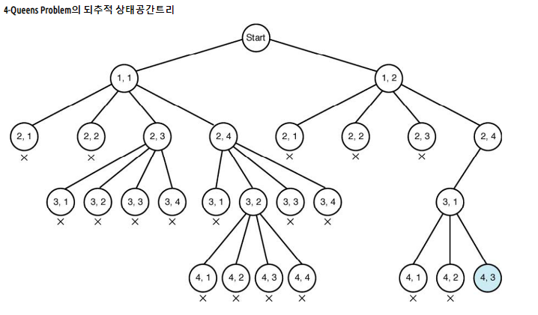
Algorithm
Using Branch and Bound method
Base: Full Search
Reducing Time Complexity: Branch and Bound
UE i can not connect AP j
Capacity of AP is full
< http://lazineer.tistory.com/111 >

Slide 4
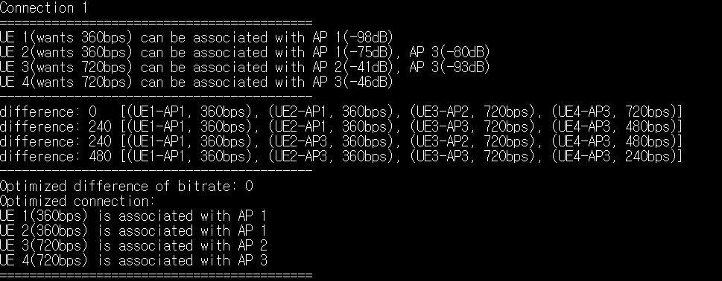
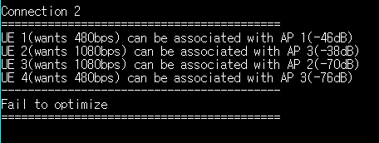
Algorithm
However, some cases fail to solve the problem
There are remaining UEs which was not connected to any AP

Slide 5
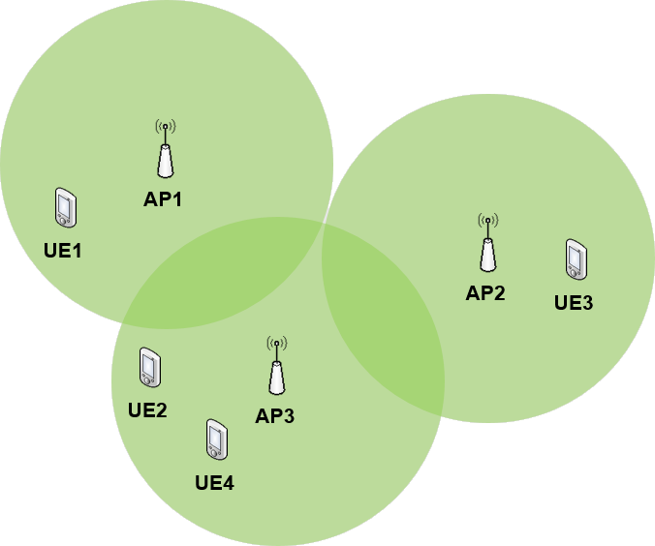


Algorithm
However, some cases fail to solve the problem
There are remaining UEs which was not connected to any AP
$$∞$$
$$r_{2,3}^{req}≫r_{4,3}^{req}$$

Slide 6
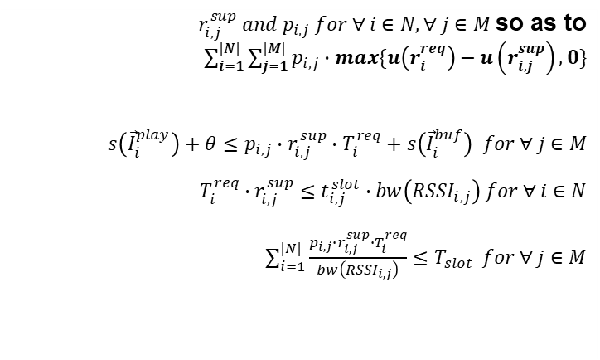


Algorithm
Sort UE order according to request bitrate
$t_{i,j}^{slot}=\frac{T_{i}^{req}∙r_{i}^{req}}{bw\left({RSSI}_{i,j}\right)}$
$t_{i,j}^{slot}∝r_{i}^{req}$
Determine Minimize subject to and and
$r_{i,j}^{sup} and p_{i,j} for ∀ i∈N, ∀ j∈M$so as to $\sum_{i=1}^{|N|}{\sum_{j=1}^{|M|}{p_{i,j}∙max\{u\left(r_{i}^{req}\right)−u\left(r_{i,j}^{sup}\right),0\}}}$ $s\left({\vec{I}}_{i}^{play}\right)+θ≤p_{i,j}∙r_{i,j}^{sup}∙T_{i}^{req}+s\left({\vec{I}}_{i}^{buf}\right) for ∀ j∈M$ $$T_{i}^{req}∙r_{i,j}^{sup}≤t_{i,j}^{slot}∙bw\left({RSSI}_{i,j}\right) for ∀ i∈N$$ $\sum_{i=1}^{|N|}{\frac{p_{i,j}∙r_{i,j}^{sup}∙T_{i}^{req}}{bw\left({RSSI}_{i,j}\right)}≤T_{slot}} for ∀ j∈M$
$$r_{2,3}^{req}≫r_{4,3}^{req}$$

Slide 7
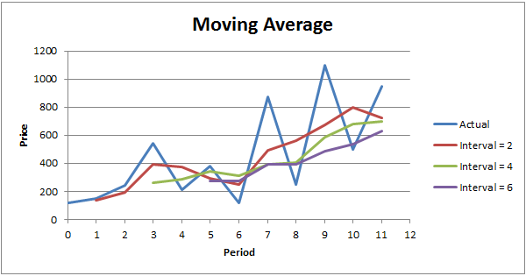
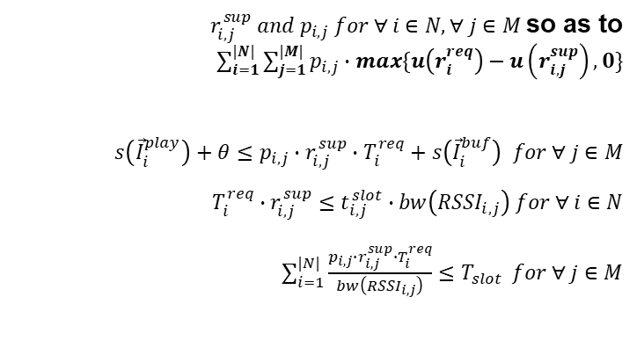
Bandwidth Curve-Fitting
RSSI estimation
Fluctuation
At SDN, collect RSSI every 5sec
Using Moving Average to reduce fluctuation
Estimate future RSSI using ARIMA model
Buffer underflow
Moving average can not consider difference between estimated value and real value
Later consider buffer underflow constraints from problem formulation
Determine Minimize subject to and and
$r_{i,j}^{sup} and p_{i,j} for ∀ i∈N, ∀ j∈M$so as to $\sum_{i=1}^{|N|}{\sum_{j=1}^{|M|}{p_{i,j}∙max\{u\left(r_{i}^{req}\right)−u\left(r_{i,j}^{sup}\right),0\}}}$ $s\left({\vec{I}}_{i}^{play}\right)+θ≤p_{i,j}∙r_{i,j}^{sup}∙T_{i}^{req}+s\left({\vec{I}}_{i}^{buf}\right) for ∀ j∈M$ $$T_{i}^{req}∙r_{i,j}^{sup}≤t_{i,j}^{slot}∙bw\left({RSSI}_{i,j}\right) for ∀ i∈N$$ $\sum_{i=1}^{|N|}{\frac{p_{i,j}∙r_{i,j}^{sup}∙T_{i}^{req}}{bw\left({RSSI}_{i,j}\right)}≤T_{slot}} for ∀ j∈M$
< https://bestengagingcommunities.com/2016/08/13/how-to-leverage-moving-averages-to-confirm-a-saas-companys-traction/ >

Slide 8
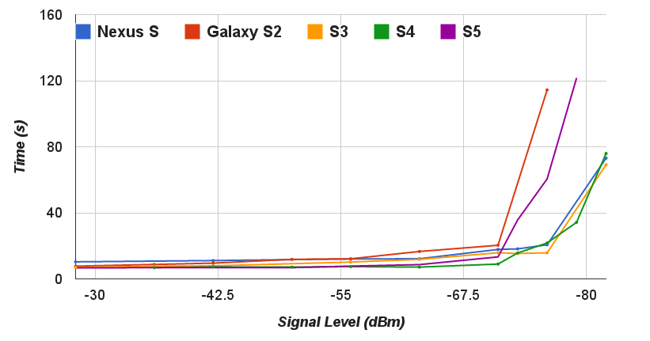
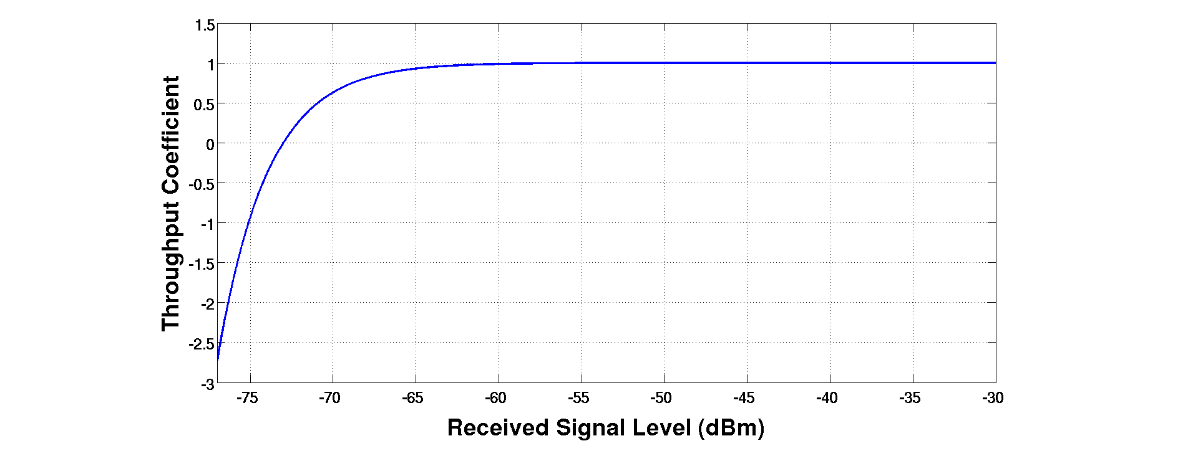

Bandwidth Curve-Fitting
Estimation
Using RSSI
$1−e^{−k_{0}∙(S−k_{1)}}$
< An SDN Platform for Traffic Offloading >

Slide 9

Future work
Curve-Fitting
Using SSIM / PSNR, draw $αlog⁡(1+βx)$
Modify Bandwidth Curve-Fitting

