Slide 1
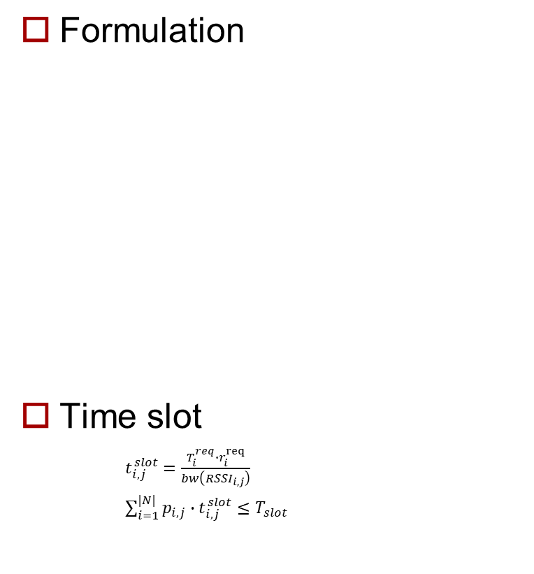
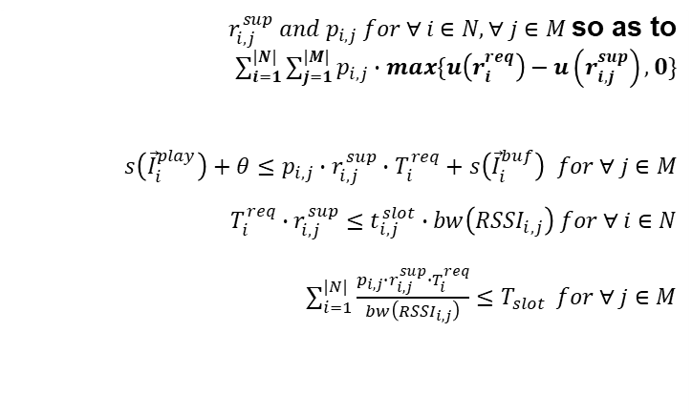
Modification
Formulation
Time slot
$t_{i,j}^{slot}=\frac{T_{i}^{req}∙r_{i}^{req}}{bw\left({RSSI}_{i,j}\right)}$
$\sum_{i=1}^{|N|}{p_{i,j}∙t_{i,j}^{slot}≤T_{slot}}$
Determine Minimize subject to and and
$r_{i,j}^{sup} and p_{i,j} for ∀ i∈N, ∀ j∈M$so as to $\sum_{i=1}^{|N|}{\sum_{j=1}^{|M|}{p_{i,j}∙max\{u\left(r_{i}^{req}\right)−u\left(r_{i,j}^{sup}\right),0\}}}$ $s\left({\vec{I}}_{i}^{play}\right)+θ≤p_{i,j}∙r_{i,j}^{sup}∙T_{i}^{req}+s\left({\vec{I}}_{i}^{buf}\right) for ∀ j∈M$ $$T_{i}^{req}∙r_{i,j}^{sup}≤t_{i,j}^{slot}∙bw\left({RSSI}_{i,j}\right) for ∀ i∈N$$ $\sum_{i=1}^{|N|}{\frac{p_{i,j}∙r_{i,j}^{sup}∙T_{i}^{req}}{bw\left({RSSI}_{i,j}\right)}≤T_{slot}} for ∀ j∈M$
Notes:
(오전에 보여줄 필요는 없음)수정된 Formulation 및 Time slot

Slide 2
Plan
Fairness
Cost Function
Papers for performance comparison

Slide 3





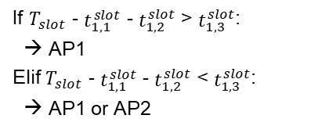
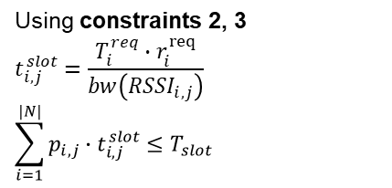
Fairness
Time Slot
AP1
$$t_{1,1}^{slot}$$
$$t_{2,1}^{slot}$$
UE1
UE2
$$T_{slot}$$
Using constraints 2, 3
$$t_{i,j}^{slot}=\frac{T_{i}^{req}∙r_{i}^{req}}{bw\left({RSSI}_{i,j}\right)}$$
$$\sum_{i=1}^{|N|}{p_{i,j}∙t_{i,j}^{slot}≤T_{slot}}$$
Where?
AP2
$$T_{slot}$$
If $T_{slot}$ - $t_{1,1}^{slot}$ - $t_{1,2}^{slot}$ > $t_{1,3}^{slot}$:
→ AP1
Elif $T_{slot}$ - $t_{1,1}^{slot}$ - $t_{1,2}^{slot}$ < $t_{1,3}^{slot}$:
→ AP1 or AP2

Slide 4
Fairness
function dfs(index_ue):
if index_ue == N + 1:
sum = 0
for i from 1 to N:
sum += max(ue[i].reqQuality – ue[i].quality, 0)
sol = min(sum, sol)
for j from 1 to M:
if p[index_ue][j] == False:
continue
if ap[j].timeslot == T:
continue
c[index_ue][j] = True
if ue[index_ue].timeslot + ap[j].timeslot <= T:
ue[index_ue].quality = calQality(index_ue, ue[index_ue].timeslot)
ap[j].timeslot += ue[index_ue].timeslot
else:
ue[index_ue].quality = calQality(index_ue, T - ap[j].timeslot)
ap[j].timeslot = T
dfs(index_ue + 1)
c[index_ue][j] = False
restore(ue[index_ue], ap[j])
Sum == 0:
Using Threshold
So, Sum > Threshold
Check fairness: Jain Fairness index
Find outlier: ML / Data mining

