Slide 1
Research Jae Jun Ha Multimedia Computing and Networking Lab POSTECH 2018-07-06
Notes:
세미나 발표를 시작하겠습니다.

Slide 2
Problem Description
Problem Description
Quality
SSIM(Structural SIMilarity index)
For measuring the similarity between two images
Based on an initial uncompressed or distortion-free image as reference
To improve on traditional methods such as PSNR and MSE
< Wikipedia >
Curve Fitting
There is research that has shown that the mapping between bitrate and video quality is non-linear
< Leveraging SDN to Provide an In-network QoE Measurement Framework, 2015 INFOCOM Workshop >

Slide 3
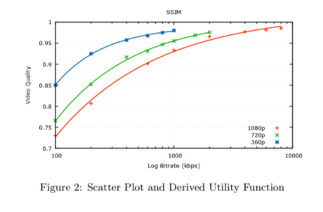
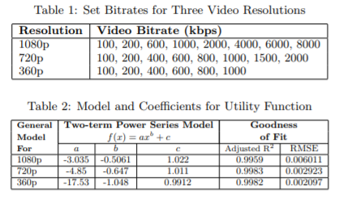
Problem Description
Problem Description
Quality
Curve Fitting
The two-term power series model has proven to be the most suitable function.
< Towards network-wide QoE fairness using openflow-assisted adaptive video streaming, 2013 SIGCOMM WORKSHOP >

Slide 4
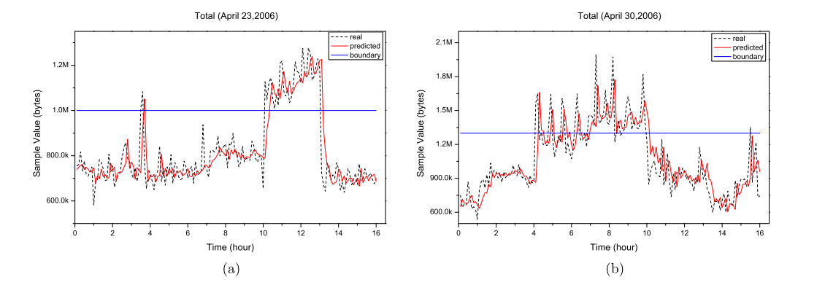
Problem Description
Problem Description
Bandwidth
Open Flow API
For measuring traffic information
Prediction Model
To predictive future bandwidth using prior traffic
Using Time-Series Forecast model: ARIMA
< Dynamic bandwidth provisioning using ARIMA-based traffic forecasting for Mobile WiMAX, 2011 Computer Communication >

Slide 5
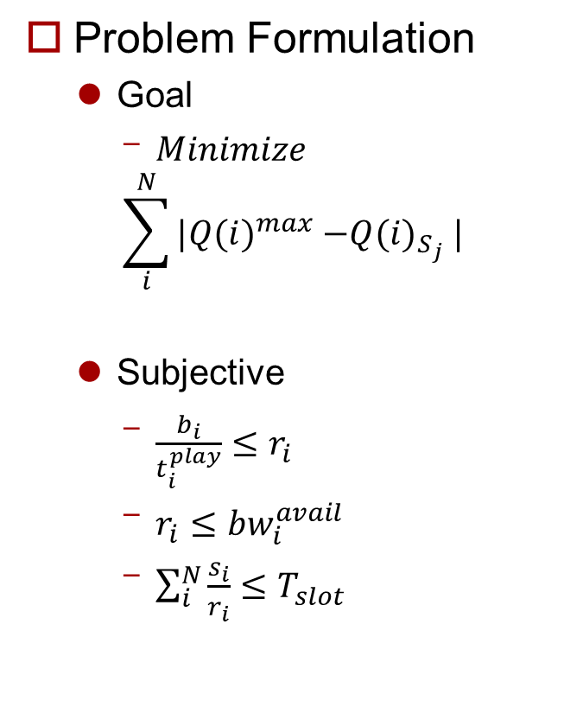
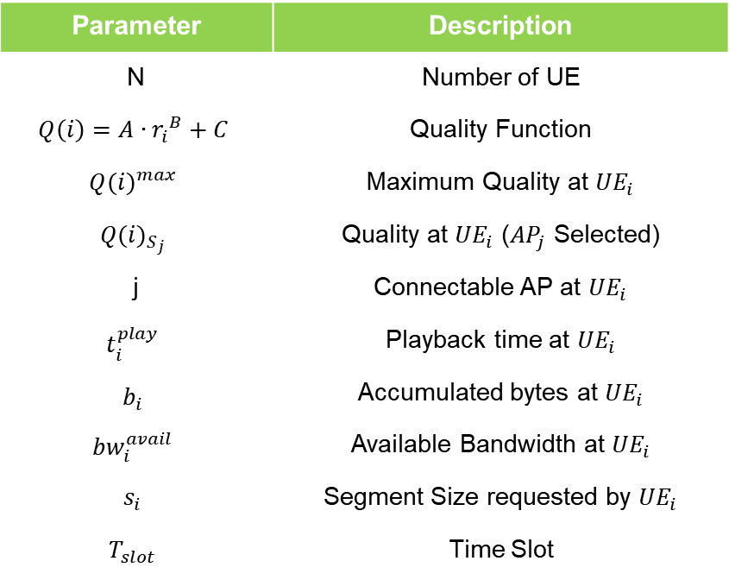
Problem Formulation
Problem Formulation
Goal
$Minimize$
$$\sum_{i}^{N}{|{Q(i)}_{}^{max}{−Q(i)}_{S_{j}}|}$$
Subjective
$\frac{b_{i}}{t_{i}^{play}}≤r_{i}$
$r_{i}≤{bw}_{i}^{avail}$
$\sum_{i}^{N}{\frac{s_{i}}{r_{i}}≤T_{slot}}$
Parameter | Description
N | Number of UE
$$Q\left(i\right)=A∙{r_{i}}^{B}+C$$ | Quality Function
$${Q(i)}_{}^{max}$$ | Maximum Quality at ${UE}_{i}$
$${Q(i)}_{S_{j}}$$ | Quality at ${UE}_{i}$ (${AP}_{j}$ Selected)
j | Connectable AP at ${UE}_{i}$
$$t_{i}^{play}$$ | Playback time at ${UE}_{i}$
$$b_{i}$$ | Accumulated bytes at ${UE}_{i}$
$${bw}_{i}^{avail}$$ | Available Bandwidth at ${UE}_{i}$
$$s_{i}$$ | Segment Size requested by ${UE}_{i}$
$$T_{slot}$$ | Time Slot

Slide 6
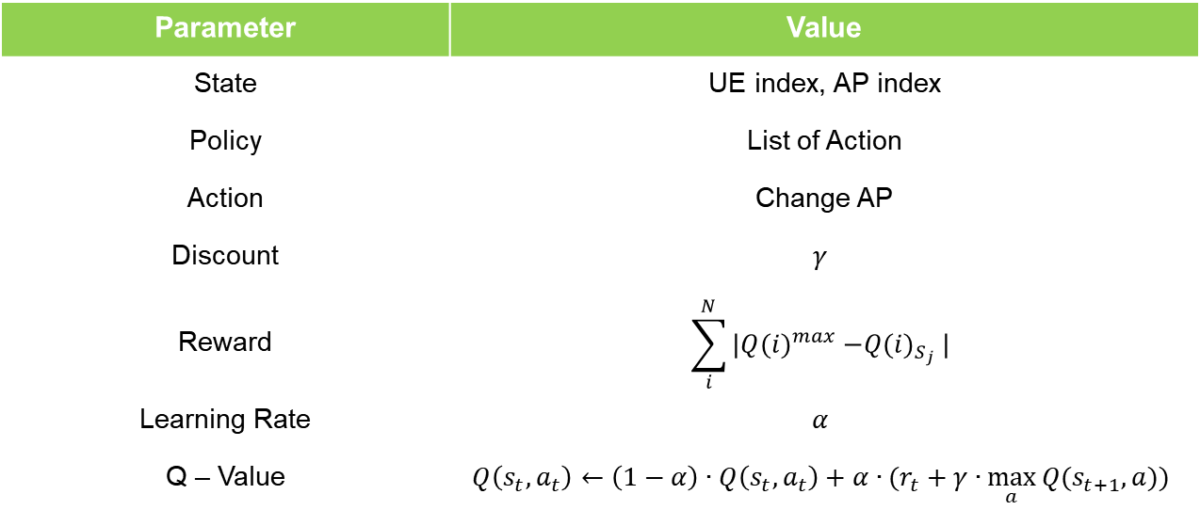
Problem Formulation
Problem Formulation (MDP)
Find Policy which minimize long term reward
Using Q – Learning (at first, all Q = 1)
Parameter | Value
State | UE index, AP index
Policy | List of Action
Action | Change AP
Discount | $$γ$$
Reward | $$\sum_{i}^{N}{|{Q(i)}_{}^{max}{−Q(i)}_{S_{j}}|}$$
Learning Rate | $$α$$
Q – Value | $$Q\left(s_{t},a_{t}\right)←\left(1−α\right)∙Q\left(s_{t},a_{t}\right)+α∙(r_{t}+γ∙\max_{a}{Q(s_{t+1},a))}$$

Slide 7
Future Work
Future Work
Modified Problem Formulation

