Slide 1
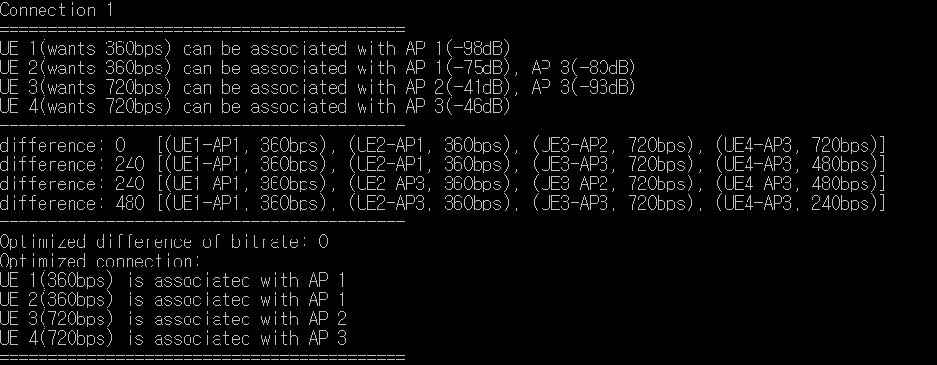
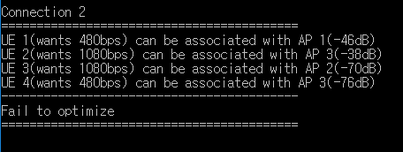
Simulation
Normal case
Abnormal case → Sorting UE

Slide 2
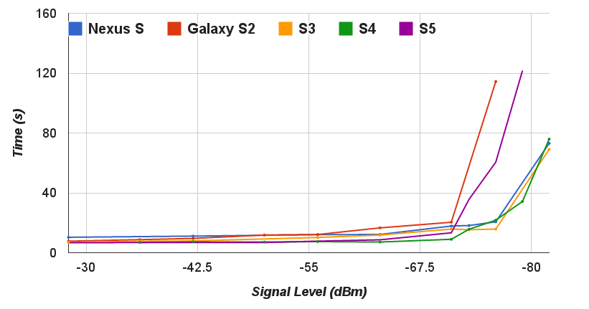
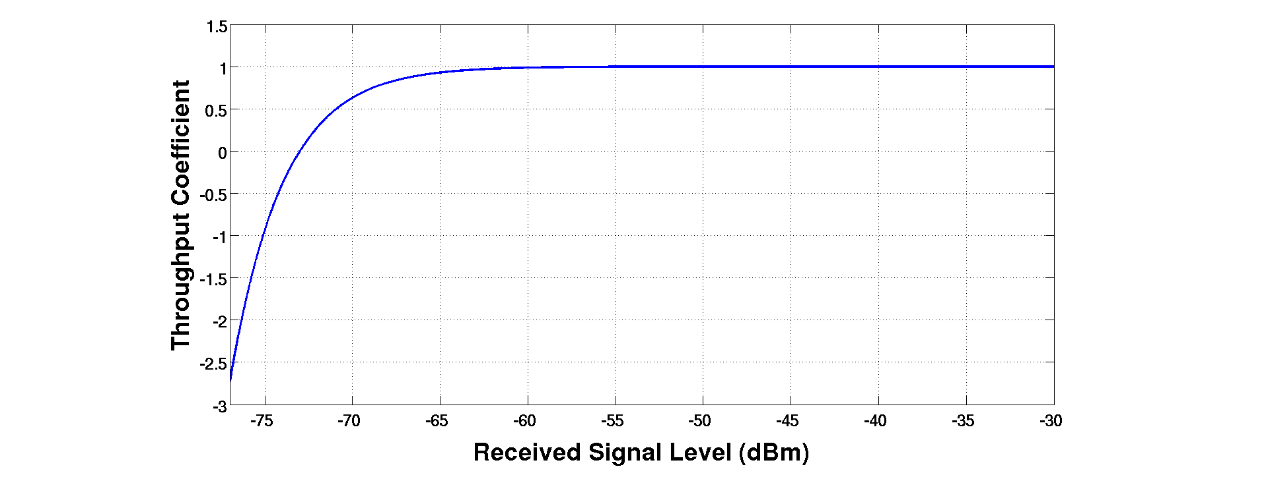

Bandwidth Curve-Fitting
Estimation
$1−e^{−k_{0}∙(S−k_{1)}}$
Time-Varying
Like Open flow API, collect RSSI every 5 sec
Using the above model, derive bandwidth
Using ARIMA for time-varying property
< An SDN Platform for Traffic Offloading >

Slide 3
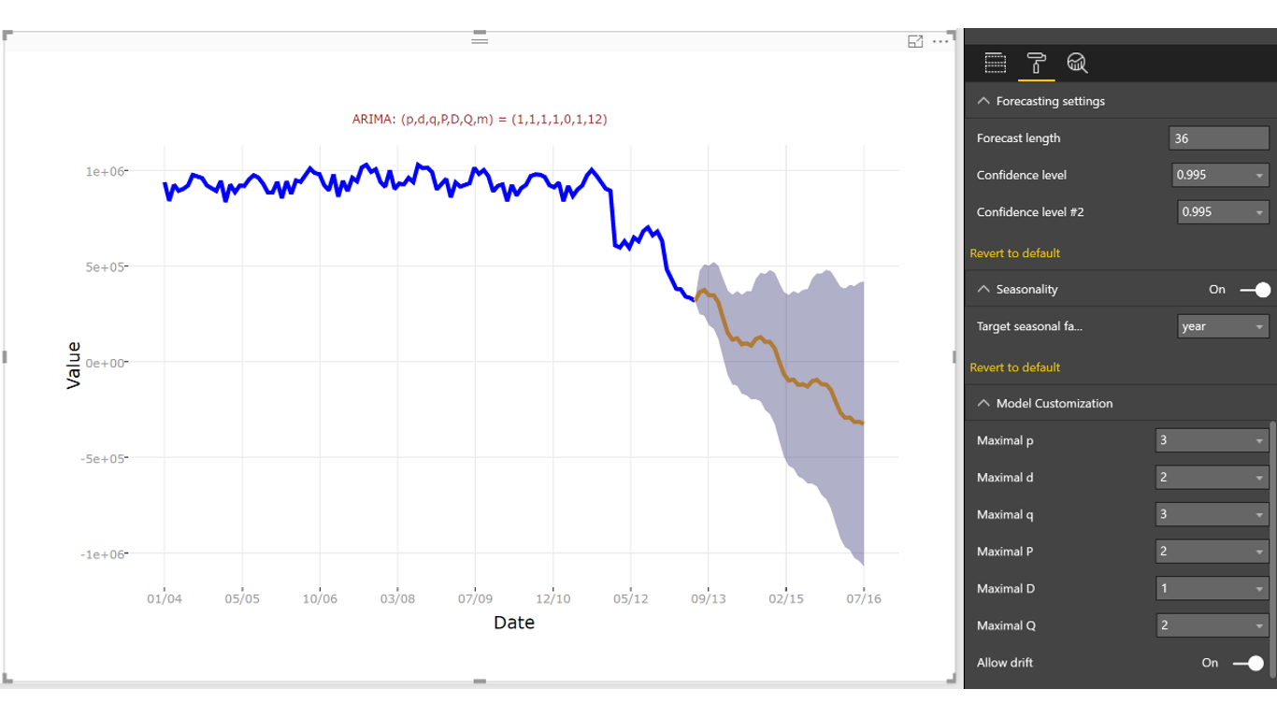
Question
< https://appsource.microsoft.com/en-us/product/power-bi-visuals/WA104380888?tab=Overview >

