Slide 1
Artificial Intelligence-Based Handoff Management for Dense WLANs: A Deep Reinforcement Learning Approach ZIJUN HAN, TAO LEI, ZHAOMING LU, XIANGMING WEN, WEI ZHENG, (Member IEEE), AND LINGCHAO GUO IEEE ACCESS
Notes:
다.

Slide 2
Contents
Background
Problem
Architecture
System Model
Proposed Scheme
Algorithm
Experiment
Conclusion
Notes:
발표 순서는 다음과 같습니다

Slide 3
Background
There are no mechanisms for ensuring the seamless handoff. Typically the handoff delay in WLAN is approximately 300 ms or more
SDN controller can give a global view of the network so that real-time network status and statistics can be detected through OpenFlow protocol
For SDN-based WLAN, there is no channel scanning in discovery process
The network is dynamic. So self learning is required
Notes:
오늘 세미나 할 내용을 간단히 설명드리자면

Slide 4
Problem
Focusing on improving the data rate during handoff process by selecting AP
RL can be solution for self-learning
There is Q-learning
However, Q-learning cannot achieve desired results in the case of the infinite numbers of state space
So, DQN is used

Slide 5
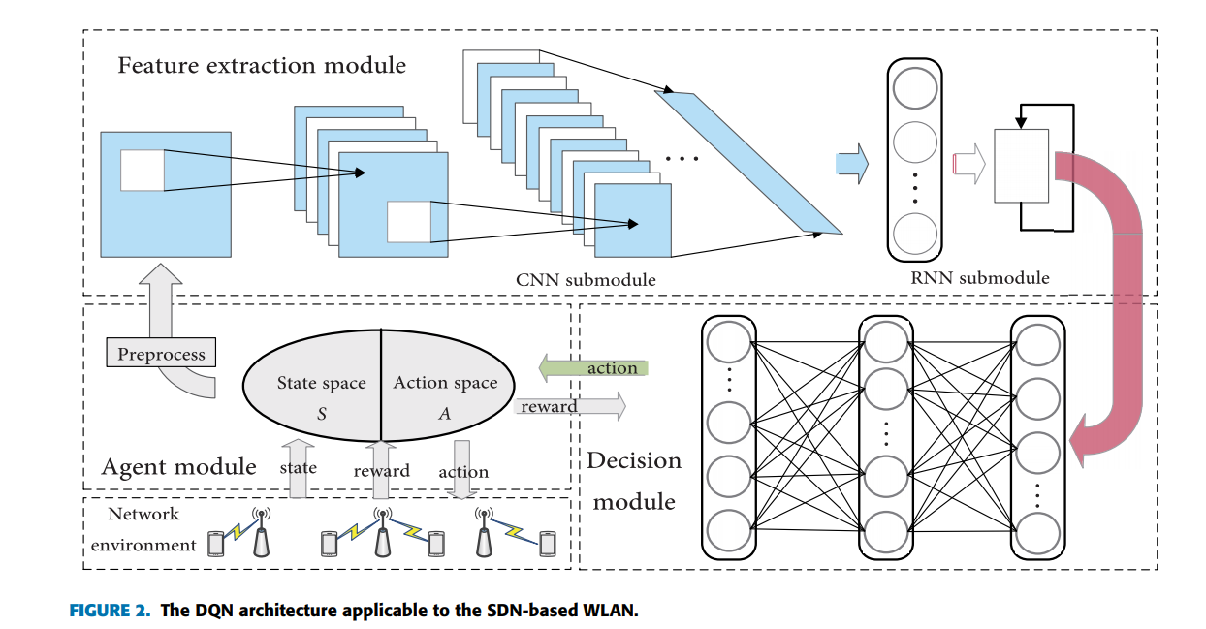
Architecture
DQN Architecture
Each network used to extract feature
CNN: spatial location of STA
RNN: temporary feature like mobile velocity
Deep Neural Network is leveraged to realize the mapping of state to action
Notes:
앞에서 정의한 State, Action, Reward를 가지고 DQN 동작
State에서 CNN을 거치고 RNN을 거치고 Decision module을 거치면서 Action을 생성한다.
생성된 Action을 통해 Reward를 계산하고 그 Reward를 바탕으로 네트워크를 수정

Slide 6
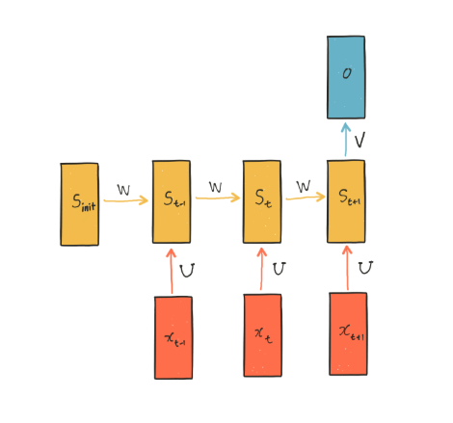
RNN(Recurrent Neural Network)
A recurrent neural network (RNN) is a class of artificial neural networks where connections between nodes form a directed graph along a temporal sequence
This allows it to exhibit temporal dynamic behavior.
Unlike feedforward neural networks, RNNs can use their internal state (memory) to process sequences of inputs
< https://dreamgonfly.github.io/rnn/2017/09/04/understanding-rnn.html >
Notes:
시퀀스가 시간에 따른 SINR
Hidden state
기존의 Neural Network와 달리 Hidden state 개념(기억과 유사)을 가짐
Hidden state는 지금까지 입력된 데이터를 요약한 정보
새로운 데이터가 들어올 때마다 Hidden state(기억)를 수정
모든 입력을 다 처리하고 난 후 network에 남겨진 Hidden state는 시퀀스 전체를 요약한 정보

Slide 7
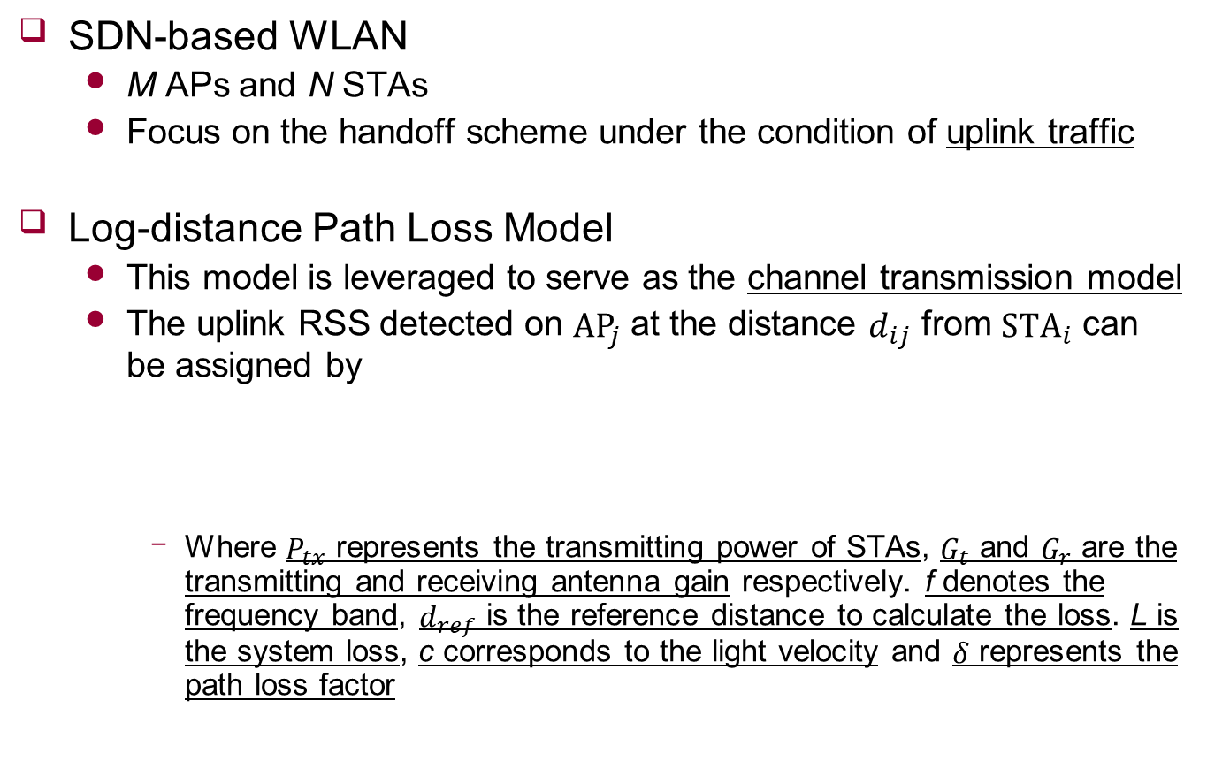
System Model
SDN-based WLAN
M APs and N STAs
Focus on the handoff scheme under the condition of uplink traffic
Log-distance Path Loss Model
This model is leveraged to serve as the channel transmission model
The uplink RSS detected on ${AP}_{j}$ at the distance $d_{ij}$ from ${STA}_{i}$ can be assigned by
Where $P_{tx}$ represents the transmitting power of STAs, $G_{t}$ and $G_{r}$ are the transmitting and receiving antenna gain respectively. f denotes the frequency band, $d_{ref}$ is the reference distance to calculate the loss. L is the system loss, c corresponds to the light velocity and $δ$ represents the path loss factor
$$P_{d_{ij}}=P_{tx}+G_{t}+G_{r}−20\log_{10}\left(\frac{4πfd_{ref}\sqrt{L}}{c}\right)−10δ\log_{10}\left(d_{ij}/d_{ref}\right)$$

Slide 8

System Model
SINR
The uplink SINR from ${STA}_{i}$ to ${AP}_{j}$ is
Where $I_{r}=\sum_{k∈N,k≠i}{P_{d_{ij}}(1≤k≤N,1≤j≤M)}$ indicates the cumulative interference caused by other STAs. and $σ^{2}$ is additive white Gaussian noise
$${SINR}_{ij}=\frac{P_{d_{ij}}}{I_{r}+σ^{2}}$$

Slide 9
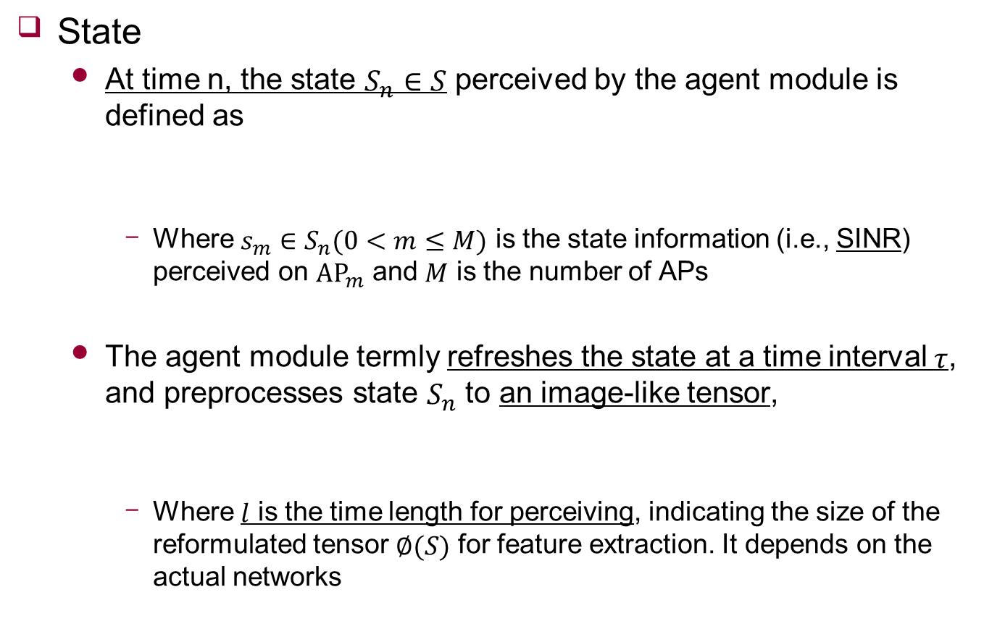
Proposed Scheme
State
At time n, the state $S_{n}∈S$ perceived by the agent module is defined as
Where $s_{m}∈S_{n}(0<m≤M)$ is the state information (i.e., SINR) perceived on ${AP}_{m}$ and $M$ is the number of APs
The agent module termly refreshes the state at a time interval $τ$, and preprocesses state $S_{n}$ to an image-like tensor,
Where $l$ is the time length for perceiving, indicating the size of the reformulated tensor $∅(S)$ for feature extraction. It depends on the actual networks
$$S_{n}=\{s_{1},s_{2},…,s_{m},…,s_{M−1},s_{M}\}$$
$$∅(S_{n})={\{S_{n−l+1},S_{n−l+2},…,S_{n−l+j},…,S_{n−1},S_{n}\}}^{T}$$

Slide 10
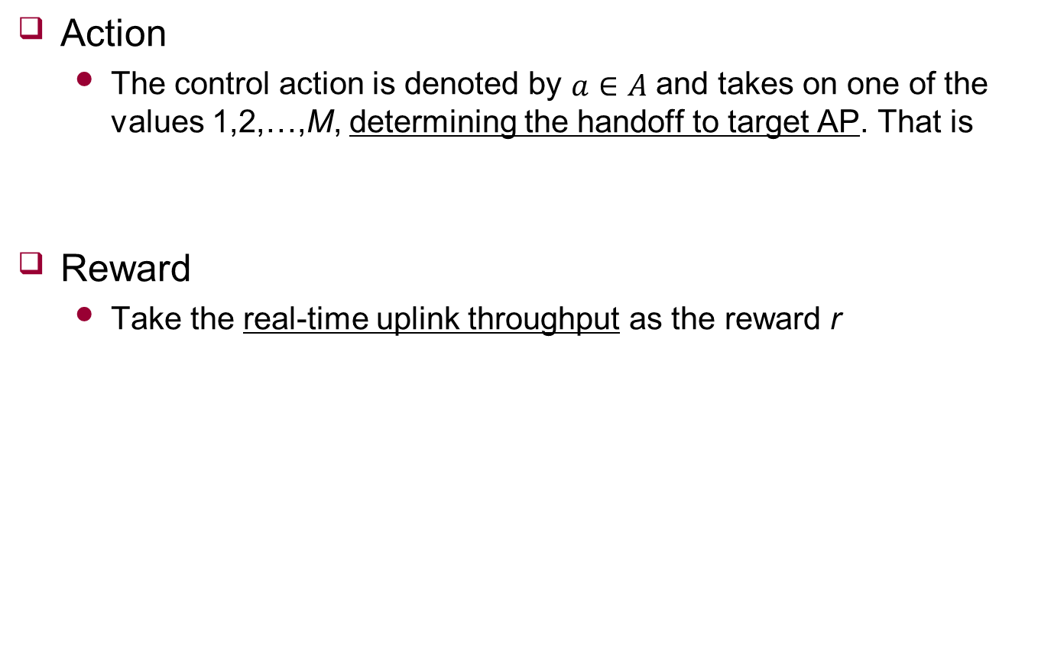
Proposed Scheme
Action
The control action is denoted by $a∈A$ and takes on one of the values 1,2,…,M, determining the handoff to target AP. That is
Reward
Take the real-time uplink throughput as the reward r
$$A=\{a_{1},a_{2},…,a_{m},…,a_{M−1},a_{M}\}$$

Slide 11
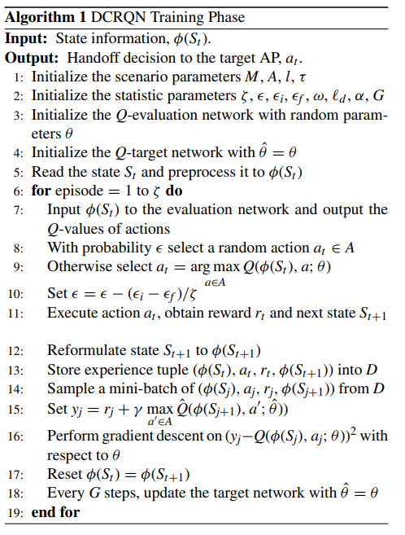
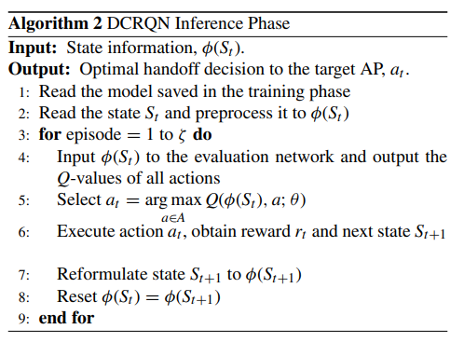
Algorithm

Slide 12
Experiment
Environment
The WLAN system model is established by means of Mininet-WiFi emulator
The learning phase is implemented on TensorFlow, a Google’s open source platform for deep learning
Analysis considers a dense WLAN consisting of 9 APs and 12 STAs
Among the STAs, one serves as a mobile object observed by the agent module, while others are stationary to produce background traffic
The observed STA moves randomly throughout the radio coverage areas

Slide 13
Experiment
Other tools
Iperf
A survey instrument for network performance, is leveraged to measure the throughput between two ports by creating data stream
tcpdump
Its command is adopted to capture time stamp of packets to depict the variations in throughput
iw
In response to the handoff instructions made by the decision module

Slide 14
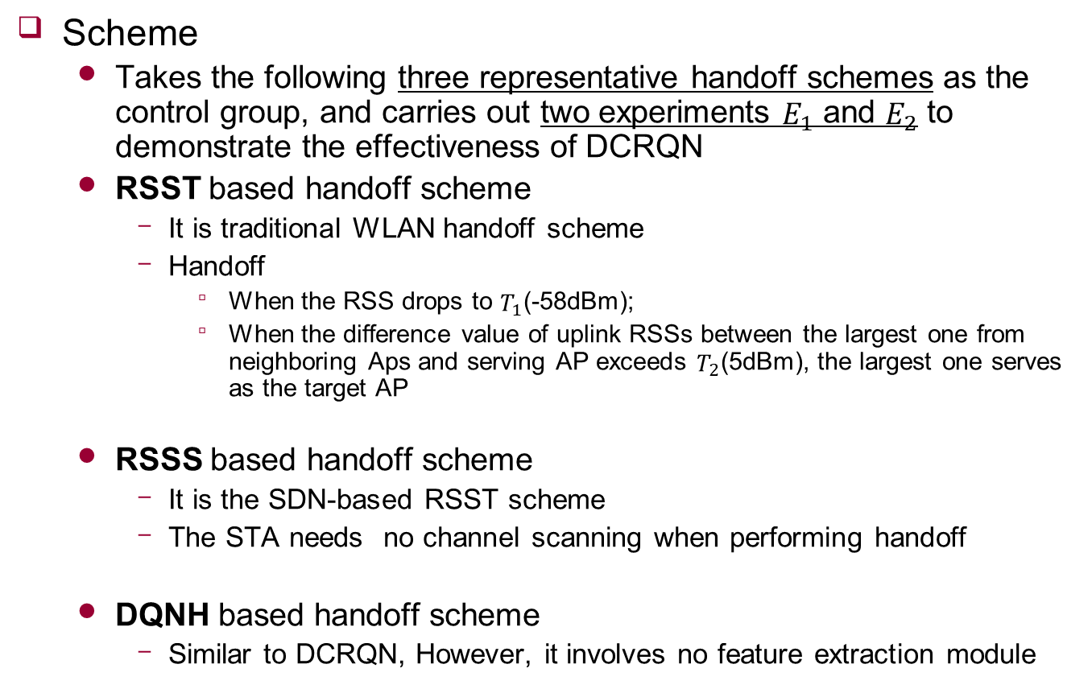
Experiment
Scheme
Takes the following three representative handoff schemes as the control group, and carries out two experiments $E_{1}$ and $E_{2}$ to demonstrate the effectiveness of DCRQN
RSST based handoff scheme
It is traditional WLAN handoff scheme
Handoff
When the RSS drops to $T_{1}$(-58dBm);
When the difference value of uplink RSSs between the largest one from neighboring Aps and serving AP exceeds $T_{2}$(5dBm), the largest one serves as the target AP
RSSS based handoff scheme
It is the SDN-based RSST scheme
The STA needs no channel scanning when performing handoff
DQNH based handoff scheme
Similar to DCRQN, However, it involves no feature extraction module

Slide 15
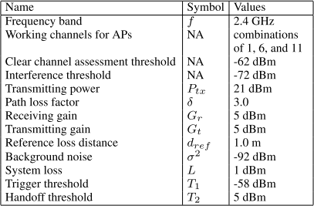
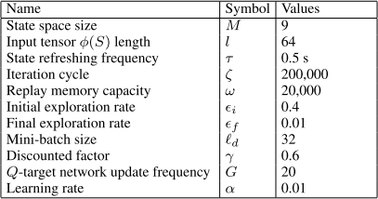
Experiment
Parameters

Slide 16
Experiment
Neural Network
CNN
16 kernels that each size is 5 x 5, activation function is ReLU
32 kernels that each size is 3 x 3, activation function is ReLU
Max pooling function, kernel is 2 x 2
RNN
Two RNN cells that each size is 256, activation function is tanh
DNN
Two fully connected layers, sizes are 256, 128, activation function is ReLU

Slide 17
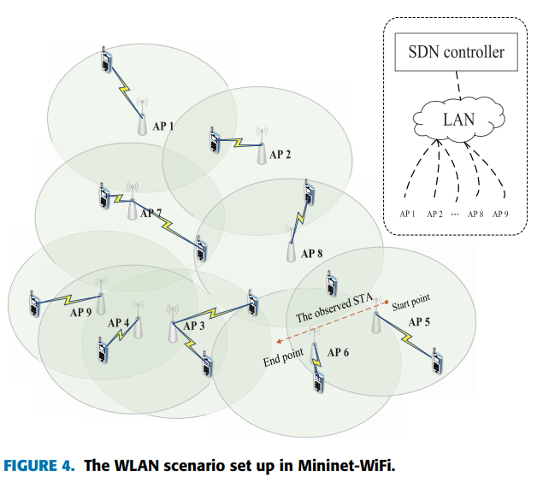

Experiment
Experiment $E_{1}$
Compare the trend of throughput variation in the case of a single handoff

Slide 18
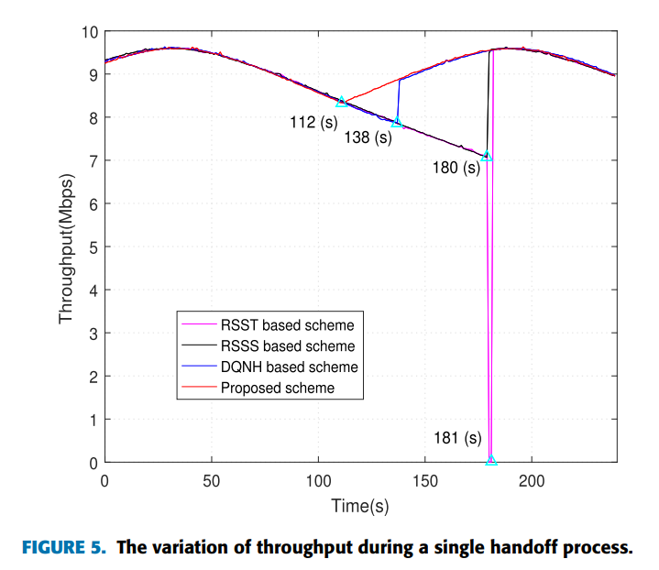

Experiment
Experiment $E_{1}$

Slide 19
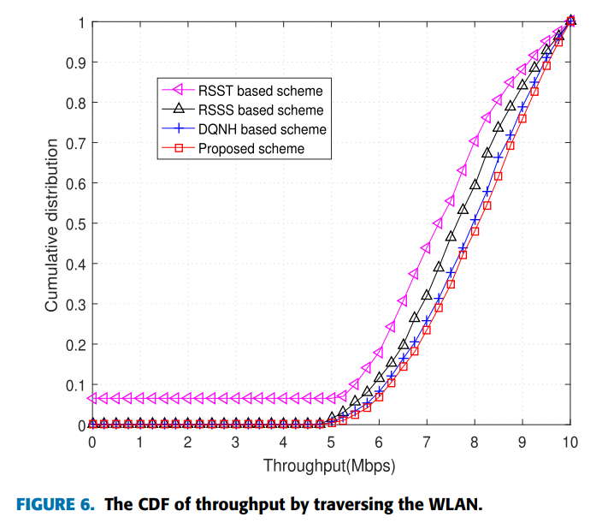
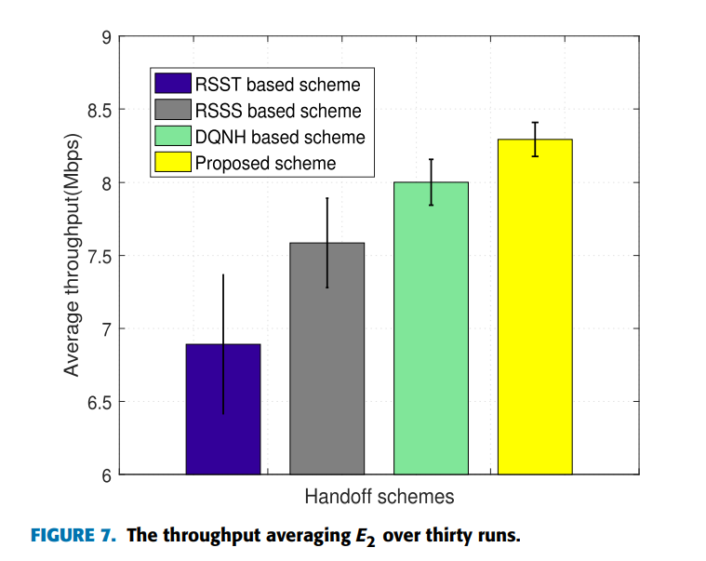

Experiment
Experiment $E_{2}$

Slide 20
Conclusion
Focus on the handoff management scheme in the SDN based WLAN
Propose DCRQN, a novel DQN-based handoff decision algorithm where SINR is leveraged to characterize the STA’s state
Besides, CNN and RNN are resorted to extract the fine-grained features of the wireless signals, respectively
The experimental results show that the proposed scheme can significantly improve the data rate during the handoff process, outperforming the traditional handoff scheme

Slide 21
Research
Consider network and state
In this paper, there is preprocessing process
State will be consist of timeslot (resource)
will check that state is configured correctly for neural network

