Slide 1





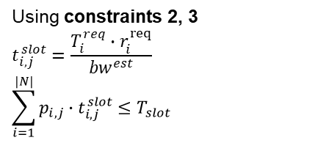
Progress
AP1
$$t_{1,1}^{slot}$$
$$t_{2,1}^{slot}$$
UE1
UE2
$$T_{slot}$$
Using constraints 2, 3
$$t_{i,j}^{slot}=\frac{T_{i}^{req}∙r_{i}^{req}}{{bw}^{est}}$$
$$\sum_{i=1}^{|N|}{p_{i,j}∙t_{i,j}^{slot}≤T_{slot}}$$
Where?
AP2
$$T_{slot}$$

Slide 2
Progress
Research
Experiment
Tomorrow ~ Wednesday
SDN
GitHub

