Slide 1
Research Jae Jun Ha Media Computing and Networking Laboratory POSTCH 2019-10-11
Notes:
발표 시작하겠습니다

Slide 2
Contents
Multiple Path
Comparison

Slide 3
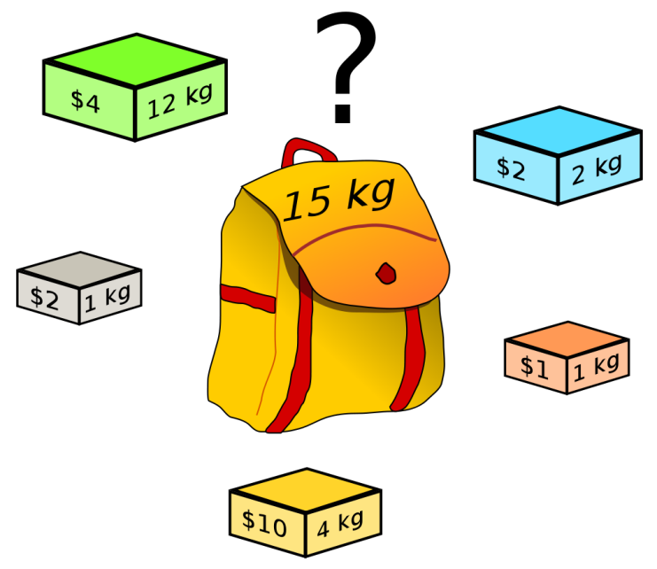

Knapsack Problem
There are two knapsack problems
0 / 1 Knapsack Problem
It takes $O\left(2^{n}\right)$
Fractional Knapsack Problem
It takes $O\left(n^{2}\right)$
However, there was no solution about MKP
< https://ko.wikipedia.org/wiki/배낭_문제 >

Slide 4
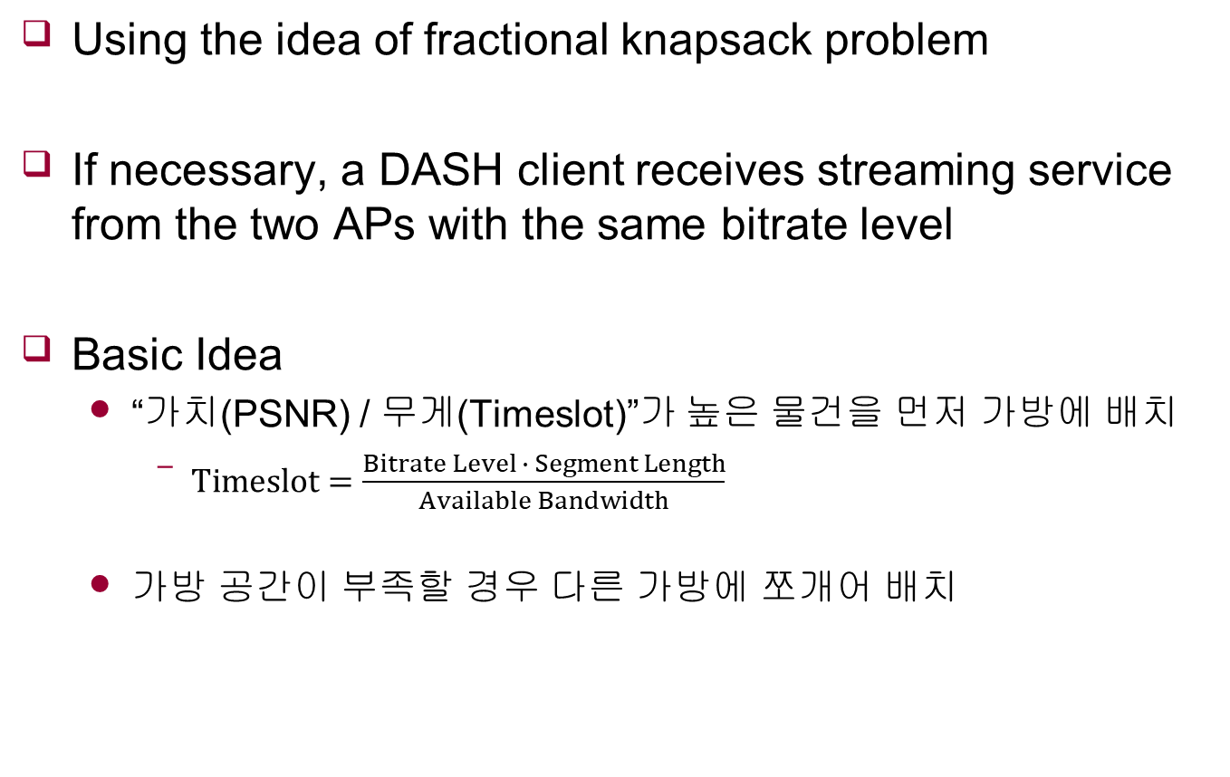
Multiple Path
Using the idea of fractional knapsack problem
If necessary, a DASH client receives streaming service from the two APs with the same bitrate level
Basic Idea
“가치(PSNR) / 무게(Timeslot)”가 높은 물건을 먼저 가방에 배치
$Timeslot=\frac{Bitrate Level ∙ Segment Length}{Available Bandwidth}$
가방 공간이 부족할 경우 다른 가방에 쪼개어 배치

Slide 5
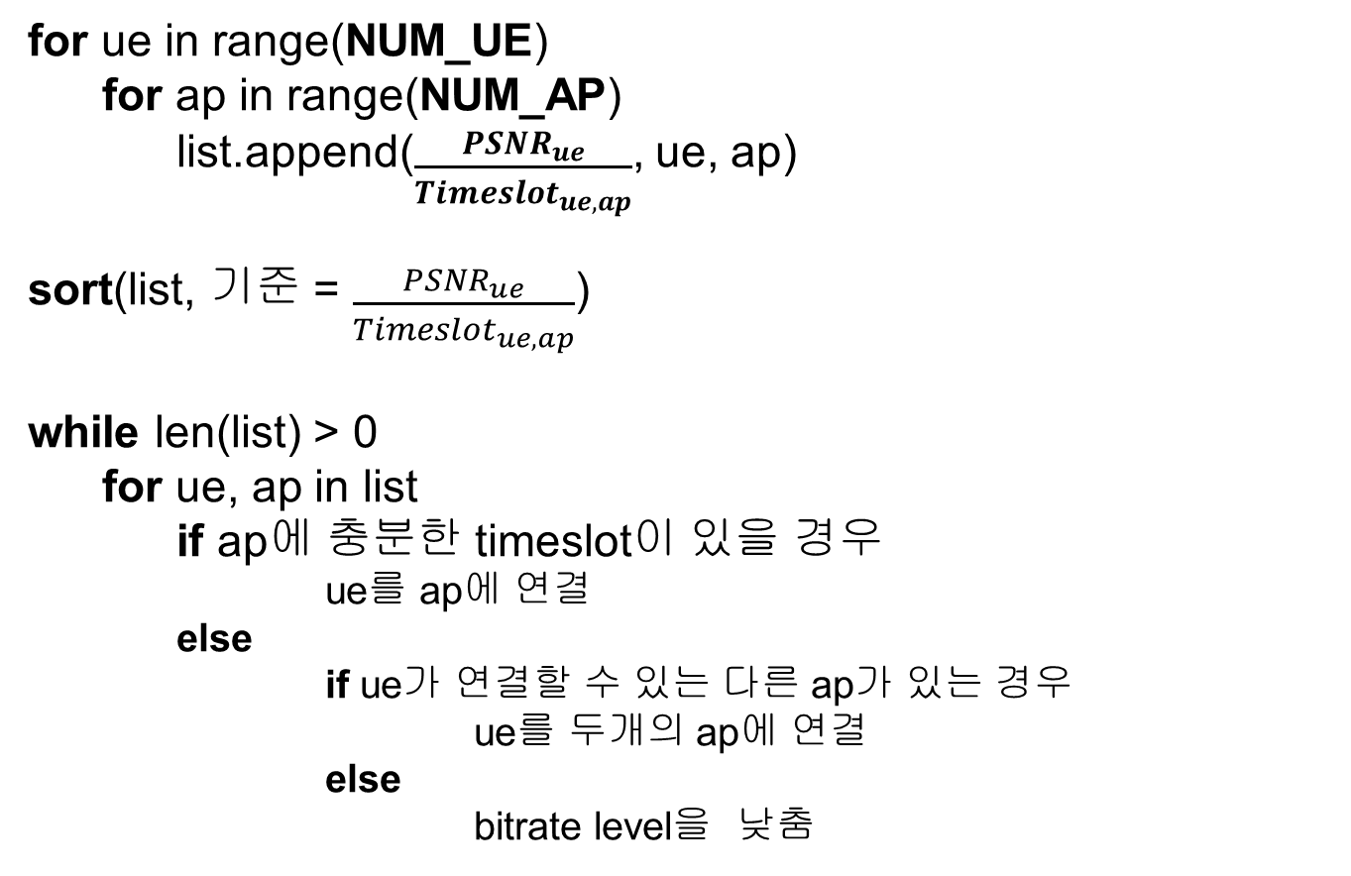
Algorithm
for ue in range(NUM_UE)
for ap in range(NUM_AP)
list.append($\frac{{PSNR}_{ue}}{{Timeslot}_{ue, ap}}$, ue, ap)
sort(list, 기준 = $\frac{{PSNR}_{ue}}{{Timeslot}_{ue, ap}}$)
while len(list) > 0
for ue, ap in list
if ap에 충분한 timeslot이 있을 경우
ue를 ap에 연결
else
if ue가 연결할 수 있는 다른 ap가 있는 경우
ue를 두개의 ap에 연결
else
bitrate level을 낮춤

Slide 6
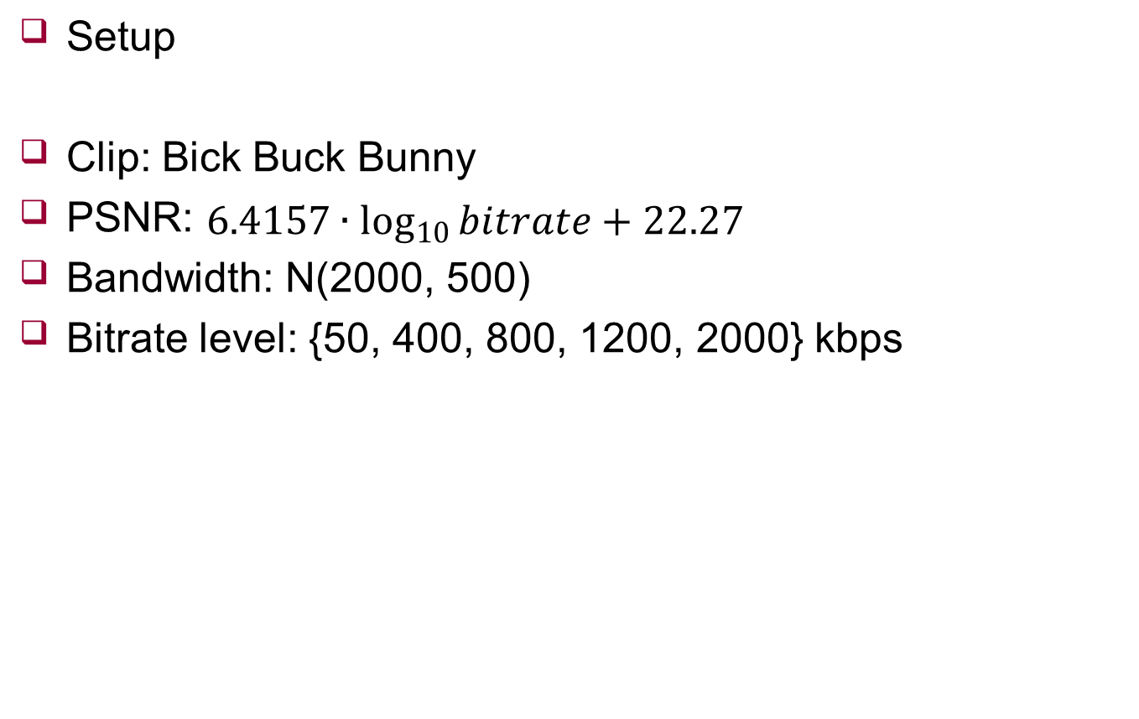
Comparison
Setup
Clip: Bick Buck Bunny
PSNR: $6.4157∙\log_{10}{bitrate}+22.27$
Bandwidth: N(2000, 500)
Bitrate level: {50, 400, 800, 1200, 2000} kbps

Slide 7
Comparison
UE: 8, AP: 3
 |  | AVG | 1 | 2 | 3 | 4 | 5 | 6 | 7 | 8 | 9 | 10
Multipath | PSNR | 39.44 | 40.69 | 40.39 | 38.42 | 40.01 | 39.26 | 39.32 | 39.25 | 39.32 | 37.83 | 39.91
 | Time | 0.00019 | 0.00018 | 0.00022 | 0.00012 | 0.0002 | 0.00024 | 0.00025 | 0.00013 | 0.00023 | 0.00011 | 0.00022
DQN | PSNR | 39.221 | 40.25 | 39.97 | 38.42 | 39.21 | 39.28 | 39.93 | 38.56 | 38.96 | 37.66 | 39.97
 | Time | 0.018931 | 0.02274 | 0.02405 | 0.0086 | 0.02311 | 0.02518 | 0.0081 | 0.02297 | 0.02353 | 0.00657 | 0.02446
MTM | PSNR | 38.718 | 39.93 | 38.52 | 38.28 | 37.17 | 38.46 | 39.04 | 39.25 | 39.45 | 37.83 | 39.25
 | Time | 0.007258 | 0.00603 | 0.00597 | 0.00991 | 0.0089 | 0.00721 | 0.00702 | 0.00632 | 0.00708 | 0.00598 | 0.00816
MTHM | PSNR | 39.065 | 39.83 | 39.83 | 38.28 | 37.56 | 39.42 | 40.17 | 38.96 | 39.35 | 37.83 | 39.42
 | Time | 0.00018 | 0.00018 | 0.00019 | 0.00015 | 0.00021 | 0.00018 | 0.00018 | 0.00016 | 0.00019 | 0.00016 | 0.0002
Greedy | PSNR | 38.321 | 39.15 | 37.25 | 38.42 | 38.9 | 38.3 | 37.57 | 38.46 | 38.66 | 37.66 | 38.84
 | Time | 0.00006 | 0.00006 | 0.00007 | 0.00005 | 0.00006 | 0.00006 | 0.00007 | 0.00006 | 0.00006 | 0.00005 | 0.00006
Random | PSNR | 35.995 | 35.83 | 36.31 | 35.83 | 37.76 | 34.86 | 37.03 | 35.58 | 36.55 | 33.89 | 36.31
 | Time | 0.000064 | 0.00006 | 0.00007 | 0.00006 | 0.00007 | 0.00006 | 0.00006 | 0.00006 | 0.00007 | 0.00006 | 0.00007
BB | PSNR | 39.895 | 40.69 | 40.73 | 38.42 | 40.11 | 40.11 | 40.84 | 39.42 | 40.11 | 37.83 | 40.69
 | Time | 123.556 | 226.8622 | 138.8807 | 22.8827 | 106.9907 | 117.9842 | 279.7887 | 42.44457 | 92.78152 | 5.65032 | 201.2945
Ideal | PSNR | 40.538 | 41.57 | 41.51 | 38.42 | 40.95 | 41.11 | 41.89 | 39.42 | 41.17 | 37.83 | 41.51

Slide 8
Comparison
Advantage of Fractional Knapsack Problem
Request
Multipath
DQN
UE 0 | UE 1 | UE 2 | UE 3 | UE 4 | UE 5 | UE 6 | UE 7
1200 kbps | 2000 kbps | 1200 kbps | 1200 kbps | 800 kbps | 50 kbps | 1200 kbps | 1200 kbps
AP 0 | 0.90 | UE 5 (50 kbps) UE 7 (1200 kbps) UE 6 (400kbps)
AP 1 | 0.90 | UE 4 (800 kbps) UE 2 (1200 kbps) UE 3 (1200 kbps, 0.77 %) UE 1 (400 kbps)
AP 2 | 1.00 | UE 0 (1200 kbps) UE 3 (1200 kbps, 99.23 %)
AP 0 | 0.89 | UE 0 (800 kbps) UE 1 (800 kbps)
AP 1 | 0.83 | UE 3 (400 kbps) UE 5 (50 kbps) UE 6 (400 kbps)
AP 2 | 0.96 | UE 2 (400 kbps) UE 4 (800 kbps) UE 7 (800 kbps)

Slide 9
Future Work
Scheduling Issue in real system
MPMTP
Implements multi-path based system
Each UE has two network interfaces

