Slide 1
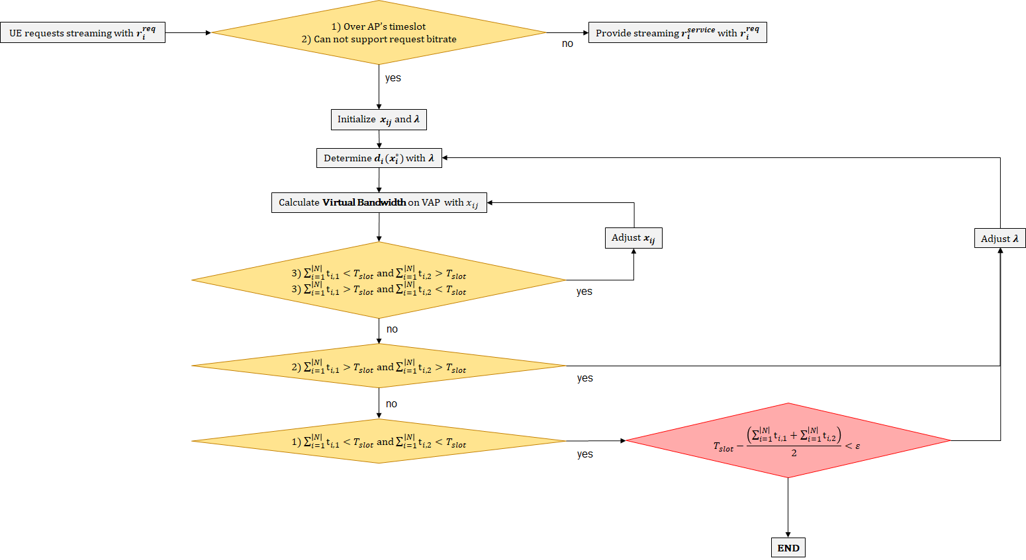
Consider Congestion
Congestion

Slide 2

$x_{i,j}$ adjustment

Slide 3





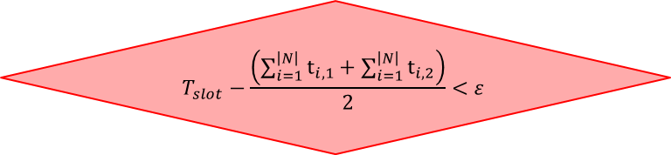
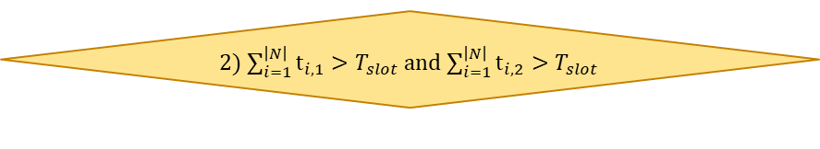
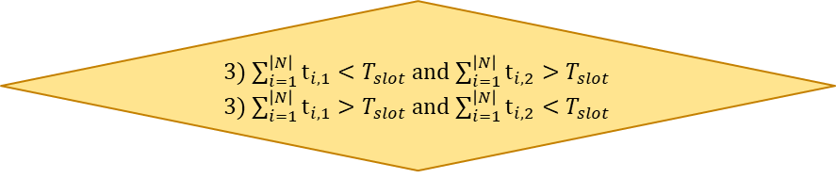

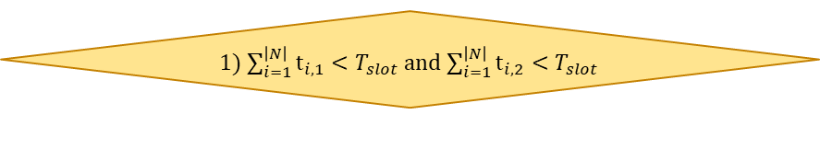

Appendix
Loop
1) Over AP’s timeslot
2) Can not support request bitrate
UE requests streaming with $r_{i}^{req}$
Provide streaming $r_{i}^{service}$ with $r_{i}^{req}$
no
yes
Initialize $x_{ij}$ and $λ$
Determine $d_{i}(x_{i}^{∗})$ with $λ$
Calculate Virtual Bandwidth on VAP with $x_{ij}$
Adjust $x_{ij}$
Adjust $λ$
3) $\sum_{i=1}^{\left|N\right|}{t_{i,1}}<T_{slot}$ and $\sum_{i=1}^{\left|N\right|}{t_{i,2}}>T_{slot}$
3) $\sum_{i=1}^{\left|N\right|}{t_{i,1}}>T_{slot}$ and $\sum_{i=1}^{\left|N\right|}{t_{i,2}}<T_{slot}$
yes
no
2) $\sum_{i=1}^{\left|N\right|}{t_{i,1}}>T_{slot}$ and $\sum_{i=1}^{\left|N\right|}{t_{i,2}}>T_{slot}$
yes
no
$$T_{slot}−\frac{\left(\sum_{i=1}^{\left|N\right|}{t_{i,1}}+\sum_{i=1}^{\left|N\right|}{t_{i,2}}\right)}{2}<ε$$
1) $\sum_{i=1}^{\left|N\right|}{t_{i,1}}<T_{slot}$ and $\sum_{i=1}^{\left|N\right|}{t_{i,2}}<T_{slot}$
yes
END

