Slide 1
Goal
Goal
To maximize QoE in video streaming over multiple WiFi networks with SDN
Adjusting Bitrate
To ensure total QoE
AP Load Balancing
To ensure minimum QoE for each user
Notes:
QoE에 대한 정의도 없음
Survey도 부족함
다른 논문에서 multiple WiFi 가져와서 설명할 필요도 있음
어떤 어려움, 이슈들이 있기에 SDN으로 AP를 관리하는 지
통신사는 실제로 이렇게 하고 있다
Related work 좀 뽑아놓아야
그런데에서는 QoE를 어떻게 쓰고 있다. 로드벨런싱을 어떻게 하고 잇는지
목표 -> 두가지 목표가 아니라 두 가지 방법
멀티플 네트워크나 비디오 스트리밍 갑자기 말하면 와닫지 않음 -> 관련 배경을 설명해줘야…(전에)

Slide 2




Basic Idea
Basic Idea
Media Server
SDN Controller
AP
Client

Slide 3
Basic Idea
Basic Idea
Media Server
SDN Controller
AP
Client

Slide 4
Basic Idea
Basic Idea
Media Server
SDN Controller
AP
Client

Slide 5
Basic Idea
Basic Idea
Media Server
SDN Controller
AP
Client

Slide 6
Basic Idea
Basic Idea
Media Server
SDN Controller
AP
Client

Slide 7
Basic Idea
Basic Idea
Media Server
SDN Controller
AP

Slide 8
Basic Idea
Basic Idea
AP collects information from clients
List of connectable APs
Using load balancing
Bandwidth
Using bitrate adjustment, load balancing
Buffer state
Using bitrate adjustment

Slide 9
Basic Idea
Basic Idea
When does SDN controller do Load Balancing?
New client is added
Average bandwidth per total bandwidth is very small
A specific client is disconnected

Slide 10
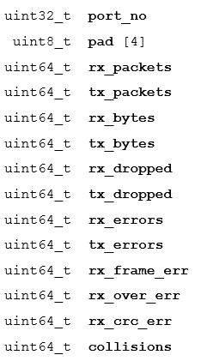
Basic Idea
Basic Idea
SDN collects information using Open Flow protocol
Using OFPMP_PORT_STATS message
Clients respond to it with ofp_port_stats message
< ofp_port_stats structure >

Slide 11
Basic Idea
Basic Idea
SDN collects information using Open Flow protocol
Using OFPMP_PORT_STATS message
Calculate available bandwidth
Define bandwidth as rx_bytes / time
< ofp_port_stats structure >

Slide 12
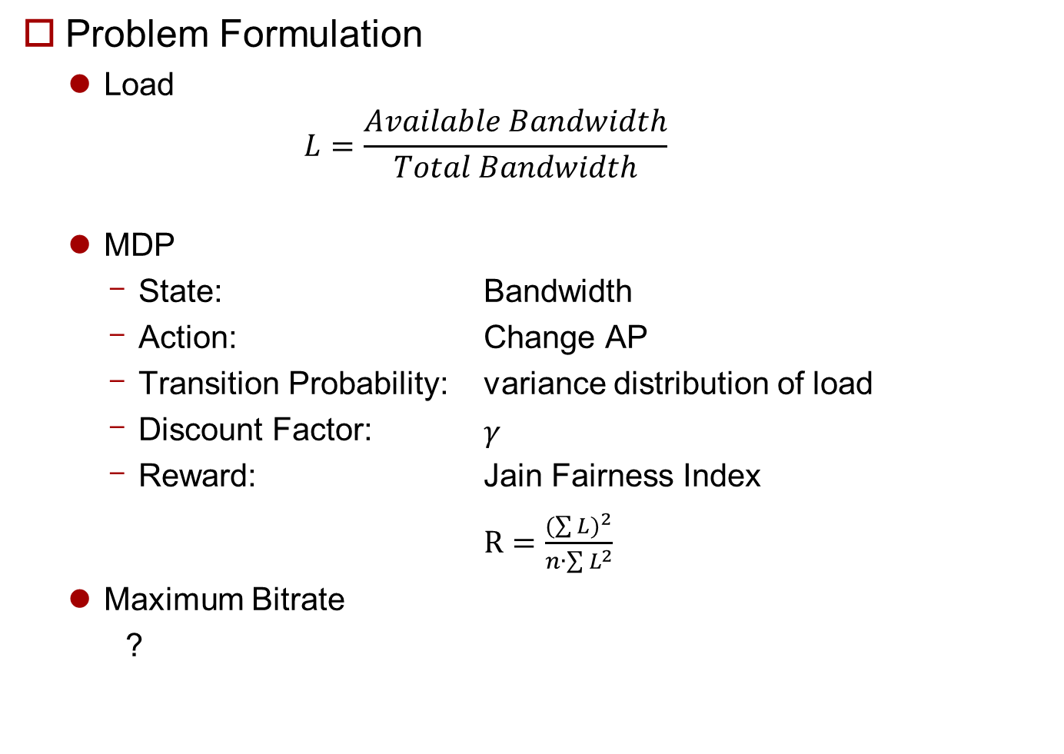
Problem Formulation
Problem Formulation
Load
$$L=\frac{Available Bandwidth}{Total Bandwidth}$$
MDP
State: Bandwidth
Action: Change AP
Transition Probability: variance distribution of load
Discount Factor: $γ$
Reward: Jain Fairness Index
$R=\frac{{(\sum{L})}^{2}}{n∙\sum{L^{2}}}$
Maximum Bitrate
?

