Slide 1
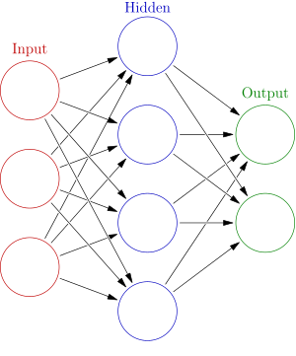
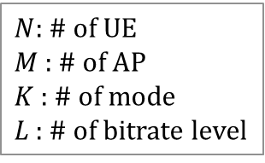


Neural Network
Input << output
$N$: # of UE
$M$ : # of AP
$K$ : # of mode
$L$ : # of bitrate level
State
action
$$N×M×K$$
$${(M+1)}^{N}×L^{N}$$
# of State << # of Action
< https://ko.wikipedia.org/wiki/인공_신경망 >

Slide 2



Neural Network
Input << output
$N$: # of UE
$M$ : # of AP
$K$ : # of mode
$L$ : # of bitrate level
State
action
$$N×M×K$$
$${(M+1)}^{1}×L^{1}$$
$$or$$
$${(M+1)}^{2}×L^{2}$$
Only one UE or a few UE
< https://ko.wikipedia.org/wiki/인공_신경망 >

