Slide 1
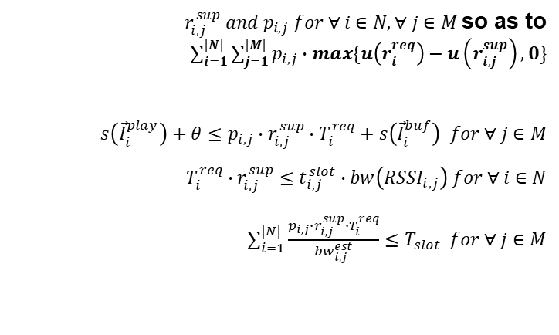
Formulation
Determine Minimize subject to and and
$r_{i,j}^{sup} and p_{i,j} for ∀ i∈N, ∀ j∈M$so as to $\sum_{i=1}^{|N|}{\sum_{j=1}^{|M|}{p_{i,j}∙max\{u\left(r_{i}^{req}\right)−u\left(r_{i,j}^{sup}\right),0\}}}$ $s\left({\vec{I}}_{i}^{play}\right)+θ≤p_{i,j}∙r_{i,j}^{sup}∙T_{i}^{req}+s\left({\vec{I}}_{i}^{buf}\right) for ∀ j∈M$ $$T_{i}^{req}∙r_{i,j}^{sup}≤t_{i,j}^{slot}∙bw\left({RSSI}_{i,j}\right) for ∀ i∈N$$ $\sum_{i=1}^{|N|}{\frac{p_{i,j}∙r_{i,j}^{sup}∙T_{i}^{req}}{{bw}_{i,j}^{est}}≤T_{slot}} for ∀ j∈M$
Notes:
Formulation은 이런 형태로

Slide 2
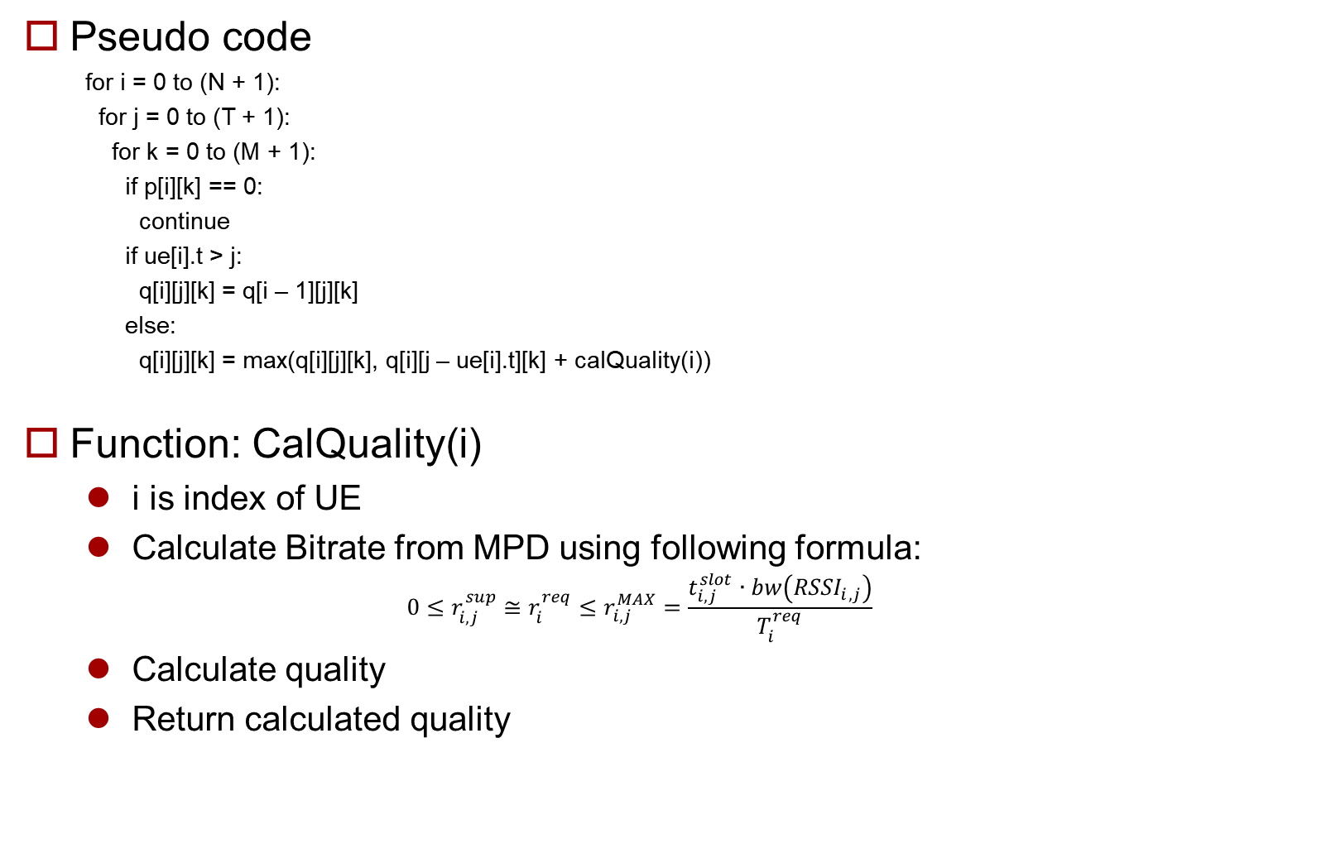
Algorithm
Pseudo code
for i = 0 to (N + 1):
for j = 0 to (T + 1):
for k = 0 to (M + 1):
if p[i][k] == 0:
continue
if ue[i].t > j:
q[i][j][k] = q[i – 1][j][k]
else:
q[i][j][k] = max(q[i][j][k], q[i][j – ue[i].t][k] + calQuality(i))
Function: CalQuality(i)
i is index of UE
Calculate Bitrate from MPD using following formula:
$$0≤r_{i,j}^{sup}≅r_{i}^{req}≤r_{i,j}^{MAX}=\frac{t_{i,j}^{slot}∙bw\left({RSSI}_{i,j}\right)}{T_{i}^{req}}$$
Calculate quality
Return calculated quality

