Slide 1
Research Jae Jun Ha Media Computing and Networking Laboratory POSTCH 2019-12-30
Notes:
발표 시작하겠습니다

Slide 2
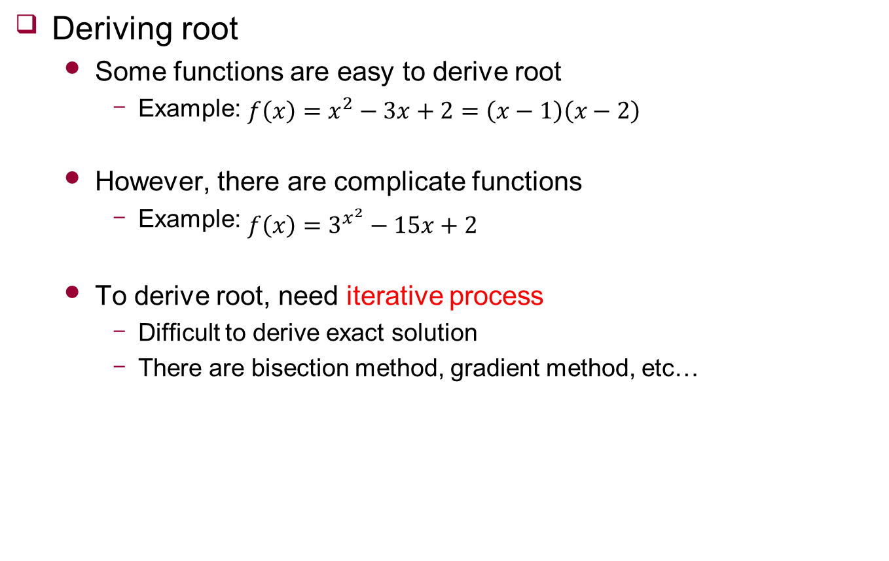
Root
Deriving root
Some functions are easy to derive root
Example: $f\left(x\right)=x^{2}−3x+2=\left(x−1\right)\left(x−2\right)$
However, there are complicate functions
Example: $f\left(x\right)=3^{x^{2}}−15x+2$
To derive root, need iterative process
Difficult to derive exact solution
There are bisection method, gradient method, etc…

Slide 3
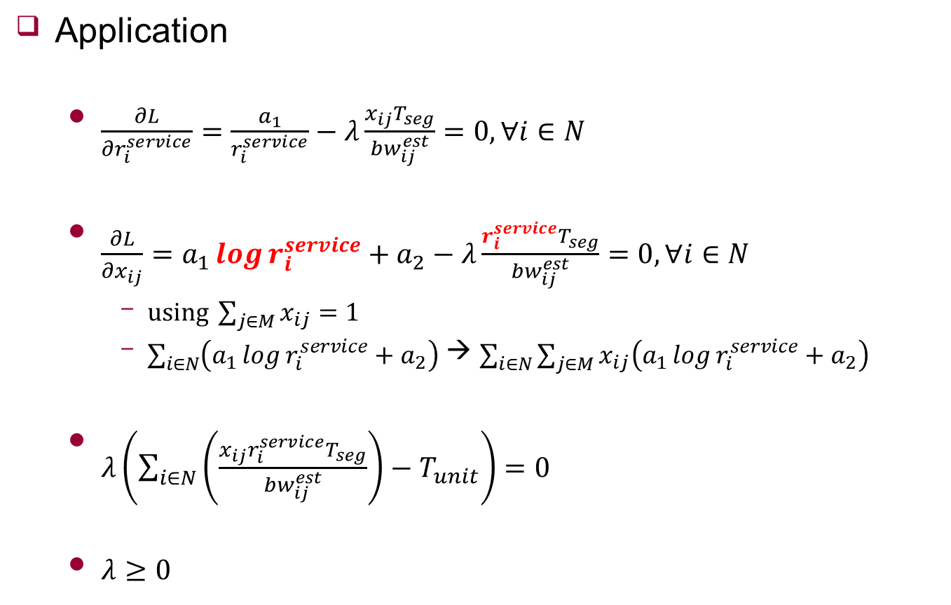
KKT Condition
Application
$\frac{∂L}{∂r_{i}^{service}}=\frac{a_{1}}{r_{i}^{service}}−λ\frac{x_{ij}T_{seg}}{{bw}_{ij}^{est}}=0,∀i∈N$
$\frac{∂L}{∂x_{ij}}=a_{1}\log{r_{i}^{service}}+a_{2}−λ\frac{r_{i}^{service}T_{seg}}{{bw}_{ij}^{est}}=0,∀i∈N$
$using \sum_{j∈M}{x_{ij}}=1$
$\sum_{i∈N}{\left(a_{1}\log{r_{i}^{service}}+a_{2}\right)}$ → $\sum_{i∈N}{\sum_{j∈M}{x_{ij}\left(a_{1}\log{r_{i}^{service}}+a_{2}\right)}}$
$λ\left(\sum_{i∈N}{\left(\frac{x_{ij}r_{i}^{service}T_{seg}}{{bw}_{ij}^{est}}\right)}−T_{unit}\right)=0$
$λ≥0$

Slide 4

KKT Condition
Application
$\frac{∂L}{∂r_{i}^{service}}=\frac{a_{1}}{r_{i}^{service}}−λ\frac{x_{ij}T_{seg}}{{bw}_{ij}^{est}}=0,∀i∈N$
$\frac{a_{1}}{r_{i}^{service}}=λ\frac{x_{ij}T_{seg}}{{bw}_{ij}^{est}}$
$a_{1}=λ\frac{x_{ij}r_{i}^{service}T_{seg}}{{bw}_{ij}^{est}}$
$λ\left(\sum_{i∈N}{\left(\frac{x_{ij}r_{i}^{service}T_{seg}}{{bw}_{ij}^{est}}\right)}−T_{unit}\right)=0$
$\sum_{i∈N}{a_{1}}=λT_{unit}$
$λ=\frac{Na_{1}}{T_{unit}}$

Slide 5
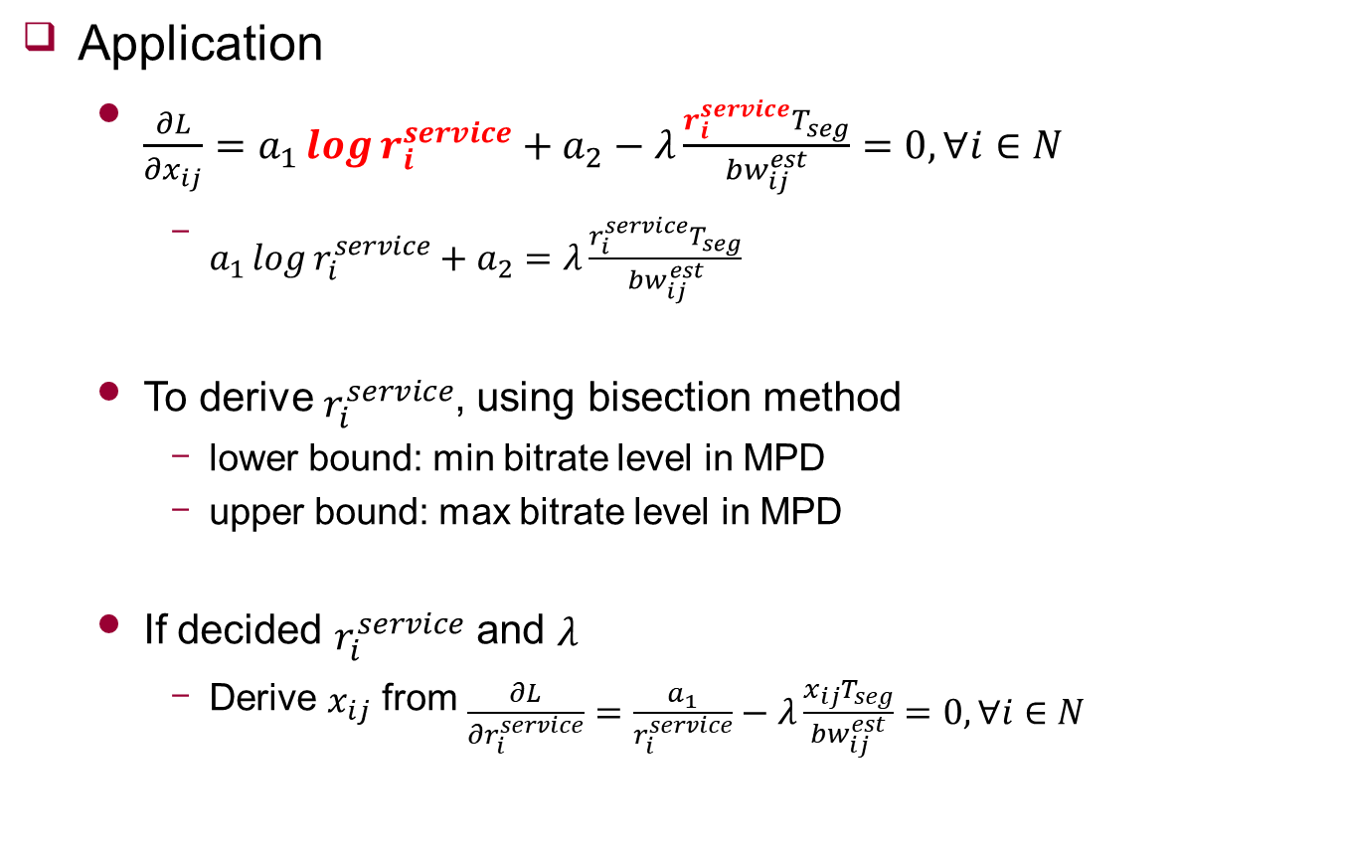
KKT Condition
Application
$\frac{∂L}{∂x_{ij}}=a_{1}\log{r_{i}^{service}}+a_{2}−λ\frac{r_{i}^{service}T_{seg}}{{bw}_{ij}^{est}}=0,∀i∈N$
$a_{1}\log{r_{i}^{service}}+a_{2}=λ\frac{r_{i}^{service}T_{seg}}{{bw}_{ij}^{est}}$
To derive $r_{i}^{service}$, using bisection method
lower bound: min bitrate level in MPD
upper bound: max bitrate level in MPD
If decided $r_{i}^{service}$ and $λ$
Derive $x_{ij}$ from $\frac{∂L}{∂r_{i}^{service}}=\frac{a_{1}}{r_{i}^{service}}−λ\frac{x_{ij}T_{seg}}{{bw}_{ij}^{est}}=0,∀i∈N$

Slide 6
Future Work
Complement algorithm

