Slide 1
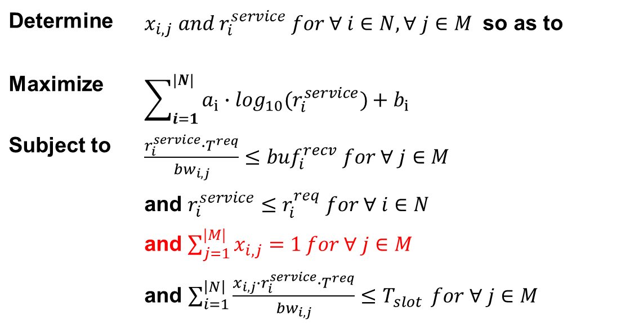
Formulation
Determine | $x_{i,j} and r_{i}^{service} for ∀ i∈N, ∀ j∈M$ so as to
Maximize | $$\sum_{i=1}^{|N|}{a_{i}∙\log_{10}(r_{i}^{service})+b_{i}}$$
Subject to | $\frac{r_{i}^{service}∙T^{req}}{{bw}_{i,j}}≤{buf}_{i}^{recv}$ $for ∀ j∈M$
 | and $r_{i}^{service}≤r_{i}^{req} for ∀ i∈N$
 | and $\sum_{j=1}^{|M|}{x_{i,j}=1}for ∀ j∈M$
 | and $\sum_{i=1}^{\left|N\right|}{\frac{x_{i,j}∙r_{i}^{service}∙T^{req}}{{bw}_{i,j}}≤T_{slot}} for ∀ j∈M$

Slide 2
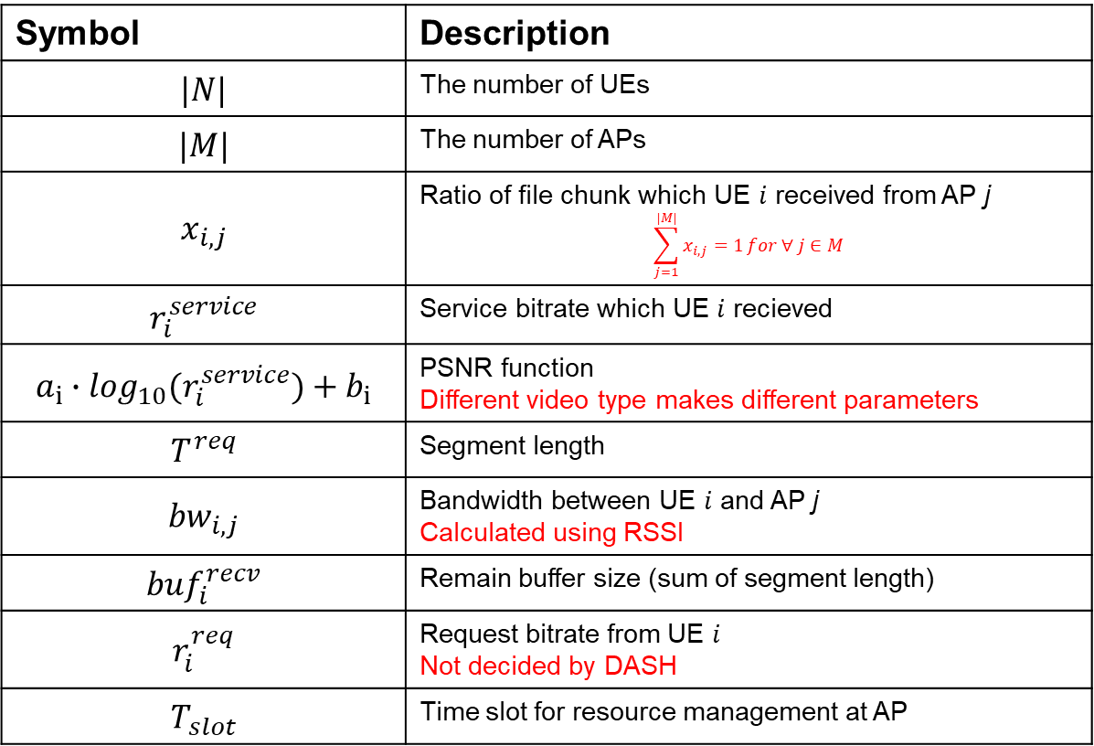
Formulation
Description
Symbol | Description
$$|N|$$ | The number of UEs
$$|M|$$ | The number of APs
$$x_{i,j}$$ | Ratio of file chunk which UE $i$ received from AP j $$\sum_{j=1}^{|M|}{x_{i,j}=1}for ∀ j∈M$$
$$r_{i}^{service}$$ | Service bitrate which UE $i$ recieved
$$a_{i}∙\log_{10}(r_{i}^{service})+b_{i}$$ | PSNR function Different video type makes different parameters
$$T^{req}$$ | Segment length
$${bw}_{i,j}$$ | Bandwidth between UE $i$ and AP j Calculated using RSSI
$${buf}_{i}^{recv}$$ | Remain buffer size (sum of segment length)
$$r_{i}^{req}$$ | Request bitrate from UE $i$ Not decided by DASH
$$T_{slot}$$ | Time slot for resource management at AP

Slide 3
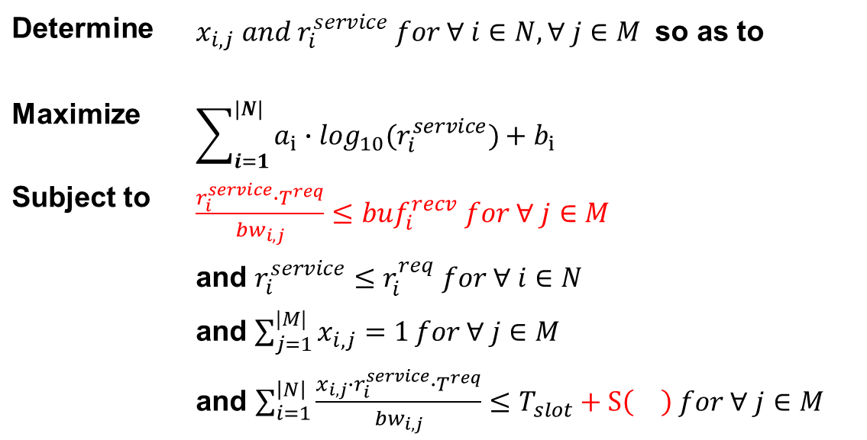
Formulation
Determine | $x_{i,j} and r_{i}^{service} for ∀ i∈N, ∀ j∈M$ so as to
Maximize | $$\sum_{i=1}^{|N|}{a_{i}∙\log_{10}(r_{i}^{service})+b_{i}}$$
Subject to | $\frac{r_{i}^{service}∙T^{req}}{{bw}_{i,j}}≤{buf}_{i}^{recv}$ $for ∀ j∈M$
 | and $r_{i}^{service}≤r_{i}^{req} for ∀ i∈N$
 | and $\sum_{j=1}^{|M|}{x_{i,j}=1}for ∀ j∈M$
 | and $\sum_{i=1}^{\left|N\right|}{\frac{x_{i,j}∙r_{i}^{service}∙T^{req}}{{bw}_{i,j}}}≤T_{slot}+S\left(\right) for ∀ j∈M$

Slide 4
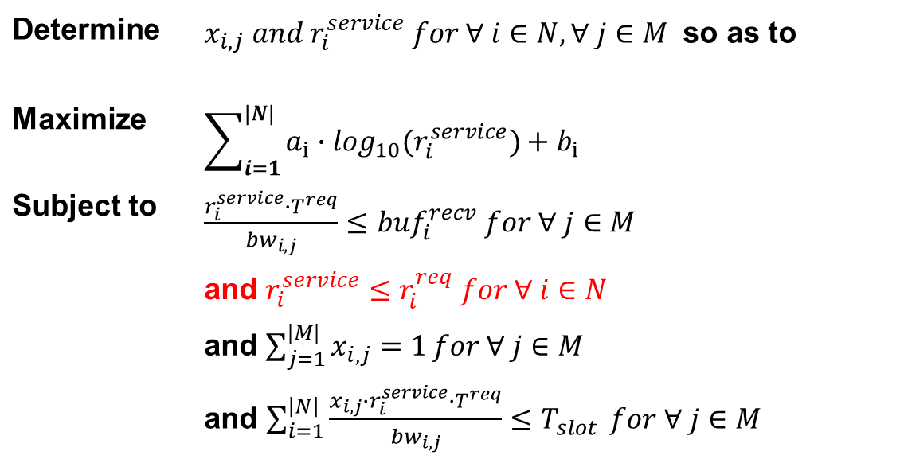
Formulation
Determine | $x_{i,j} and r_{i}^{service} for ∀ i∈N, ∀ j∈M$ so as to
Maximize | $$\sum_{i=1}^{|N|}{a_{i}∙\log_{10}(r_{i}^{service})+b_{i}}$$
Subject to | $\frac{r_{i}^{service}∙T^{req}}{{bw}_{i,j}}≤{buf}_{i}^{recv}$ $for ∀ j∈M$
 | and $r_{i}^{service}≤r_{i}^{req} for ∀ i∈N$
 | and $\sum_{j=1}^{|M|}{x_{i,j}=1}for ∀ j∈M$
 | and $\sum_{i=1}^{\left|N\right|}{\frac{x_{i,j}∙r_{i}^{service}∙T^{req}}{{bw}_{i,j}}≤T_{slot}} for ∀ j∈M$

Slide 5
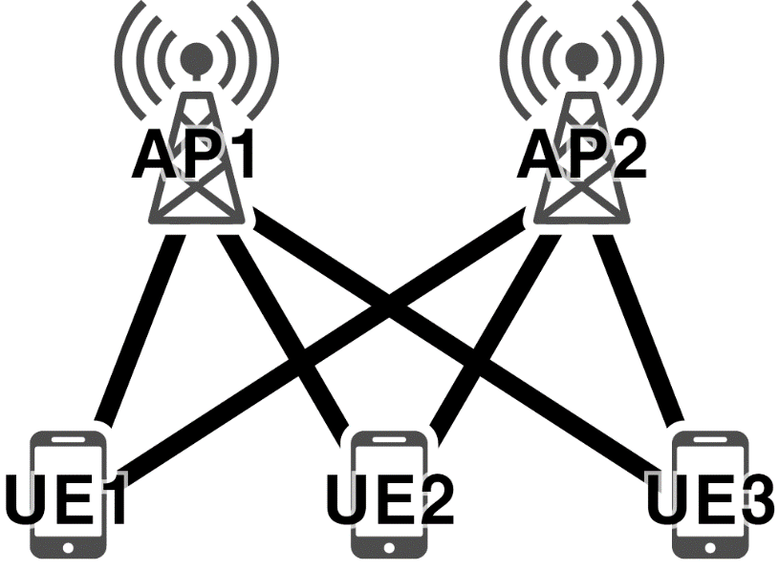
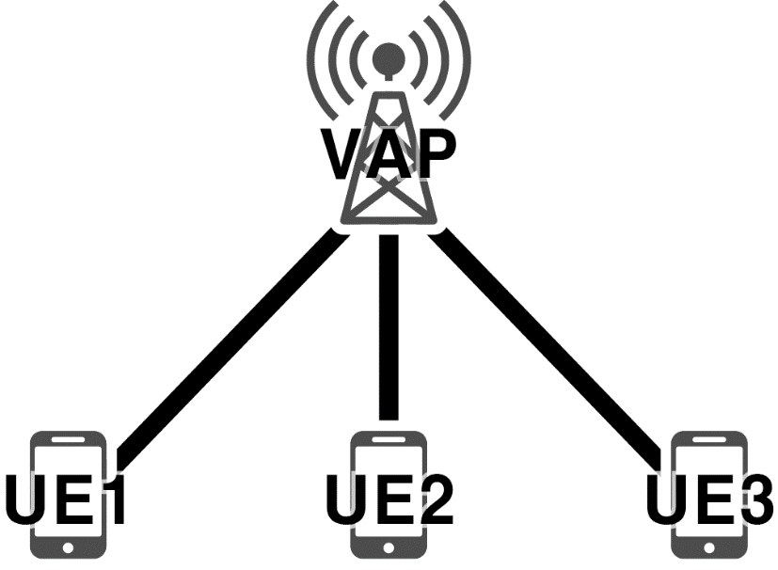

Lagrange Multiplier
Function
$L=\sum_{i=1}^{|N|}{(a_{i}∙\log_{10}(r_{i}^{service})+b_{i})}−\sum_{j=1}^{|M|}{λ_{j}∙(\sum_{i=1}^{\left|N\right|}{\frac{x_{i,j}∙r_{i}^{service}∙T^{req}}{{bw}_{i,j}}−T_{slot}})}$
VAP
Like one AP
Consider merged bandwidth
Each pair (UE – AP connection) has a different RSSI value
Notes:
마지막 제약조건만 고려한다고 해도 람다를 여러 개 사용해야합니다.
람다가 여러 개면 문제를 풀 수 없기 때문에 여러 AP를 하나로 뭉치는 방법

Slide 6

Algorithm
Function
$L=\sum_{i=1}^{|N|}{(a_{i}∙\log_{10}(r_{i}^{service})+b_{i})}−\sum_{j=1}^{|M|}{λ_{j}∙(\sum_{i=1}^{\left|N\right|}{\frac{x_{i,j}∙r_{i}^{service}∙T^{req}}{{bw}_{i,j}}−T_{slot}})}$
$L=\sum_{i=1}^{|N|}{(a_{i}∙\log_{10}(r_{i}^{service})+b_{i})}−λ∙(\sum_{i=1}^{\left|N\right|}{\frac{r_{i}^{service}∙T^{req}}{{bw}_{i}}−T_{slot}})$
$\frac{∂L}{∂r_{i}^{service}}=\frac{a_{i}}{r_{i}^{service}}−λ∙\frac{T^{req}}{{bw}_{i}}=0$
Notes:
굳이 bi-section이나 gradient method 사용할 필요 없음

Slide 7
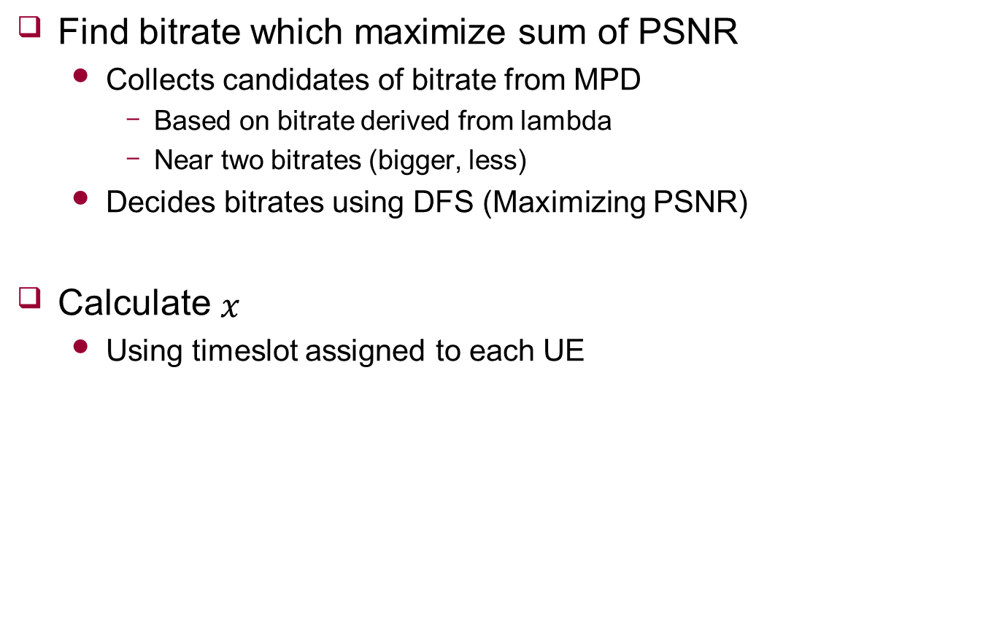
Algorithm
Find bitrate which maximize sum of PSNR
Collects candidates of bitrate from MPD
Based on bitrate derived from lambda
Near two bitrates (bigger, less)
Decides bitrates using DFS (Maximizing PSNR)
Calculate $x$
Using timeslot assigned to each UE

