Slide 1


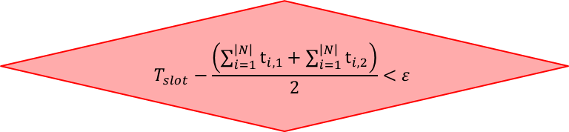
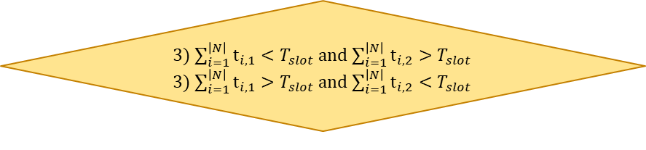
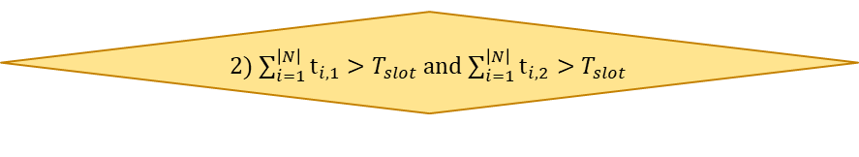


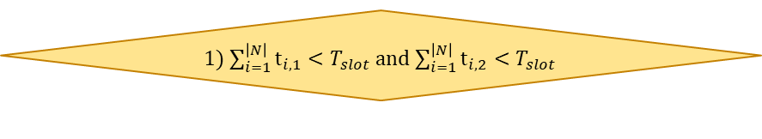

Algorithm
Initialize $x_{ij}$ and $λ$
Calculate Virtual Bandwidth on VAP with $x_{ij}$
Determine $d_{i}(x_{i}^{∗})$ with $λ$
$$T_{slot}−\frac{\left(\sum_{i=1}^{\left|N\right|}{t_{i,1}}+\sum_{i=1}^{\left|N\right|}{t_{i,2}}\right)}{2}<ε$$
1) $\sum_{i=1}^{\left|N\right|}{t_{i,1}}<T_{slot}$ and $\sum_{i=1}^{\left|N\right|}{t_{i,2}}<T_{slot}$
Adjust $λ$
Adjust $x_{ij}$
yes
no
no
yes
2) $\sum_{i=1}^{\left|N\right|}{t_{i,1}}>T_{slot}$ and $\sum_{i=1}^{\left|N\right|}{t_{i,2}}>T_{slot}$
yes
no
3) $\sum_{i=1}^{\left|N\right|}{t_{i,1}}<T_{slot}$ and $\sum_{i=1}^{\left|N\right|}{t_{i,2}}>T_{slot}$
3) $\sum_{i=1}^{\left|N\right|}{t_{i,1}}>T_{slot}$ and $\sum_{i=1}^{\left|N\right|}{t_{i,2}}<T_{slot}$
yes
END

Slide 2


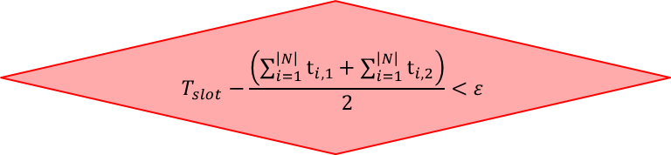



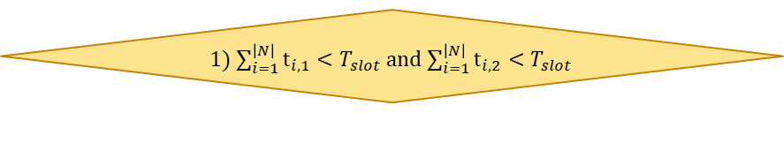

Algorithm
Initialize $x_{ij}$ and $λ$
Determine $d_{i}(x_{i}^{∗})$ with $λ$
Calculate Virtual Bandwidth on VAP with $x_{ij}$
Adjust $x_{ij}$
Adjust $λ$
3) $\sum_{i=1}^{\left|N\right|}{t_{i,1}}<T_{slot}$ and $\sum_{i=1}^{\left|N\right|}{t_{i,2}}>T_{slot}$
3) $\sum_{i=1}^{\left|N\right|}{t_{i,1}}>T_{slot}$ and $\sum_{i=1}^{\left|N\right|}{t_{i,2}}<T_{slot}$
yes
no
2) $\sum_{i=1}^{\left|N\right|}{t_{i,1}}>T_{slot}$ and $\sum_{i=1}^{\left|N\right|}{t_{i,2}}>T_{slot}$
yes
no
$$T_{slot}−\frac{\left(\sum_{i=1}^{\left|N\right|}{t_{i,1}}+\sum_{i=1}^{\left|N\right|}{t_{i,2}}\right)}{2}<ε$$
1) $\sum_{i=1}^{\left|N\right|}{t_{i,1}}<T_{slot}$ and $\sum_{i=1}^{\left|N\right|}{t_{i,2}}<T_{slot}$
yes
END

Slide 3
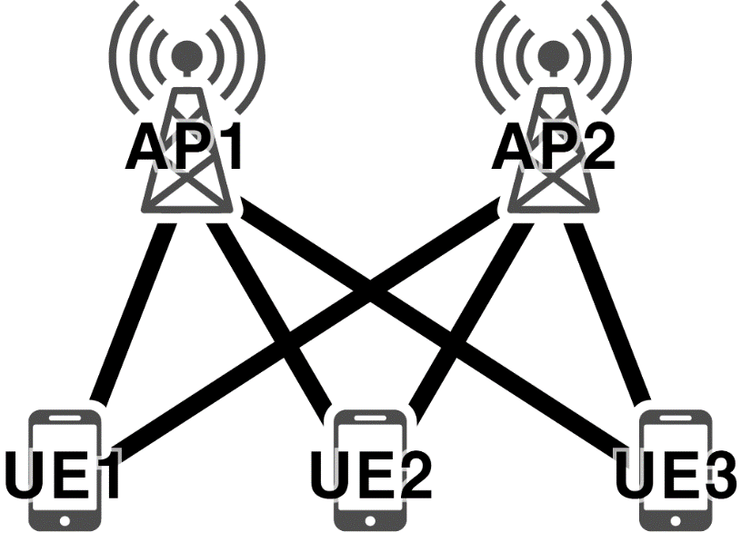

Implementation issue
Adjust $x_{ij}$
AP1: 0.5 + 0.3 + 0.1 = 0.9
AP2: 0.5 + 0.7 + 0.9 = 2.1
0.5
0.5
0.1
0.9
0.3
0.7

Slide 4
Implementation issue
Adjust $x_{ij}$
AP1: 0.5 + 0.3 + 0.1 = 0.9
AP2: 0.5 + 0.7 + 0.9 = 2.1
0.5
0.5
0.1
0.9
0.3
0.7

Slide 5


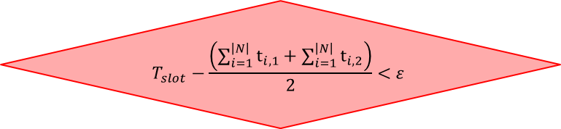


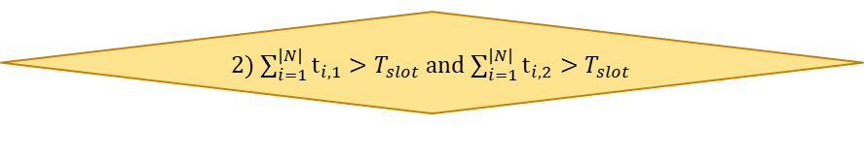


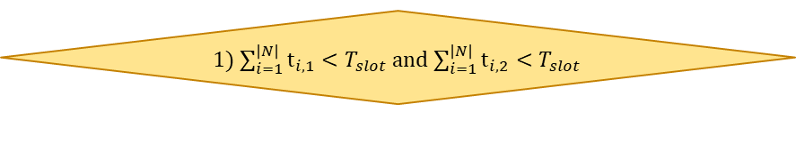

Implementation issue
Infinite loop
It depends on $ε$
Initialize $x_{ij}$ and $λ$
Calculate Virtual Bandwidth on VAP with $x_{ij}$
Determine $d_{i}(x_{i}^{∗})$ with $λ$
$$T_{slot}−\frac{\left(\sum_{i=1}^{\left|N\right|}{t_{i,1}}+\sum_{i=1}^{\left|N\right|}{t_{i,2}}\right)}{2}<ε$$
1) $\sum_{i=1}^{\left|N\right|}{t_{i,1}}<T_{slot}$ and $\sum_{i=1}^{\left|N\right|}{t_{i,2}}<T_{slot}$
Adjust $λ$
Adjust $x_{ij}$
yes
no
no
yes
2) $\sum_{i=1}^{\left|N\right|}{t_{i,1}}>T_{slot}$ and $\sum_{i=1}^{\left|N\right|}{t_{i,2}}>T_{slot}$
yes
no
3) $\sum_{i=1}^{\left|N\right|}{t_{i,1}}<T_{slot}$ and $\sum_{i=1}^{\left|N\right|}{t_{i,2}}>T_{slot}$
3) $\sum_{i=1}^{\left|N\right|}{t_{i,1}}>T_{slot}$ and $\sum_{i=1}^{\left|N\right|}{t_{i,2}}<T_{slot}$
yes
END

