Slide 1
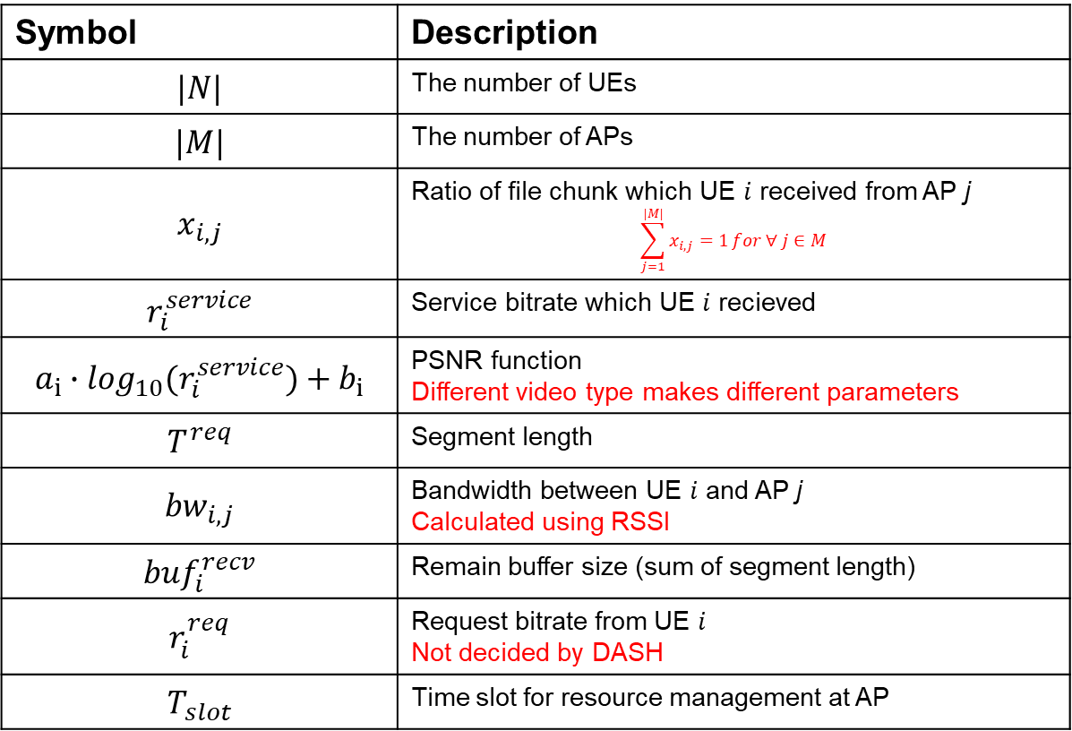
Formulation
Description
Symbol | Description
$$|N|$$ | The number of UEs
$$|M|$$ | The number of APs
$$x_{i,j}$$ | Ratio of file chunk which UE $i$ received from AP j $$\sum_{j=1}^{|M|}{x_{i,j}=1}for ∀ j∈M$$
$$r_{i}^{service}$$ | Service bitrate which UE $i$ recieved
$$a_{i}∙\log_{10}(r_{i}^{service})+b_{i}$$ | PSNR function Different video type makes different parameters
$$T^{req}$$ | Segment length
$${bw}_{i,j}$$ | Bandwidth between UE $i$ and AP j Calculated using RSSI
$${buf}_{i}^{recv}$$ | Remain buffer size (sum of segment length)
$$r_{i}^{req}$$ | Request bitrate from UE $i$ Not decided by DASH
$$T_{slot}$$ | Time slot for resource management at AP

Slide 2
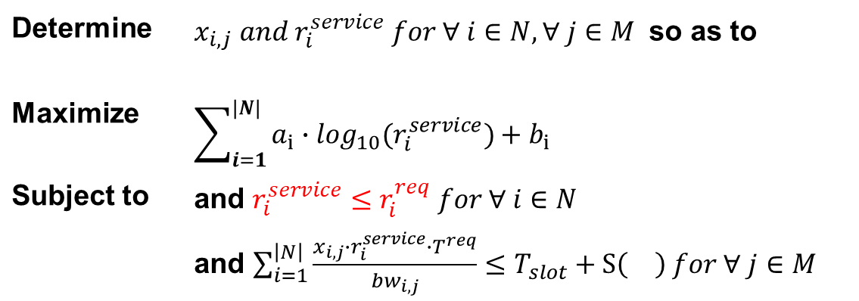
Formulation
Determine | $x_{i,j} and r_{i}^{service} for ∀ i∈N, ∀ j∈M$ so as to
Maximize | $$\sum_{i=1}^{|N|}{a_{i}∙\log_{10}(r_{i}^{service})+b_{i}}$$
Subject to | and $r_{i}^{service}≤r_{i}^{req} for ∀ i∈N$
 | and $\sum_{i=1}^{\left|N\right|}{\frac{x_{i,j}∙r_{i}^{service}∙T^{req}}{{bw}_{i,j}}}≤T_{slot}+S\left(\right) for ∀ j∈M$

