Slide 1
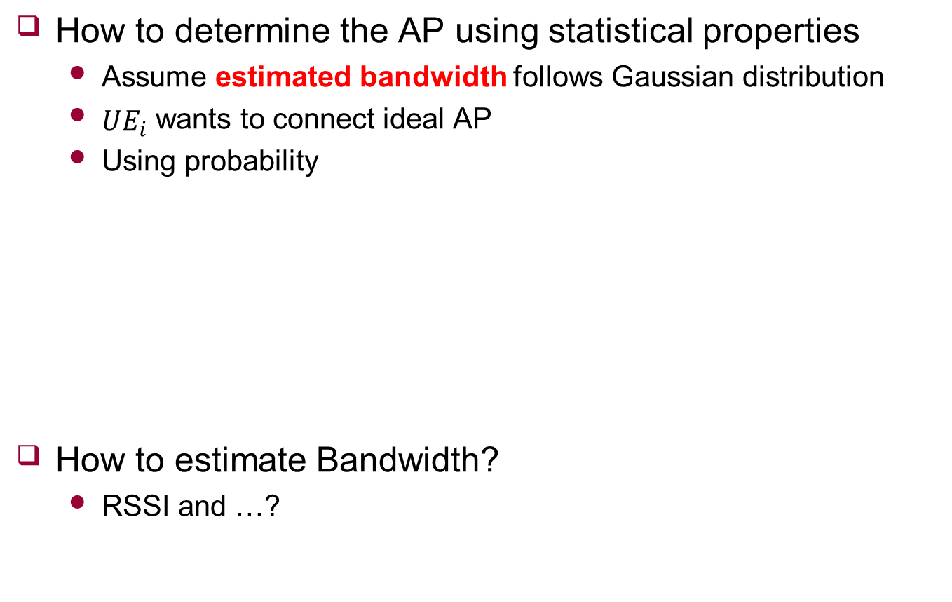




Probability
How to determine the AP using statistical properties
Assume estimated bandwidth follows Gaussian distribution
${UE}_{i}$ wants to connect ideal AP
Using probability
How to estimate Bandwidth?
RSSI and …?
$${AP}_{1}\sim N(μ_{i1}\text{,}σ_{i1}^{2})$$
$${AP}_{2}\sim N(μ_{i2}\text{,}σ_{i2}^{2})$$
$$r_{i}^{req}$$
$$r_{i}^{req}$$

