Slide 1
Research Jae Jun Ha Media Computing and Networking Laboratory POSTCH 2019-11-23
Notes:
발표 시작하겠습니다

Slide 2
Contents
Adaptation
Full Search
Frackable Knapsack Problem

Slide 3
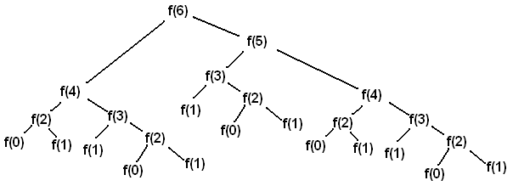
Full Search
File size adaptation
Split into L chunks
Time complexity
It is based on Depth First Search (DFS)
It has an exponential time complexity
def depth_first_search(i):
if i == N:
# do something
return
# connect to APs
depth_first_search(i + 1)
< Example of recursive call >
Recursive call
Notes:
Adaptative하게 조절하는 것을 먼저 Full search에 시도
재귀적으로 호출

Slide 4

Full Search
Time complexity
Original ${(M)}^{N}$
Adaptive ${(M)}^{NL}$
M: # of APs
N: # of UEs
L: # of file units
UEs’ file unit
def depth_first_search(i):
if i == NL:
# do something
return
# connect to APs
depth_first_search(i + 1)

Slide 5

Full Search
Example
Original ${(M)}^{N}$
Unit ${(M)}^{NL}$
M = 3, N = 5, L = 2 ➔ $\frac{{\left(3\right)}^{5∗2}}{{\left(3\right)}^{5}}=243$
M = 3, N = 5, L = 3 ➔ $\frac{{\left(3\right)}^{5∗3}}{{\left(3\right)}^{5}}=59,049$
M = 3, N = 5, L = 4 ➔ $\frac{{\left(3\right)}^{5∗4}}{{\left(3\right)}^{5}}=14,348,907$
…
 | 1 | 2 | 3 | 4 | 5 | 6 | 7 | 8 | 9 | 10 | avg
Original | 0.21984 | 0.20659 | 0.55644 | 0.35192 | 0.04078 | 0.03911 | 0.54944 | 0.15173 | 0.08095 | 0.03308 | 0.22299
Unit | 41.65202 | 56.51021 | 144.04396 | 85.69934 | 10.05589 | 8.21138 | 153.57816 | 40.70983 | 18.23895 | 5.06443 | 56.37642
252배

Slide 6
Frackable Knapsack Problem
Basic idea
High “value / weight” first
Resource
RSSI + Timeslot
Consider both Physical and Network layer

Slide 7
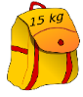
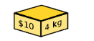
Frackable Knapsack Problem
Frackable Knapsack
To apply the algorithm, must look sequentially
Computer can't solve the problem parallel
The result of ① affects the result of ②, ③, ④
Timeslot
④
①
②
③

Slide 8

Frackable Knapsack Problem
Frackable Knapsack
Need to consider timeslot (congestion)
Find the timeslot to be assigned to each AP
Sometimes, need to adjust bitrate
BW
1Mbps
BW
100Kbps
BW를 많이 support할 수 있는
AP의 Time slot이 충분하지 않을 경우
$$\left\{\begin{aligned}\begin{matrix}{max(t}_{a,}\frac{t∗{bw}_{a}∗t_{a}∗K_{a}}{\left({bw}_{a}+{bw}_{b}\right)∗(t_{a}+t_{b})}) & AP a\end{matrix} \\ \begin{matrix}t−{max(t}_{a,}\frac{t∗{bw}_{b}∗t_{b}∗K_{b}}{({bw}_{a}+{bw}_{b})∗(t_{a}+t_{b})}) & AP b\end{matrix}\end{aligned}\right.$$
$$\frac{{bw}_{a}∗t_{a}∗K_{a}}{\left({bw}_{a}+{bw}_{b}\right)∗(t_{a}+t_{b})}+\frac{{bw}_{b}∗t_{b}∗K_{b}}{\left({bw}_{a}+{bw}_{b}\right)∗(t_{a}+t_{b})}=1$$
quantization
L units
Notes:
RSSI (UE 입장)와 Timeslot (AP 입장)
쪼개는 것 어떻게?

Slide 9


Frackable Knapsack Problem
Greedy
Test
PSNR: Adaptive < Greedy
Time: Adaptive < Greedy
Gain
I think we need to look at the real testbed
Notes:
RSSI (UE 입장)와 Timeslot (AP 입장)
쪼개는 것 어떻게?

Slide 10
Future Work
Show real testbed result
Improve algorithm
Test according to L size

