Slide 1
How Much Can Visual Quality of HTTP Adaptive Streaming Be Improved By Cooperative SDN-enabled WiFi APs? Jae Jun Ha Media Computing and Networking Laboratory POSTCH 2020-06-13
Notes:
제목에 관한 문의

Slide 2
Contents
Introduction
Proposed Video Streaming Service
System Architecture
Problem Description
Proposed Algorithm
Experimental Results
Experimental Environments
Performance Verification of Proposed System
Performance Comparison with Other Algorithms
Conclusion
Notes:
30초

Slide 3
Introduction

Slide 4
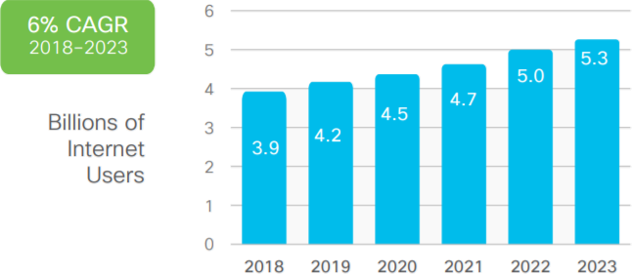
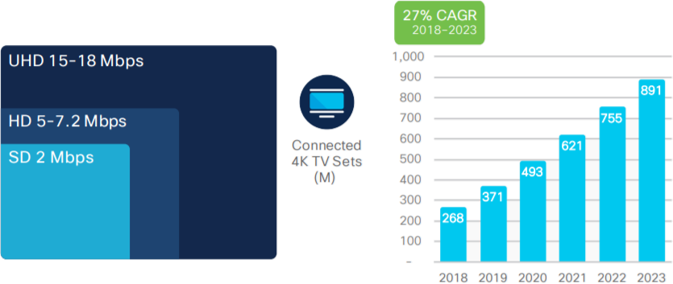
Introduction
Trend of traffic
The total number of Internet users is expected to increase from 3.9 billion in 2018 to 5.3 billion in 2023.
Video streaming had heavy effect on traffic
Over time, clients want higher quality video streaming.
< https://www.cisco.com/c/en/us/solutions/collateral/executive-perspectives/annual-internet-report/white-paper-c11-741490.html >
Notes:
30초
인터넷 사용자 증가 → traffic 증가 → bandwidth 관리 필요
특히 고품질의 비디오 스트링 서비스 요청 증가 (더 많은 대역폭이 필요)

Slide 5








Introduction
DASH (Dynamic Adaptive Streaming over HTTP)
It is one of the adaptive bitrate streaming technologies that enables high quality streaming of media over the Internet, delivered from a traditional HTTP web server.
Several encoding bitrate
500 Kbps
1 Mbps
10 Mbps
10 Mbps
DASH Client
1 Mbps
Video
DASH Server
500 Kbps
DASH Client
Video Segments
DASH Client
Notes:
1분
이러한 video traffic을 다루기 위한 기술로써 DASH가 있습니다.
세그먼트 잘게 쪼개 저장하는 것 설명

Slide 6
Introduction
Problem of DASH
However, DASH streaming has big issue.
Because this streaming technology considers each client situation, not the overall client, it causes unfairness of the overall resource usage.
480p
480p
1080p
144p
< Ideal case >
< A specific client preempts resource >
Notes:
1분
전체가 아닌 각 클라이언트 상황만 고려 → 자원 사용의 불공정성

Slide 7
Introduction
SDN (Software Defined Networking)
SDN is composed of a structure that separates data planes and control planes of network equipment. It connects controllers and network equipment using Open Flow API.
Through the centralized structure on the controller, overall network is controlled. It enables efficient use of the network.
Clients
SDN
Network
Applications
Controller
API
OpenFlow Control
Network
Applications
Network Fabric
Notes:
1분

Slide 8
Introduction
Warning
SDN enabled DASH can only be used in private networks
Bitrate adjustment is against network neutrality
This system intervenes end-to-end
It can be used with permission
Notes:
30초
해당 시스템에서는 SDN을 이용해서 bitrate를 전체적인 관점에서 제어하려고 한다.
그런데 SDN을 사용시 주의할 점이 있다.

Slide 9


Introduction
Multiple Wi-Fi connection
The wireless network situation is changing rapidly. So, it is necessary to use the resource according to the situation.
Through multiple interfaces, chunks can be received differently depending on the unstable wireless network situation.
Network B
Network A
Notes:
30초

Slide 10
Proposed Video Streaming Service
System Architecture

Slide 11
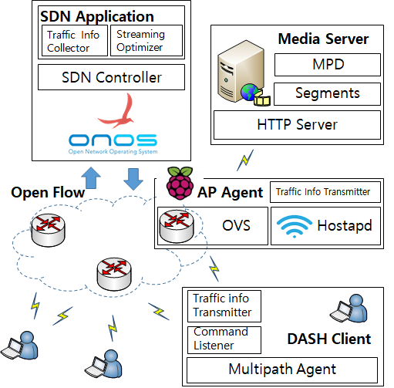
System Architecture
The system consists of four elements.
Notes:
3분

Slide 12
System Architecture
SDN Application periodically collects resource information.
Based on the collected resources, the bitrate and delivery ratio of the client are determined.
Notes:
3분

Slide 13
System Architecture
Media Server keeps MPD (Media Presentation Description) and videos.
it keeps the videos in segment units according to the encoding rate.
Notes:
3분

Slide 14
System Architecture
AP agent periodically provides resource information to SDN application.
Notes:
3분

Slide 15
System Architecture
DASH Client is a client that receives video streaming.
DASH Client connects to multiple APs using multiple interfaces.
Bitrate and delivery ratio are controlled by SDN Application.
Notes:
3분

Slide 16
Proposed Video Streaming Service
Problem Description

Slide 17
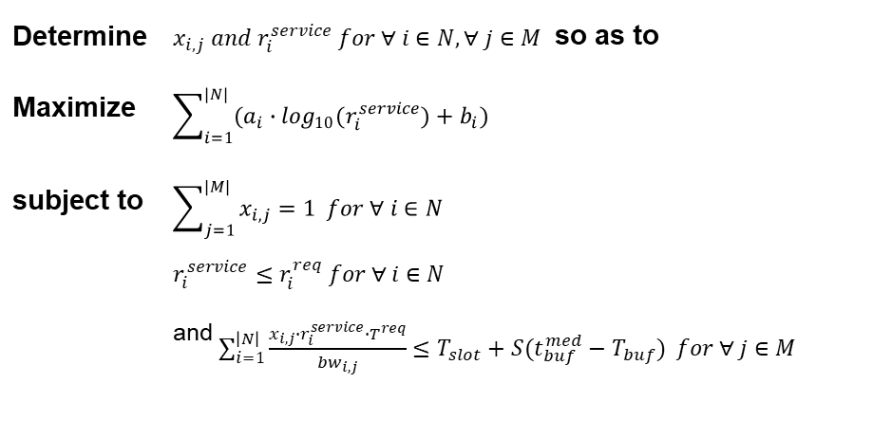
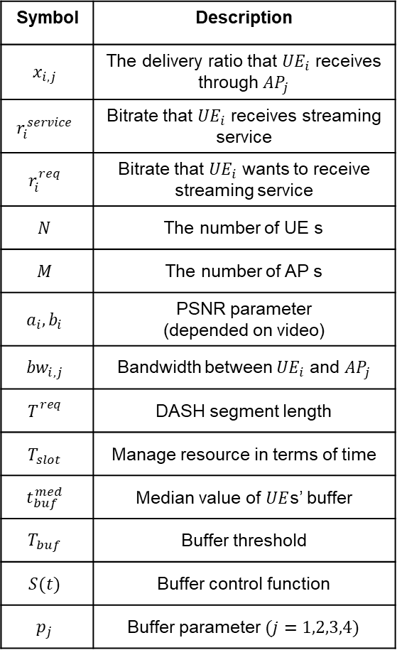
Problem Description
Problem Formulation
Symbol | Description
$$x_{i,j}$$ | The delivery ratio that ${UE}_{i}$ receives through ${AP}_{j}$
$$r_{i}^{service}$$ | Bitrate that ${UE}_{i}$ receives streaming service
$$r_{i}^{req}$$ | Bitrate that ${UE}_{i}$ wants to receive streaming service
$$N$$ | The number of UE s
$$M$$ | The number of AP s
$$a_{i},b_{i}$$ | PSNR parameter (depended on video)
$${bw}_{i,j}$$ | Bandwidth between ${UE}_{i}$ and ${AP}_{j}$
$$T_{}^{req}$$ | DASH segment length
$$T_{slot}$$ | Manage resource in terms of time
$$t_{buf}^{med}$$ | Median value of $UE$s’ buffer
$$T_{buf}$$ | Buffer threshold
$$S(t)$$ | Buffer control function
$$p_{j}$$ | Buffer parameter $(j=1,2,3,4)$
Determine | $x_{i,j} and r_{i}^{service} for ∀ i∈N, ∀ j∈M$ so as to
Maximize | $$\sum_{i=1}^{|N|}{(a_{i}∙\log_{10}(r_{i}^{service})+b_{i})}$$
subject to | $$\sum_{j=1}^{|M|}{x_{i,j}}=1 for ∀ i∈N$$
 | $$r_{i}^{service}≤r_{i}^{req} for ∀ i∈N$$
 | and $\sum_{i=1}^{\left|N\right|}{\frac{x_{i,j}∙r_{i}^{service}∙T^{req}}{{bw}_{i,j}}≤T_{slot}+S(t_{buf}^{med}−T_{buf})} for ∀ j∈M$
( $S\left(t\right)=p_{1}∙t^{3}+p_{2}∙t^{2}+p_{3}∙t+p_{4}$ )
Notes:
Proportional Fairness 보장하기 위해 Log 함수 사용
Underflow 발생을 막기 위해 Buffer occupancy 조절하기 위한 함수
Threshold보다 작으면 / 크면
여기서 람다 얘기를 해야함
해당 연구에서는 bitrate를 Lagrange Multiplier로 사용해서 구한다.

Slide 18
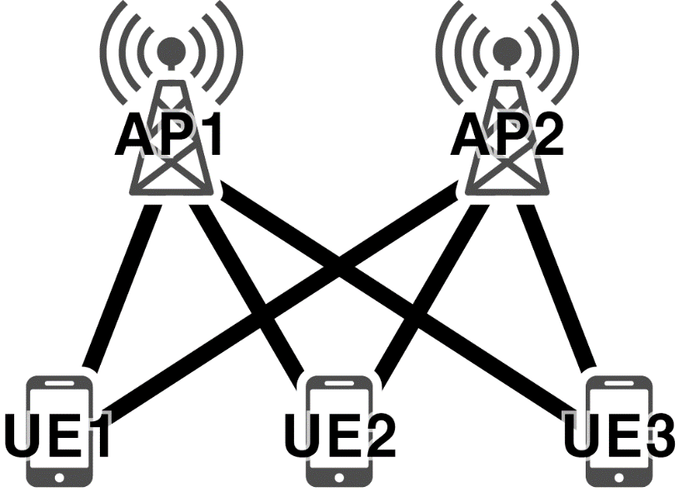
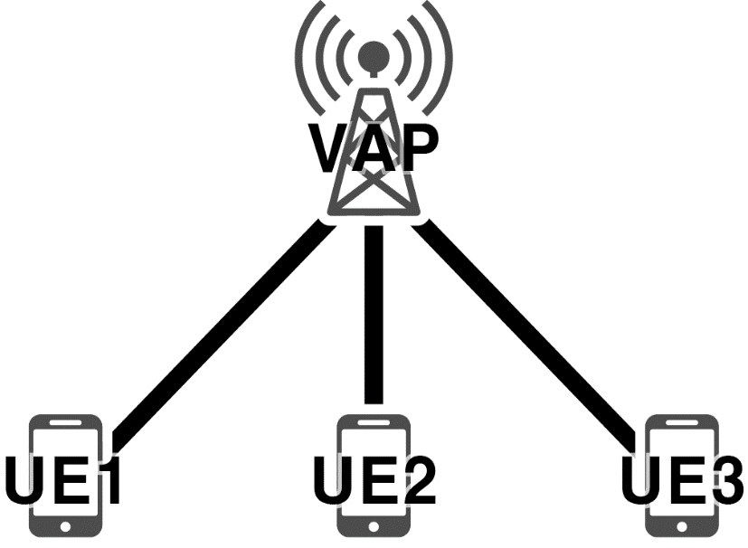
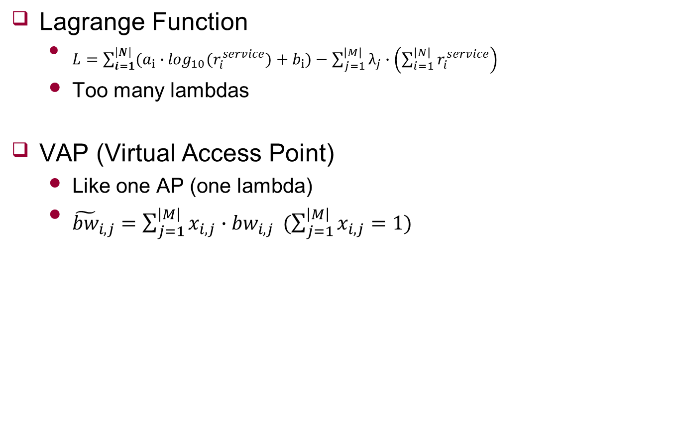
Problem Description
Lagrange Function
$L=\sum_{i=1}^{|N|}{(a_{i}∙\log_{10}(r_{i}^{service})+b_{i})}−\sum_{j=1}^{\left|M\right|}{λ_{j}∙\left(\sum_{i=1}^{\left|N\right|}{r_{i}^{service}}\right)}$
Too many lambdas
VAP (Virtual Access Point)
Like one AP (one lambda)
${\tilde{bw}}_{i,j}=\sum_{j=1}^{\left|M\right|}{x_{i,j}∙{bw}_{i,j}} (\sum_{j=1}^{\left|M\right|}{x_{i,j}}=1)$
Notes:
2분
Optimal solution 풀기 위해 Lagrange Multiplier 사용 한다는 것 설명
Lagrange Multiplier를 사용할 경우 AP 하나당 람다가 생긴다
여러 람다가 생길 경우 람다 간에 dependency가 생겨 복잡 해져서 람다 값들을 구할 수 없다.
그래서 $x_{i,j}$ 값을 정한다.

Slide 19
Proposed Video Streaming Service
Proposed Algorithm

Slide 20











Algorithm
Request with $r_{i}^{req}$
Over AP’s timeslot
Provide streaming $r_{i}^{service}$ with $r_{i}^{req}$
no
yes
Initialize $x_{i,j}$ and $λ$
Determine $d_{i}(x_{i}^{∗})$ with $λ$
Calculate Virtual Bandwidth on VAP with $x_{i,j}$
Adjust $x_{i,j}$
Adjust $λ$
$t_{1}≤T_{slot}$ and $t_{2}>T_{slot}$
$t_{1}>T_{slot}$ and $t_{2}≤T_{slot}$
yes
no
$t_{1}>T_{slot}$ and $t_{2}>T_{slot}$
yes
no
$t_{1}≤T_{slot}$ and $t_{2}≤T_{slot}$
$$\left|λ−λ_{pre}\right|<ε$$
yes
END
Notes:
2분

Slide 21

Algorithm
Request with $r_{i}^{req}$
Over AP’s timeslot
Provide streaming $r_{i}^{service}$ with $r_{i}^{req}$
no
yes
Normal
Initialize $x_{i,j}$ and $λ$
Determine $d_{i}(x_{i}^{∗})$ with $λ$
Calculate Virtual Bandwidth on VAP with $x_{i,j}$
Adjust $x_{i,j}$
Adjust $λ$
$t_{1}≤T_{slot}$ and $t_{2}>T_{slot}$
$t_{1}>T_{slot}$ and $t_{2}≤T_{slot}$
yes
no
$t_{1}>T_{slot}$ and $t_{2}>T_{slot}$
yes
no
$t_{1}≤T_{slot}$ and $t_{2}≤T_{slot}$
$$\left|λ−λ_{pre}\right|<ε$$
yes
END
Notes:
2분

Slide 22
Algorithm
Request with $r_{i}^{req}$
Over AP’s timeslot
Provide streaming $r_{i}^{service}$ with $r_{i}^{req}$
no
yes
Initialize $x_{i,j}$ and $λ$
Congestion
Determine $d_{i}(x_{i}^{∗})$ with $λ$
Calculate Virtual Bandwidth on VAP with $x_{i,j}$
Adjust $x_{i,j}$
Adjust $λ$
$t_{1}≤T_{slot}$ and $t_{2}>T_{slot}$
$t_{1}>T_{slot}$ and $t_{2}≤T_{slot}$
yes
no
$t_{1}>T_{slot}$ and $t_{2}>T_{slot}$
yes
no
$t_{1}≤T_{slot}$ and $t_{2}≤T_{slot}$
$$\left|λ−λ_{pre}\right|<ε$$
yes
END
Notes:
2분

Slide 23


Algorithm
Request with $r_{i}^{req}$
Over AP’s timeslot
Provide streaming $r_{i}^{service}$ with $r_{i}^{req}$
no
yes
Initialize $x_{i,j}$ and $λ$
$λ$ Adjustment
Determine $d_{i}(x_{i}^{∗})$ with $λ$
$x_{i,j}$ Adjustment
Calculate Virtual Bandwidth on VAP with $x_{i,j}$
Adjust $x_{i,j}$
Adjust $λ$
$t_{1}≤T_{slot}$ and $t_{2}>T_{slot}$
$t_{1}>T_{slot}$ and $t_{2}≤T_{slot}$
yes
no
$t_{1}>T_{slot}$ and $t_{2}>T_{slot}$
yes
no
$t_{1}≤T_{slot}$ and $t_{2}≤T_{slot}$
$$\left|λ−λ_{pre}\right|<ε$$
yes
END
Notes:
2분
Inner loop
Out loop

Slide 24
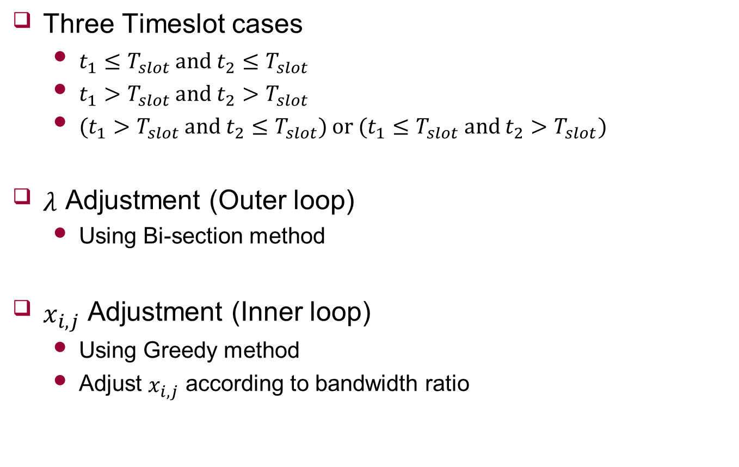


Algorithm
Three Timeslot cases
$t_{1}≤T_{slot}$ and $t_{2}≤T_{slot}$
$t_{1}>T_{slot}$ and $t_{2}>T_{slot}$
$(t_{1}>T_{slot}$ and $t_{2}≤T_{slot})$ or $(t_{1}≤T_{slot}$ and $t_{2}>T_{slot})$
$λ$ Adjustment (Outer loop)
Using Bi-section method
$x_{i,j}$ Adjustment (Inner loop)
Using Greedy method
Adjust $x_{i,j}$ according to bandwidth ratio
$λ$ Adjustment
$x_{i,j}$ Adjustment
Notes:
1분
Timeslot 설명하고

Slide 25

Algorithm
$λ$ Adjustment (Outer loop)

Slide 26

Algorithm
$x_{i,j}$ Adjustment (Inner loop)

Slide 27
Experimental Results
Experimental Environment

Slide 28
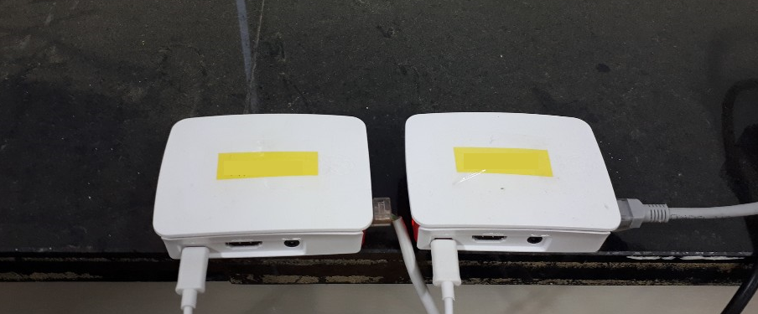
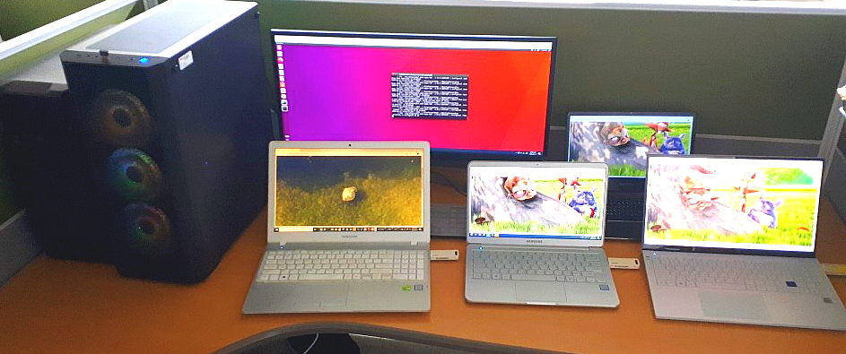
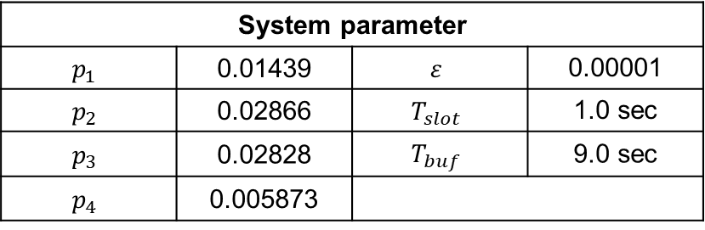
Experimental Environment
Device
SDN Controller
Ubuntu 16.04
ONOS 1.13.0
Media Server
Window 10
Python3 webserver
Access Point
Ubuntu 16.04
Raspberry PI3
Hostapd
DASH Clients
Window 10
Palcon Proxy
Access
Point
Media
Server
SDN
Controller
DASH
Clients
System parameter
$$p_{1}$$ | 0.01439 | $$ε$$ | 0.00001
$$p_{2}$$ | 0.02866 | $$T_{slot}$$ | 1.0 sec
$$p_{3}$$ | 0.02828 | $$T_{buf}$$ | 9.0 sec
$$p_{4}$$ | 0.005873

Slide 29
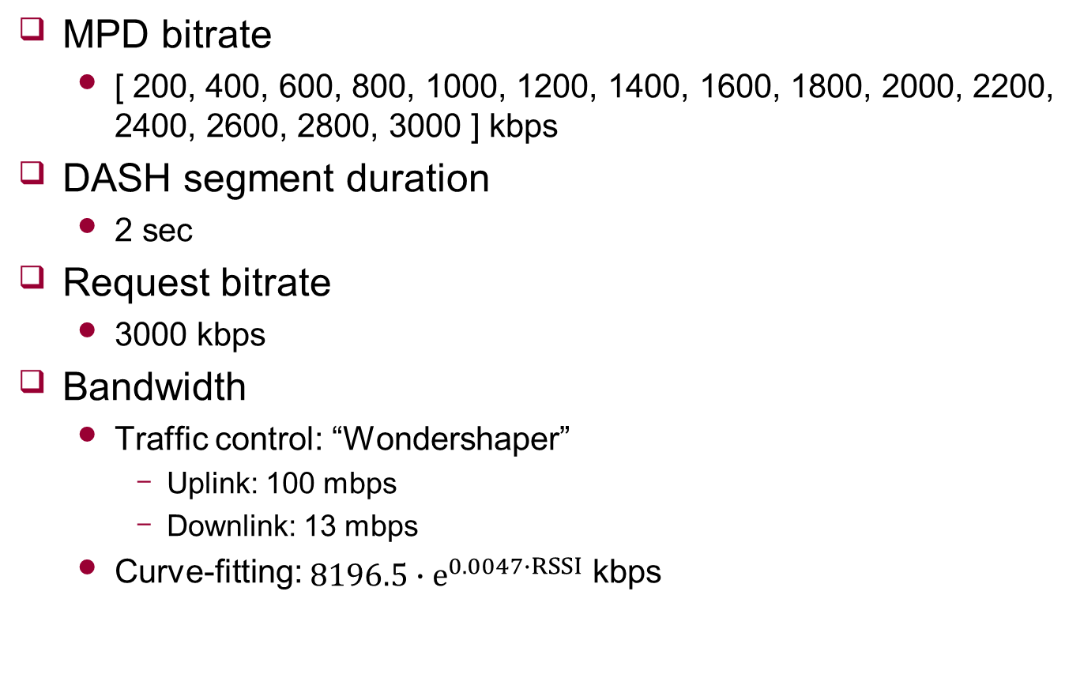
Experimental Environment
MPD bitrate
[ 200, 400, 600, 800, 1000, 1200, 1400, 1600, 1800, 2000, 2200, 2400, 2600, 2800, 3000 ] kbps
DASH segment duration
2 sec
Request bitrate
3000 kbps
Bandwidth
Traffic control: “Wondershaper”
Uplink: 100 mbps
Downlink: 13 mbps
Curve-fitting: $8196.5∙e^{0.0047∙RSSI}$ kbps
Notes:
Frozen이 발생하는 조건 찾으면서 traffic control과 timeslot 값 정함

Slide 30


Experimental Environment
Situation
Three cases
Scenario 1
Scenario 2
Scenario 3
< single >
< multi >

Slide 31
Experimental Results
Performance Comparison of Other Algorithms

Slide 32
Performance Comparison with Other Algorithms
DASH.js
Decide AP based on strong RSSI
Decide bitrate based on download throughput
Non cooperative SDN enabled DASH
Decide AP based on strong RSSI
Same algorithm when decide bitrates

Slide 33
Performance Comparison with Other Algorithms
Same video
UE1: Big Buck Bunny
UE2: Big Buck Bunny
UE3: Big Buck Bunny
UE4: Big Buck Bunny

Slide 34
Performance Comparison with Other Algorithms
Scenario 1
Bitrate
PSNR
Case Device | Cooperative SDN enabled DASH |  | Non cooperative SDN enabled DASH |  | DASH.js
 | Avg | Std | Avg | Std | Avg | Std
UE 1 | 1617.82 | 109.36 | 837.62 | 100.35 | 656 | 724.23
UE 2 | 1631.37 | 124.44 | 825.74 | 77.91 | 894 | 806.77
UE 3 | 1611.88 | 100.78 | 829.70 | 86.22 | 896 | 926.15
UE 4 | 1613.86 | 94.43 | 851.49 | 103.99 | 942 | 972.47
Total | 1618.77 | 108.15 | 836.14 | 93.24 | 847 | 866.66
Case Device | Cooperative SDN enabled DASH |  | Non cooperative SDN enabled DASH |  | DASH.js
 | Avg | Std | Avg | Std | Avg | Std
UE 1 | 43.43 | 3.96 | 40.39 | 3.89 | 36.80 | 5.32
UE 2 | 43.44 | 3.97 | 40.33 | 3.94 | 38.16 | 6.29
UE 3 | 43.40 | 3.97 | 40.35 | 3.91 | 37.67 | 6.30
UE 4 | 43.41 | 3.97 | 40.48 | 3.94 | 37.55 | 6.62
Total | 43.42 | 3.97 | 40.39 | 3.91 | 37.55 | 6.15

Slide 35

Performance Comparison with Other Algorithms
Buffer state (-: consumed, -: received / y: bytes($×{10}^{6}$), x: time)
UE 1
UE 2
UE 3
UE 4
Cooperative SDN enabled DASH
Non cooperative SDN enabled DASH
DASH.js
Notes:
초반 구간은 확인 결과 버퍼를 다 못 채우는 경향

Slide 36
Performance Comparison with Other Algorithms
Scenario 2
Bitrate
PSNR
Case Device | Cooperative SDN enabled DASH |  | Non cooperative SDN enabled DASH |  | DASH.js
 | Avg | Std | Avg | Std | Avg | Std
UE 1 | 1598.02 | 65.97 | 1063.37 | 93.05 | 1292 | 731.08
UE 2 | 1592.08 | 48.10 | 1075.25 | 122.20 | 1142 | 750.11
UE 3 | 1598.02 | 92.14 | 3000.00 | 0.00 | 3000 | 0
UE 4 | 1611.76 | 52.62 | 1071.29 | 95.79 | 1112 | 658.32
Total | 1600.00 | 67.40 | 1552.48 | 840.63 | 1636.5 | 1002.84
Case Device | Cooperative SDN enabled DASH |  | Non cooperative SDN enabled DASH |  | DASH.js
 | Avg | Std | Avg | Std | Avg | Std
UE 1 | 43.37 | 3.96 | 41.52 | 3.81 | 41.23 | 5.26
UE 2 | 43.35 | 3.91 | 41.56 | 3.89 | 40.45 | 5.66
UE 3 | 43.43 | 3.92 | 45.85 | 3.99 | 45.85 | 4.01
UE 4 | 43.37 | 3.93 | 41.55 | 3.77 | 40.64 | 5.74
Total | 43.38 | 3.93 | 42.62 | 4.29 | 42.04 | 5.65

Slide 37
Performance Comparison with Other Algorithms
Buffer state (-: consumed, -: received / y: bytes($×{10}^{6}$), x: time)
UE 1
UE 2
UE 3
UE 4
Cooperative SDN enabled DASH
Non cooperative SDN enabled DASH
DASH.js
Notes:
초반 구간은 확인 결과 버퍼를 다 못 채우는 경향

Slide 38
Performance Comparison with Other Algorithms
Scenario 3
Bitrate
PSNR
Case Device | Cooperative SDN enabled DASH |  | Non cooperative SDN enabled DASH |  | DASH.js
 | Avg | Std | Avg | Std | Avg | Std
UE 1 | 1598.02 | 65.97 | 1580.20 | 170.04 | 1852 | 711.02
UE 2 | 1598.02 | 71.73 | 1580.20 | 71.78 | 1378 | 664.17
UE 3 | 1590.10 | 65.26 | 1603.96 | 68.82 | 1630 | 767.72
UE 4 | 1590.10 | 71.07 | 1596.04 | 112.51 | 1474 | 728.44
Total | 1594.06 | 68.68 | 1590.10 | 113.89 | 1583.5 | 738.23
Case Device | Cooperative SDN enabled DASH |  | Non cooperative SDN enabled DASH |  | DASH.js
 | Avg | Std | Avg | Std | Avg | Std
UE 1 | 43.37 | 3.91 | 43.25 | 3.91 | 43.34 | 4.43
UE 2 | 43.37 | 3.96 | 43.33 | 3.93 | 41.89 | 5.43
UE 3 | 43.34 | 3.90 | 43.38 | 3.93 | 42.50 | 5.61
UE 4 | 43.36 | 3.94 | 43.37 | 3.94 | 42.20 | 4.97
Total | 43.36 | 3.93 | 43.33 | 3.93 | 42.48 | 5.14

Slide 39
Performance Comparison with Other Algorithms
Buffer state (-: consumed, -: received / y: bytes($×{10}^{6}$), x: time)
UE 1
UE 2
UE 3
UE 4
Cooperative SDN enabled DASH
Non cooperative SDN enabled DASH
DASH.js
Notes:
초반 구간은 확인 결과 버퍼를 다 못 채우는 경향

Slide 40
Performance Comparison with Other Algorithms
Different video
UE1: Big Buck Bunny
UE2: Big Buck Bunny
UE3: Sintel
UE4: Elephant Dream

Slide 41
Performance Comparison with Other Algorithms
Scenario 1
Bitrate
PSNR
Case Device | Cooperative SDN enabled DASH |  | Non cooperative SDN enabled DASH |  | DASH.js
 | Avg | Std | Avg | Std | Avg | Std
UE 1 | 1724.75 | 217.73 | 881.19 | 141.22 | 944 | 756.43
UE 2 | 1742.57 | 218.61 | 902.97 | 133.84 | 844 | 742.68
UE 3 | 1366.34 | 237.26 | 687.13 | 139.07 | 808 | 762.73
UE 4 | 1578.22 | 212.30 | 788.12 | 111.95 | 718 | 811.08
Total | 1602.97 | 268.09 | 814.85 | 157.26 | 828.5 | 770.05
Case Device | Cooperative SDN enabled DASH |  | Non cooperative SDN enabled DASH |  | DASH.js
 | Avg | Std | Avg | Std | Avg | Std
UE 1 | 43.71 | 4.18 | 40.64 | 4.17 | 38.93 | 6.49
UE 2 | 43.74 | 4.15 | 40.74 | 4.02 | 38.28 | 6.05
UE 3 | 42.57 | 3.71 | 43.82 | 4.16 | 41.90 | 5.60
UE 4 | 43.24 | 3.80 | 37.63 | 6.89 | 34.97 | 7.70
Total | 43.53 | 4.00 | 40.71 | 5.42 | 38.52 | 6.94

Slide 42
Performance Comparison with Other Algorithms
Buffer state (-: consumed, -: received / y: bytes($×{10}^{6}$), x: time)
UE 1
UE 2
UE 3
UE 4
Cooperative SDN enabled DASH
Non cooperative SDN enabled DASH
DASH.js
Notes:
초반 구간은 확인 결과 버퍼를 다 못 채우는 경향

Slide 43
Performance Comparison with Other Algorithms
Scenario 2
Bitrate
PSNR
Case Device | Cooperative SDN enabled DASH |  | Non cooperative SDN enabled DASH |  | DASH.js
 | Avg | Std | Avg | Std | Avg | Std
UE 1 | 1770.30 | 224.07 | 1148.51 | 136.88 | 986 | 511.09
UE 2 | 1776.24 | 209.26 | 1156.44 | 133.81 | 1180 | 662.72
UE 3 | 1384.16 | 206.21 | 3000.00 | 0.00 | 2946 | 89.24
UE 4 | 1603.96 | 245.32 | 1039.60 | 171.24 | 1266 | 699.82
Total | 1633.66 | 273.33 | 1586.14 | 827.62 | 1594.5 | 958.10
Case Device | Cooperative SDN enabled DASH |  | Non cooperative SDN enabled DASH |  | DASH.js
 | Avg | Std | Avg | Std | Avg | Std
UE 1 | 43.81 | 4.17 | 41.90 | 4.06 | 40.39 | 5.62
UE 2 | 43.82 | 4.14 | 41.93 | 4.06 | 40.93 | 5.14
UE 3 | 46.02 | 3.82 | 48.25 | 3.70 | 48.20 | 3.69
UE 4 | 40.73 | 7.79 | 38.77 | 6.86 | 38.85 | 8.23
Total | 43.60 | 5.57 | 42.71 | 5.94 | 42.09 | 6.90

Slide 44
Performance Comparison with Other Algorithms
Buffer state (-: consumed, -: received / y: bytes($×{10}^{6}$), x: time)
UE 1
UE 2
UE 3
UE 4
Cooperative SDN enabled DASH
Non cooperative SDN enabled DASH
DASH.js
Notes:
초반 구간은 확인 결과 버퍼를 다 못 채우는 경향

Slide 45
Performance Comparison with Other Algorithms
Scenario 3
Bitrate
PSNR
Case Device | Cooperative SDN enabled DASH |  | Non cooperative SDN enabled DASH |  | DASH.js
 | Avg | Std | Avg | Std | Avg | Std
UE 1 | 1778.22 | 198.81 | 1679.21 | 195.15 | 1854 | 616.84
UE 2 | 1780.20 | 215.27 | 1782.18 | 207.00 | 1702 | 537.48
UE 3 | 1384.16 | 234.94 | 1382.18 | 180.43 | 1642 | 669.87
UE 4 | 1592.08 | 225.01 | 1520.79 | 186.85 | 1400 | 779.02
Total | 1633.66 | 272.97 | 1591.09 | 245.59 | 1649.5 | 674.38
Case Device | Cooperative SDN enabled DASH |  | Non cooperative SDN enabled DASH |  | DASH.js
 | Avg | Std | Avg | Std | Avg | Std
UE 1 | 43.83 | 4.17 | 43.59 | 4.15 | 43.47 | 4.15
UE 2 | 43.83 | 4.15 | 43.84 | 4.17 | 43.30 | 4.91
UE 3 | 46.05 | 3.73 | 46.02 | 3.78 | 45.90 | 4.42
UE 4 | 40.73 | 7.75 | 40.52 | 7.79 | 39.07 | 8.13
Total | 43.61 | 5.54 | 43.49 | 5.59 | 42.94 | 6.13

Slide 46
Performance Comparison with Other Algorithms
Buffer state (-: consumed, -: received / y: bytes($×{10}^{6}$), x: time)
UE 1
UE 2
UE 3
UE 4
Cooperative SDN enabled DASH
Non cooperative SDN enabled DASH
DASH.js
Notes:
초반 구간은 확인 결과 버퍼를 다 못 채우는 경향

Slide 47
Conclusion

Slide 48
Conclusion
We proposed HTTP adaptive video streaming service over cooperative SDN-enabled Wi-Fi networks
Existing DASH has a resource monopoly problem, causing unfairness of the overall resource
SDN & multi interface can manage resources in terms of overall view
Proposed bitrate and delivery ratio allocation
Increases video quality
Prevent buffer underflow

Slide 49
Experimental Results
Performance Verification of Proposed System

Slide 50
Appendix
Request with $r_{i}^{req}$
Over AP’s timeslot
Provide streaming $r_{i}^{service}$ with $r_{i}^{req}$
no
yes
Initialize $x_{i,j}$ and $λ$
Determine $d_{i}(x_{i}^{∗})$ with $λ$
Calculate Virtual Bandwidth on VAP with $x_{i,j}$
Adjust $x_{i,j}$
Adjust $λ$
$t_{1}≤T_{slot}$ and $t_{2}>T_{slot}$
$t_{1}>T_{slot}$ and $t_{2}≤T_{slot}$
yes
no
$t_{1}>T_{slot}$ and $t_{2}>T_{slot}$
yes
no
$t_{1}≤T_{slot}$ and $t_{2}≤T_{slot}$
$$\left|λ−λ_{pre}\right|<ε$$
yes
END

