Slide 1
Research Jae Jun Ha Media Computing and Networking Laboratory POSTCH 2020-01-21
Notes:
발표 시작하겠습니다

Slide 2
Contents
Algorithm
Comparison

Slide 3
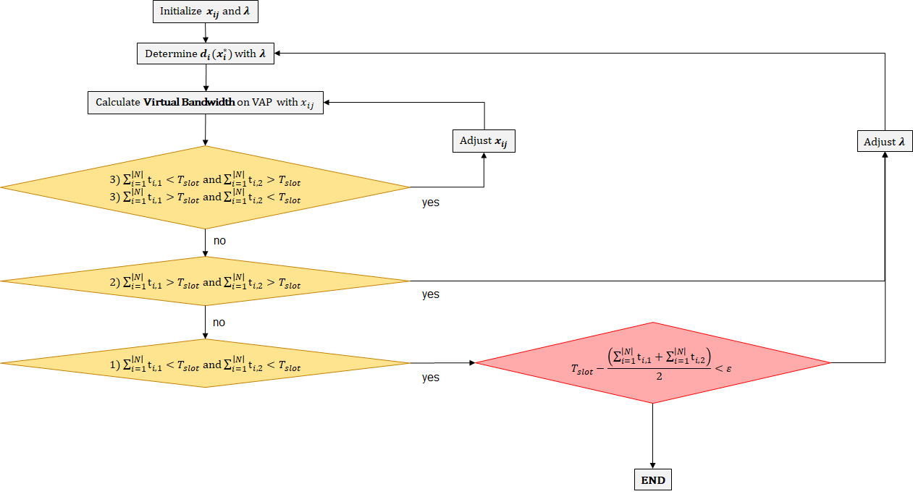
Algorithm
Loop
Notes:
전체적인 알고리즘 구조는 이렇다

Slide 4


Algorithm
Loop
Outer: adjust λ
Inner: adjust $x_{ij}$
λ
$$x_{ij}$$
Notes:
바깥쪽은 λ를 조절
안쪽은 $x_{ij}$를 조절

Slide 5
Algorithm
Loop
Outer: adjust λ
Inner: adjust $x_{ij}$
Notes:
λ를 안쪽에서 조절하게 되면 종료 조건을 자주 검사하게 되는데
컴퓨터에서 if 문은 알고리즘에서 시간을 많이 잡아먹는다
그 예로 코드 최적화를 할 때 for문에서 조건 검사를 최소화 하기 위해 풀어쓰기도 한다.

Slide 6
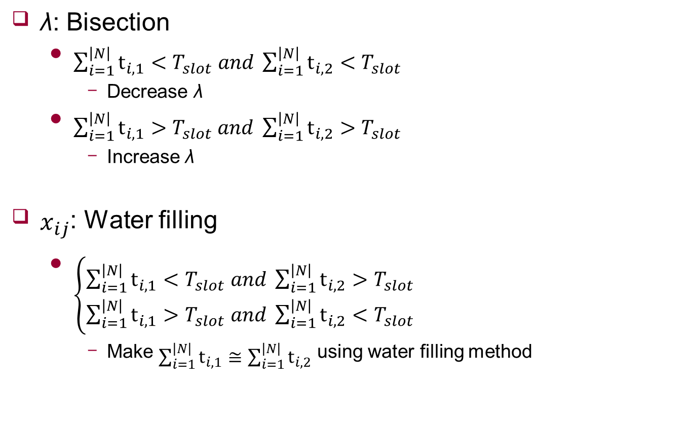
Adjustment
λ: Bisection
$\sum_{i=1}^{\left|N\right|}{t_{i,1}}<T_{slot} and \sum_{i=1}^{\left|N\right|}{t_{i,2}}<T_{slot}$
Decrease λ
$\sum_{i=1}^{\left|N\right|}{t_{i,1}}>T_{slot}$ $and \sum_{i=1}^{\left|N\right|}{t_{i,2}}>T_{slot}$
Increase λ
$x_{ij}$: Water filling
$\left\{\begin{aligned}\sum_{i=1}^{\left|N\right|}{t_{i,1}}<T_{slot} and \sum_{i=1}^{\left|N\right|}{t_{i,2}}>T_{slot} \\ \sum_{i=1}^{\left|N\right|}{t_{i,1}}>T_{slot} and \sum_{i=1}^{\left|N\right|}{t_{i,2}}<T_{slot}\end{aligned}\right.$
Make $\sum_{i=1}^{\left|N\right|}{t_{i,1}}≅\sum_{i=1}^{\left|N\right|}{t_{i,2}}$ using water filling method

Slide 7

Situation
Random RSSI ~ $N(−70, 5^{2})$
Bandwidth model
A. Y. Ding et al., “Vision: Augmenting WiFi offloading with an opensource collaborative platform,” in Proc. MCS, 2015, pp. 44–48.
Video
Tears of steel: UE3, UE5
Big buck bunny: UE2, UE4
Elephants dream: UE1
-71dB
-69dB
-70dB
-70dB
-67dB
-67dB
-76dB
-64dB
-60dB
-67dB
Notes:
어제 말씀 드린 환욱이 알고리즘 람다 2개로 고려해서 수정했다.

Slide 8
Situation
Single: 39.49
AP1: UE2 (900kbps), UE3 (900kbps), UE4 (900kbps), UE5 (900kbps),
AP2: UE1 (4000kbps)
Multi: 40.29
UE1: (2000kbps, AP1: 0%, AP2: 100%)
UE2: (900kbps, AP1: 14.3%, AP2: 85.7%)
UE3: (1500kbps, AP1: 89.6%, AP2: 10.4%)
UE4: (1500kbps, AP1: 85.5%, AP2: 14.5%)
UE5: (1500kbps, AP1: 71.9%, AP2: 28.1%)
-71dB
-69dB
-70dB
-70dB
-67dB
-67dB
-76dB
-64dB
-60dB
-67dB

Slide 9
Situation
Single: 39.49
AP1: UE2 (900kbps), UE3 (900kbps), UE4 (900kbps), UE5 (900kbps),
AP2: UE1 (4000kbps)
Multi: 40.29
UE1: (2000kbps, AP1: 0%, AP2: 100%)
UE2: (900kbps, AP1: 14.3%, AP2: 85.7%)
UE3: (1500kbps, AP1: 89.6%, AP2: 10.4%)
UE4: (1500kbps, AP1: 85.5%, AP2: 14.5%)
UE5: (1500kbps, AP1: 71.9%, AP2: 28.1%)
-71dB
-69dB
-70dB
-70dB
-67dB
-67dB
-76dB
-64dB
-60dB
-67dB
λ = 47.97
λ = 12.16
λ = 29.68

Slide 10
Situation
Single: 39.49
AP1: UE2 (900kbps), UE3 (900kbps), UE4 (900kbps), UE5 (900kbps),
AP2: UE1 (4000kbps)
Multi: 40.29
UE1: (2000kbps, AP1: 0%, AP2: 100%)
UE2: (900kbps, AP1: 14.3%, AP2: 85.7%)
UE3: (1500kbps, AP1: 89.6%, AP2: 10.4%)
UE4: (1500kbps, AP1: 85.5%, AP2: 14.5%)
UE5: (1500kbps, AP1: 71.9%, AP2: 28.1%)
 | #1 | #2 | #3 | #4 | #5 | #6 | #7 | #8 | #9 | #10
Single | 40.51 | 38.96 | 39.77 | 40.74 | 39.39 | 40.54 | 37.56 | 41.79 | 41.15 | 36.99
Multi | 41.12 | 38.9 | 40.05 | 41.34 | 39.63 | 40.58 | 40.41 | 41.71 | 42.35 | 39.75
-71dB
-69dB
-70dB
-70dB
-67dB
-67dB
-76dB
-64dB
-60dB
-67dB

Slide 11
Algorithm
Loop
Outer: adjust λ
Inner: adjust $x_{ij}$
λ
$$x_{ij}$$
Notes:
$x_{ij}$를 조절을 최대한 full search 비슷하게 해야 함

Slide 12
Future Work
Improve algorithm
x adjustment

Slide 13



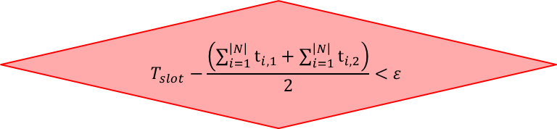
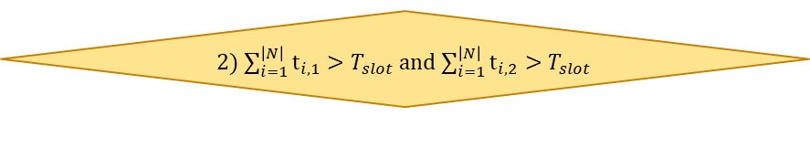
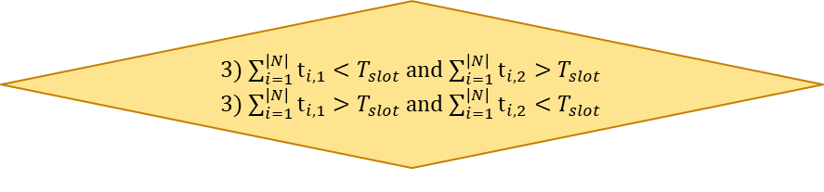

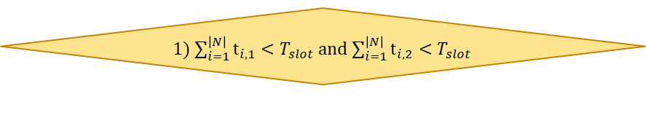

Appendix
Loop
Initialize $x_{ij}$ and $λ$
Determine $d_{i}(x_{i}^{∗})$ with $λ$
Calculate Virtual Bandwidth on VAP with $x_{ij}$
Adjust $x_{ij}$
Adjust $λ$
3) $\sum_{i=1}^{\left|N\right|}{t_{i,1}}<T_{slot}$ and $\sum_{i=1}^{\left|N\right|}{t_{i,2}}>T_{slot}$
3) $\sum_{i=1}^{\left|N\right|}{t_{i,1}}>T_{slot}$ and $\sum_{i=1}^{\left|N\right|}{t_{i,2}}<T_{slot}$
yes
no
2) $\sum_{i=1}^{\left|N\right|}{t_{i,1}}>T_{slot}$ and $\sum_{i=1}^{\left|N\right|}{t_{i,2}}>T_{slot}$
yes
no
$$T_{slot}−\frac{\left(\sum_{i=1}^{\left|N\right|}{t_{i,1}}+\sum_{i=1}^{\left|N\right|}{t_{i,2}}\right)}{2}<ε$$
1) $\sum_{i=1}^{\left|N\right|}{t_{i,1}}<T_{slot}$ and $\sum_{i=1}^{\left|N\right|}{t_{i,2}}<T_{slot}$
yes
END

