Slide 1
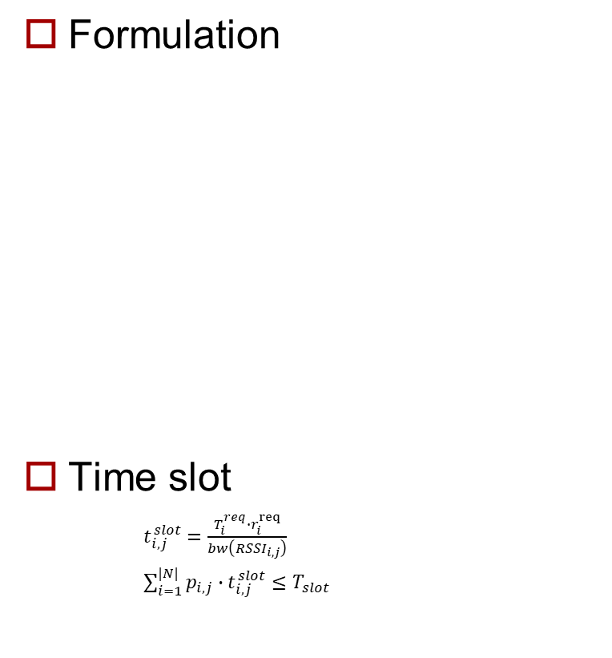
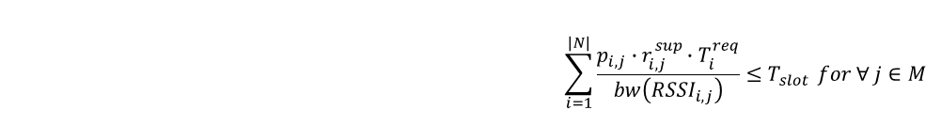
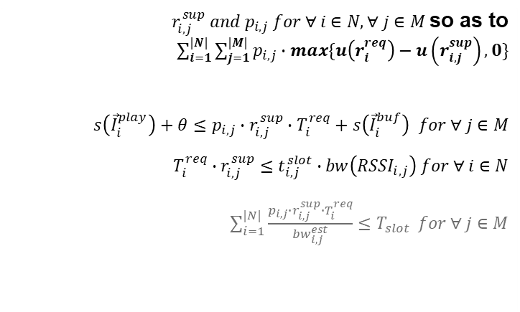
Modification
Formulation
Time slot
$t_{i,j}^{slot}=\frac{T_{i}^{req}∙r_{i}^{req}}{bw\left({RSSI}_{i,j}\right)}$
$\sum_{i=1}^{|N|}{p_{i,j}∙t_{i,j}^{slot}≤T_{slot}}$
Determine Minimize subject to and and
$r_{i,j}^{sup} and p_{i,j} for ∀ i∈N, ∀ j∈M$so as to $\sum_{i=1}^{|N|}{\sum_{j=1}^{|M|}{p_{i,j}∙max\{u\left(r_{i}^{req}\right)−u\left(r_{i,j}^{sup}\right),0\}}}$ $s\left({\vec{I}}_{i}^{play}\right)+θ≤p_{i,j}∙r_{i,j}^{sup}∙T_{i}^{req}+s\left({\vec{I}}_{i}^{buf}\right) for ∀ j∈M$ $$T_{i}^{req}∙r_{i,j}^{sup}≤t_{i,j}^{slot}∙bw\left({RSSI}_{i,j}\right) for ∀ i∈N$$ $\sum_{i=1}^{|N|}{\frac{p_{i,j}∙r_{i,j}^{sup}∙T_{i}^{req}}{{bw}_{i,j}^{est}}≤T_{slot}} for ∀ j∈M$
$$\sum_{i=1}^{|N|}{\frac{p_{i,j}∙r_{i,j}^{sup}∙T_{i}^{req}}{bw\left({RSSI}_{i,j}\right)}≤T_{slot}} for ∀ j∈M$$
Notes:
알고리즘 C언어로 설계하다 보니 Formulation 식 수정 필요 및 Time slot 재 정의

Slide 2
Plan
Cost Function
Fairness
Papers for performance comparison

