Slide 1
Goal
Goal
To maximize QoE in video streaming over multiple WiFi networks with SDN
Adjusting Bitrate
To ensure total QoE
AP Load Balancing
To ensure minimum QoE for each user
Notes:
질문 사항
Bitrate 조절

Slide 2




Basic Idea
Basic Idea
Media Server
SDN Controller
AP
Client

Slide 3
Basic Idea
Basic Idea
Media Server
SDN Controller
AP
Client

Slide 4
Basic Idea
Basic Idea
Media Server
SDN Controller
AP
Client

Slide 5
Basic Idea
Basic Idea
< before >
< after >

Slide 6
Basic Idea
Basic Idea
AP collects information from clients
List of connectable Aps
Using load balancing
Bandwidth
Using bitrate adjustment, load balancing
Estimated by icerf3
Buffer state
Using bitrate adjustment

Slide 7
Basic Idea
Basic Idea
When does SDN controller collect information?
New client is added
Average bandwidth at an AP is very small
A specific client is disconnected
One AP send signal that request load balancing

Slide 8
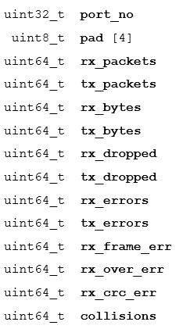
Basic Idea
Basic Idea
SDN collects information using Open Flow protocol
Using OFPMP_PORT_STATS message
AP respond to it with ofp_port_stats message
< ofp_port_stats structure >

Slide 9
Basic Idea
Basic Idea
SDN collects information using Open Flow protocol
Using OFPMP_PORT_STATS message
Calculate bandwidth and packet error rate
< ofp_port_stats structure >

Slide 10
Problem Formulation
Problem Formulation
MDP
State: Bandwidth, Packet Error Rate
Action: Hand over

