Slide 1
Research Jae Jun Ha Media Computing and Networking Laboratory POSTECH 2019-05-31

Slide 2
Contents
Last Week
Hybrid DQN
Clustering
Conclusion

Slide 3
Speed of training
Training speed is very slow
Every episode, DQN is compared to Optimal solution
Because bandwidth and AP configuration are decided randomly, comparison is essential.
For i in max episode
For j in max ue
If Rand() < epsilon
Random action
Else
Get action from network
X = DQN Step(action)
Y = Optimal Step(action)
Reward = (X / Y) * 100
Train()
Notes:
학습 속도가 느린 이유는 Optimal solution 때문에
또한 optimal solution 과 비교하는 이유는 bandwidth가 항상 랜덤으로 고려했기 때문에

Slide 4
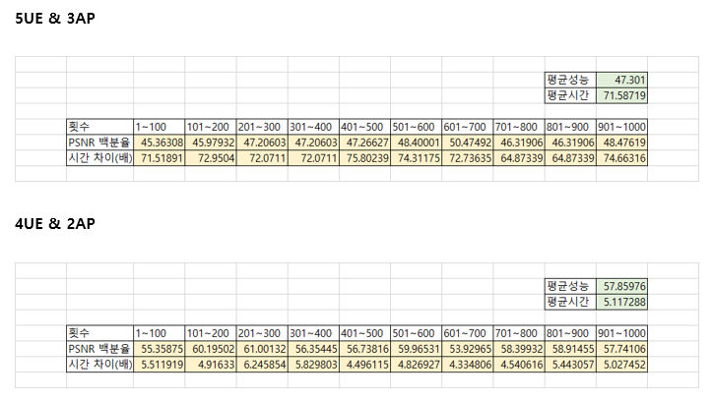
Connection ratio
In last weekly report
Notes:
저번 위클리 리포트에 DQN 사용했을 때 성능이 현저히 낮게 나옴을 보였는데 이 이유에 대해서 설명

Slide 5
Connection ratio
Connection ratio between UE and AP
There are 10 APs and connection ratio is 60%
It means one UE can connect 1 AP among 6 APs
According to connection ratio
Performance of DQN can be different
Notes:
Connection ratio를 다음과 같이 정의 했습니다.

Slide 6
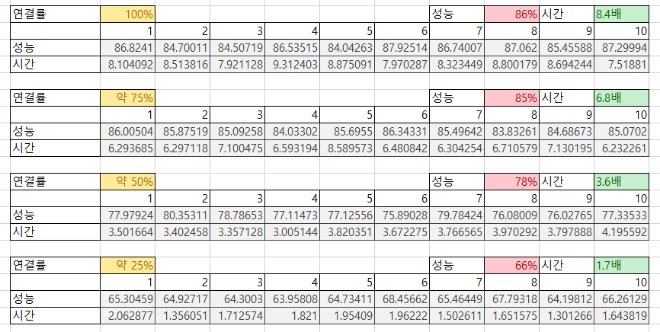
Connection ratio
According to connection ratio
4 UEs, 2 APs, 5 MPD bitrates
Notes:
AP와 UE의 연결 가능한 정도에 따라 성능이 다를 수 있음을 보임
또한 DQN 알고리즘도 약간 개선

Slide 7
The number of training
If the number of training is increased
Performance can be increased
Although the number of UE and AP are increased
Performance can be ensured to some degree if the number of training is increased
Notes:
UE 수와 AP 수가 늘어나더라도 학습 횟수가 늘어나면 성능이 나빠지지 않는다

Slide 8
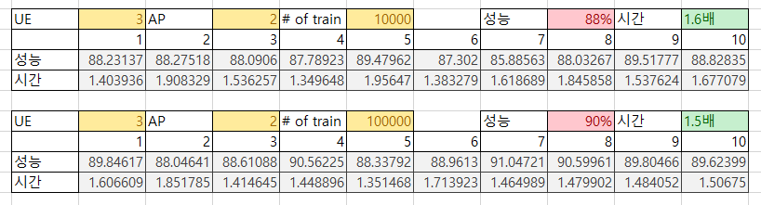
The number of training
According to the number of training
10000 → 100000
Notes:
트레이닝 수를 늘리면 성능이 약간 향상된다

Slide 9
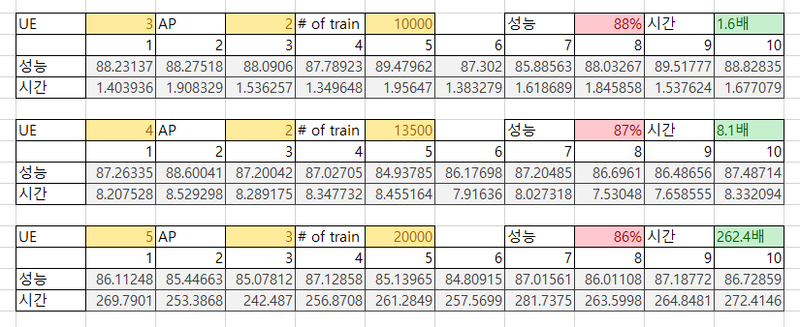
The number of training
According to the number of training
5 MPD bitrates, 100% connection ratio
Notes:
UE 수와 AP 수가 늘어나더라도 학습 횟수가 늘어나면 성능이 나빠지는 폭이 작다

Slide 10
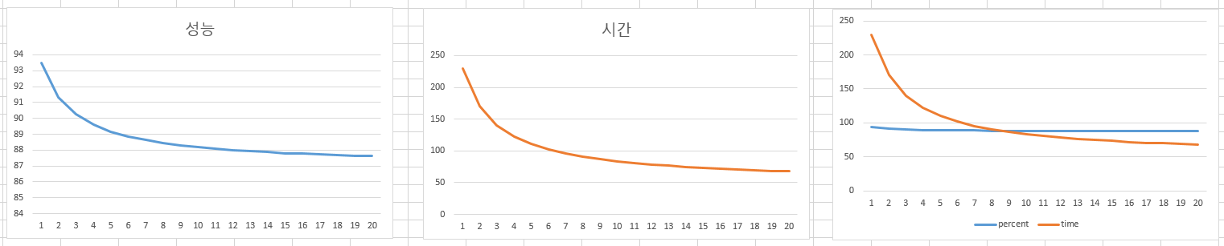
Hybrid DQN
Because DQN can not ensure optimal performance, it is better to mix DQN and Optimal solution
DQN is 8 times faster than Optimal solution, Performance of DQN is 87% of Optimal solution
High usage of DQN than ratio of speed up
Low performance
High usage of Optimal solution than ratio of speed up
Delayed order
Notes:
UE가 새로 들어올 때 혹은 나갈 때라고 말했는데 이게 언제 나가고 들어올지 알 수 없다.
DQN 특정 횟수 수행했을 때 Optimal solution 실행 되게 했을 때 그래프를 엑셀로 그려봤음
상대적으로 Optimal solution 대 DQN 성능 변동이 크지 않음
기본적인 speed up 비율에 따르는게 나을 것 같음

Slide 11
Clustering
Consider
Available bandwidth
# of connectable APs
Optimal clustering
Need to function considering two elements
It will take lots of time
K-means

Slide 12
Conclusion
Summary
High connection ratio → High performance
High training count → High performance
Hybrid DQN → Ratio speed up
Clustering → K-means
Future Work
Test at real testbed

