Slide 1
Research Jae Jun Ha Media Computing and Networking Laboratory POSTCH 2019-10-04
Notes:
발표 시작하겠습니다

Slide 2
Contents
Algorithms
Comparison

Slide 3
Algorithms
Deep Q-Network (DQN)
Random
It selects both AP and Bitrate randomly
Greedy
0/1 Multiple Knapsack Problem (MKP)
Martello and Toth Method (MTM)
Martello and Toth Heuristic Method (MTHM)
Branch and Bound
It is modification version of Brute force algorithm
Notes:
비교 알고리즘들을 소개하겠습니다.
그냥 냅색(활용되는 곳도 많고, 솔루션이 다양)이랑 멀티플 냅색이랑 다르다고 말하면서 MKP 소개
멀티플 냅색이 일반 냅색이랑 왜 다른지
근본적으로 제 문제의 경우 냅색 사용할 수 없다. → 수정해서 적용
사실 MTM이랑 MTHM 성능이 어느게 좋다고 말할 수 없다. 둘 다 내 문제에 적용했을때는
Ideal은 결과 보여줄 때 같이 넣기

Slide 4
Deep Q-Network (DQN)
There are two steps
AP Selection
Bitrate Selection
AP Selection
Using DQN solution
Goal: balancing fairness using timeslot
State: timeslot
Action: AP
Reward: Jain Fairness Index
Bitrate Selection
Using Greedy solution
Goal: minimizing the difference between request bitrate and service bitrate
The complexity was not so great that I decided to use greedy solution in this case
Notes:
Time slot을 고려하여 UE를 AP에 배분하고 그 후 Greedy를 적용
State: timeslot 부분 설명 더 들어가야할 수도?
Bitrate와 AP 왜 동시에 고려 안하냐?
차원이 크다. 직접 해봤지만 결과가 안나온다.
구글 딥마인드 팀이 쓴 논문이나 다른 논문들도 같이 참조해봤는데 action의 차원이 크면 dimension이 커서 일반적인 DQN은 사용할 수 없다.

Slide 5
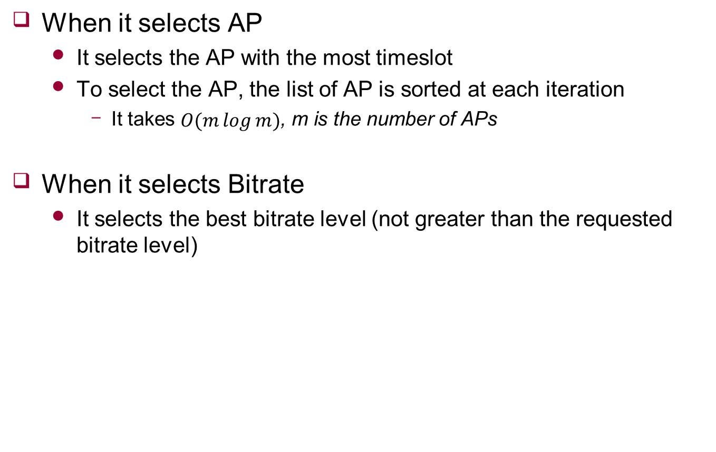
Greedy
When it selects AP
It selects the AP with the most timeslot
To select the AP, the list of AP is sorted at each iteration
It takes $O(m\log{m})$, m is the number of APs
When it selects Bitrate
It selects the best bitrate level (not greater than the requested bitrate level)
Notes:
순간 마다 최선의 선택 → 마지막 관점에서 최선이지는 않음

Slide 6
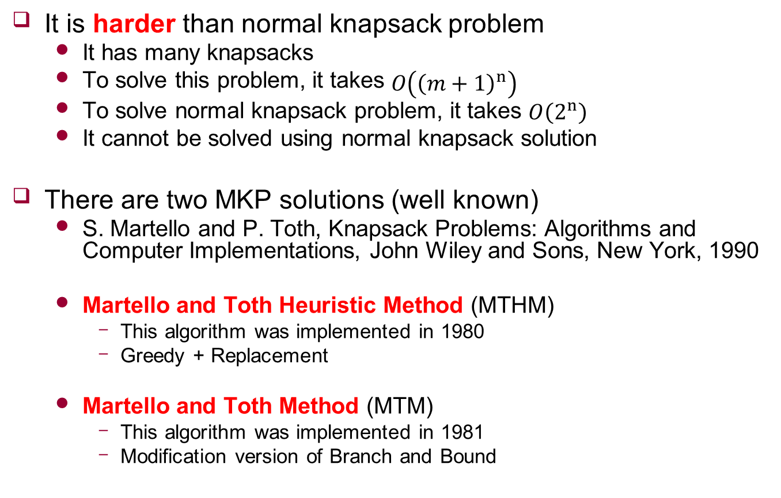
0/1 Multiple Knapsack Problem (MKP)
It is harder than normal knapsack problem
It has many knapsacks
To solve this problem, it takes $O\left({\left(m+1\right)}^{n}\right)$
To solve normal knapsack problem, it takes $O\left(2^{n}\right)$
It cannot be solved using normal knapsack solution
There are two MKP solutions (well known)
S. Martello and P. Toth, Knapsack Problems: Algorithms and Computer Implementations, John Wiley and Sons, New York, 1990
Martello and Toth Heuristic Method (MTHM)
This algorithm was implemented in 1980
Greedy + Replacement
Martello and Toth Method (MTM)
This algorithm was implemented in 1981
Modification version of Branch and Bound
Notes:
잘 알려진 두 가지 솔루션이 있습니다.
비교 알고리즘들을 소개하겠습니다.
그냥 냅색(활용되는 곳도 많고, 솔루션이 다양)이랑 멀티플 냅색이랑 다르다고 말하면서 MKP 소개
멀티플 냅색이 일반 냅색이랑 왜 다른지
근본적으로 제 문제의 경우 냅색 사용할 수 없다. → 수정해서 적용
사실 MTM이랑 MTHM 성능이 어느게 좋다고 말할 수 없다. 둘 다 내 문제에 적용했을때는
Ideal이 뭔지

Slide 7
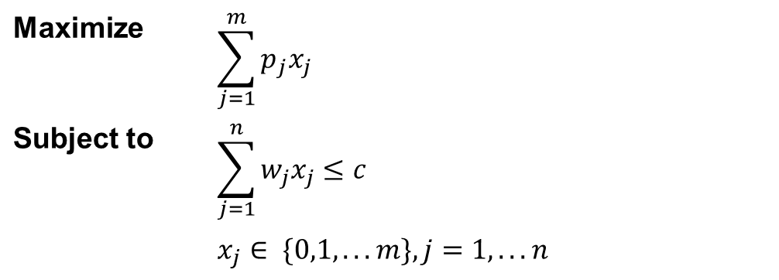
0/1 Multiple Knapsack Problem (MKP)
Definition
Things to consider
Weight of items cannot be changed
Goal of MKP is to maximize the total value of the knapsacks
Maximize | $$\sum_{j=1}^{m}{p_{j}x_{j}}$$
Subject to | $$\sum_{j=1}^{n}{w_{j}x_{j}≤c}$$
 | $$x_{j}∈ \{0,1,...m\},j=1,...n$$

Slide 8
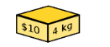
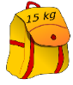
0/1 Multiple Knapsack Problem (MKP)
Weight of items cannot be changed
Weight: Request bitrate로 가정
Value: PSNR로 가정
Request bitrate
1200kbps
1200kbps
< https://ko.wikipedia.org/wiki/배낭_문제 >

Slide 9



0/1 Multiple Knapsack Problem (MKP)
Goal of MKP is to maximize the total value of the knapsacks
There can be items which not belong to any knapsack
< https://ko.wikipedia.org/wiki/배낭_문제 >

Slide 10
0/1 Multiple Knapsack Problem (MKP)
When assume amount of data as weight
Available bandwidth is not considered
Available bandwidth
900kbps
2000kbps
1000kbps
< https://ko.wikipedia.org/wiki/배낭_문제 >

Slide 11
Algorithms (Again)
Deep Q-Network (DQN)
Random
It selects both AP and Bitrate randomly
Greedy
0/1 Multiple Knapsack Problem (MKP)
Martello and Toth Method (MTM)
Martello and Toth Heuristic Method (MTHM)
Branch and Bound
It is modification version of Brute force algorithm
Notes:
다시 정리해서 말씀드리겠습니다.

Slide 12
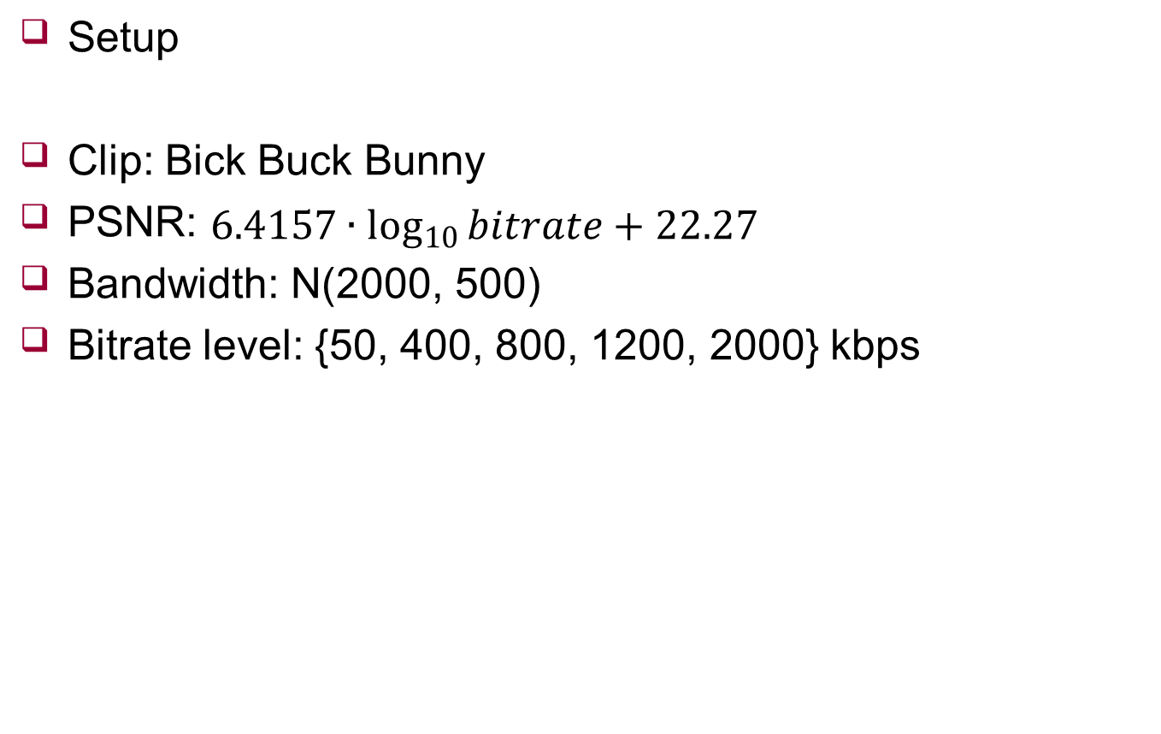
Comparison
Setup
Clip: Bick Buck Bunny
PSNR: $6.4157∙\log_{10}{bitrate}+22.27$
Bandwidth: N(2000, 500)
Bitrate level: {50, 400, 800, 1200, 2000} kbps

Slide 13
Comparison
UE: 5, AP: 2
PSNR
Time
 | AVG | 1 | 2 | 3 | 4 | 5 | 6 | 7 | 8 | 9 | 10
Ideal | 39.91 | 38.03 | 37.93 | 39.7 | 41.41 | 38.77 | 40.47 | 40.09 | 41.76 | 41.35 | 39.6
Optimal | 39.48 | 38.03 | 37.93 | 39.47 | 40.74 | 38.32 | 40.19 | 39.58 | 40.74 | 40.51 | 39.31
DQN | 39.16 | 37.81 | 37.64 | 39.19 | 40.35 | 38.32 | 39.96 | 38.42 | 40.35 | 40.51 | 39.09
Knapsack(MTHM) | 39.05 | 37.81 | 37.64 | 38.96 | 40.51 | 38.32 | 39.74 | 38.58 | 39.74 | 40.12 | 39.03
Knapsack(MTM) | 39.02 | 37.81 | 37.64 | 39.47 | 39.74 | 38.32 | 39.58 | 38.42 | 40.35 | 39.74 | 39.09
Greedy | 37.46 | 38.03 | 37.64 | 38.54 | 39.47 | 38.16 | 38.16 | 38.8 | 31.81 | 36.71 | 37.28
Random | 35.92 | 34.33 | 35.87 | 37.26 | 38.19 | 34.33 | 34.94 | 34.33 | 35.87 | 37.81 | 36.26
 | AVG | 1 | 2 | 3 | 4 | 5 | 6 | 7 | 8 | 9 | 10
Greedy | 0.000000 | 0 | 0 | 0 | 0 | 0 | 0 | 0 | 0 | 0 | 0
Random | 0.000020 | 0 | 0 | 0 | 0 | 0 | 0 | 0.0001 | 0.0001 | 0 | 0
Knapsack(MTHM) | 0.000100 | 0.0001 | 0.0001 | 0.0001 | 0.0001 | 0.0001 | 0.0001 | 0.0001 | 0.0001 | 0.0001 | 0.0001
DQN | 0.003680 | 0.0035 | 0.0038 | 0.0039 | 0.0034 | 0.0043 | 0.0032 | 0.0038 | 0.0037 | 0.0037 | 0.0035
Knapsack(MTM) | 0.005580 | 0.0053 | 0.0057 | 0.0056 | 0.0055 | 0.0057 | 0.0054 | 0.0061 | 0.0058 | 0.0055 | 0.0052
Optimal | 0.018960 | 0.005 | 0.005 | 0.0169 | 0.0393 | 0.0078 | 0.0175 | 0.0139 | 0.039 | 0.0285 | 0.0167

Slide 14
Comparison
UE: 8, AP: 3
PSNR
Time
 | AVG | 1 | 2 | 3 | 4 | 5 | 6 | 7 | 8 | 9 | 10
Optimal | - | - | - | - | - | - | - | - | - | - | -
Ideal | 40.27 | 40.21 | 38.9 | 41.35 | 41.54 | 38.78 | 41.54 | 41.09 | 39.36 | 39.29 | 40.63
DQN | 39.40 | 39.93 | 38.48 | 39.83 | 39.83 | 38.46 | 39.93 | 40.07 | 38.52 | 38.62 | 40.31
Knapsack(MTM) | 39.18 | 40.07 | 38.38 | 39.11 | 39.59 | 37.83 | 39.69 | 39.69 | 38.32 | 39.01 | 40.07
Knapsack(MTHM) | 38.95 | 36.79 | 38.9 | 39.73 | 40.07 | 38.32 | 38.48 | 39.59 | 38.76 | 39.15 | 39.69
Greedy | 38.94 | 40.21 | 38.9 | 37.57 | 39.15 | 38.46 | 38.52 | 39.08 | 38.22 | 38.9 | 40.39
Random | 35.61 | 34.62 | 34.86 | 35.34 | 34.86 | 38.78 | 36.31 | 35.34 | 34.86 | 36.55 | 34.62
 | AVG | 1 | 2 | 3 | 4 | 5 | 6 | 7 | 8 | 9 | 10
Greedy | 0.000100 | 0.0001 | 0.0001 | 0.0001 | 0.0001 | 0.0001 | 0.0001 | 0.0001 | 0.0001 | 0.0001 | 0.0001
Random | 0.000100 | 0.0001 | 0.0001 | 0.0001 | 0.0001 | 0.0001 | 0.0001 | 0.0001 | 0.0001 | 0.0001 | 0.0001
Knapsack(MTHM) | 0.000140 | 0.0002 | 0.0001 | 0.0002 | 0.0001 | 0.0001 | 0.0002 | 0.0002 | 0.0001 | 0.0001 | 0.0001
DQN | 0.005330 | 0.0054 | 0.0051 | 0.0056 | 0.005 | 0.0055 | 0.005 | 0.0057 | 0.0052 | 0.0053 | 0.0055
Knapsack(MTM) | 0.009790 | 0.0057 | 0.006 | 0.0065 | 0.009 | 0.0093 | 0.0079 | 0.0086 | 0.0062 | 0.0268 | 0.0119
Optimal | - | - | - | - | - | - | - | - | - | - | -

Slide 15
Comparison
UE: 12, AP: 5
PSNR
Time
 | AVG | 1 | 2 | 3 | 4 | 5 | 6 | 7 | 8 | 9 | 10
Optimal | - | - | - | - | - | - | - | - | - | - | -
Ideal | 40.12 | 41.38 | 41.5 | 40.29 | 38.43 | 39.49 | 40.6 | 39.03 | 40.48 | 41.12 | 38.89
DQN | 39.37 | 40.3 | 39.66 | 39.38 | 38.21 | 39.27 | 39.89 | 38.63 | 39.96 | 40.18 | 38.24
Knapsack(MTM) | 39.16 | 39.91 | 39.11 | 39.59 | 37.96 | 38.92 | 39.69 | 38.51 | 39.8 | 40.18 | 37.93
Knapsack(MTHM) | 38.99 | 39.91 | 38.88 | 39.43 | 38.21 | 39.2 | 39.2 | 38.51 | 39.86 | 38.83 | 37.86
Greedy | 38.70 | 38.27 | 39.23 | 38.68 | 38.33 | 39.07 | 39.03 | 38.61 | 39.55 | 38.87 | 37.37
Random | 35.70 | 37.13 | 34.78 | 34.78 | 34.46 | 36.39 | 36.32 | 36.39 | 36.87 | 35.58 | 34.3
 | AVG | 1 | 2 | 3 | 4 | 5 | 6 | 7 | 8 | 9 | 10
Greedy | 0.000100 | 0.0001 | 0.0001 | 0.0001 | 0.0001 | 0.0001 | 0.0001 | 0.0001 | 0.0001 | 0.0001 | 0.0001
Random | 0.000110 | 0.0001 | 0.0001 | 0.0001 | 0.0001 | 0.0001 | 0.0001 | 0.0001 | 0.0001 | 0.0001 | 0.0002
Knapsack(MTHM) | 0.000280 | 0.0003 | 0.0003 | 0.0002 | 0.0002 | 0.0003 | 0.0003 | 0.0002 | 0.0003 | 0.0003 | 0.0004
DQN | 0.009010 | 0.0095 | 0.0079 | 0.0082 | 0.0084 | 0.0099 | 0.0098 | 0.0079 | 0.0096 | 0.009 | 0.0099
Knapsack(MTM) | 0.578600 | 0.7725 | 0.1113 | 0.3173 | 0.059 | 1.6059 | 0.2624 | 1.4669 | 0.5259 | 0.3422 | 0.3226
Optimal | - | - | - | - | - | - | - | - | - | - | -

Slide 16
Future Work
NS3 Simulator
Dynamic situation
Bandwidth fluctuation
Continuous streaming

