Slide 1
Research Jae Jun Ha Media Computing and Networking Laboratory POSTCH 2020-03-13
Notes:
발표 시작하겠습니다.
오늘 발표 드릴 내용은 알고리즘에 관한 내용을 정리했습니다.

Slide 2

Contents
Flow Chart
$x_{ij}$ Adjustment

Slide 3


Flow Chart
Scenario
One UE wants to get a streaming service from a system where multiple users was already getting streaming
If a UE can not receive streaming service with request bitrate
If APs’ timeslot overflow

Slide 4
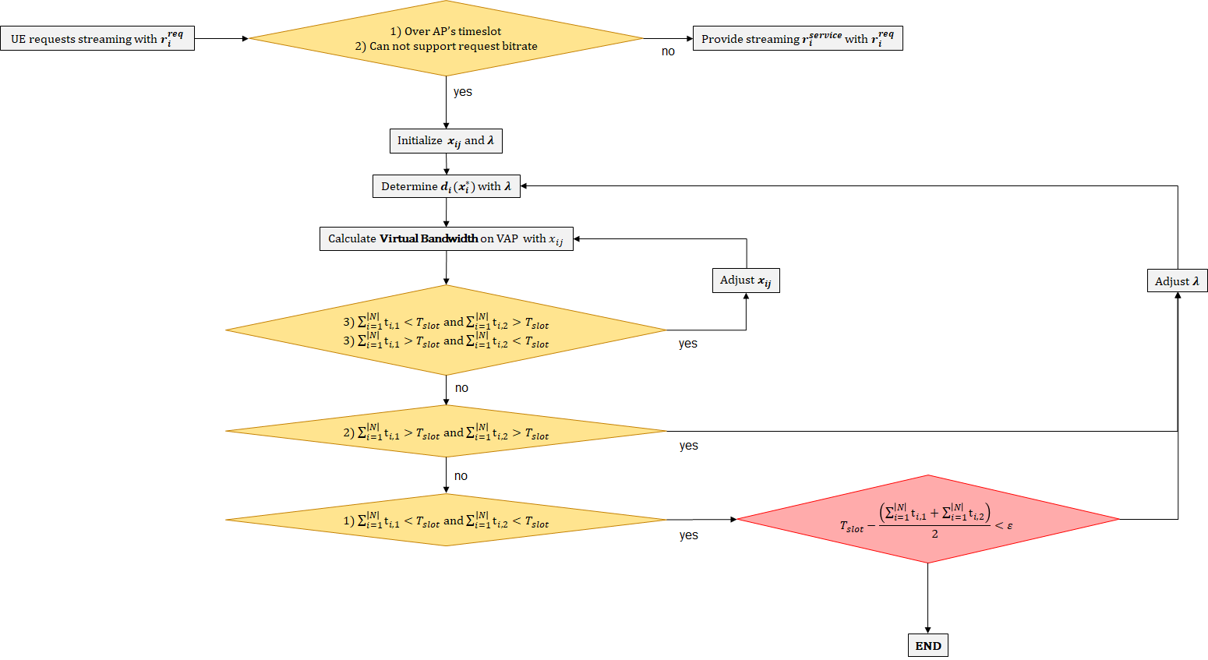
Flow Chart
Scenario
Congestion

Slide 5
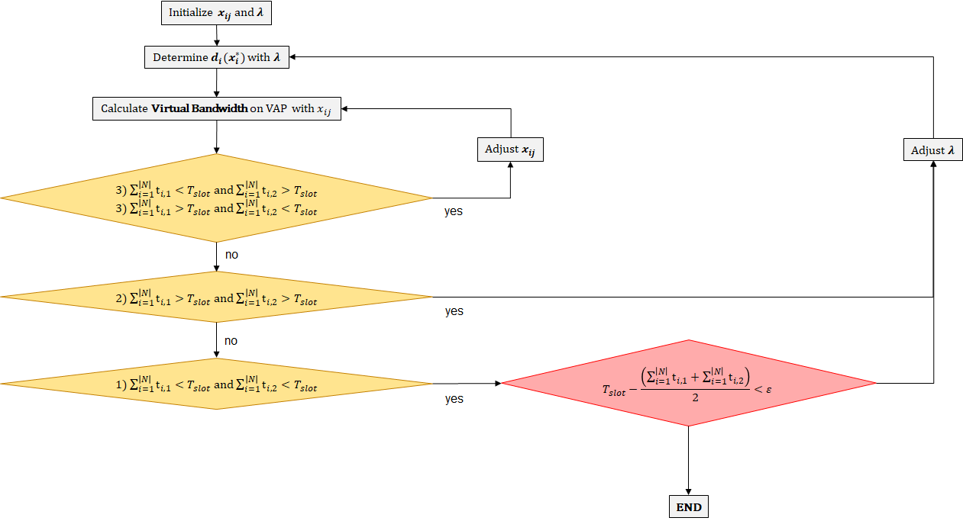
Flow Chart
Two Loops

Slide 6
Flow Chart
Two Loops
Outer Loop
Inner Loop

Slide 7

Flow Chart
Two Loops
Outer Loop
Inner Loop
+$\left|λ_{min}− λ_{max}\right|<ε$

Slide 8
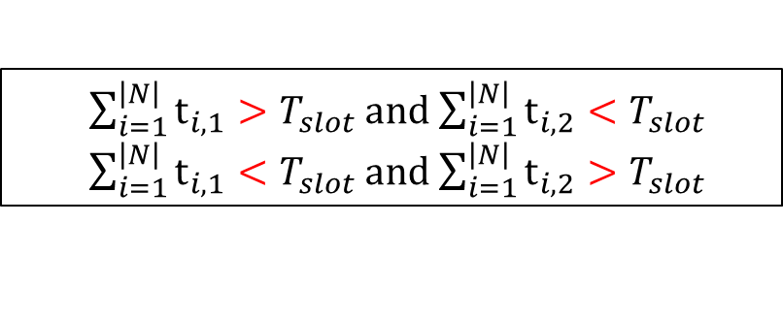



$x_{ij}$ Adjustment
$\sum_{i=1}^{\left|N\right|}{t_{i,1}}>T_{slot}$ and $\sum_{i=1}^{\left|N\right|}{t_{i,2}}<T_{slot}$
$\sum_{i=1}^{\left|N\right|}{t_{i,1}}<T_{slot}$ and $\sum_{i=1}^{\left|N\right|}{t_{i,2}}>T_{slot}$
By adjusting $x_{ij}$
$\sum_{i=1}^{\left|N\right|}{t_{i,1}}<T_{slot}$ and $\sum_{i=1}^{\left|N\right|}{t_{i,2}}<T_{slot}$
$\sum_{i=1}^{\left|N\right|}{t_{i,1}}>T_{slot}$ and $\sum_{i=1}^{\left|N\right|}{t_{i,2}}>T_{slot}$

Slide 9


$x_{ij}$ Adjustment
Find an AP with little timeslot
Ex)
Increase $x_{i1}$ and make below condition
$for ∀i∈N$
 | AP 1 | AP 2
Timeslot | 0.79 | 3.27
$\sum_{i=1}^{\left|N\right|}{t_{i,1}}<T_{slot}$ and $\sum_{i=1}^{\left|N\right|}{t_{i,2}}<T_{slot}$
$\sum_{i=1}^{\left|N\right|}{t_{i,1}}>T_{slot}$ and $\sum_{i=1}^{\left|N\right|}{t_{i,2}}>T_{slot}$

Slide 10
$x_{ij}$ Adjustment
Find an AP with little timeslot
Ex)
There are many cases
 | AP 1 | AP 2
Timeslot | 0.79 | 3.27
 | AP 1 | AP 2
Timeslot | 1.3 | 2.0
 | AP 1 | AP 2
Timeslot | 1.5 | 1.5
 | AP 1 | AP 2
Timeslot | 1.9 | 0.5

Slide 11
Algorithm
Two Loops
Outer Loop
Inner Loop
+$\left|λ_{min}− λ_{max}\right|<ε$

Slide 12
$x_{ij}$ Adjustment
Find an AP with little timeslot
Ex)
There are many cases
 | AP 1 | AP 2
Timeslot | 0.79 | 3.27
 | AP 1 | AP 2
Timeslot | 1.3 | 2.0
Standard
 | AP 1 | AP 2
Timeslot | 1.5 | 1.5
 | AP 1 | AP 2
Timeslot | 1.9 | 0.5

Slide 13
$x_{ij}$ Adjustment
Find an AP with little timeslot
Ex)
There are many cases
 | AP 1 | AP 2
Timeslot | 0.79 | 3.27
 | AP 1 | AP 2
Timeslot | 1.3 | 2.0
Standard
 | AP 1 | AP 2
Timeslot | 1.5 | 1.5
Final result
1.9 / 1.9
 | AP 1 | AP 2
Timeslot | 1.9 | 0.5

Slide 14
$x_{ij}$ Adjustment
Find an AP with little timeslot
Ex)
There are many cases
 | AP 1 | AP 2
Timeslot | 0.79 | 3.27
 | AP 1 | AP 2
Timeslot | 1.3 | 2.0
Standard
 | AP 1 | AP 2
Timeslot | 1.5 | 1.5
Final result
1.9 / 1.9
 | AP 1 | AP 2
Timeslot | 1.9 | 0.5
In addition, Fairness

Slide 15
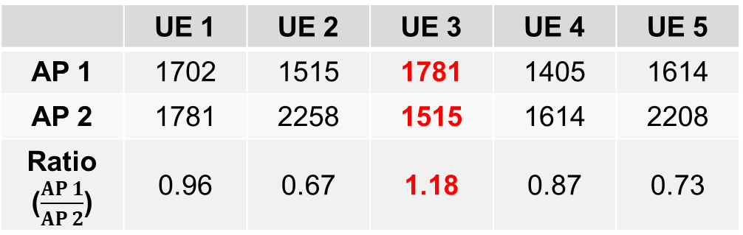

$x_{ij}$ Adjustment
Which $x_{ij}$ will you adjust?
Bandwidth 비율을 계산하고 비율이 큰 $x_{ij}$를 조절
Timeslot를 최대한 채우기 위해 AP 1 Timeslot의 증가분에 비해
AP 2 Timeslot의 감소분이 큰 $x_{ij}$를 조절
 | AP 1 | AP 2
Timeslot | 0.79 | 3.27
 | UE 1 | UE 2 | UE 3 | UE 4 | UE 5
AP 1 | 1702 | 1515 | 1781 | 1405 | 1614
AP 2 | 1781 | 2258 | 1515 | 1614 | 2208
Ratio ($\frac{AP 1}{AP 2}$) | 0.96 | 0.67 | 1.18 | 0.87 | 0.73
Notes:
만일 $x_{31}=1$일 경우 두 번째 비율 큰 것 선택

Slide 16


$x_{ij}$ Adjustment
If fail to find $x_{ij}$ which satisfy below condition
$\sum_{i=1}^{\left|N\right|}{t_{i,1}}<T_{slot}$ and $\sum_{i=1}^{\left|N\right|}{t_{i,2}}<T_{slot}$
$\sum_{i=1}^{\left|N\right|}{t_{i,1}}>T_{slot}$ and $\sum_{i=1}^{\left|N\right|}{t_{i,2}}>T_{slot}$
Notes:
만일 $x_{31}=1$일 경우 두 번째 비율 큰 것 선택

Slide 17
Future Work
Real Testbed

