Slide 1
Research Jae Jun Ha Media Computing and Networking Laboratory POSTECH 2019-01-04
Notes:
세미나 발표를 시작하겠습니다.

Slide 2
Contents
Survey
Bitrate selection
AP selection
Future work

Slide 3
Rate Adaptation for Adaptive HTTP Streaming
C. Liu, I. Bouazizi, and M. Gabbouj, “Rate adaptation for adaptive HTTP streaming,” in Proc. ACM MMSys, 2011, pp. 169–174
Why I chose this paper?
Because DASH is an HTTP-based rate adaptation technology and to understand how it responds to fluctuating network conditions.

Slide 4
Rate Adaptation for Adaptive HTTP Streaming
Motivation
HTTP is often used as a means of multimedia transmission
Rate adaptation is required depending on fluctuating network capacity
It is hard to cope with volatility at Adaptive HTTP
This paper proposes rate adaptation algorithm for adaptive HTTP streaming
It detects bandwidth changes using a smoothed HTTP throughput based on the segment fetch time (SFT)

Slide 5
Rate Adaptation for Adaptive HTTP Streaming
Algorithm
It compares the segment fetch time with the media duration contained in the segment to detect congestion and probe the spare network capacity
Adapts the bitrate by switching up/down between different representations each time after receiving a media segment and before sending the next request

Slide 6

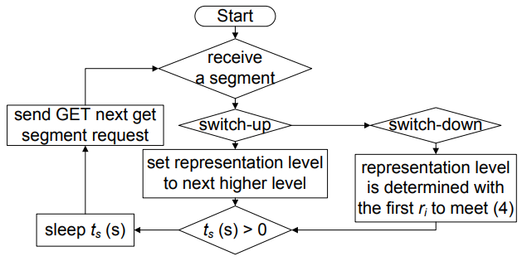




Rate Adaptation for Adaptive HTTP Streaming
Algorithm
Notes:
E값은 encoding된 media의 bitrate의 차이들에 의해 결정됨
t_s: buffer overflow 막기 위해
감마: buffer underflow 막기 위해 congestion 발생시 SFT가 길어짐, congestion에 따라 감마 값을 다르게

Slide 7
SARA: Segment Aware Rate Adaptation Algorithm for Dynamic Adaptive Streaming Over HTTP
P. Juluri, V. Tamarapalli, and D. Medhi. SARA: Segment Aware Rate Adaptation Algorithm for Dynamic Adaptive Streaming over HTTP. In Communication Workshop (ICCW), 2015 IEEE International Conference on, pages 1765–1770, 2015
Why I chose this paper?
To refer throughput estimation and bitrate selection based on buffer state

Slide 8
SARA: Segment Aware Rate Adaptation Algorithm for Dynamic Adaptive Streaming Over HTTP
Motivation
To decide bitrate, client use ABR(Adaptive BitRate selection) algorithm depending on current network condition
ABR algorithm ignores segment size and this makes it difficult to predict exactly when the next segment will be received.
SARA(Segment-Aware Rate Adaptation) algorithm
Consider segment size variation in addition to bandwidth and buffer occupancy
To predict the time required to download the next segment

Slide 9

SARA: Segment Aware Rate Adaptation Algorithm for Dynamic Adaptive Streaming Over HTTP
Enhanced MPD
It contains media representation, segment duration, segment URLs + size of segment
Throughput estimation
Using weighted harmonic mean
To avoid effect of instantaneous variation
Weight are proportional to segment size
Time to download the next segment is predicted by

Slide 10


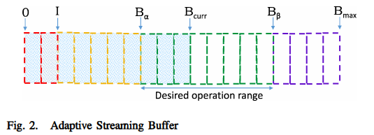


SARA: Segment Aware Rate Adaptation Algorithm for Dynamic Adaptive Streaming Over HTTP
Algorithm
Fast start $(B_{curr}≤I)$
Additive increase $\left(I≤B_{curr}≤B_{α}\right)$
Aggressive switching $(B_{α}≤B_{curr}≤B_{β})$
Delayed download $(B_{β}≤B_{curr}≤B_{max})$

Slide 11
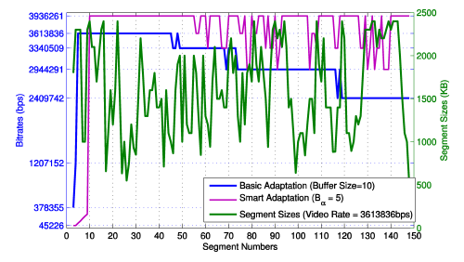
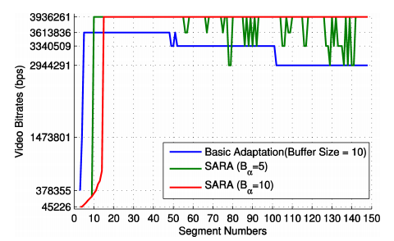
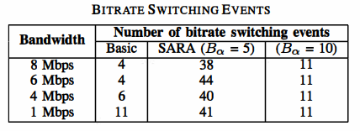
SARA: Segment Aware Rate Adaptation Algorithm for Dynamic Adaptive Streaming Over HTTP
Comparison

Slide 12
Load balancing in overlapping wireless LAN cells
H. Velayos, V. Aleo, and G. Karlsson, “Load Balancing in Overlapping Wireless LAN Cells,” Proc. IEEE Int’l Conf. Comm. (ICC ’98), 1998
Why I chose this paper?
To understand how to do load balancing

Slide 13
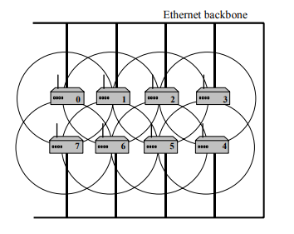
Load balancing in overlapping wireless LAN cells
To increase available capacity, some APs are added with overlapping coverage
In addition, available capacity was not increased when using strength signal

Slide 14
Load balancing in overlapping wireless LAN cells
Periodically collect load level via Ethernet
Load metric is the access point throughput
Bytes per second
There are three states
Under-loaded
Over-loaded
Balanced

Slide 15
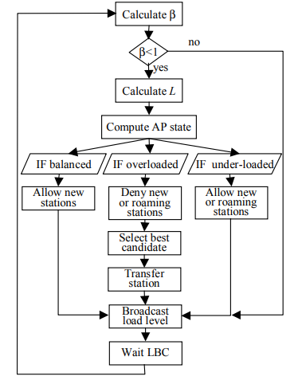


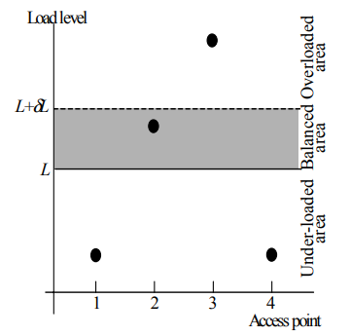
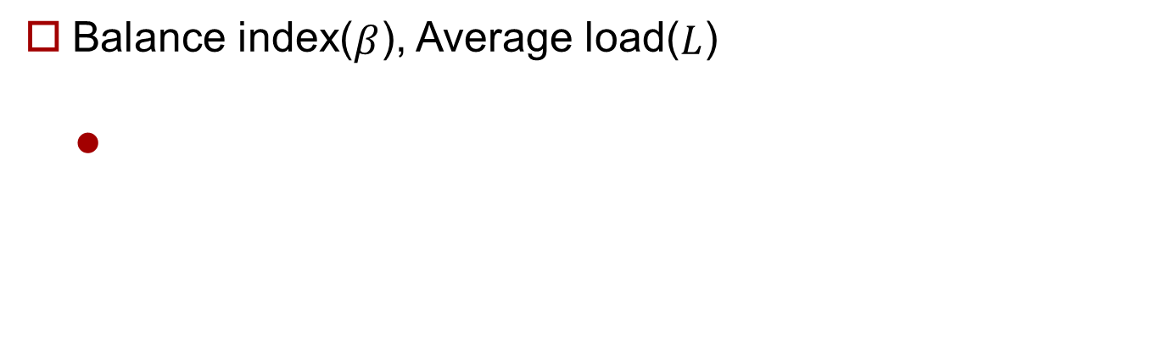
Load balancing in overlapping wireless LAN cells
Balance index($β$), Average load($L$)

Slide 16
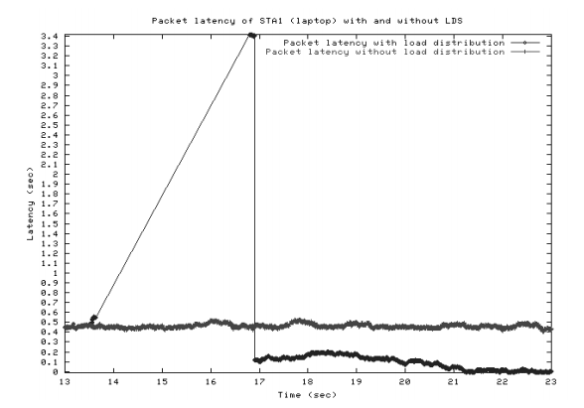
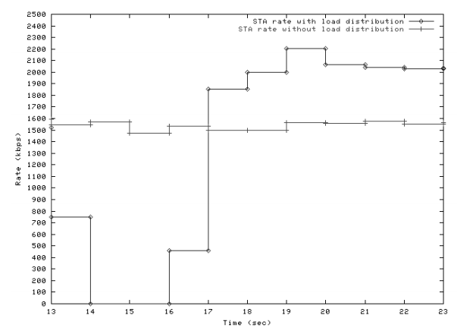
Load balancing in overlapping wireless LAN cells
Test
Balanced area: L~1.1L
Each station has same throughput

Slide 17
Generalized Proportional Fair Scheduling in Third Generation Wireless Data Networks
T. Bu, L. Li, and R. Ramjee, “Generalized proportional fair scheduling in third generation wireless data networks,” in Proc. 2006 IEEE INFOCOM, pp. 1–12
Why I chose this paper?
It considers Proportional fairness
Similar Problem formulation

Slide 18
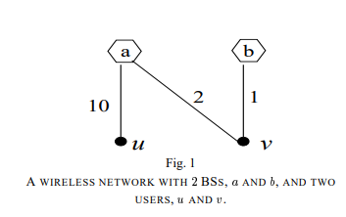
Generalized Proportional Fair Scheduling in Third Generation Wireless Data Networks
Max-min fairness ignores rate of usage
If u uses 10 and v uses 1 then they will use same bandwidth in terms of Max-min fairness (10/11, 10/11)
It doesn’t consider the ratio
Proportional fairness (5, 1/2) has more aggregate throughput than max-min fairness (20/11 vs 11/2)
Example of load balancing when considering proportional fairness
Situation: u-a and v-b
Proportional fair: 5, 1
Max-min fair: 5/6, 1/6

Slide 19
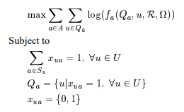

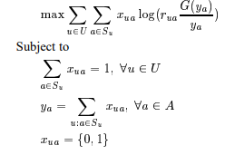

Generalized Proportional Fair Scheduling in Third Generation Wireless Data Networks
Utility function
Using Logarithm function
Rough problem formulation
Algorithm
Offline: K-cut algorithm, optimal but very large
Online: Greedy-0 + Greedy-k algorithm

Slide 20
Future work
Apply them in my research
Survey other papers

