Slide 1
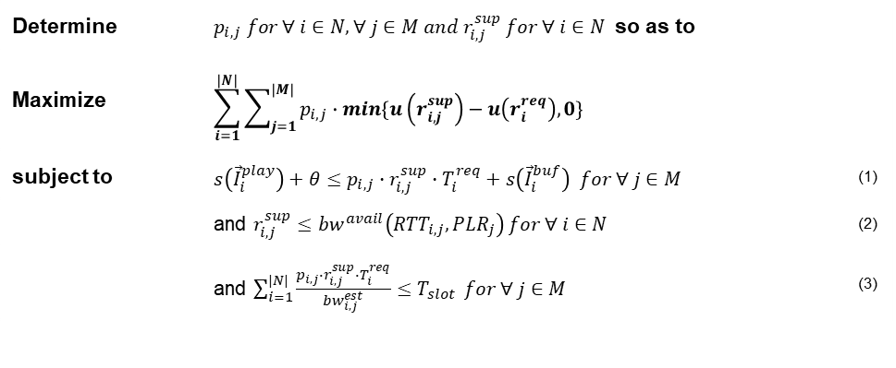
Problem
Formulation
Available bandwidth vs Estimated bandwidth
전자: 연결하기 전 이용 가능한 Bandwidth
TFRC(TCP-friendly Rate Control)사용
https://pdfs.semanticscholar.org/5f74/98e2c73748a34e3d216a97bb256d7c3b7a23.pdf
후자: 연결 후 실질적으로 사용 중인 Bandwidth
“세그먼트 크기 / 세그먼트를 받는 시간” MA 나 ARIMA 모델 이용
Determine | $p_{i,j} for ∀ i∈N, ∀ j∈M and r_{i,j}^{sup} for ∀ i∈N$ so as to
Maximize | $$\sum_{i=1}^{|N|}{\sum_{j=1}^{|M|}{p_{i,j}∙min\{u\left(r_{i,j}^{sup}\right)−u\left(r_{i}^{req}\right),0\}}}$$
subject to | $s\left({\vec{I}}_{i}^{play}\right)+θ≤p_{i,j}∙r_{i,j}^{sup}∙T_{i}^{req}+s\left({\vec{I}}_{i}^{buf}\right) for ∀ j∈M$ | (1)
 | and $r_{i,j}^{sup}≤{bw}^{avail}\left({RTT}_{i,j},{PLR}_{j}\right) for ∀ i∈N$ | (2)
 | and $\sum_{i=1}^{|N|}{\frac{p_{i,j}∙r_{i,j}^{sup}∙T_{i}^{req}}{{bw}_{i,j}^{est}}≤T_{slot}} for ∀ j∈M$ | (3)

Slide 2
Problem
Formulation
Consider all cases (Optimal solution)
Determine | $p_{i,j} for ∀ i∈N, ∀ j∈M and r_{i,j}^{sup} for ∀ i∈N$ so as to
Maximize | $$\sum_{i=1}^{|N|}{\sum_{j=1}^{|M|}{p_{i,j}∙min\{u\left(r_{i,j}^{sup}\right)−u\left(r_{i}^{req}\right),0\}}}$$
subject to | $s\left({\vec{I}}_{i}^{play}\right)+θ≤p_{i,j}∙r_{i,j}^{sup}∙T_{i}^{req}+s\left({\vec{I}}_{i}^{buf}\right) for ∀ j∈M$ | (1)
 | and $r_{i,j}^{sup}≤{bw}^{avail}\left({RTT}_{i,j},{PLR}_{j}\right) for ∀ i∈N$ | (2)
 | and $\sum_{i=1}^{|N|}{\frac{p_{i,j}∙r_{i,j}^{sup}∙T_{i}^{req}}{{bw}_{i,j}^{est}}≤T_{slot}} for ∀ j∈M$ | (3)
↓
↓
↓

Slide 3
Setting
Utility function
1 * ln(request - support) + 0
Segment duration
1 sec
Timeslot
1.0
Timeslot이 클수록 AP가 받아 들일 수 있는 자원이 크기에 Greedy와 Optimal이 동일한 결과를 보임
Bandwidth
RSSI → PER, RTT
Random RSSI (Rayleigh distribution)
5 UEs and 3 Aps
Random connection

