Slide 1
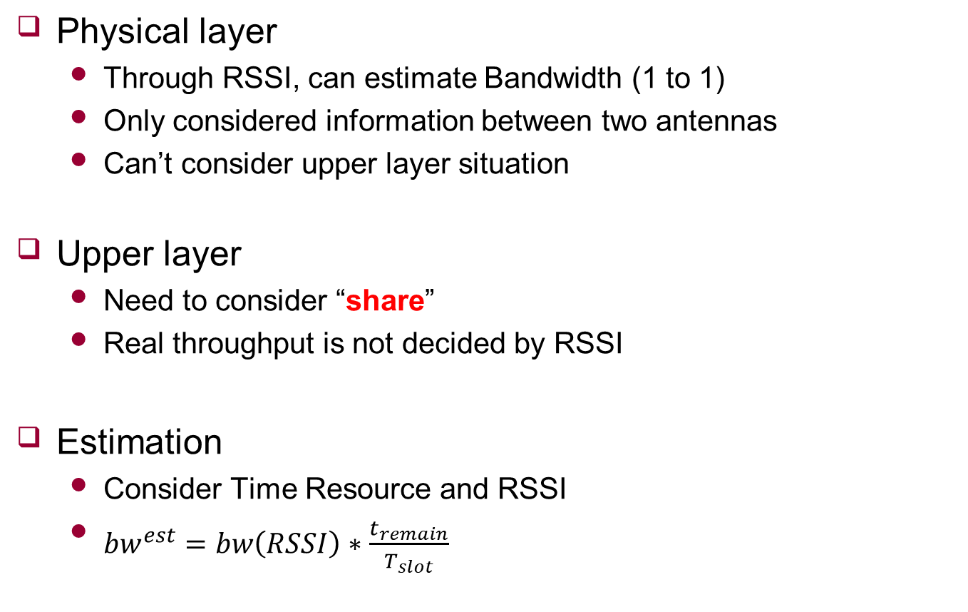


Bandwidth
Physical layer
Through RSSI, can estimate Bandwidth (1 to 1)
Only considered information between two antennas
Can’t consider upper layer situation
Upper layer
Need to consider “share”
Real throughput is not decided by RSSI
Estimation
Consider Time Resource and RSSI
${bw}^{est}=bw\left(RSSI\right)∗\frac{t_{remain}}{T_{slot}}$
$$t_{remain}$$
UE1
UE2
$$T_{slot}$$

Slide 2





Probability
How to determine the AP using statistical properties
Assume estimated bandwidth follows Gaussian distribution
${UE}_{i}$ wants to connect ideal AP
Using probability
$${AP}_{1}\sim N(μ_{i1}\text{,}σ_{i1}^{2})$$
$${AP}_{2}\sim N(μ_{i2}\text{,}σ_{i2}^{2})$$
$$r_{i}^{req}$$
$$r_{i}^{req}$$

