Slide 1
Research Jae Jun Ha Media Computing and Networking Laboratory POSTECH 2018-12-21
Notes:
세미나 발표를 시작하겠습니다.

Slide 2
Contents
Survey for Bandwidth Estimation
WBEST
Algorithm
Modeling TCP Throughput
RTT Estimation
Bandwidth Estimation
Future work

Slide 3
WBEST
“WBest: a Bandwidth Estimation Tool for IEEE 802.11 Wireless Networks”, In Proceedings of 33rd IEEE Conference on Local Computer Networks (LCN)
Wireless Bandwidth estimation tool
Through GitHub, can get open source code
It uses Time and PLR to estimate bandwidth

Slide 4
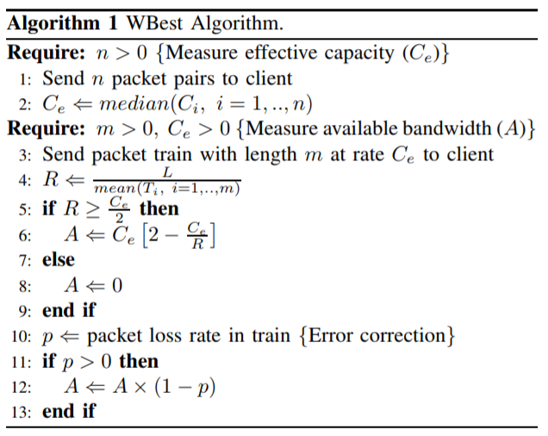
Algorithm
< WBest: a Bandwidth Estimation Tool for IEEE 802.11 Wireless Networks >

Slide 5
Modeling TCP Throughput
“Modeling TCP Throughput: A Simple Model and its Empirical Validation”, Sigcomm 1998
It uses Congestion control principle
It also uses RTT and PLR to estimate bandwidth

Slide 6
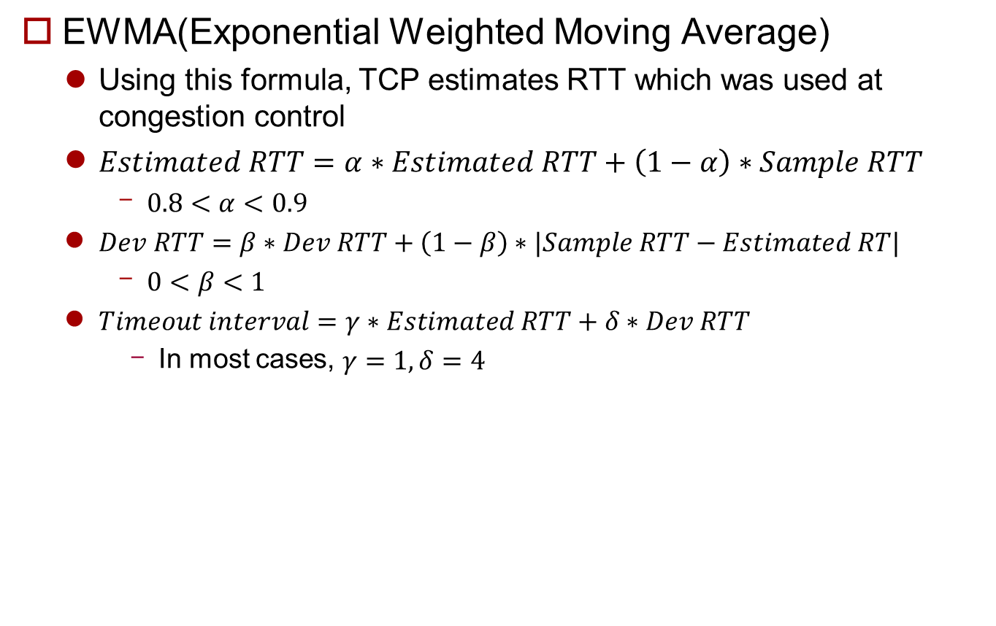
RTT Estimation
EWMA(Exponential Weighted Moving Average)
Using this formula, TCP estimates RTT which was used at congestion control
$Estimated RTT=α∗Estimated RTT+\left(1−α\right)∗Sample RTT$
$0.8<α<0.9$
$Dev RTT=β∗Dev RTT+\left(1−β\right)∗|Sample RTT−Estimated RT|$
$0<β<1$
$Timeout interval=γ∗Estimated RTT+δ∗Dev RTT$
In most cases, $γ=1,δ=4$
Notes:
Congestion control에서 RTT를 다음과 같이 estimation함
특히 Congestion control에서 사용되는 Timeout interval에 사용됨
Congestion control를 기반으로 하는 bandwidth 예측은 이를 활용하므로 사용할 계획
Sample RTT의 경우 ICMP프로토콜의 프로그램 중 하나인 PING 프로그램을 이용하여 주기적으로 수집할 예정

Slide 7
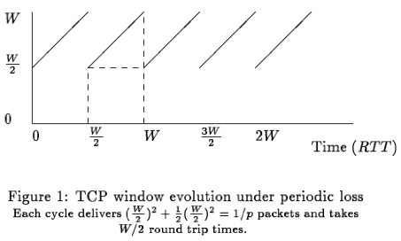


Bandwidth Estimation
Some assumptions
Infinitely long TCP flow
Packet loss rate = p, Duplicate가 주기적 발생
$E\left(p\right)=\frac{1}{p}$
$p\left(k\right)={(1−p)}^{k−1}p$
$E(p)=\sum_{k=1}^{∞}{{\left(1−p\right)}^{k−1}pk}=\frac{1}{p}$
의미하는 바: packet 손실이 일어나기 전까지 전송되는 packet의 양
$$\frac{1}{p}={(\frac{W}{2})}^{2}+\frac{1}{2}{(\frac{W}{2})}^{2}=\frac{3}{8}W^{2},W=\sqrt{\frac{8}{3p}}$$
$$Throughput= \frac{\frac{3}{8}W^{2}}{RTT×\frac{W}{2}}=\frac{1}{RTT×\sqrt{\frac{2}{3}p}}$$
< https://blog.thousandeyes.com/a-very-simple-model-for-tcp-throughput/ >

Slide 8

Bandwidth Estimation
Some assumptions
Consider
Timeouts (6 timeout)
Receiver window
Delayed ACKs
$B\left(p\right)≈min⁡(\frac{W_{max}}{RTT},\frac{1}{RTT\sqrt{\left(\frac{2}{3}\right)p}+T_{0}\min\left(1,3\sqrt{\left(\frac{3}{8}\right)p}\right)p\left(1+2^{5}p^{2}\right)})$
$T_{0}:initial time out interval$
Delayed ACKs
Timeouts

Slide 9
Future work
SDN Testbed
Bandwidth Estimation
Detail Algorithm
Using bandwidth estimation

