Slide 1
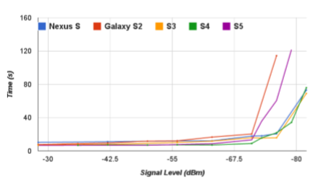





Estimate Bandwidth
To optimize Bitrate, need to know bandwidth
$$\sum_{i=1}^{|N|}{T_{{UE}_{i}}}+T_{new}≤T_{slot}, for ∀ j∈M$$
$$\sum_{i=1}^{|N|}{\frac{p_{i,j}∙r_{i,j}^{sup}∙T_{i}^{req}}{{bw}_{i,j}^{est}}}+T_{new}≤T_{slot}, for ∀ j∈M$$
?
1~20Kbps
$$\sum_{i=1}^{|N|}{\frac{p_{i,j}∙r_{i,j}^{sup}∙T_{i}^{req}}{{bw}_{i,j}^{est}}∙f\left(s_{i,j}\right)}+T_{new}∙f\left(s_{new,j}\right)≤T_{slot}, for ∀ j∈M$$
0.5~11Kbps
From the perspective of AP
UE1
UE2
< An Open-source Software Defined Platform for Collaborative and Energy-aware WiFi Offloading, Mobicom 2015 >
Consider RSSI
$×f\left(s_{i,j}\right)$ - RSSI에 따른 시간 변화율$=\frac{RSSI가s_{i,j}{값일 때 transsmission delay}}{RSSI가\max{값일 때 transsmission delay}}={Ae}^{−B(S−C)}$
From the perspective of UE
UE1
UE2
Notes:
Notation 표 있어야함
F의 정의 잘하고, 왜 f를 곱했는지 설명 잘해야 함

Slide 2
Estimate Bandwidth
Bandwidth 남을 때 새로운 AP추가 될 경우 그 Bandwidth 사용, 그 외의 경우 Controller가 정해줌

