Slide 1
Research Jae Jun Ha Media Computing and Networking Laboratory POSTECH 2018-11-16
Notes:
세미나 발표를 시작하겠습니다.

Slide 2
Contents
Contents
Simulation
Fairness
Future Work

Slide 3
Algorithm
function dfs(index_ue):
if index_ue == N + 1:
sum = 0
for i from 1 to N:
sum += max(ue[i].reqQuality – ue[i].quality, 0)
sol = min(sum, sol)
for j from 1 to M:
if p[index_ue][j] == False:
continue
if ap[j].timeslot == T:
continue
c[index_ue][j] = True
if ue[index_ue].timeslot + ap[j].timeslot <= T:
ue[index_ue].quality = calQality(index_ue, ue[index_ue].timeslot)
ap[j].timeslot += ue[index_ue].timeslot
else:
ue[index_ue].quality = calQality(index_ue, T - ap[j].timeslot)
ap[j].timeslot = T
dfs(index_ue + 1)
c[index_ue][j] = False
restore(ue[index_ue], ap[j])
C version simulation code
https://github.com/jaejunha/Paper
/blob/master/Code/SDN_Application/handover.cpp

Slide 4





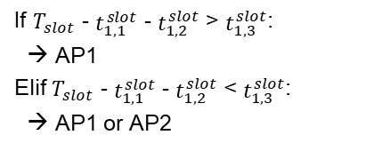
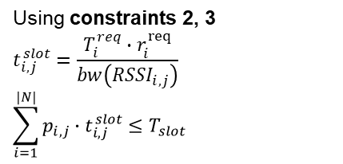
Time Resource
AP1
$$t_{1,1}^{slot}$$
$$t_{2,1}^{slot}$$
UE1
UE2
$$T_{slot}$$
Using constraints 2, 3
$$t_{i,j}^{slot}=\frac{T_{i}^{req}∙r_{i}^{req}}{bw\left({RSSI}_{i,j}\right)}$$
$$\sum_{i=1}^{|N|}{p_{i,j}∙t_{i,j}^{slot}≤T_{slot}}$$
Where?
AP2
$$T_{slot}$$
If $T_{slot}$ - $t_{1,1}^{slot}$ - $t_{1,2}^{slot}$ > $t_{1,3}^{slot}$:
→ AP1
Elif $T_{slot}$ - $t_{1,1}^{slot}$ - $t_{1,2}^{slot}$ < $t_{1,3}^{slot}$:
→ AP1 or AP2

Slide 5
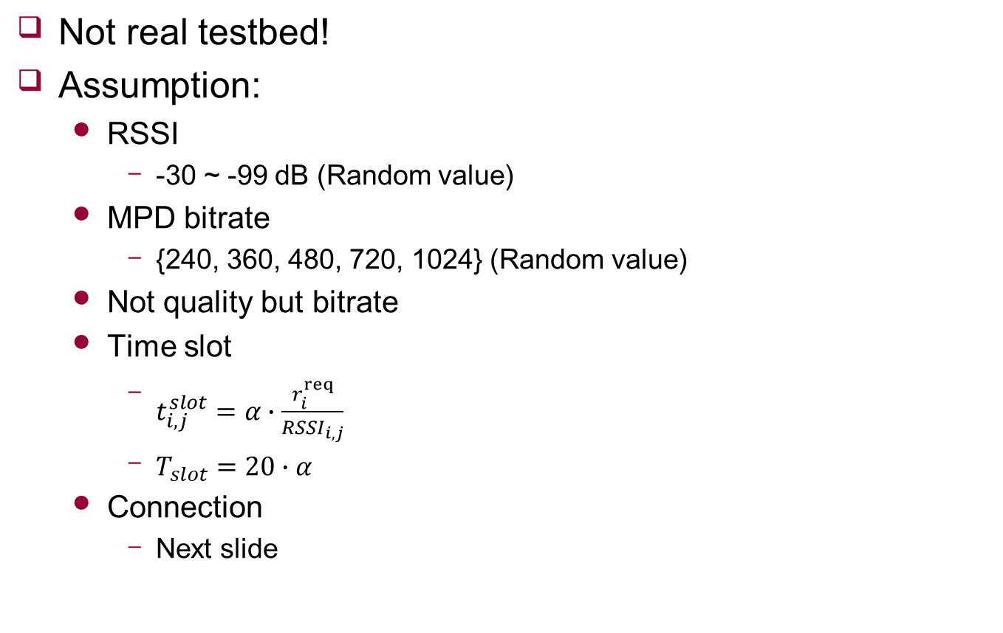
Simulation
Not real testbed!
Assumption:
RSSI
-30 ~ -99 dB (Random value)
MPD bitrate
{240, 360, 480, 720, 1024} (Random value)
Not quality but bitrate
Time slot
$t_{i,j}^{slot}=α∙\frac{r_{i}^{req}}{{RSSI}_{i,j}}$
$T_{slot}=20∙α$
Connection
Next slide
Notes:
Time slot 정의 간단하게 짚고 넘어가는 것도(피티 슬라이드)
Handover AP에 얼마나 잘 배분 되는지

Slide 6

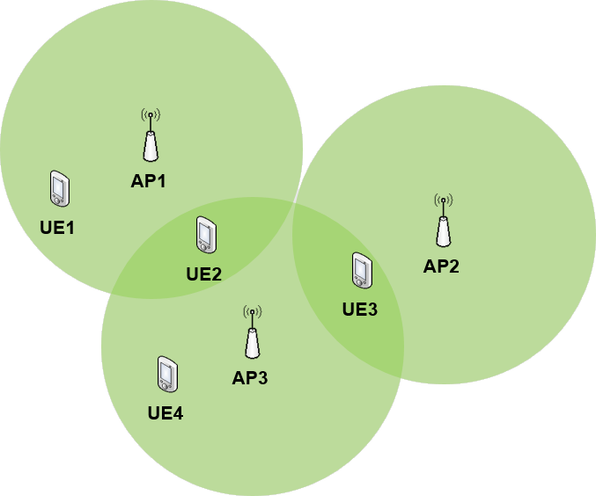
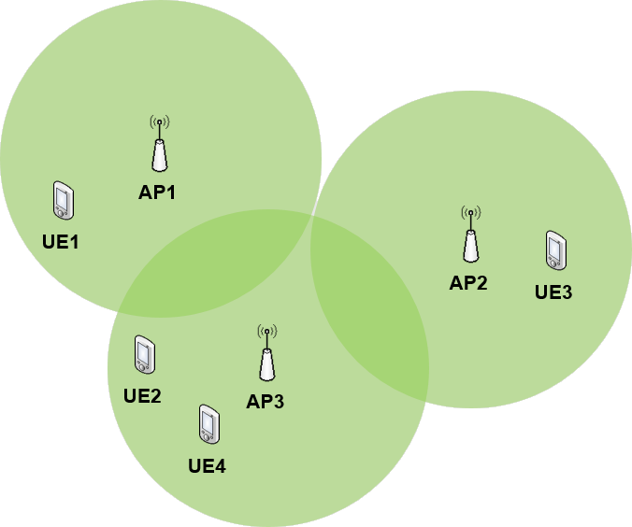
Simulation - Connection
AP1
UE1
UE2
AP2
UE3
AP3
UE4
AP1
UE1
AP2
UE3
UE2
AP3
UE4
<Connection 1>
<Connection 2>

Slide 7
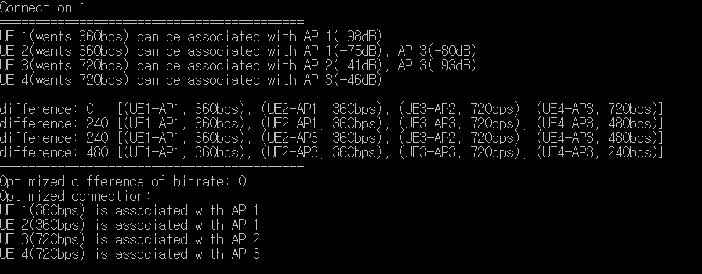
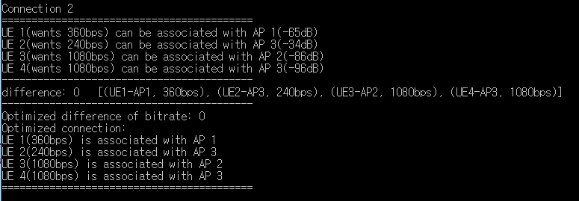
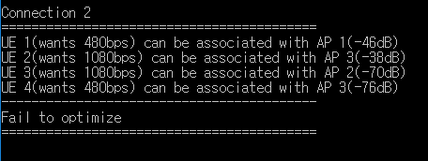
Simulation
Success
Fail
Some UEs doesn’t have connection with any AP
Notes:
그림과 같이 두가지 경우로 나뉨
정렬 필요
시간 복잡도는 ?

Slide 8
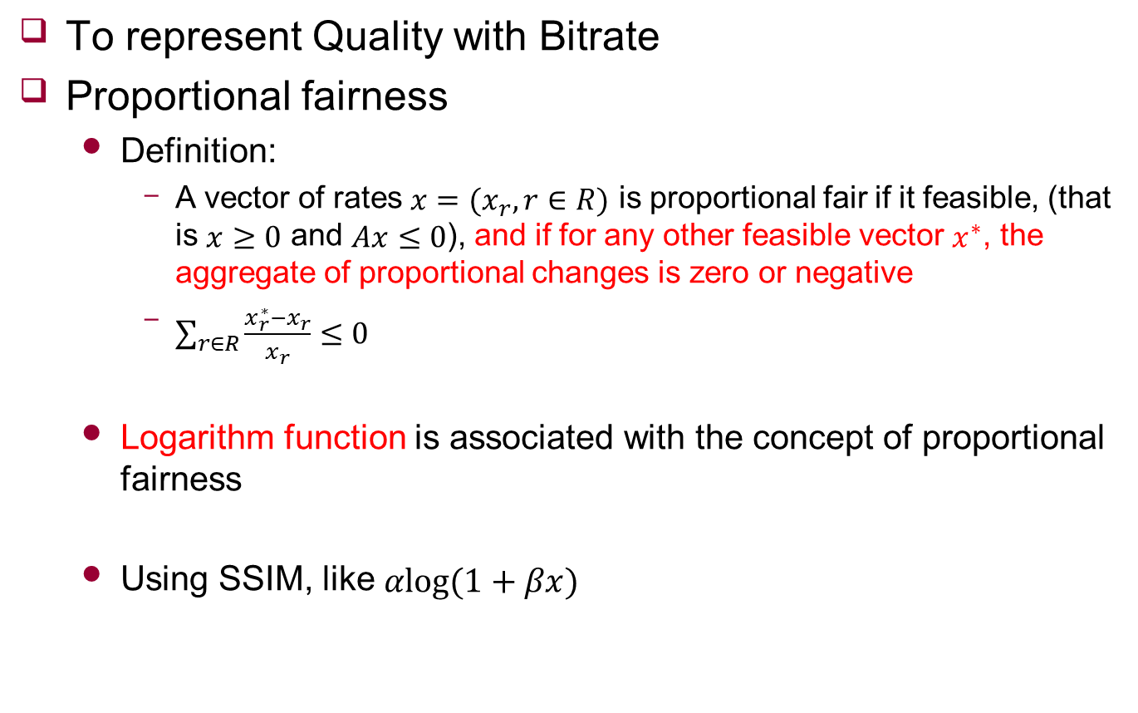
Utility function
To represent Quality with Bitrate
Proportional fairness
Definition:
A vector of rates $x=(x_{r},r∈R)$ is proportional fair if it feasible, (that is $x≥0$ and $Ax≤0$), and if for any other feasible vector $x^{∗}$, the aggregate of proportional changes is zero or negative
$\sum_{r∈R}{\frac{x_{r}^{∗}−x_{r}}{x_{r}}≤0}$
Logarithm function is associated with the concept of proportional fairness
Using SSIM, like $αlog⁡(1+βx)$

Slide 9
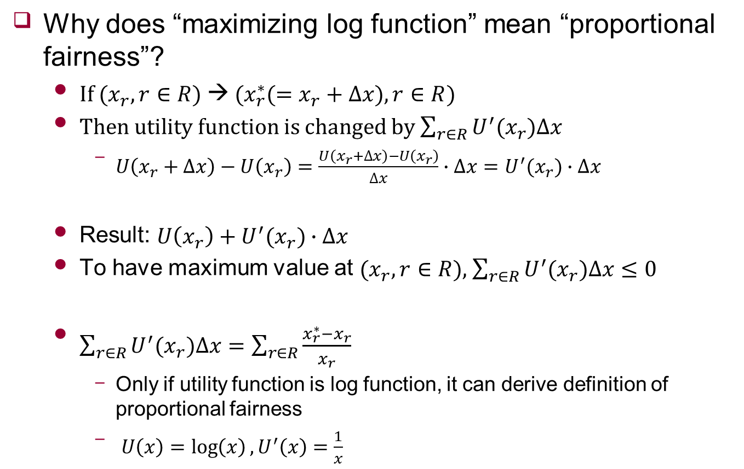
Proof
Why does “maximizing log function” mean “proportional fairness”?
If ($x_{r},r∈R$) → ($x_{r}^{∗}(=x_{r}+∆x),r∈R$)
Then utility function is changed by $\sum_{r∈R}{U^{′}(x_{r})∆x}$
$U\left(x_{r}+∆x\right)−U\left(x_{r}\right)=\frac{U\left(x_{r}+∆x\right)−U\left(x_{r}\right)}{∆x}∙∆x=U^{′}(x_{r})∙∆x$
Result: $U\left(x_{r}\right)+U^{′}(x_{r})∙∆x$
To have maximum value at ($x_{r},r∈R$), $\sum_{r∈R}{U^{′}(x_{r})∆x}≤0$
$\sum_{r∈R}{U^{′}(x_{r})∆x}=\sum_{r∈R}{\frac{{x_{r}^{∗}−x}_{r}}{x_{r}}}$
Only if utility function is log function, it can derive definition of proportional fairness
$U\left(x\right)=\log\left(x\right), U^{′}\left(x\right)=\frac{1}{x}$

Slide 10

Future work
Utility Function Fitting
Using SSIM, like $αlog⁡(1+βx)$
Bandwidth Function Fitting
Modify Algorithm
Consider alignment

