Slide 1
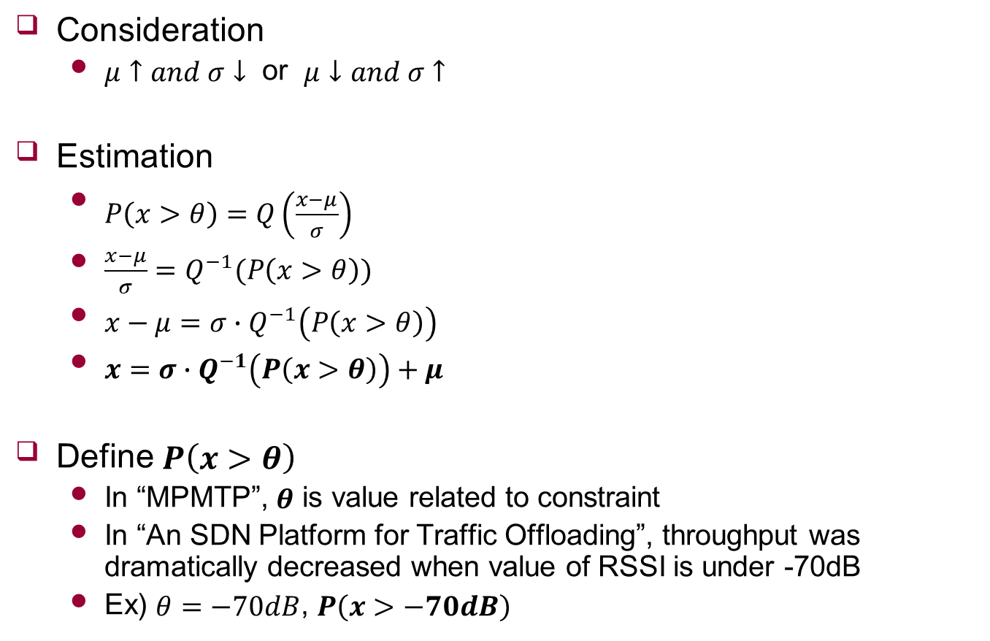
Q-Function
Consideration
$μ↑and σ↓$ or $μ↓and σ↑$
Estimation
$P\left(x>θ\right)=Q\left(\frac{x−μ}{σ}\right)$
$\frac{x−μ}{σ}=Q^{−1}(P\left(x>θ\right))$
$x−μ=σ∙Q^{−1}\left(P\left(x>θ\right)\right)$
$x=σ∙Q^{−1}\left(P\left(x>θ\right)\right)+μ$
Define $P\left(x>θ\right)$
In “MPMTP”, $θ$ is value related to constraint
In “An SDN Platform for Traffic Offloading”, throughput was dramatically decreased when value of RSSI is under -70dB
Ex) $θ=−70dB$, $P\left(x>−70dB\right)$
Notes:
일단 생각한 것 다 설명 드리고
내가 하려고 하는게 맞는지 물어보기
저번 시간에 말한 것 다시 물어보기
→ Mean 과 variable은 측정 값인데 저걸 가지고 ?

