Slide 1
Research Jae Jun Ha Media Computing and Networking Laboratory POSTCH 2020-01-03
Notes:
발표 시작하겠습니다

Slide 2
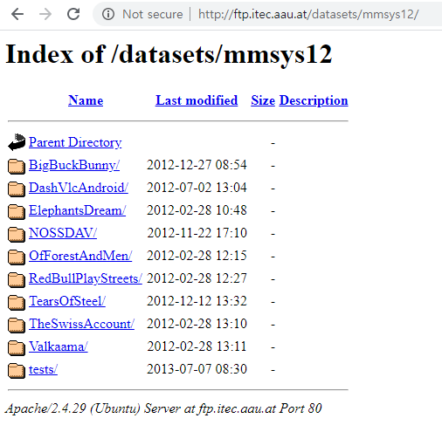
Current Status: RD curve
This site provides DASH video files
I used the BigBuckBunny
This site only provides all information(including PSNR) about it
To consider other video types, I’m creating DASH file about other video types

Slide 3




















Overview
Decide bitrate ($r_{i}^{service}$) and chunk ratio ($x_{i,j}$)
$$T_{unit}$$
$$T_{unit}$$
$${bw}_{1,1}$$
$${bw}_{3,2}$$
$$x_{1,1}$$
$$x_{3,2}$$
$$x_{1,2}$$
$${bw}_{1,2}$$
$$x_{3,1}$$
$${bw}_{2,1}$$
$$x_{2,1}$$
$$x_{2,2}$$
$${bw}_{2,2}$$
$${bw}_{3,1}$$
$$r_{1}^{service}$$
$$r_{3}^{service}$$
$$r_{2}^{service}$$

Slide 4
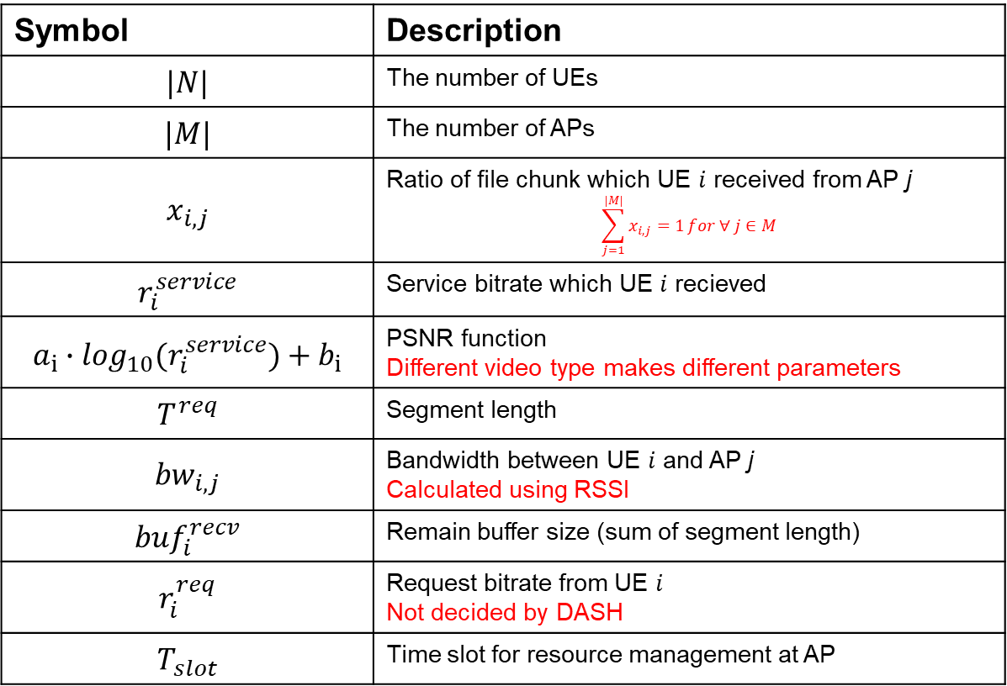
Formulation
Description
Symbol | Description
$$|N|$$ | The number of UEs
$$|M|$$ | The number of APs
$$x_{i,j}$$ | Ratio of file chunk which UE $i$ received from AP j $$\sum_{j=1}^{|M|}{x_{i,j}=1}for ∀ j∈M$$
$$r_{i}^{service}$$ | Service bitrate which UE $i$ recieved
$$a_{i}∙\log_{10}(r_{i}^{service})+b_{i}$$ | PSNR function Different video type makes different parameters
$$T^{req}$$ | Segment length
$${bw}_{i,j}$$ | Bandwidth between UE $i$ and AP j Calculated using RSSI
$${buf}_{i}^{recv}$$ | Remain buffer size (sum of segment length)
$$r_{i}^{req}$$ | Request bitrate from UE $i$ Not decided by DASH
$$T_{slot}$$ | Time slot for resource management at AP

Slide 5
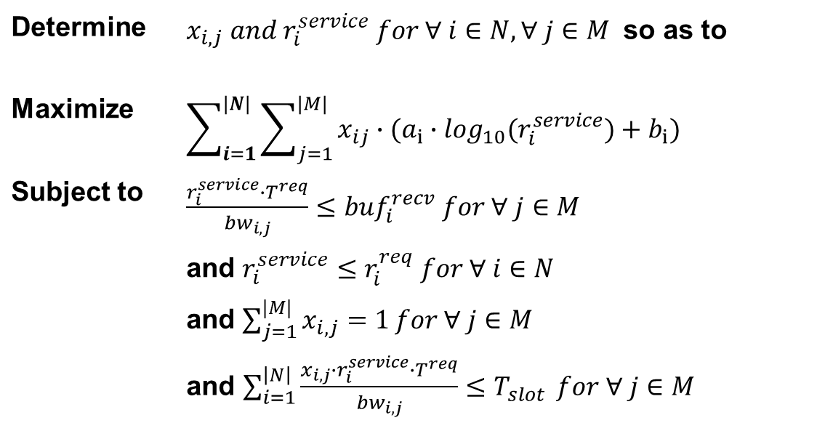
Formulation
Determine | $x_{i,j} and r_{i}^{service} for ∀ i∈N, ∀ j∈M$ so as to
Maximize | $$\sum_{i=1}^{|N|}{\sum_{j=1}^{|M|}{x_{ij}∙(a_{i}∙\log_{10}(r_{i}^{service})+b_{i})}}$$
Subject to | $\frac{r_{i}^{service}∙T^{req}}{{bw}_{i,j}}≤{buf}_{i}^{recv}$ $for ∀ j∈M$
 | and $r_{i}^{service}≤r_{i}^{req} for ∀ i∈N$
 | and $\sum_{j=1}^{|M|}{x_{i,j}=1}for ∀ j∈M$
 | and $\sum_{i=1}^{\left|N\right|}{\frac{x_{i,j}∙r_{i}^{service}∙T^{req}}{{bw}_{i,j}}≤T_{slot}} for ∀ j∈M$

Slide 6

Lagrange Multiplier
Function
$L=\sum_{i=1}^{|N|}{\sum_{j=1}^{|M|}{x_{ij}∙(a_{i}∙\log_{10}(r_{i}^{service})+b_{i})}}−\sum_{j=1}^{|M|}{λ_{j}∙(\sum_{i=1}^{\left|N\right|}{\frac{x_{i,j}∙r_{i}^{service}∙T^{req}}{{bw}_{i,j}}−T_{slot}})}$
$\frac{r_{i}^{service}∙T^{req}}{{bw}_{i,j}}≤{buf}_{i}^{recv}$ $for ∀ j∈M$
$r_{i}^{service}≤r_{i}^{req} for ∀ i∈N$
$\sum_{j=1}^{|M|}{x_{i,j}=1}for ∀ j∈M$
Method
Bisection and Analytic
Difficult: Several lambdas

Slide 7
Future Work
RD curve fitting for several video types
Gradient method

