Slide 1
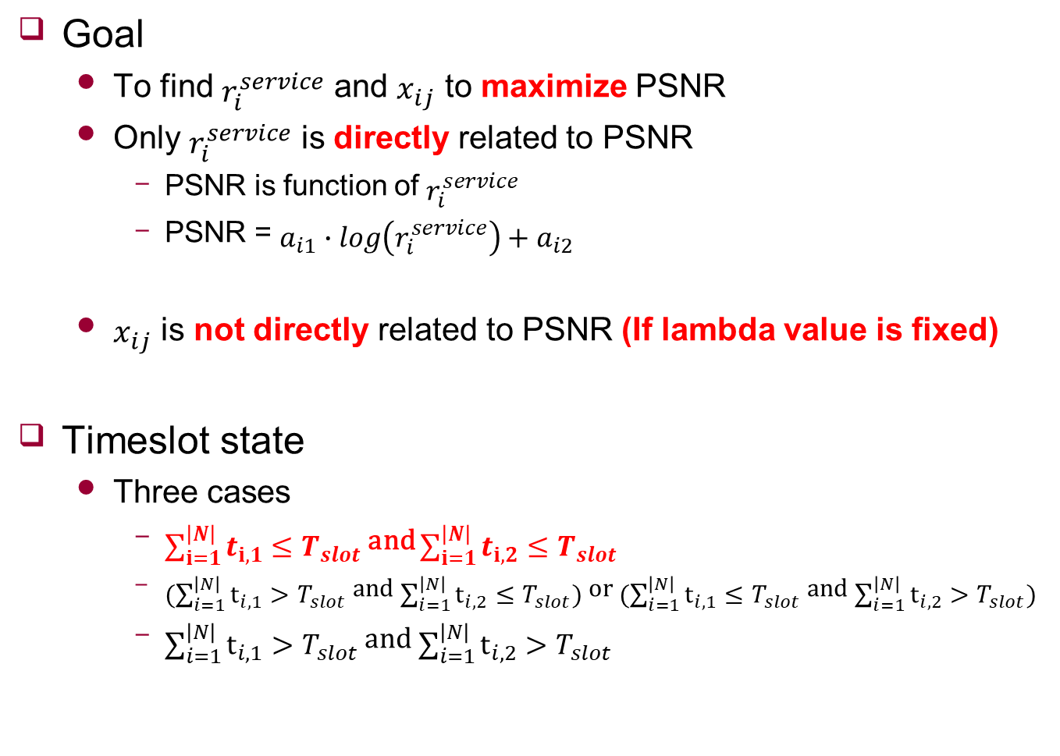
Fast Algorithm
Goal
To find $r_{i}^{service}$ and $x_{ij}$ to maximize PSNR
Only $r_{i}^{service}$ is directly related to PSNR
PSNR is function of $r_{i}^{service}$
PSNR = $a_{i1}∙\log\left(r_{i}^{service}\right)+a_{i2}$
$x_{ij}$ is not directly related to PSNR (If lambda value is fixed)
Timeslot state
Three cases
$\sum_{i=1}^{\left|N\right|}{t_{i,1}}≤T_{slot}$ and $\sum_{i=1}^{\left|N\right|}{t_{i,2}}≤T_{slot}$
$(\sum_{i=1}^{\left|N\right|}{t_{i,1}}>T_{slot}$ and $\sum_{i=1}^{\left|N\right|}{t_{i,2}}≤T_{slot})$ or $(\sum_{i=1}^{\left|N\right|}{t_{i,1}}≤T_{slot}$ and $\sum_{i=1}^{\left|N\right|}{t_{i,2}}>T_{slot})$
$\sum_{i=1}^{\left|N\right|}{t_{i,1}}>T_{slot}$ and $\sum_{i=1}^{\left|N\right|}{t_{i,2}}>T_{slot}$

Slide 2
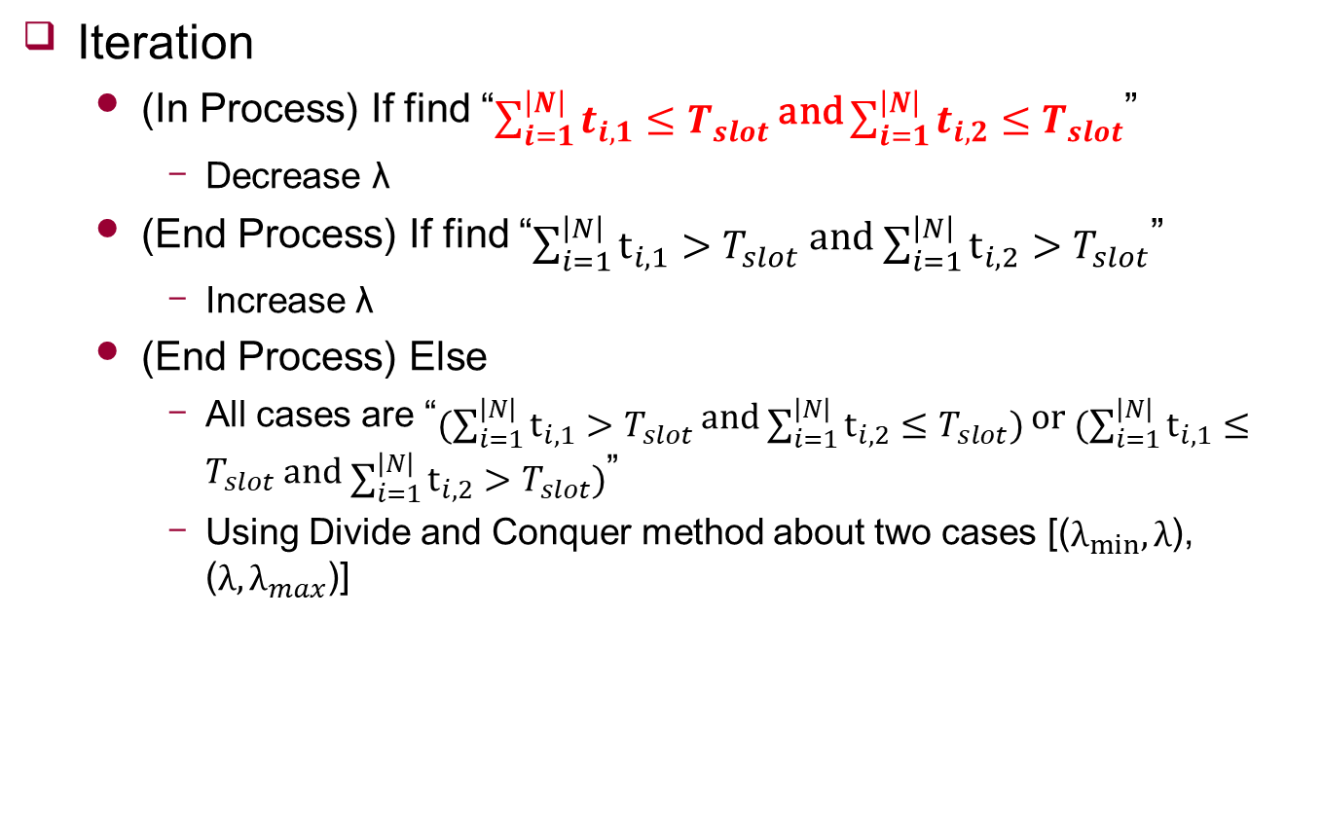
Fast Algorithm
Iteration
(In Process) If find “$\sum_{i=1}^{\left|N\right|}{t_{i,1}}≤T_{slot}$ and $\sum_{i=1}^{\left|N\right|}{t_{i,2}}≤T_{slot}$”
Decrease λ
(End Process) If find “$\sum_{i=1}^{\left|N\right|}{t_{i,1}}>T_{slot}$ and $\sum_{i=1}^{\left|N\right|}{t_{i,2}}>T_{slot}$”
Increase λ
(End Process) Else
All cases are “$(\sum_{i=1}^{\left|N\right|}{t_{i,1}}>T_{slot}$ and $\sum_{i=1}^{\left|N\right|}{t_{i,2}}≤T_{slot})$ or $(\sum_{i=1}^{\left|N\right|}{t_{i,1}}≤T_{slot}$ and $\sum_{i=1}^{\left|N\right|}{t_{i,2}}>T_{slot})$”
Using Divide and Conquer method about two cases [($λ_{min},λ$), ($λ,λ_{max}$)]

Slide 3
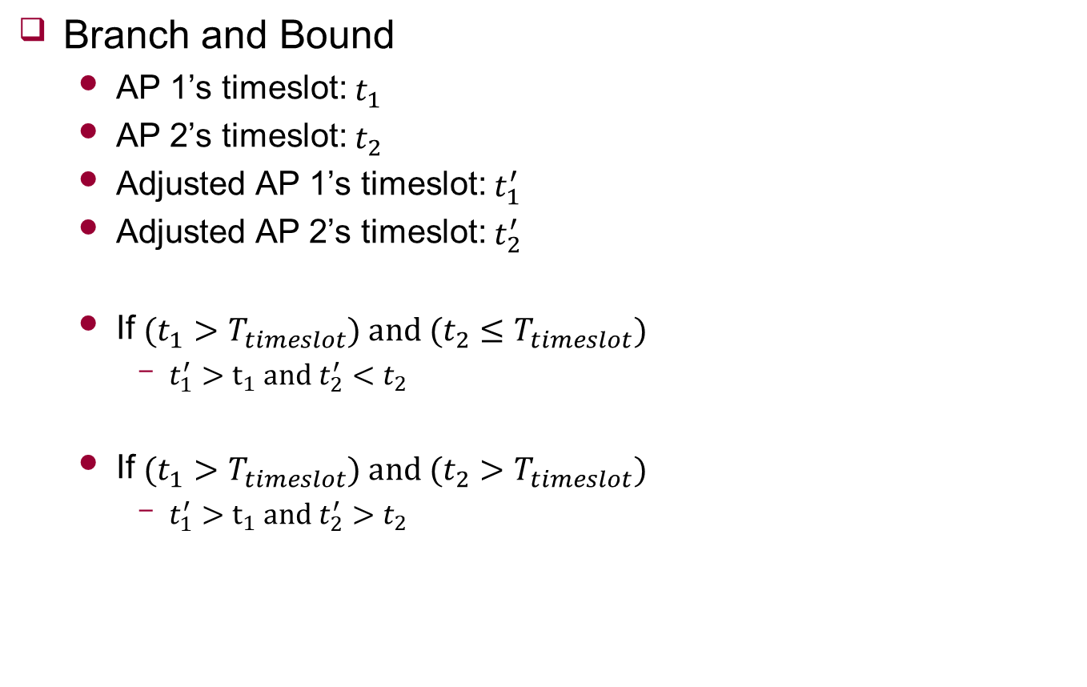
Fast Algorithm
Branch and Bound
AP 1’s timeslot: $t_{1}$
AP 2’s timeslot: $t_{2}$
Adjusted AP 1’s timeslot: $t_{1}^{′}$
Adjusted AP 2’s timeslot: $t_{2}^{′}$
If $(t_{1}>T_{timeslot}) and (t_{2}≤T_{timeslot})$
$t_{1}^{′}>t_{1} and t_{2}^{′}<t_{2}$
If $(t_{1}>T_{timeslot}) and (t_{2}>T_{timeslot})$
$t_{1}^{′}>t_{1} and t_{2}^{′}>t_{2}$
Notes:
Adaptive?

Slide 4





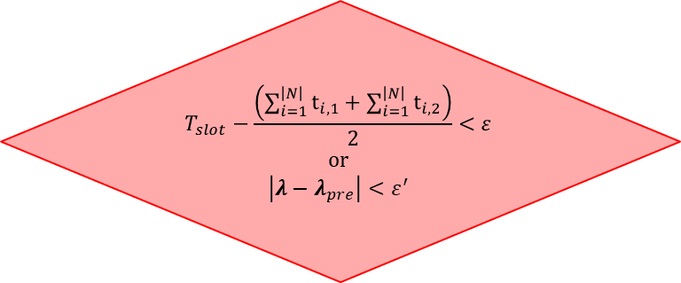
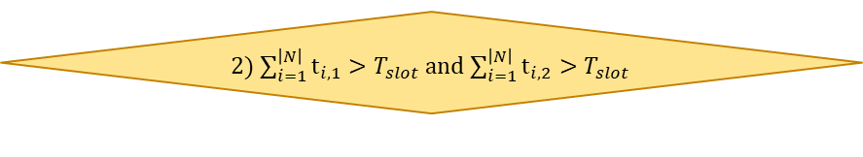
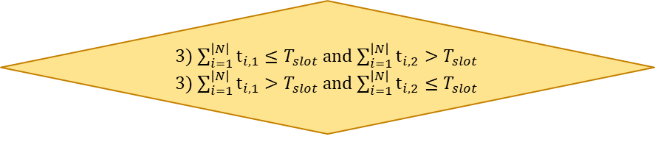

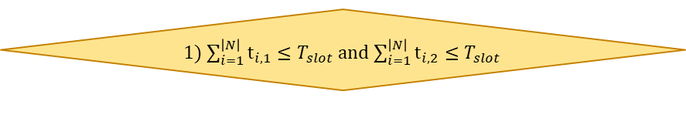

Appendix
Loop
UE requests streaming with $r_{i}^{req}$
Over AP’s timeslot
Provide streaming $r_{i}^{service}$ with $r_{i}^{req}$
no
yes
Initialize $x_{ij}$ and $λ$
Determine $d_{i}(x_{i}^{∗})$ with $λ$
Calculate Virtual Bandwidth on VAP with $x_{ij}$
Adjust $x_{ij}$
Adjust $λ$
3) $\sum_{i=1}^{\left|N\right|}{t_{i,1}}≤T_{slot}$ and $\sum_{i=1}^{\left|N\right|}{t_{i,2}}>T_{slot}$
3) $\sum_{i=1}^{\left|N\right|}{t_{i,1}}>T_{slot}$ and $\sum_{i=1}^{\left|N\right|}{t_{i,2}}≤T_{slot}$
yes
no
2) $\sum_{i=1}^{\left|N\right|}{t_{i,1}}>T_{slot}$ and $\sum_{i=1}^{\left|N\right|}{t_{i,2}}>T_{slot}$
yes
$$T_{slot}−\frac{\left(\sum_{i=1}^{\left|N\right|}{t_{i,1}}+\sum_{i=1}^{\left|N\right|}{t_{i,2}}\right)}{2}<ε$$
or
$$\left|λ−λ_{pre}\right|<ε^{′}$$
no
1) $\sum_{i=1}^{\left|N\right|}{t_{i,1}}≤T_{slot}$ and $\sum_{i=1}^{\left|N\right|}{t_{i,2}}≤T_{slot}$
yes
END

